Slide 1
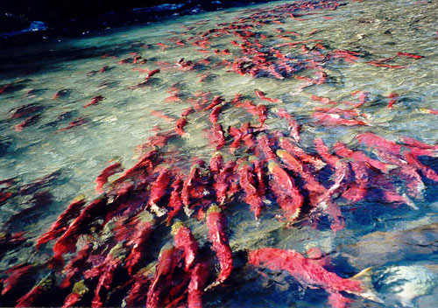
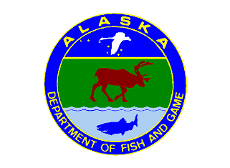
Reservations of Water for Salmon
in Alaska
Shawn Johnson
Alaska Department of Fish and Game
Division of Sport Fish
Research and Technical Services

Slide 2
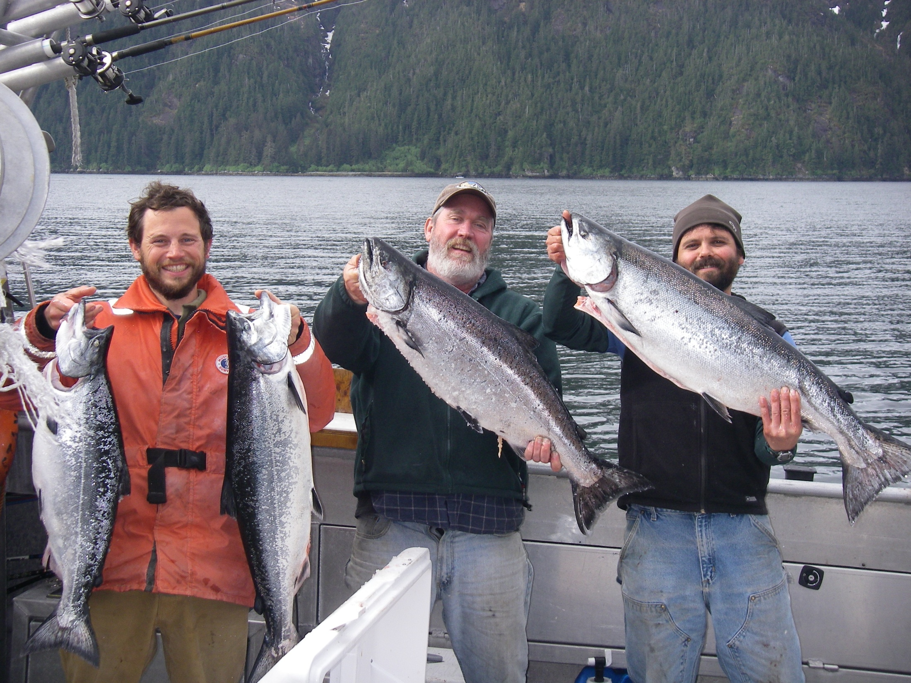
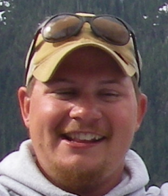
Thank you Alaska Sustainable Salmon Fund
From the Water Shop
Jarrod Sowa
Jason Hass

Slide 3
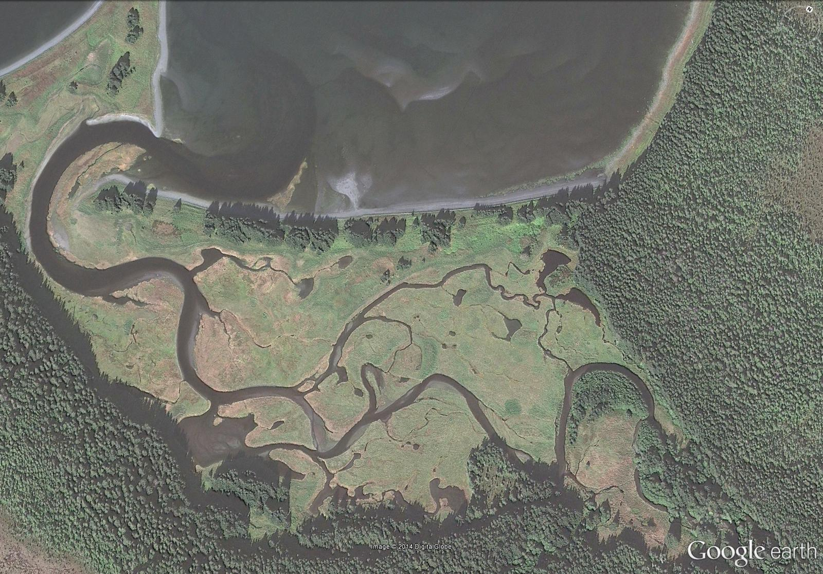
Alaska Water Law
Reservation of Water Process
Why File Reservations of Water?
What We’ve Done, What’s Left To Do

Slide 4
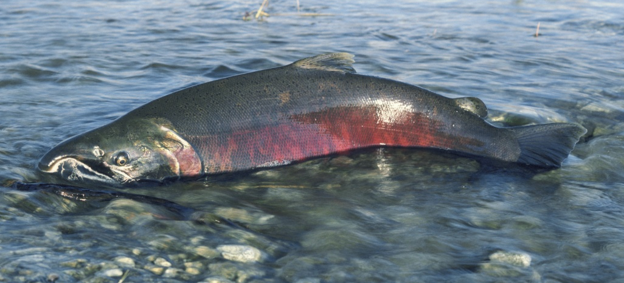
SALMON NEED WATER
“We know just what to do. We just need the river to do it.”
…anonymous salmon

Slide 5
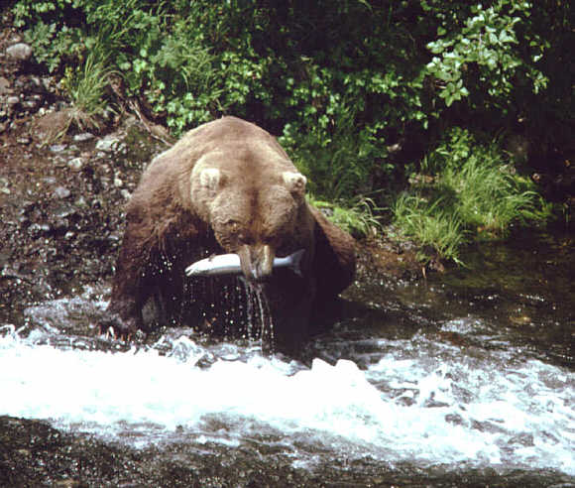
“Wherever occurring in their natural state,
fish, wildlife, and waters are reserved to the people
for common use”
…Alaska Constitution

Slide 6
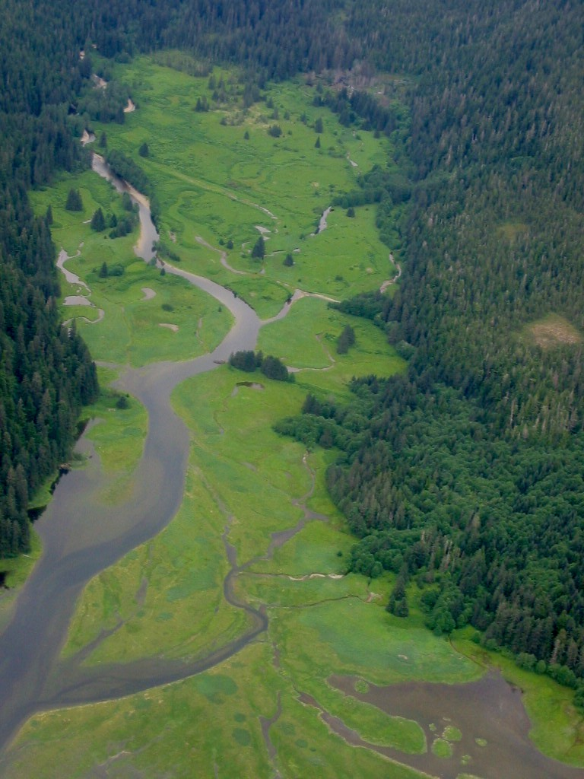
AS 46.15 Alaska Water Use Act (1966)
established procedures for appropriating water
doctrine of prior appropriation = first in time, first in right
administered by Alaska Department of Natural Resources
amended in 1980

Slide 7
Alaska’s Instream Flow Law (Alaska Statute 46.15.145)
A reservation of water may be secured for the following uses:
protection of fish and wildlife habitat, migration, and propagation
recreation and parks
navigation and parks
sanitation and water quality

Slide 8
Reservation of Water Process
Fill out a reservation of water application
Application includes: maps, hydrologic data, fish distribution and periodicity, and flow requests
File application with DNR, given priority date
Application adjudicated
Certificate of Reservation issued

Slide 9
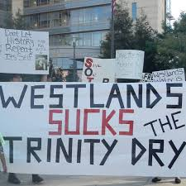
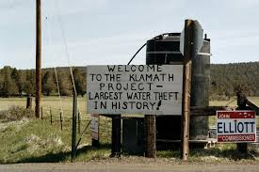
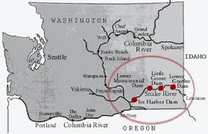
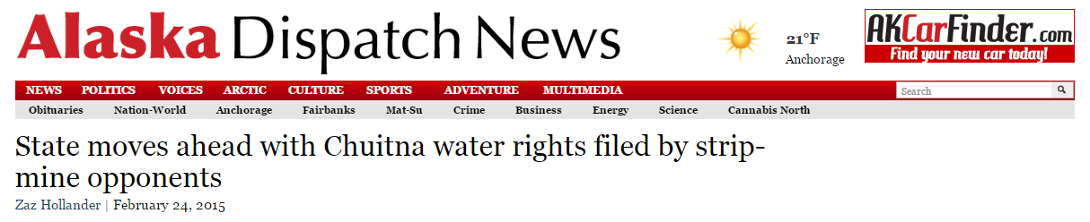
Why File for Reservations of Water?
Alaska water allocation
Unallocated >99%
Allocated < 1%

Slide 10
Title 16 Habitat Permits
Anadromous Fish Act (AS 16.05.871)
…an individual or government agency needs a permit from ADF&G
Habitat before altering or affecting “the natural flow or bed” of a
specified waterbody
Fish Passage Act (AS 16.05.841)
…an individual or government agency needs a permit from ADF&G
Habitat for activities within or across a stream used by fish if that activity
could represent an impediment to the efficient passage of resident or
anadromous fish

Slide 11
Taku River

Slide 12
Peterson Creek (No. Douglas Island)

Slide 13
AKSSF Funded ADF&G Reservation of Water Applications in SEAK
92 reservation of water applications
encompassing 49 watersheds and
126 stream reaches

Slide 14
AKSSF Funded ADF&G Certificates of Reservation in SEAK
20
3, 15
16, 17
19
2. Klehini River
3. Lake Creek
5. Old Situk River
7. Shelokum Creek
8. Situk River
9. Stikine River
10. Taku River
11. West Fork Situk
13. Farragut River
14. Harding River
15. Auke Creek
16. Lemon Creek
17. Mendenhall River
18. Nakwasina River
19. Peterson Creek (No. Douglas)
20. Cowee Creek
21. Harris River
13
18
12
14
21

Slide 15
AKSSF Funded ADF&G Stream Gaging Projects in SEAK
12
Peterson Creek (No. Douglas)
Sitkoh Creek
Sawmill Creek
West Fork Situk
Threemile Creek
Cowee Creek
Holgate Creek
Lost River
Chilkoot River
Peterson Creek (nr Amalga Harbor)
Thorne River
Windfall Creek
11

Slide 16
Future work in SEAK
Prepare and file ROWs for salmon streams with 5 years of stream gage data (13 streams left)
Break multiple-reach applications into single reach applications
Adjudicate and secure certificates of reservation
Continue existing stream gages
Install and operate new stream gages

Slide 17
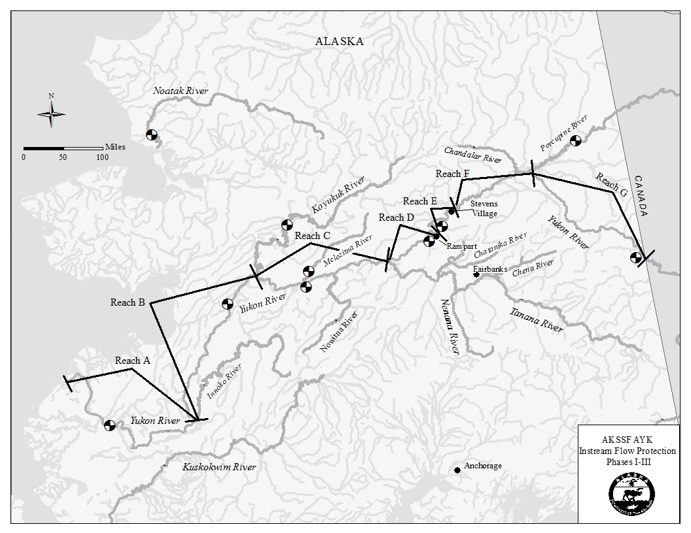
AKSSF Funded ADF&G Reservation of Water Applications in AYK
AYK stuff

Slide 18
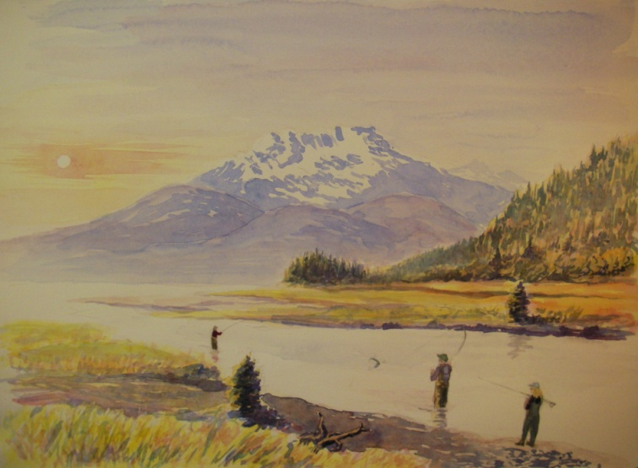
The End

