Slide 1
Comparison of qPCR, histology, & explant culture for assessing Ichthyophonus in Yukon Chinook salmon
Jayde Ferguson¹, Davis Stewart¹, Franklin Woitel¹, Paul Hershberger², Richard Kocan³, Elizabeth Lee⁴, Zach Liller⁵, Toshihide Hamazaki⁵, Fred West⁵, & Theodore Meyers⁶
¹Alaska Depart. Fish & Game (ADF&G), Division Commercial Fisheries (DCF), Fish Pathology Laboratory, Anchorage, AK
²U.S.G.S., Western Fisheries Research Center, Marrowstone Station, Nordland, WA
³School Aquatic & Fishery Sciences, University of Washington, Seattle, WA
⁴ADF&G, DCF, Gene Conservation Laboratory, Anchorage, AK
⁵ADF&G, DCF, Arctic Yukon Kuskokwim Region, Anchorage, AK
⁶ADF&G, DCF, Fish Pathology Twin Lakes Laboratory, Juneau, AK

Slide 2
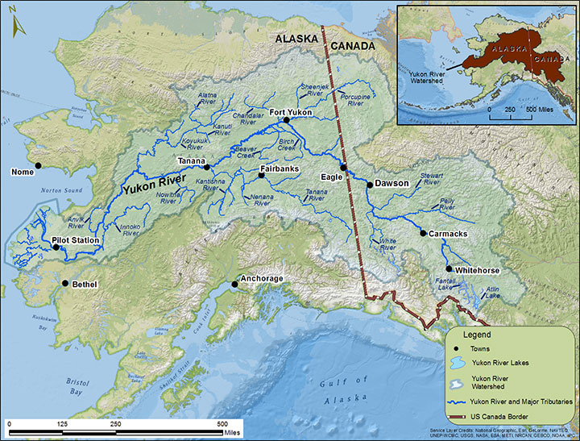
Background- Yukon River
Yukon River- 3rd longest river North America
  2,000 mi mainstem; transboundary
  Longest salmon migration
    30 mi/day; 1mo. Migration
    Fast current, rapids
  World’s largest
  subsistence fishery
    Chinook, summer/fall
    chum, coho, pink,
    sockeye
Notes:
Missouri & Mississippi 1st & 2nd longest; 35-50% Chinook Canadian-origin/rtn

Slide 3
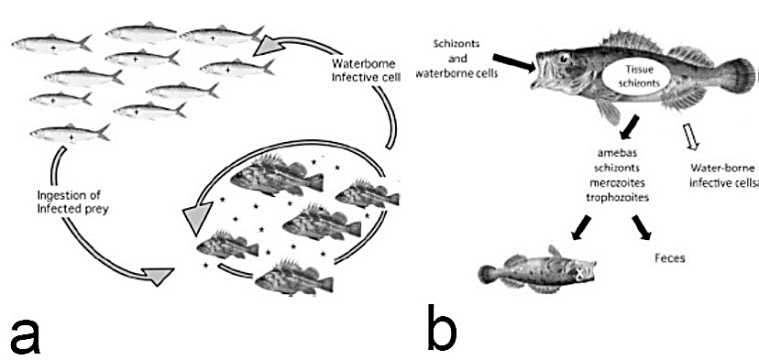
Background- Ichthyophonus
  Unicellular, multinucleated mesomycetozoan
    Cryptic species- Yukon isolate marine origin
  Piscivorous fish- infected prey
    Amoeboid invades gut mucosa
    Organs, submicron blood stage
    size, nuclear ÷ (schizont)
    Infected fish dies or eaten
= expt. confirmed; = uk mech, but confirmed infective
(Kocan 2019)
Notes:
Working knowledge of Ichthyophonus transmission between piscivores and planktivores, as well as among demersal piscivores. (+) = infected prey; (*) = waterborne infective cell. (b) Portal of entry and exit of Ichthyophonus cells from fish. Solid arrows = experimentally confirmed; the fate of cells exiting host is unknown. Empty arrows = exit route unknown, but cells confirmed to be infective (from Kocan, 2019).

Slide 4
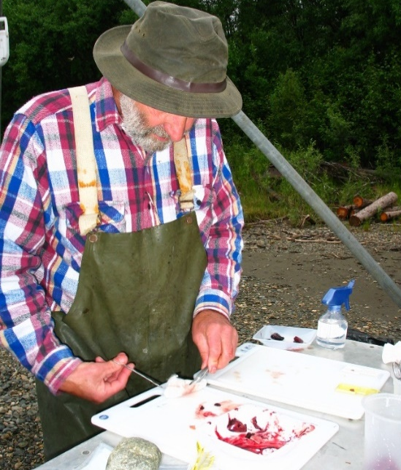
Previous Yukon Chinook Ich Studies
Early 2000’s: low runs & Ich, several studies
1) Ich lower-mid river, then at spawning grounds
2) prevalence upriver = assoc. mortality 60%
(Kocan et al., 2004)
3) Infected fish spawn as successful uninfected
(Hamazaki et al. 2013)
Prevalence only!
Notes:
Tanana confluence- CDN-bound prevalence & severity vs. Tanana (Kocan & Hershberger 2006)
pop. differ resistance- unlikely, chronic persistent infect (McVicar & McLay 1985)
genetic diff. feeding behavior- unlikely, same food source in ocean
physiological diff. sexual maturation affect disease course- possibly
- Tanana fish 1,000 mi less migration, so less lipid reserve
severely infected fish died en route, less infected population- likely
- swimming stamina due to cardiac damage

Slide 5
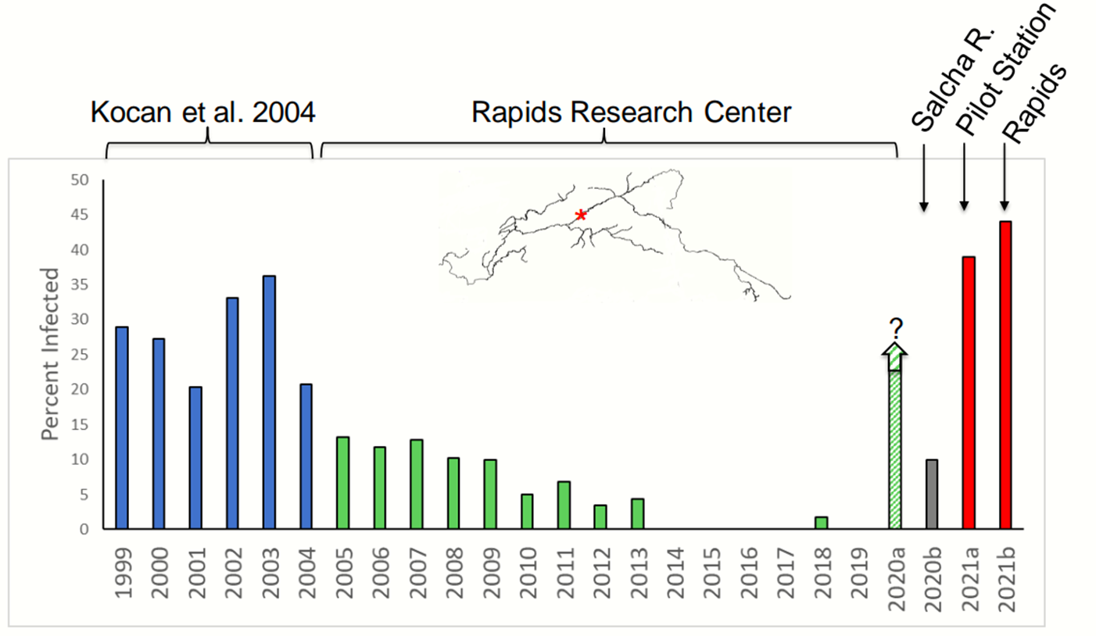
Ich Resurgence
  2020: record Ich Rampart Rapids since monitoring (2000’s)
    Limited sampling on Chena and Salcha spawning grounds (hi H₂0)
  Since 2020: large discrepancy fish abundance
    30-50% less Canadian-origin fish
    Sonar in lower river vs. sonar passage at border
  Ich-associated en route mortality leading hypothesis
Since 2020
Notes:
2020 samples (Salcha) 1/10, 1.3/mm2 (0.01/mm3)

Slide 6
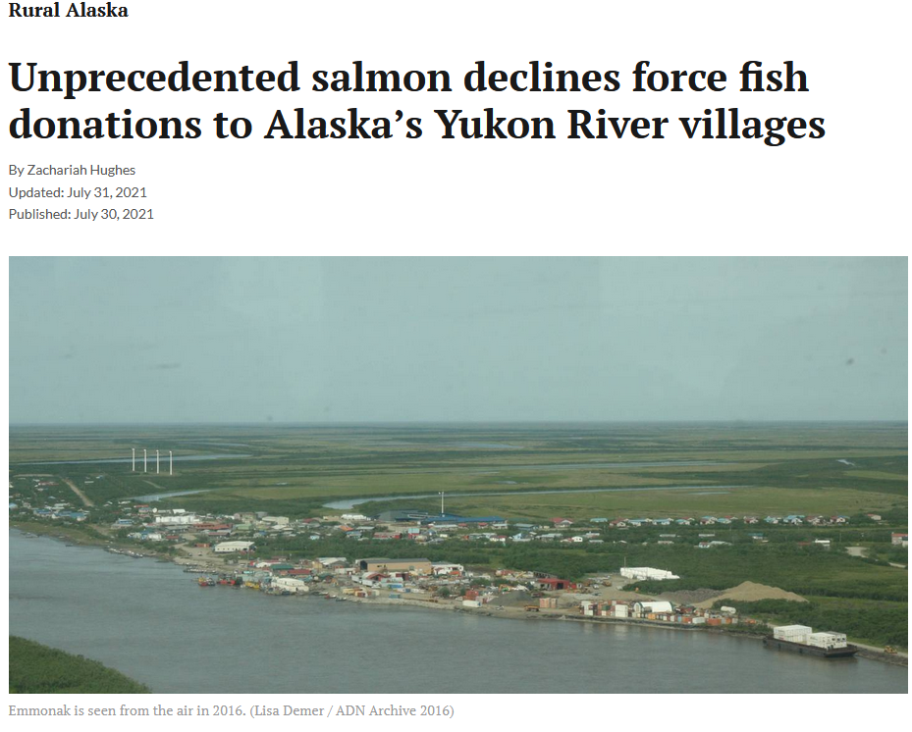
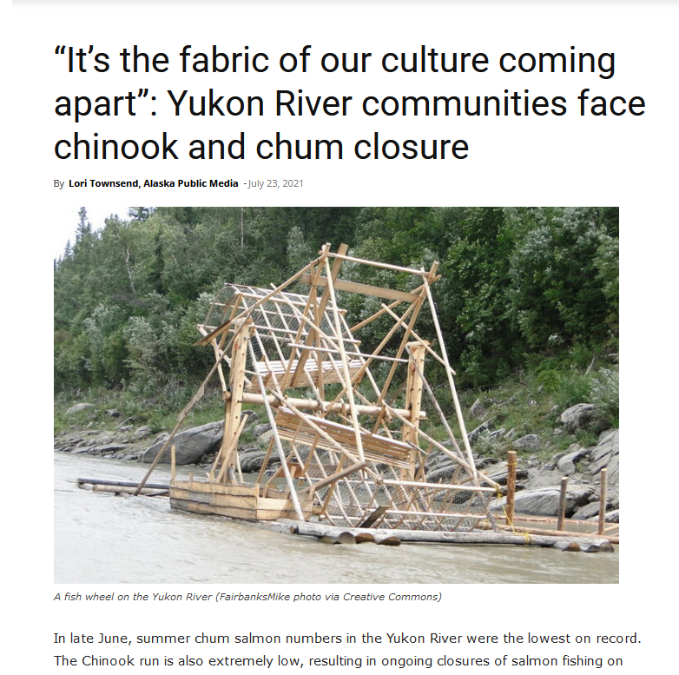
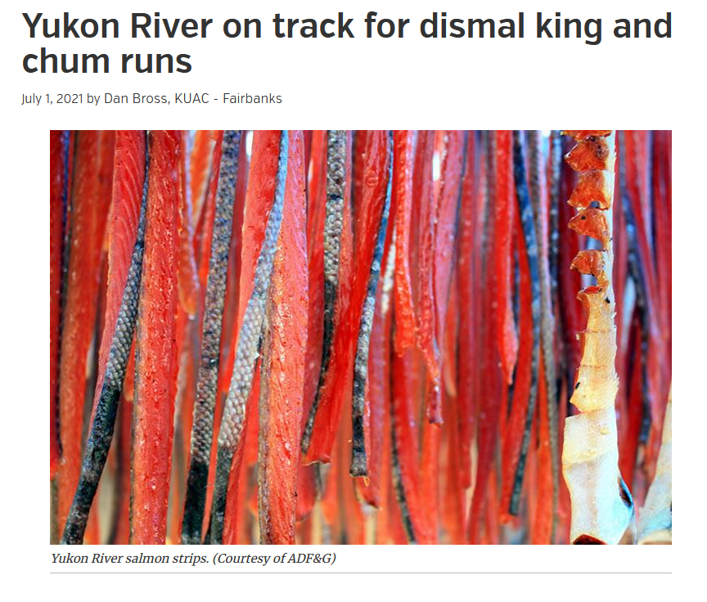
Ich Resurgence
Notes:
Fishery disasters significantly impacting rural Alaskan’s basic food security, culture, economics and way of life. A real hardship for these Alaskans.

Slide 7
Impacts of Parasite-associated Mortality on Yukon Chinook Fishery Management
  Escapement Goal Mgmt- # fish on spawning ground
    Projected Escapement = Projected (Run – Harvest)
      Parasite-associated mortality unaccounted ??? = escapement goal not met
    Can we predict parasite-associated mortality in season?
Notes:
Rampart Rapids is where my fish camp where we did alot of research. Rampart is the village 35 miles upriver from the Rampart Rapids. Everyone calls the Rampart Rapids the "Rapids". The name Rampart Rapids is in multiple history books and names the place where the river narrows and current speeds up 35 miles down from the village of Rampart. It has a long history as a prime native fishing spot and dangerous place during the gold rush for rafts and scows. One thing that seems to get neglected however is the severity of the ICH in the early 90's. While no studies were done back then myself and Bill Fliris, who first recognized it in the Chinook in the late 80's, have both felt strongly that the severity back then was greater than that of the 2000 years.
Size at age returns impacts?

Slide 8
Overall study:
Develop a method to predict parasite-associated mortality in season
Develop rapid screening method assessing infection prevalence and density
Determine lethal threshold infection density level
Develop a prediction model

Slide 9
Develop rapid screening prevalence & density:qPCR
  Ich prevalence by culture (gold standard) vs. qPCR
    Analytical Sensitivity (ASe)
    & Specificity (ASp)
  Ich density by histology (gold standard) vs. qPCR
    Linear regression
Notes:
There is an inverse, linear relationship between the logarithm of the initial template amount and the Ct-value. More input DNA results in a lower Ct as fewer cycles are needed for the fluorescence to reach the threshold.

Slide 10
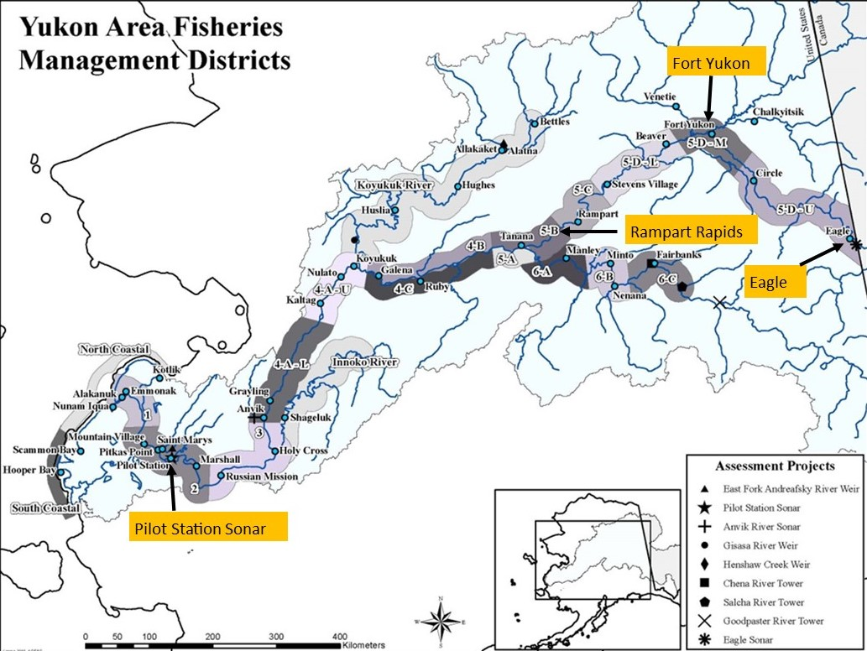
Study site
Pilot Station handling mortalities-
representative of run by sex, age, and size

Slide 11
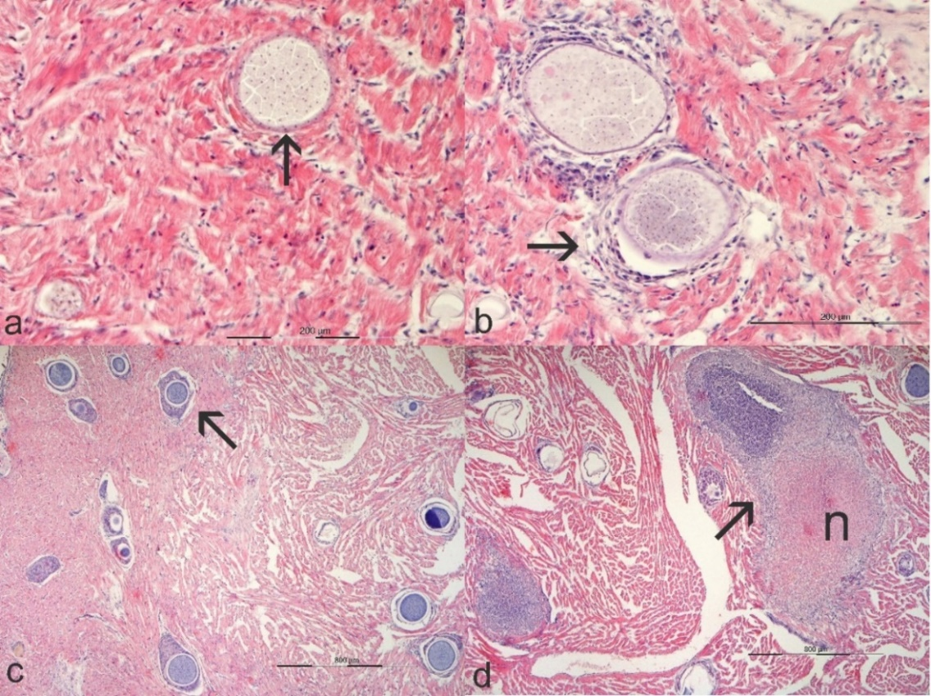
Methods
Hearts: 198 (2021); 75 (2023)
  Explant culture: prevalence only, MEM-5
  Histology: schizonts/mm³,
  severity graded
  qPCR (White et al. 2013):
  18S rDNA, copies/mg
  - modified, 0.5g homogenized,
  then subsample
Notes:
Figure 4. Histopathology of Ichthyophonus infections in Yukon Chinook salmon showing examples of inflammation index. a) Grade-0, parasite is intimately associated with myocytes and void of inflammation (arrow), b) Grade-1, parasite surrounded by mild inflammation (arrow), c) Grade-2, parasites encapsulated by discrete granulomas (arrow), d) Grade-3, obliterative necrotizing granulomatous inflammation (arrow), parasite present in lesion in previous section, n = caseous necrosis.

Slide 12
Prevalence
 | Test | Positive | Negative | Prevalence (%) | Kappa (κ) | Agreement (%)
2021 | Culture | 88 | 112 | 44.0ª | 0.85 | 93
 | qPCR | 96 | 102 | 48.5ª
 | Histology | 87 | 112 | 43.7ª
2023 | Culture | 36 | 39 | 48ª | 1 | 100
 | qPCR | 36 | 39 | 48ª
 | Histology | 35 | 40 | 46.7ª
Contaminated cultures: 12% (2021) 1.3% (2023)
Notes:
No diff by test, sex, size, or country of origin (χ2); Differed by age: 1.3yr lower prevalence than 1.4 yr

Slide 13
Analytical sensitivity & specificity
 |  | Pathogen
 |  |  | Present | Absent
2021 | Test result | Positive | 94 (True Positives) | 5 (False Positives)
 |  | Negative | 1 (False Negatives) | 105 (True Negatives)
 |  |  | 99.0% (ASe) | 95.5% (ASp)
2023 |  | Positive | 36 (True Positives) | 0 (False Positives)
 |  | Negative | 0 (False Negatives) | 39 (True Negatives)
 |  |  | 100% (ASe) | 100% (ASp)
Notes:
>/= 97% Accuracy
Table 5. Calculations of diagnostic sensitivity (Se), Specificity (Sp), Positive Predictive Value (PPV), and Negative Predictive Value (NPV) of qPCR using explant tissue culture as the gold standard. The modified results from these two tests after accounting for histology results are also summarized.

Slide 14
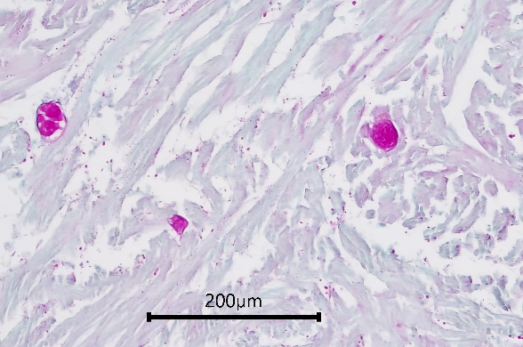
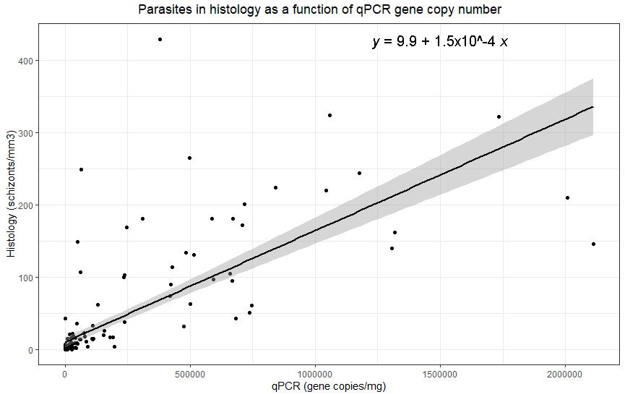
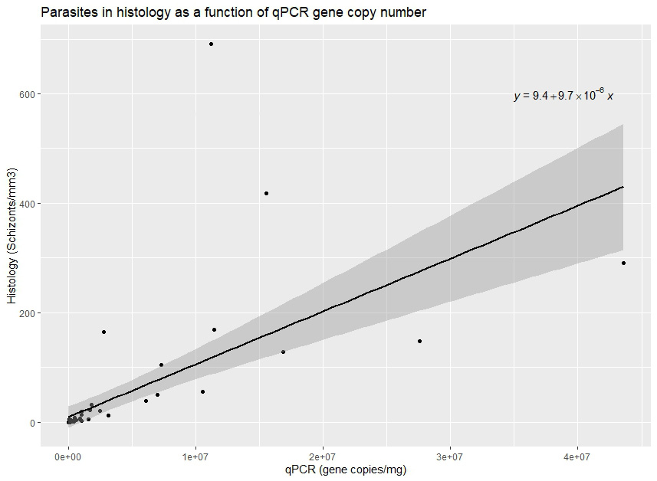
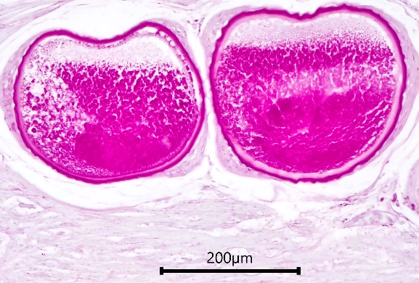
Density: qPCR vs histology
Lots small, low copy
5e+05
1e+06
qPCR (gene copies/mg)
1.5e+06
2e+06
2021:
P<0.0001;
adjust R² = 0.6
2023:
P<0.0001;
adjust R² = 0.4
Few big, high copy
Notes:
1 schizont = 6.7x10^3 copies (2021); 1 schizont = 1.0x10^5; I think the 2021 data need re-testing as they may need diluting
vs
1 schizont = 1.4x10⁴ copies (Lowe et al., 2018)
Different hosts: herring vs salmon
Counts culture vs histology
Histology low sensitivity, light infections
Increase 1 gene copy #/mg predicts that average schizonts/mm³ increase by 1.5x¹⁰⁻⁴ +/-9.9
This correlated increase may appear small, but the resulting number of parasites in section is much higher when considering that samples contained an average of 2.9x10⁸ copies/g and a maximum of 2.1x10⁹ copies/g that would correlate to 44 schizonts/mm³ and 320 schizonts/mm³, respectively, in histological section. Note: 1 schizont = 1.4x10^4 copies

Slide 15
 | Advantages | Disadvantages
Culture | “gold standard” | Cannot determine density
 | Detects viable parasite, visualized | Poor in remote field setting: contamination, variable temps.
 | Higher Ase than qPCR for light infections | Archives poorly
 | Low cost | Does not provide health info or other infections
 |  | Can have low Asp, grows morphologically similar organisms
 |  | Long turnaround (2wks)
 |  | Not high-throughput
Histology | Provides density data | Only partially assess viability by tissue integrity
 | Provides health & other disease info | Low Ase due to random distribution, small sample amount
 | Visualizes parasite; “gold standard” | Moderate cost
 | Easy to fix in field | Long turnaround (1mo+)
 | Easily archives | Not high-throughput
 | High ASp, can use special stains, IHC
qPCR | Provides density data | Only partially assess viability by low Ct values
 | High Ase & ASp | Cannot visualize parasite
 | Easy to fix in field | Cannot provide additional health/infection info
 | Easily archive | Lower ASe than culture for light infections, but can increase
 | Use sequence for molecular epidemiology | Higher cost
 | Rapid turnaround (2d)
 | High-throughput

Slide 16
Conclusions
qPCR fit rapid high-throughput screening
  High Ase & Asp; accurate & robust
    Could be used for non-lethal sampling (investigating)
  Quantifies infections; standardized burden (copy #)
Culture gold standard
  Cannot determine infection density
  Assesses viability, but can use low Ct and histo as proxy
  Longer turnaround and challenging in remote field setting

Slide 17

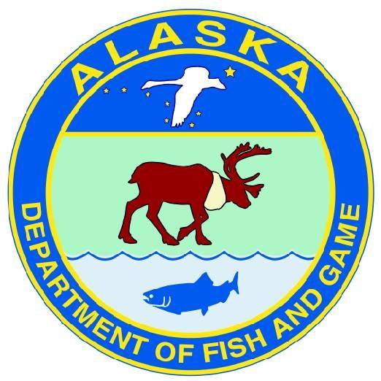

Acknowledgments
Pacific Salmon Treaty Implementation
ADF&G Commercial & Sport Fish Divisions
Alaska Sustainable Salmon Fund
  Partially funded by the Department of Commerce and the Alaska Department of Fish and Game under federal grant NA22NMF4380212
Notes:
The Yukon River Salmon Agreement (the Agreement) establishing the Yukon River Panel (YRP) and its Joint Technical Committee (JTC) was recognized by both the US and Canada as an executive agreement on December 4, 2002 and now forms Chapter 8 of the Pacific Salmon Treaty (1985). The Agreement helps to ensure that adequate numbers of salmon are allowed to pass from the US into Canada and spawn in their natal streams.

Slide 18
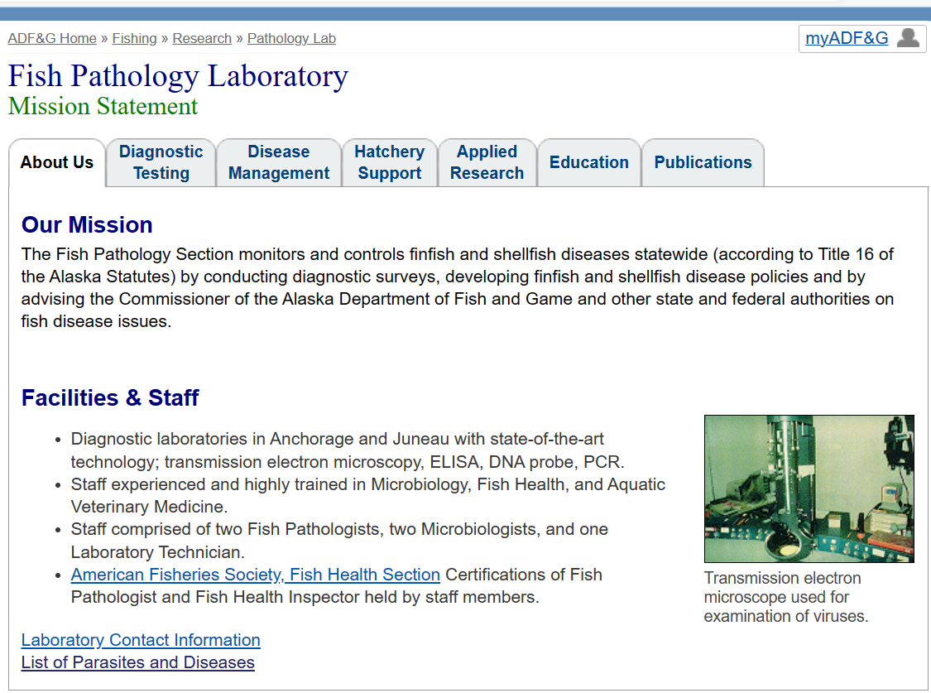
Questions

