Slide 1


Investigating the impacts of Ichthyophonus on
Yukon River Chinook Salmon
Jayde Ferguson, Ph.D.
Fish Pathologist, ADF&G

Slide 2








Opportunity to ENGAGE the scientific community as well
FWS and ADFG initiated study and decision to lethally sample fish
To gain most benefit, small organ or tissue samples taken for various studies before fish were distributed to communities
One of largest collective efforts to understand Yukon River Chinook salmon
Working Together to Monitor Health
of Yukon River Salmon
Community engagement
Ichthyophonus: River, marine, lab studies
Non-lethal Ichthyophonus method dev.
Other disease and health screenings
Radio telemetry studies
Thiamine deficiency studies
Fecundity
Heat stress
Paralytic shellfish toxins
Heart stress
Notes:
The theme is “Working Together to Monitor Health of Yukon River Salmon”. While ADF&G and the FWS initiated the Ichthyophonus study and made the decision to lethally sample Chinook salmon in the short term, other agencies have subsequently joined for additional studies, including the:
- US Geological Survey
- the Knik Tribe
- the University of Alaska Fairbanks
- as well as the University of Waterloo in Ontario Canada
The idea is to investigate additional factors that may or may not be impacting Chinook salmon health.
[ANIMATE 1] Through engagement with Yukon River communities, and also the wider scientific community, a few additional small organ or tissue samples were taken from the same study fish to investigate this range of topics you see here to better understand what may be contributing to low Chinook salmon runs in recent years.

Slide 3
Terminology
Prevalence: % infected fish in sampled population
Intensity: Total # parasites infecting the entire host
  Mean Intensity – excludes uninfected fish; measures burden of infected popul.
Density: The # parasites infecting a unit from host (e.g., mg)
  Most practical proxy of intensity for Ichthyophonus vs worms from GI, etc.
Abundance: Intensity (or Density) x Prevalence-
  Measure of parasite burden in total popul. (infected + uninfected)

Slide 4
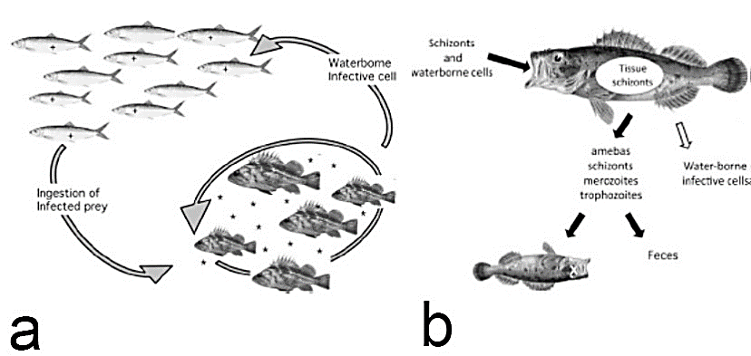
Ichthyophonus & Yukon Chinook
Marine origin- Unicellular, multinucleated
Mesomycetozoan: both fungus & animal
  Meso = middle; Myceto = fungus; Zoa = animal
  Cryptic species complex
  Lifecycle: eat infected prey
1988: 1st detect local Yukon R.
fishers, lab confirm
= expt. confirmed; = uk mech, but confirmed infective
(Kocan 2019)

Slide 5
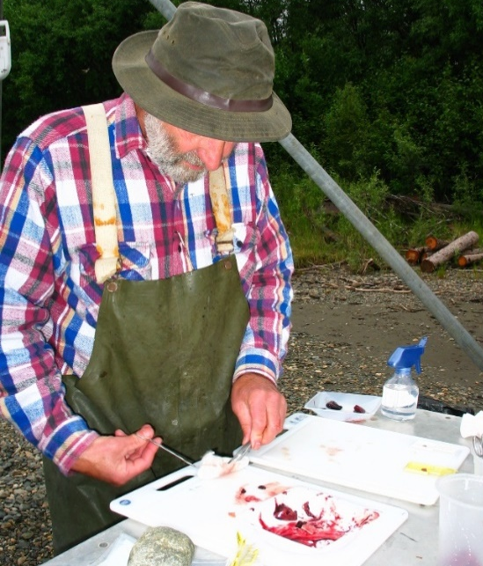
Previous Yukon Chinook Ich Studies
Early 2000’s: low runs & Ich, several studies
1) Ich lower-mid river, then at spawning grounds
2) prevalence upriver = assoc. mortality 60%
(Kocan et al., 2004)
3) Infected fish spawn as successful uninfected
(Hamazaki et al. 2013)
Prevalence only!
Notes:
Tanana confluence- CDN-bound prevalence & severity vs. Tanana (Kocan & Hershberger 2006)
pop. differ resistance- unlikely, chronic persistent infect (McVicar & McLay 1985)
genetic diff. feeding behavior- unlikely, same food source in ocean
physiological diff. sexual maturation affect disease course- possibly
- Tanana fish 1,000 mi less migration, so less lipid reserve
severely infected fish died en route, less infected population- likely
- swimming stamina due to cardiac damage

Slide 6
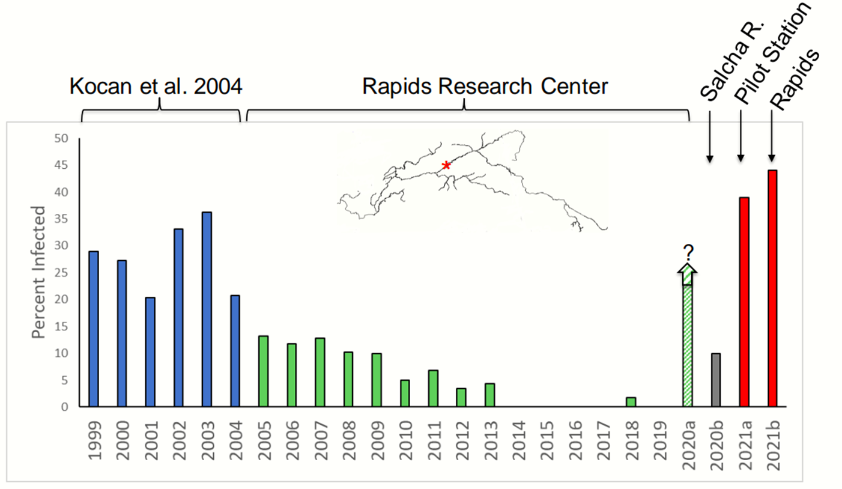
Ich Resurgence
  2020: record Ich Rampart Rapids since monitoring (2000’s)
    Limited sampling on Chena and Salcha spawning grounds (hi H₂0)
  Since 2020: large discrepancy fish abundance
    30-50% less Canadian-origin fish
    Sonar in lower river vs. sonar passage at border
  Ich-associated en route mortality leading hypothesis
Since 2020
Notes:
2020 samples (Salcha) 1/10, 1.3/mm2 (0.01/mm3)

Slide 7
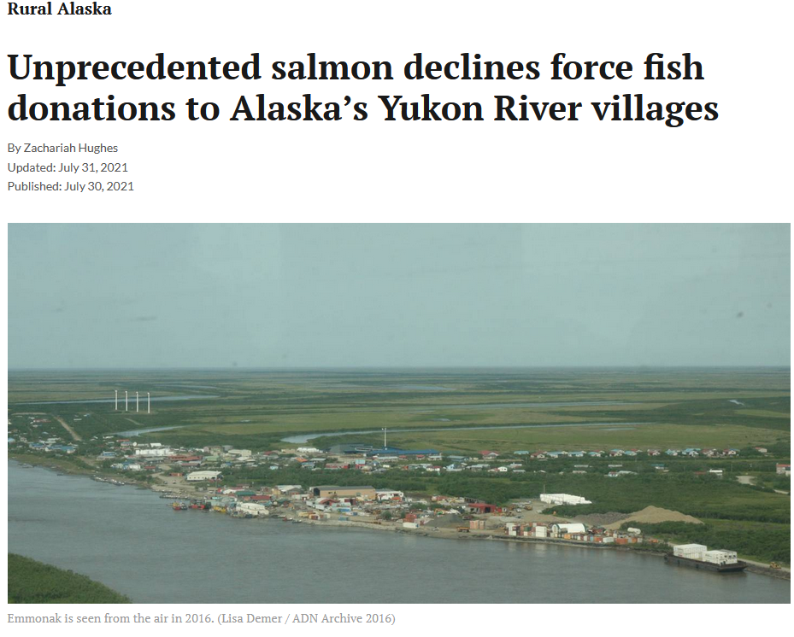
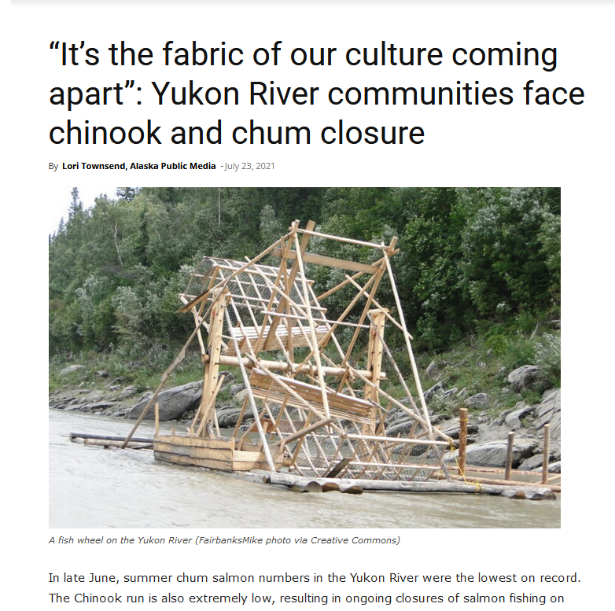
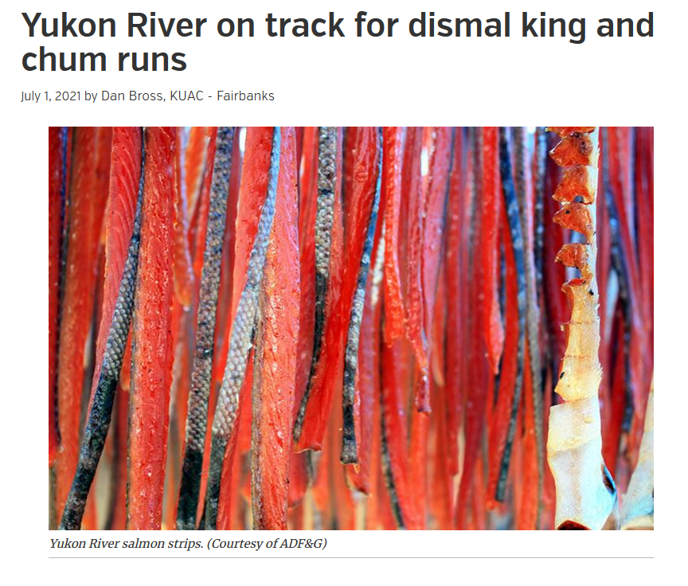
Ich Resurgence
Notes:
Fishery disasters significantly impacting rural Alaskan’s basic food security, culture, economics and way of life. A real hardship for these Alaskans.

Slide 8
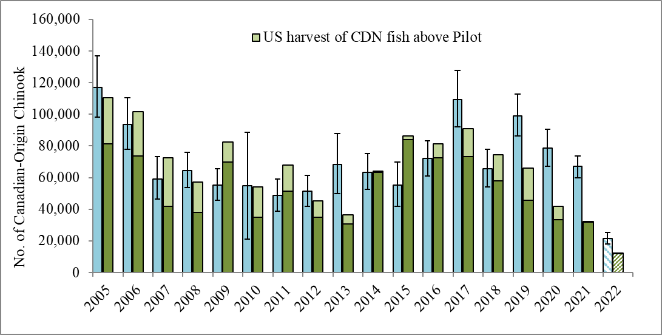
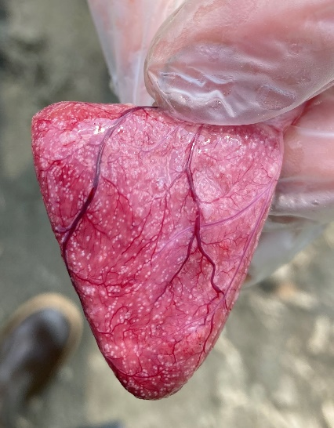
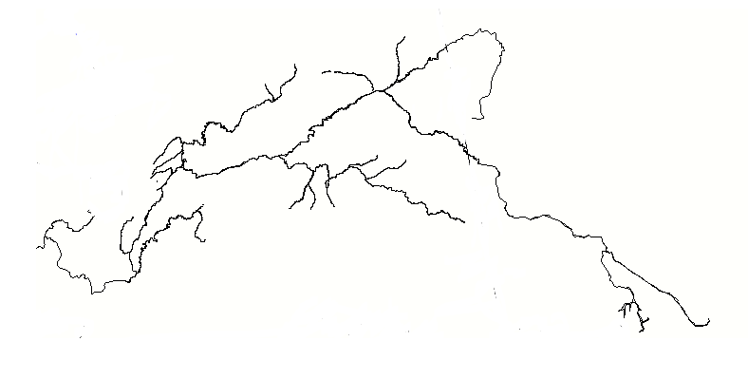
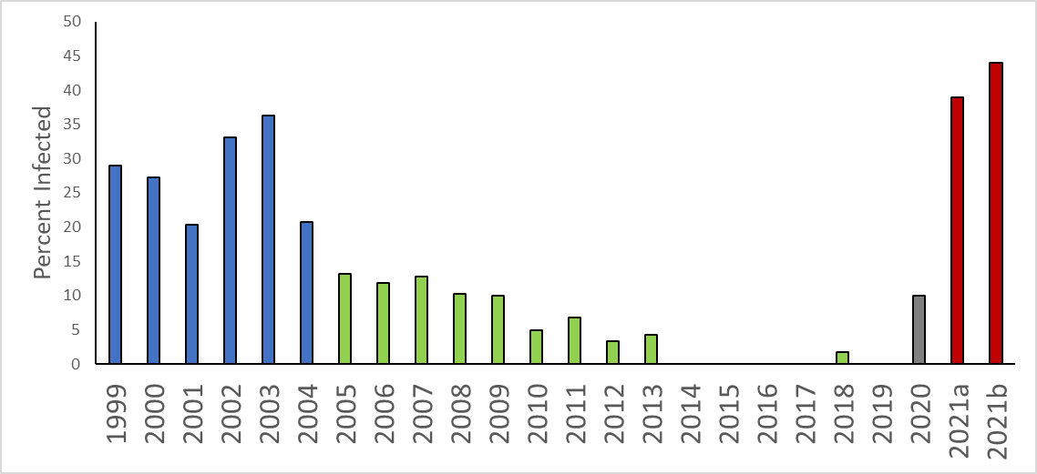
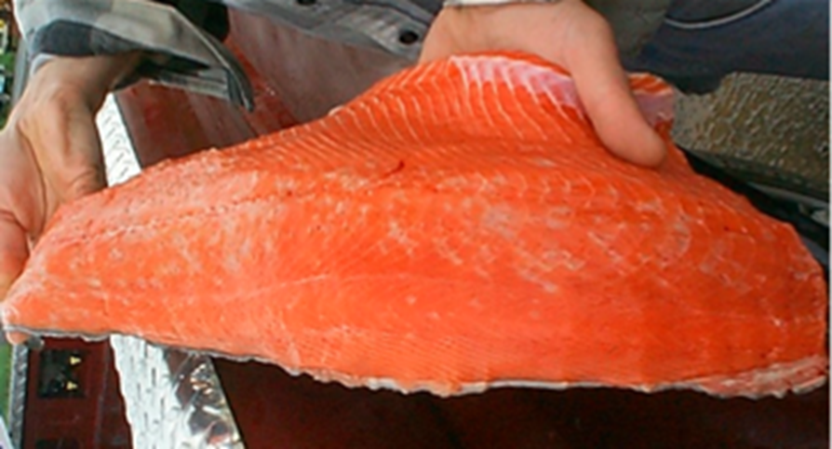
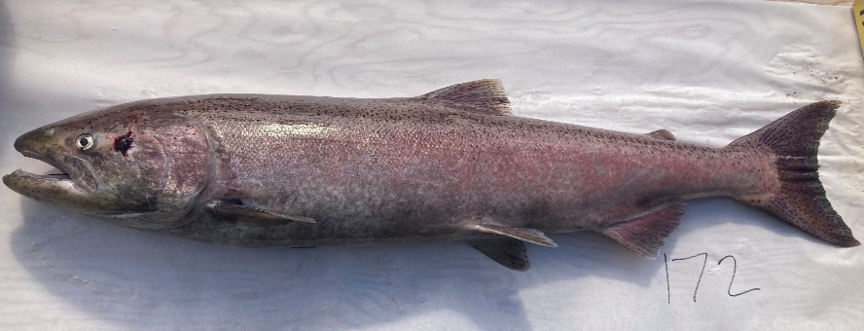
Four Consecutive Years of “Difference Between Estimates”
44% Fewer Fish
Canadian passage
12,025
Arrived
Eagle
Pilot
All Stocks | % Canadian | Canadian run
48,439 | 45% | 21,648 ± 5,000
Entered

Slide 9
Ichthyophonus-associated Mortality Fishery Management
  Escapement Goal Mgmt- # fish on spawning ground
    Projected Escapement = Projected (Run – Harvest)
    Ich-mortality unaccounted ??? = escapement goal not met
  Can we predict parasite-associated mortality in season?
Notes:
Rampart Rapids is where my fish camp where we did alot of research. Rampart is the village 35 miles upriver from the Rampart Rapids. Everyone calls the Rampart Rapids the "Rapids". The name Rampart Rapids is in multiple history books and names the place where the river narrows and current speeds up 35 miles down from the village of Rampart. It has a long history as a prime native fishing spot and dangerous place during the gold rush for rafts and scows. One thing that seems to get neglected however is the severity of the ICH in the early 90's. While no studies were done back then myself and Bill Fliris, who first recognized it in the Chinook in the late 80's, have both felt strongly that the severity back then was greater than that of the 2000 years.
Size at age returns impacts?

Slide 10
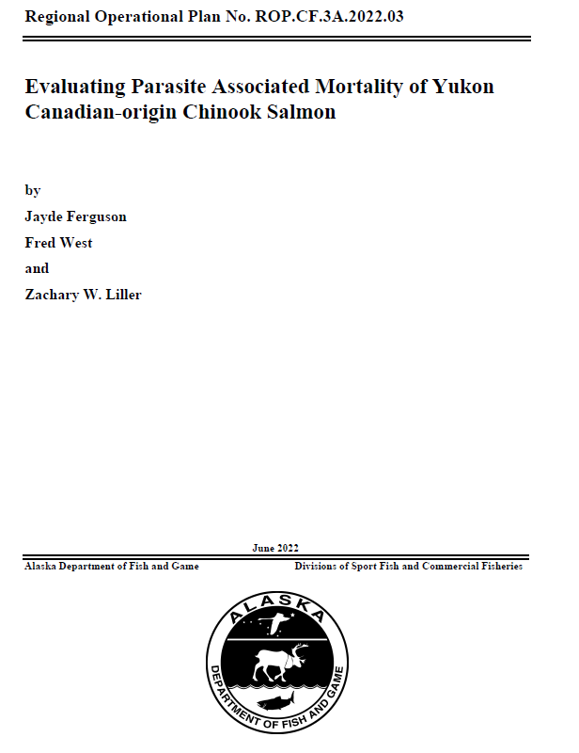

Evaluating parasite associated mortality of Yukon Canadian-origin Chinook salmon
Ferguson, J., F. West, & Z. Liller (2022)
ADF&G, Div. Comm. Fish., Regional
Operational Plan No. ROP.CF.3A.2022.03

Slide 11
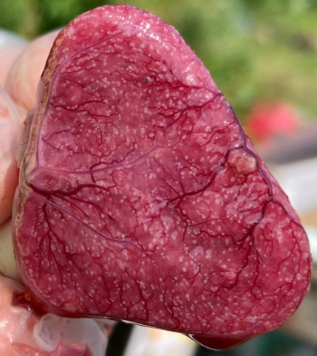
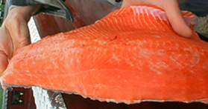
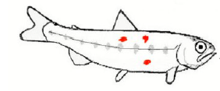
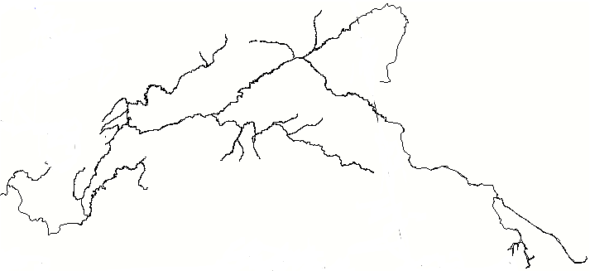
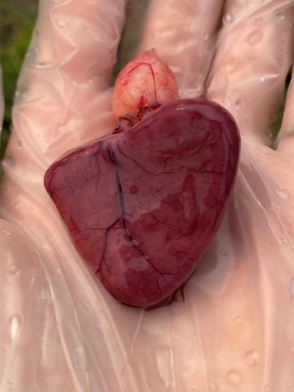
Disease peaks midriver- visible white spots heart & muscle
- Progresses with migration/maturation/senescence
- Survive mild infections, but high burden & severe disease fatal
- Stress is an important factor
Visible lesions
Salmon infected marine environ.
Infected fish enter river, most not yet diseased, req. lab tests to detect lower river
Fort Yukon
No visible lesions
Upriver fishers rarely report visible lesions
Eagle
Few heavily infected fish upper river
≈ en route mortality
Rapids
Pilot Station
Notes:
Fortunately, we know quite a bit about Ichthyophonus from a combination of local and western science. We know that salmon become infected in the ocean by eating diseased prey. Those infected fish rarely show visible signs of being sick when they enter the Yukon River. The disease progresses as the fish continue their upriver migration, especially when the fish are under stress. By the time the fish reach the middle river, disease progression peaks before mortality and the fish often show visible signs of infection. Upriver fishermen rarely report seeing infected fish, which suggests that the most heavily infected fish died downriver.

Slide 12
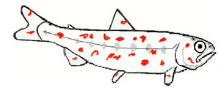
Data for Future Model Development
Evaluate for evidence of Ichthyophonus-associated mortality; compare results from Lower (Pilot) and Upriver (Eagle)
Fort Yukon
Eagle
Rapids
Determine the infection level associated with mortality
Pilot Station
Determine how fast replicates between lower and middle river sites; water-temp dependent
Notes:
After the samples collected in all three years are analyzed, we will undertake several key analyses. First, we will use samples to determine if Ichthyophonus disease was associated with mortality and if so how much. We will also use samples to determine how fast the disease progresses as the fish migrate upriver and what level of disease severity is associated with mortality. These results will allow us to develop a future monitoring program to better inform fishery management decisions during times when this disease is present. With that, I’ll turn it back to Scott to discuss community engagement and planning for the 2024 season.

Slide 13
Overall study:
Develop a method to predict parasite-associated mortality in season
Develop rapid screening method assessing infection prevalence and density
Determine lethal threshold infection density level
Develop a prediction model

Slide 14
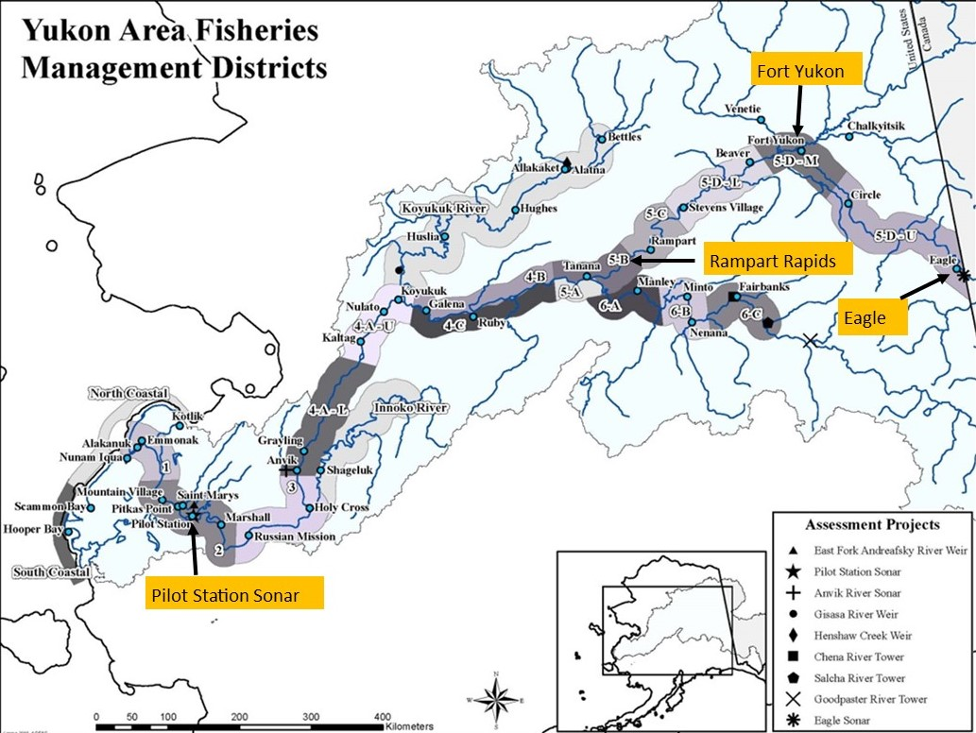
Study site
Pilot Station handling mortalities-
Sampled other studies
Fish donated community
representative of run by sex, age, and size

Slide 15
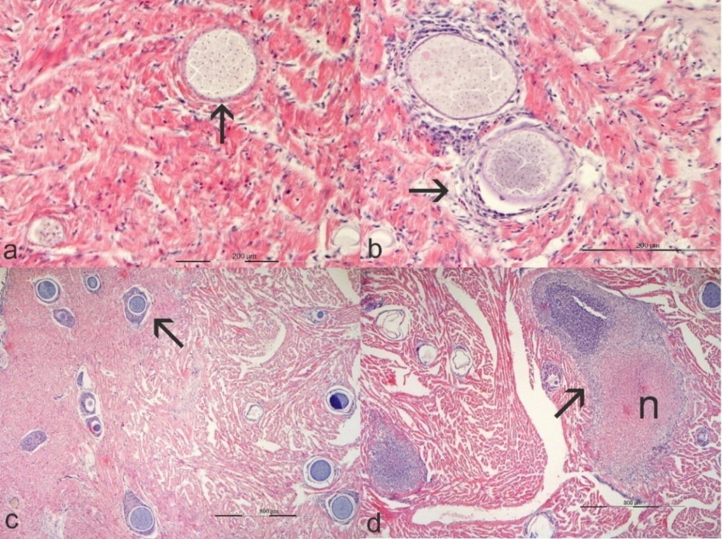
Methods
Hearts: 198 (2021); 75 (2023)
  Explant culture: prevalence only, MEM-5
  Histology: schizonts/mm³,
  severity graded
  qPCR (White et al. 2013):
  18S rDNA, copies/mg
  - modified, 0.5g homogenized,
  then subsample
Notes:
Figure 4. Histopathology of Ichthyophonus infections in Yukon Chinook salmon showing examples of inflammation index. a) Grade-0, parasite is intimately associated with myocytes and void of inflammation (arrow), b) Grade-1, parasite surrounded by mild inflammation (arrow), c) Grade-2, parasites encapsulated by discrete granulomas (arrow), d) Grade-3, obliterative necrotizing granulomatous inflammation (arrow), parasite present in lesion in previous section, n = caseous necrosis.

Slide 16
Prevalence
 | Test | Positive | Negative | Prevalence (%) | Kappa (κ) | Agreement (%)
2021 | Culture | 88 | 112 | 44.0ª | 0.85 | 93
 | qPCR | 96 | 102 | 48.5ª
 | Histology | 87 | 112 | 43.7ª
2023 | Culture | 36 | 39 | 48ª | 1 | 100
 | qPCR | 36 | 39 | 48ª
 | Histology | 35 | 40 | 46.7ª
Contaminated cultures: 12% (2021) 1.3% (2023)
  Fungi and bacteria- affects interpretation
Notes:
Fungi/BacT contam = impact interp; No diff by test, sex, size, or country of origin (χ2); Differed by age: 1.3yr lower prevalence than 1.4 yr

Slide 17
Diagnostic Sensitivity (Dse) & Specificity (DSp)
 |  | Pathogen
 |  |  | Present | Absent
2021 | Test result | Positive | 94 (True Positives) | 5 (False Positives)
 |  | Negative | 1 (False Negatives) | 105 (True Negatives)
 |  |  | 99.0% (DSe) | 95.5% (DSp)
2023 |  | Positive | 36 (True Positives) | 0 (False Positives)
 |  | Negative | 0 (False Negatives) | 39 (True Negatives)
 |  |  | 100% (DSe) | 100% (DSp)
Notes:
>/= 97% Accuracy
Table 5. Calculations of diagnostic sensitivity (Se), Specificity (Sp), Positive Predictive Value (PPV), and Negative Predictive Value (NPV) of qPCR using explant tissue culture as the gold standard. The modified results from these two tests after accounting for histology results are also summarized.

Slide 18
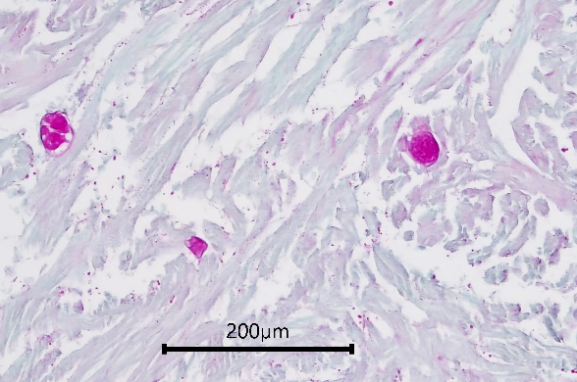
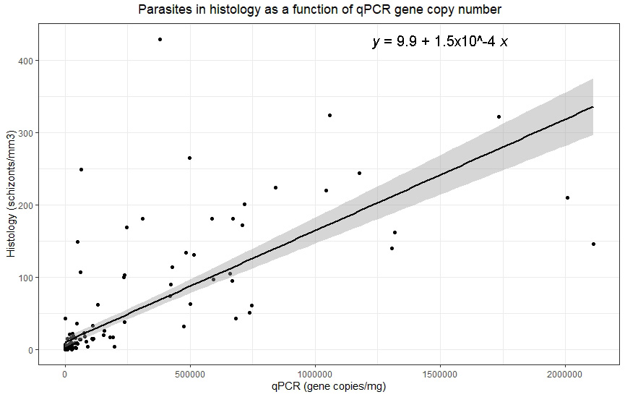
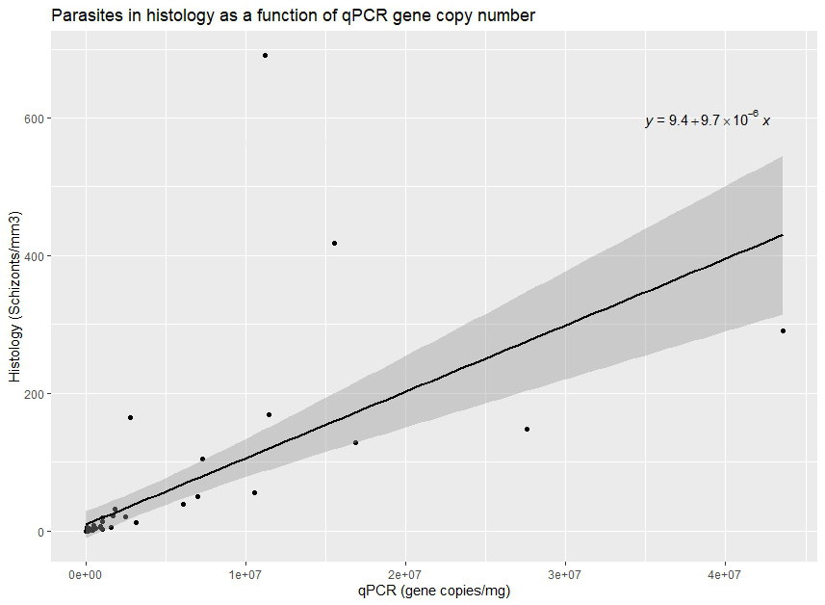
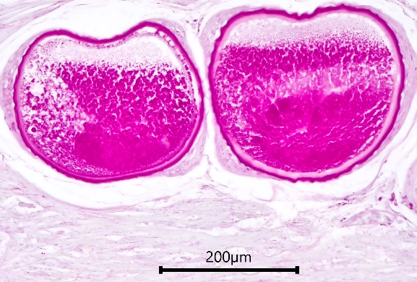
Density: qPCR vs histology
Lots small, low copy
5e+05
1e+06
qPCR (gene copies/mg)
1.5e+06
2e+06
2021:
P<0.0001;
adjust R² = 0.6
2023:
P<0.0001;
adjust R² = 0.4
Few big, high copy
Notes:
1 schizont = 6.7x10^3 copies (2021); 1 schizont = 1.0x10^5; I think the 2021 data need re-testing as they may need diluting
vs
1 schizont = 1.4x10⁴ copies (Lowe et al., 2018)
Different hosts: herring vs salmon
Counts culture vs histology
Histology low sensitivity, light infections
Increase 1 gene copy #/mg predicts that average schizonts/mm³ increase by 1.5x¹⁰⁻⁴ +/-9.9
This correlated increase may appear small, but the resulting number of parasites in section is much higher when considering that samples contained an average of 2.9x10⁸ copies/g and a maximum of 2.1x10⁹ copies/g that would correlate to 44 schizonts/mm³ and 320 schizonts/mm³, respectively, in histological section. Note: 1 schizont = 1.4x10^4 copies

Slide 19
 | Advantages | Disadvantages
Culture | “gold standard” | Cannot determine density
 | Detects viable parasite, visualized | Poor in remote field setting: contamination, variable temps.
 | Higher DSe than qPCR for light infections | Archives poorly
 | Low cost | Does not provide health info or other infections
 |  | Can have low DSp, grows morphologically similar organisms
 |  | Long turnaround (2wks)
 |  | Not high-throughput
Histology | Provides density data | Only partially assess viability by tissue integrity
 | Provides health & other disease info | Low DSe due to random distribution, small sample amount
 | Visualizes parasite; “gold standard” | Moderate cost
 | Easy to fix in field | Long turnaround (1mo+)
 | Easily archives | Not high-throughput
 | High DSp, can use special stains, IHC
qPCR | Provides density data | Only partially assess viability by low Ct values
 | High DSe & DSp | Cannot visualize parasite
 | Easy to fix in field | Cannot provide additional health/infection info
 | Easily archive | Lower DSe than culture for light infections, but can increase
 | Use sequence for molecular epidemiology | Higher cost
 | Rapid turnaround (2d)
 | High-throughput

Slide 20
Conclusions
qPCR fit rapid high-throughput screening
  High DSe & DSp; accurate & robust
  Candidate non-lethal sampling (investigating)
  Quantifies infections; standardize burden (copy #)
Culture gold standard
  Cannot determine infection density
  Assesses viability, but can use low Ct and histo as proxy
  Longer turnaround and challenging in remote field setting

Slide 21
Overall study:
Develop a method to predict parasite-associated mortality in season
Develop rapid screening method assessing infection prevalence and density
Determine lethal threshold infection density level
Develop a prediction model

Slide 22
Data for Future Model Development
Evaluate for evidence of Ichthyophonus-associated mortality; compare results from Lower (Pilot) and Upriver (Eagle)
Fort Yukon
Eagle
Rapids
Determine the infection level associated with mortality
Pilot Station
Determine how fast replicates between lower and middle river sites; water-temp dependent
Notes:
After the samples collected in all three years are analyzed, we will undertake several key analyses. First, we will use samples to determine if Ichthyophonus disease was associated with mortality and if so how much. We will also use samples to determine how fast the disease progresses as the fish migrate upriver and what level of disease severity is associated with mortality. These results will allow us to develop a future monitoring program to better inform fishery management decisions during times when this disease is present. With that, I’ll turn it back to Scott to discuss community engagement and planning for the 2024 season.

Slide 23
N 200
n 156
n 176
n 144

Slide 25
Data for Future Model Development
Evaluate for evidence of Ichthyophonus-associated mortality; compare results from Lower (Pilot) and Upriver (Eagle)
Fort Yukon
X
Eagle
Rapids
X
Determine the infection level associated with mortality
Pilot Station
Determine how fast replicates between lower and middle river sites; water-temp dependent
Notes:
After the samples collected in all three years are analyzed, we will undertake several key analyses. First, we will use samples to determine if Ichthyophonus disease was associated with mortality and if so how much. We will also use samples to determine how fast the disease progresses as the fish migrate upriver and what level of disease severity is associated with mortality. These results will allow us to develop a future monitoring program to better inform fishery management decisions during times when this disease is present. With that, I’ll turn it back to Scott to discuss community engagement and planning for the 2024 season.

Slide 26
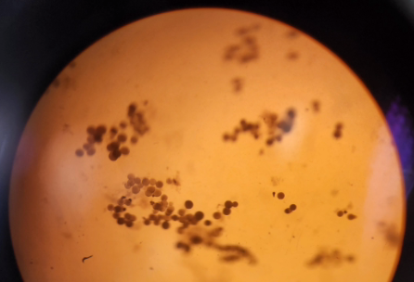
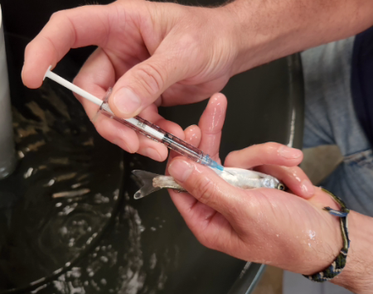
Ichthyophonus Infection Challenges
Nadia Barcelona¹, Jayde Ferguson², Paul Hershberger,³ Zachary Liller⁴ & Nathan Wolf¹
¹ Alaska Pacific Univ. Fisheries, Aquatic Science, & Technology Laboratory
² Alaska Dept. Fish & Game, Div. Comm. Fish., Fish Pathology Laboratory
³ U.S. Geological Survey Western Fisheries Research Center & Marrowstone
Marine Field Station
⁴ Alaska Dept. Fish & Game, Div. Commercial Fisheries,
Arctic-Yukon-Kuskokwim Region

Slide 27
Ichthyophonus Infection Challenges
Previous studies show Yukon Chinook susceptible
  Higher mortality (Jones & Dawe, 2002)
  30% Yukon Chinook died vs 1% of the Salish Sea Chinook (Elliott et al., 2021)
    Used WA/BC strain
  Yukon vs PNW strain (Gregg et al., 2022)
Need to challenge Yukon Fish w/ Yukon Ich strain

Slide 28
Ichthyophonus Infection Challenges
2023: Feasibility study
  100 Chinook salmon smolts from Ship Ck, Anchorage sent to USGS Marrowstone Lab
    Smolts sensitive lifestage
  Yukon Ichthyophonus strain from adult returns
  Challenged via i.p. and feeding
  Only 3/100 infected
Feasible & confirms previous work

Slide 29
Ichthyophonus Infection Challenges
2024: Pilot study
  100 Yukon Chinook salmon smolts from Chena and Salcha sent to USGS Marrowstone Lab
  Yukon Ichthyophonus from adult returns
  Challenged via i.p. and feeding

Slide 30
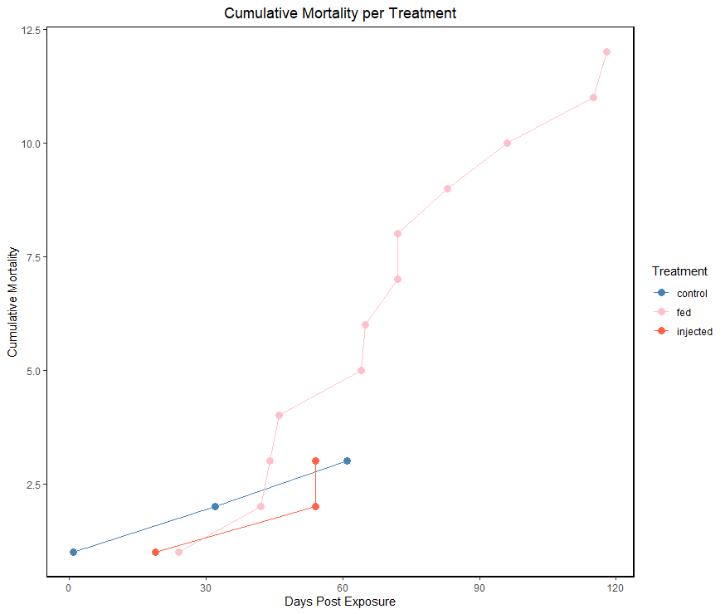
Mortality
Infected: 37% (CI: 21-56%)
Non-infected: 13% (CI: 7-23%)
n = 90
p < 0.05
GLM under a Bernoulli distribution fixed with an inverse logit link function in R Studio
Notes:
All my analysis was done in R studio
To assess mortality rate, we used a… -> we found that…
fed group immensely more mortality – random tank effects
small sample size, significant results
can conclude that Ich infection has an effect on … mortality
Explain graph and axes
Hopefully this year’s data can substantiate those findings.
Severity data incoming
95% confidence interval: confident that 95 out of 100 times, the estimate will fall between the upper and lower values

Slide 31
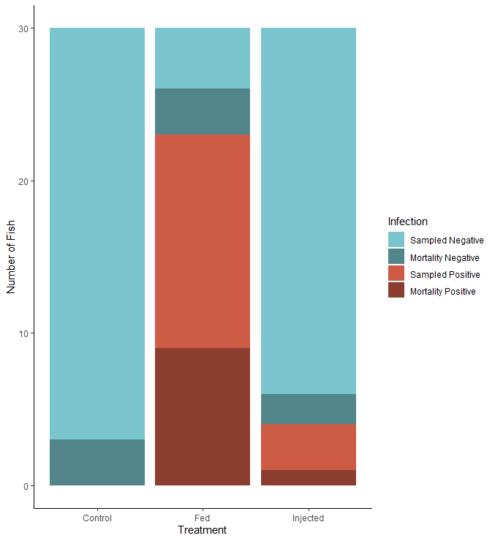
Infection
Fed: 77% (CI: 58-88%)
Injected: 13% (CI: 6 - 26%)
n = 90
p = < 0.05
GLM under a Bernoulli distribution fixed with an inverse logit link function in R Studio
Notes:
To determine the optimal transmission method….
Infection rate was…
Difference is significant..
Explain graph thoroughly
Subsequently, use the fed treatment for objective 3 study

Slide 32

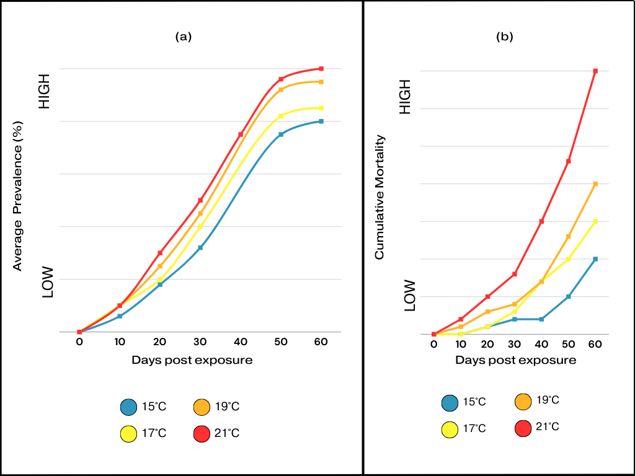
2025: Full study, induce-immunosuppression mimic adults; temp. effects, etc.
  Will be used to determine
  lethal threshold – LD₅₀

Slide 33
Overall study:
Develop a method to predict parasite-associated mortality in season
Develop rapid screening method assessing infection prevalence and density
Determine lethal threshold infection density level
Develop a prediction model

Slide 34
Prediction Model
Req. more yrs data for est. parameters
  ‘Ramp-rate’: how fast the parasite proliferates between low and mid-river
Field data also used (Dr. Wilber, Univ. TN)
  Retrospective modeling of pre- & post- mortality using Likelihood Method
Modelers (Dr. Paez, USGS, Dr. Cunningham, UAF)

Slide 35
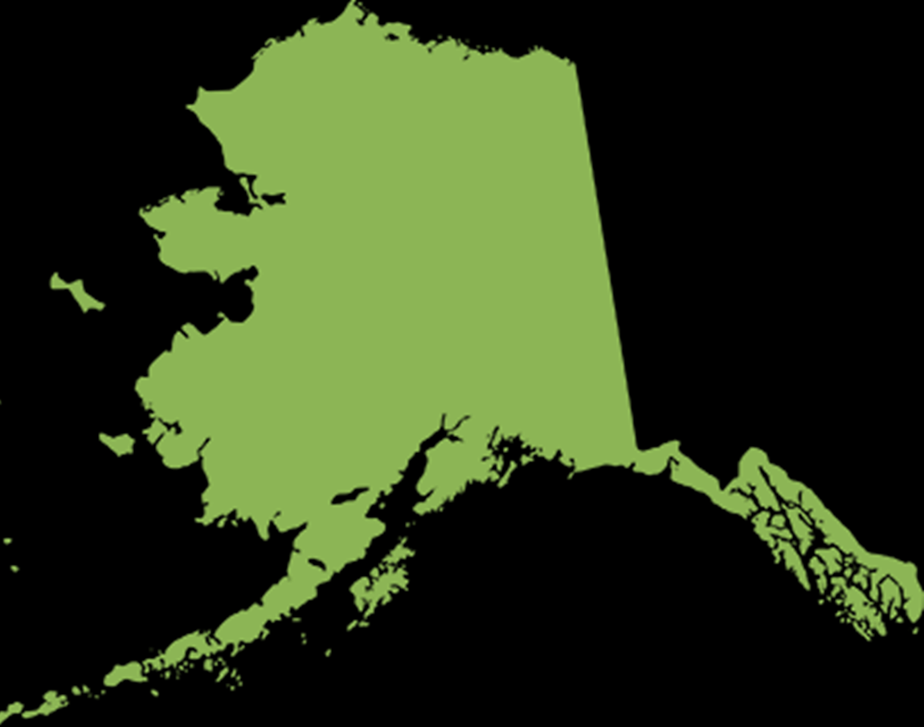
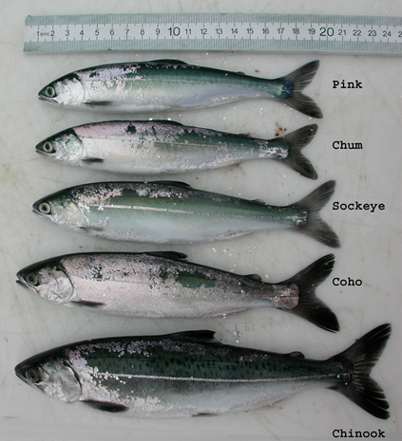
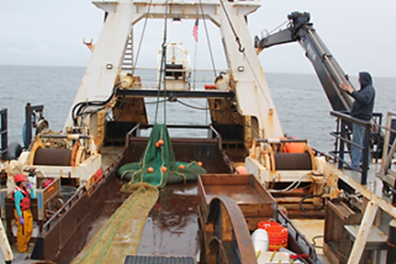


Marine Monitoring
NBS Survey 2021-2024
Chinook
  (immature & juv.)
P. herring (0-1+)
Pollock (0-2+)
Rainbow smelt,
Sandlance, Capelin
(0-1+)
35

Slide 36
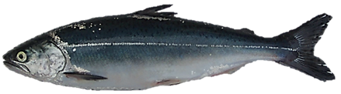
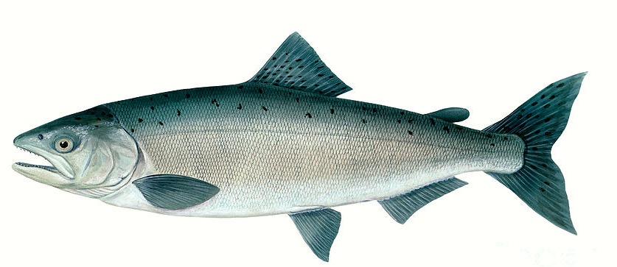
Preliminary findings –
Chinook salmon
Infections:
Uninfected (0/86)
n = 30 (‘21), 7 (‘22), 49 (‘23)
33 – 67% infected
n = 34 (‘21), 15 (‘22), 15 (‘23)
Notes:
Note: 1/18 immature chum positive (6%) in 2023 with 3.2x10^5 copies/mg
0/1 sockeye in 2023

Slide 37
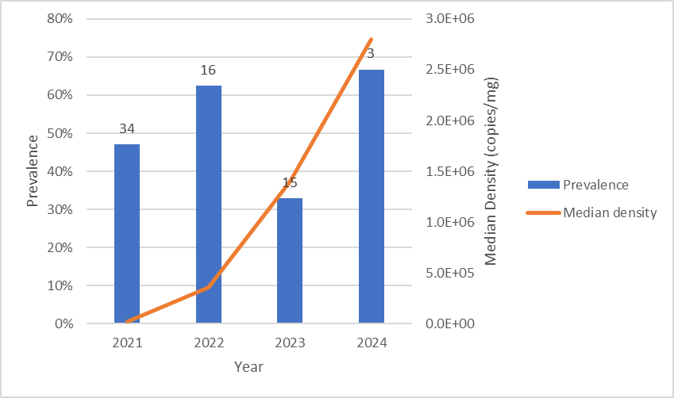
Ichthyophonus Infections in immature Chinook Salmon
(Jayde Ferguson, ADF&G Fish Pathology Laboratory)
Ichthyophonus Prevalence and Density
Ichthyophonus Abundance: Prevalence * Density
n=2; clinical
Notes:
We began monitoring Ichthyophonus infections in immature Chinook in 2021. The prevalence of Ichthyophonus (proportion of Chinook infected) has been relatively high in the immature population wihin the NBS, varing from 33% to 67% since 2021. The intensity of the infection (density of the parasite) has increased over time and has reached levels comparable to the levels present in adult Yukon River Chinook salmon. By combining prevalence and intensity we can estimate the abundance of the parasite in the host population, which has steadily increased since 2021. We were only able to sample 3 immature Chinook in 2024, which does not provide enough information to provide insight into the abundance of Ich in Chinook salmon in the NBS, so estimates of abundance in 2024 are not included the figure on the right. We have tested a variety of different prey species for Ichthyophonus to get a better handle on the transmission pathways of Ichthyophonus. Ichthyophonus was also present in chum salmon this last year. Research on Ichthyophonus is ongoing and we hope the data we collect in the NBS can help provide better insight into the impact this disease is having on salmon.

Slide 38
Preliminary findings –
Chinook salmon
Infections:
Take aways:
Juvenile Chinook salmon not infected first summer at sea
Older, larger fish = higher infection = increased exposure
Infection density increased between 2021 and 2022; 2023 similar to 2022
What does infection mean for marine mortality?

Slide 39
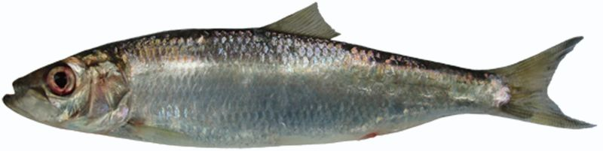
Preliminary findings –
Pacific herring
2022
Background/Question:
Pacific herring common source infection south Aleutians and in PNW
Common source of infection in GOA
Infections:
Take aways:
Consistent previous work Bering Sea (Kocan et al., 2004) vs GOA
Pacific herring not common source infection Chinook salmon
No infection present: 0/386
46% age 0, 54% age 1+

Slide 40


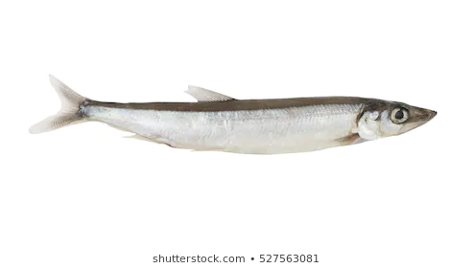
Preliminary findings–
FORAGE FISH
2022
Rainbow smelt
Sand lance
Uninfected: 0/17
Uninfected: 0/50
Capelin
0/61 uninfected*
*1 fish qPCR+ve (low); unconfirmed histo (likely cross contamination)
Take aways:
Not common source infection (consistent in 2021-2024)

Slide 41

Preliminary findings –
Walleye pollock
Background/Question:
Ichthyophonus in Bering Sea pollock (White et al. 2013)
Cannibalism in pollock = amplifies parasite pollock population
Chinook salmon eat pollock = transmission path?
Age-0, 2022
Age-2+, 2023
Density:
3x10⁴ copies/mg
Uninfected: 0/22
33% infected: 4/12
Take away: Age 2+ too large, need test more Age 1 (neg so far)
Notes:
Pollock abundance trends loosely mirror Ich infection in Yukon River Chinook
There is at least one confirmed case of a Bering Sea Chinook salmon consuming Ich-infected pollock waste (White et al. 2014)

Slide 42
FUTURE NBS sampling
Continue sampling juvenile and sub-adult Chinook salmon to monitor Ichthyophonus infection and disease trends.
Genetic ID Chinook salmon evaluate stock-specific differ infection trends.
  Done for immatures by ADF&G
No more sample P. herring, rainbow smelt, sandlance, capelin
  Test other host species- saffron cod, P. cod, etc.
    Test size of these species that Chinook eat
  Test pollock eggs/ovary- newly suspected source (new data)
Collab NOAA incorporate Ich data into run forecast
Notes:
Suggest animations here to walk through each bullet

Slide 43




Acknowledgments
Pacific Salmon Treaty Implementation
ADF&G Commercial & Sport Fish Divisions
Alaska Sustainable Salmon Fund
  Partially funded by the Depart Commerce & ADF&G federal grant NA22NMF4380212
Yukon River Panel Research & Management grant
Notes:
The Yukon River Salmon Agreement (the Agreement) establishing the Yukon River Panel (YRP) and its Joint Technical Committee (JTC) was recognized by both the US and Canada as an executive agreement on December 4, 2002 and now forms Chapter 8 of the Pacific Salmon Treaty (1985). The Agreement helps to ensure that adequate numbers of salmon are allowed to pass from the US into Canada and spawn in their natal streams.

Slide 44

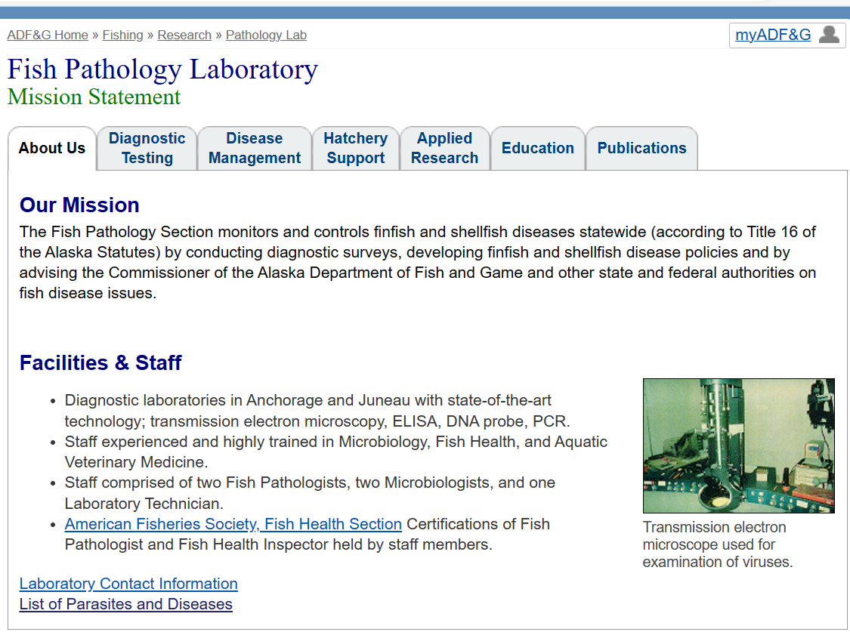

Questions

Slide 45
Literature Cited
Elliott, D. G., Conway, C. M., McKibben, C. L., MacKenzie, A. H., Hart, L. M., Groner, M. L., Purcell, M. K., Gregg, J. L., & Hershberger, P. K. (2021). Differential susceptibility of Yukon River and Salish Sea stocks of Chinook salmon Oncorhynchus tshawytscha to ichthyophoniasis. Diseases of aquatic organisms, 144, 123–131. https://doi.org/10.3354/dao03577
Ferguson, J., F. West, and Z. W. Liller. 2022. Evaluating parasite associated mortality of Yukon Canadian-origin Chinook salmon. Alaska Department of Fish and Game, Division of Commercial Fisheries, Regional Operational Plan No. ROP.CF.3A.2022.03, Anchorage
Gregg, J.L., Hershberger, P.K., Neat, A.S., Jayasekera, H.T., Ferguson, J.A., Powers, R.L., and Purcell, M.K. (2022) A phylogeny based on cytochrome-c oxidase gene sequences identifies sympatric Ichthyophonus genotypes in the NE Pacific Ocean. Dis Aquat Org 150: 61-67.
Hamazaki T, Kahler E, Borba BM, Burton T. Impact of Ichthyophonus infection on spawning success of Yukon River Chinook salmon Oncorhynchus tshawytscha. Dis Aquat Organ. 2013 Nov 6;106(3):207-15. doi: 10.3354/dao02657. PMID: 24191998.
Jones, S.R.M. and Dawe, S.C. (2002) Ichthyophonus hoferi Plehn and Muslow in British Columbia stocks of Pacific herring, Clupea pallasi [sic] Valenciennes, and its infectivity to Chinook salmon, Oncorhynchus tshawytscha (Walbaum). J Fish Dis 25: 415−421.
Kocan, R., Hershberger, P., Winton, J. (2004) Ichthyophoniasis: An emerging disease of Chinook salmon in the Yukon River. J. Aquat. Anim. Health, 16 (2), 58-72.
White, V.C., Morado, J.F., Crosson, L.M., Vadopalas, B., Friedman, C.S. (2013) Development and validation of a quantitative PCR assay for Ichthyophonus spp. Dis. Aquat. Organ. 104, 69-81.

