Slide 1
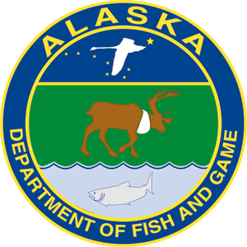
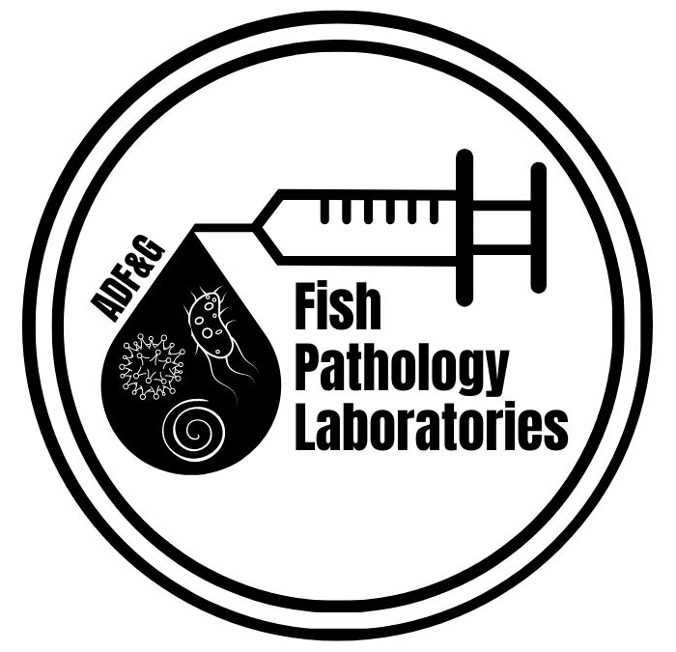
ADF&G’s Fish Pathology Program:
Protecting Alaska’s Finfish & Shellfish Resources from Diseases
Dr. Jayde (Jay-Dee) Ferguson,
Fish Pathologist, ADF&G

Slide 2
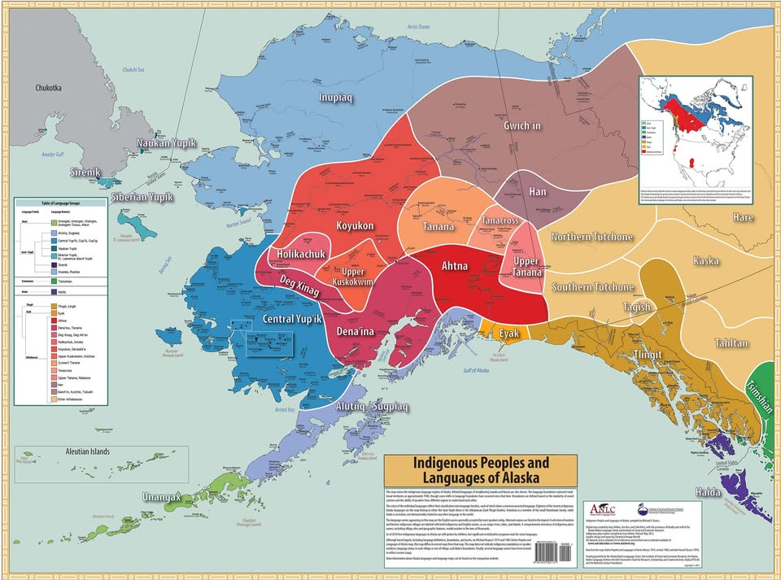
We acknowledge and respect the Indigenous communities that continue to steward the lands across Alaska and are privileged to live and work with Indigenous peoples through this project.
Notes:
Before we start we would like to “acknowledge and respect the Indigenous communities that continue to steward the lands across Alaska and the world. And we are privileged to live and work with Indigenous peoples through this project.” Today I (Jayde) am presenting from the Yup'ik, specifically the "Kuigpagmuit" (Pronounced Kweg-pag-mu-it) lands.

Slide 3

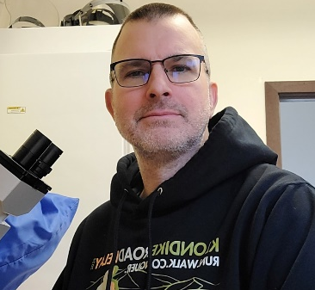

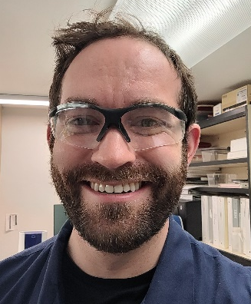
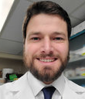
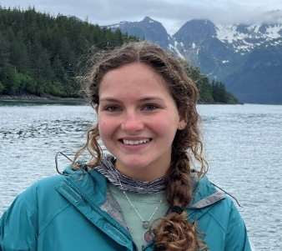
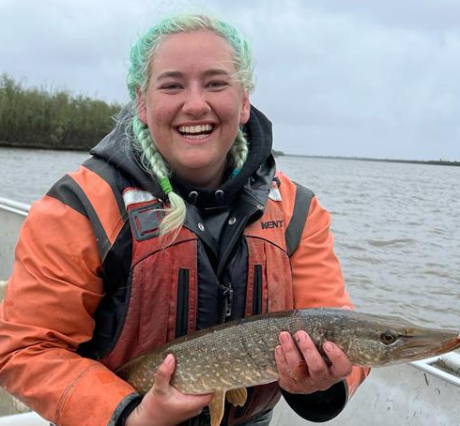
ADF&G Fish Health Team
Juneau (2 staff)– Fishery Scientist I (Ph.D.), Microbiologist II
Anchorage (3 staff + 2 Non-perms)- Fish Pathologist (Ph.D.), Micro II, Micro I
  Non-permanent Fishery Biologist I’s
  Staff experience/train– microbiology, fish and shellfish health
  Certifications– AFS Fish Health Section held by 2 staff as “Fish Pathologist”
Ted Meyers
Rich Morris
Zoe Munson
Kay Stewart
Jayde Ferguson
Frank Woitel
Davis Stewart

Slide 4
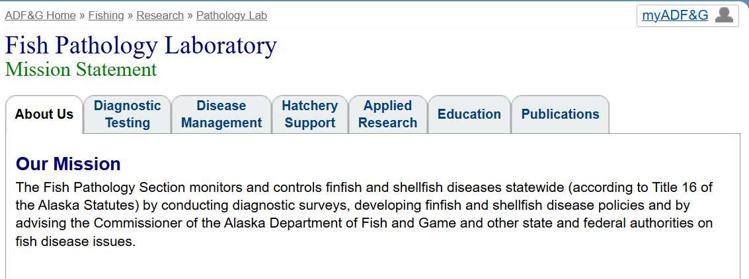
Fish Pathology Regulatory Program:
Mission Statement

Slide 5
Products & Services
1. No-cost Diagnostic & Consultation Services- anyone
2. Hatchery Support and Oversight- inspections; permitting
3. Regulatory Authority- signatory on permits; report & control diseases
4. Statewide Fish and Shellfish Disease Policy- Reduces disease agent (pathogen) introduction & amplification
5. Applied Research- Publications
6. Public Education- lab tours, mentorship, manual and field guides
7. Surveillance for endemic, emerging and pathogens- screen broodfish; investigate fish kills
Notes:
Signatory on permits (5AAC 41.005, 41.030, 41.050, 41.290, 41.300) for fish and shellfish. Evaluation of disease histories (except plants require 50 km radius rule) prior to instate transport of finfish/shellfish and marine plants including other propagative and research permits
Inspection, reporting, control of fish diseases (AS 16.40.150, 5AAC 41.020, 41.080, 41.310) – Fish/shellfish disease policy, Sockeye Salmon Culture Policy
Inspection of hatcheries (5AAC 41.080); maintain AFS/FHS health specialist certification (AS 16.05.733)
Imported Pacific oyster seed (5AAC 41.070) < 20 mm from disease certified facilities on west coast for seed from brood-stock cultured for at least 3 generations
Destruction of diseased fish (5AAC 41.080)
Categories of fish and shellfish pathogens and associated administrative actions (5AAC 41.075

Slide 6
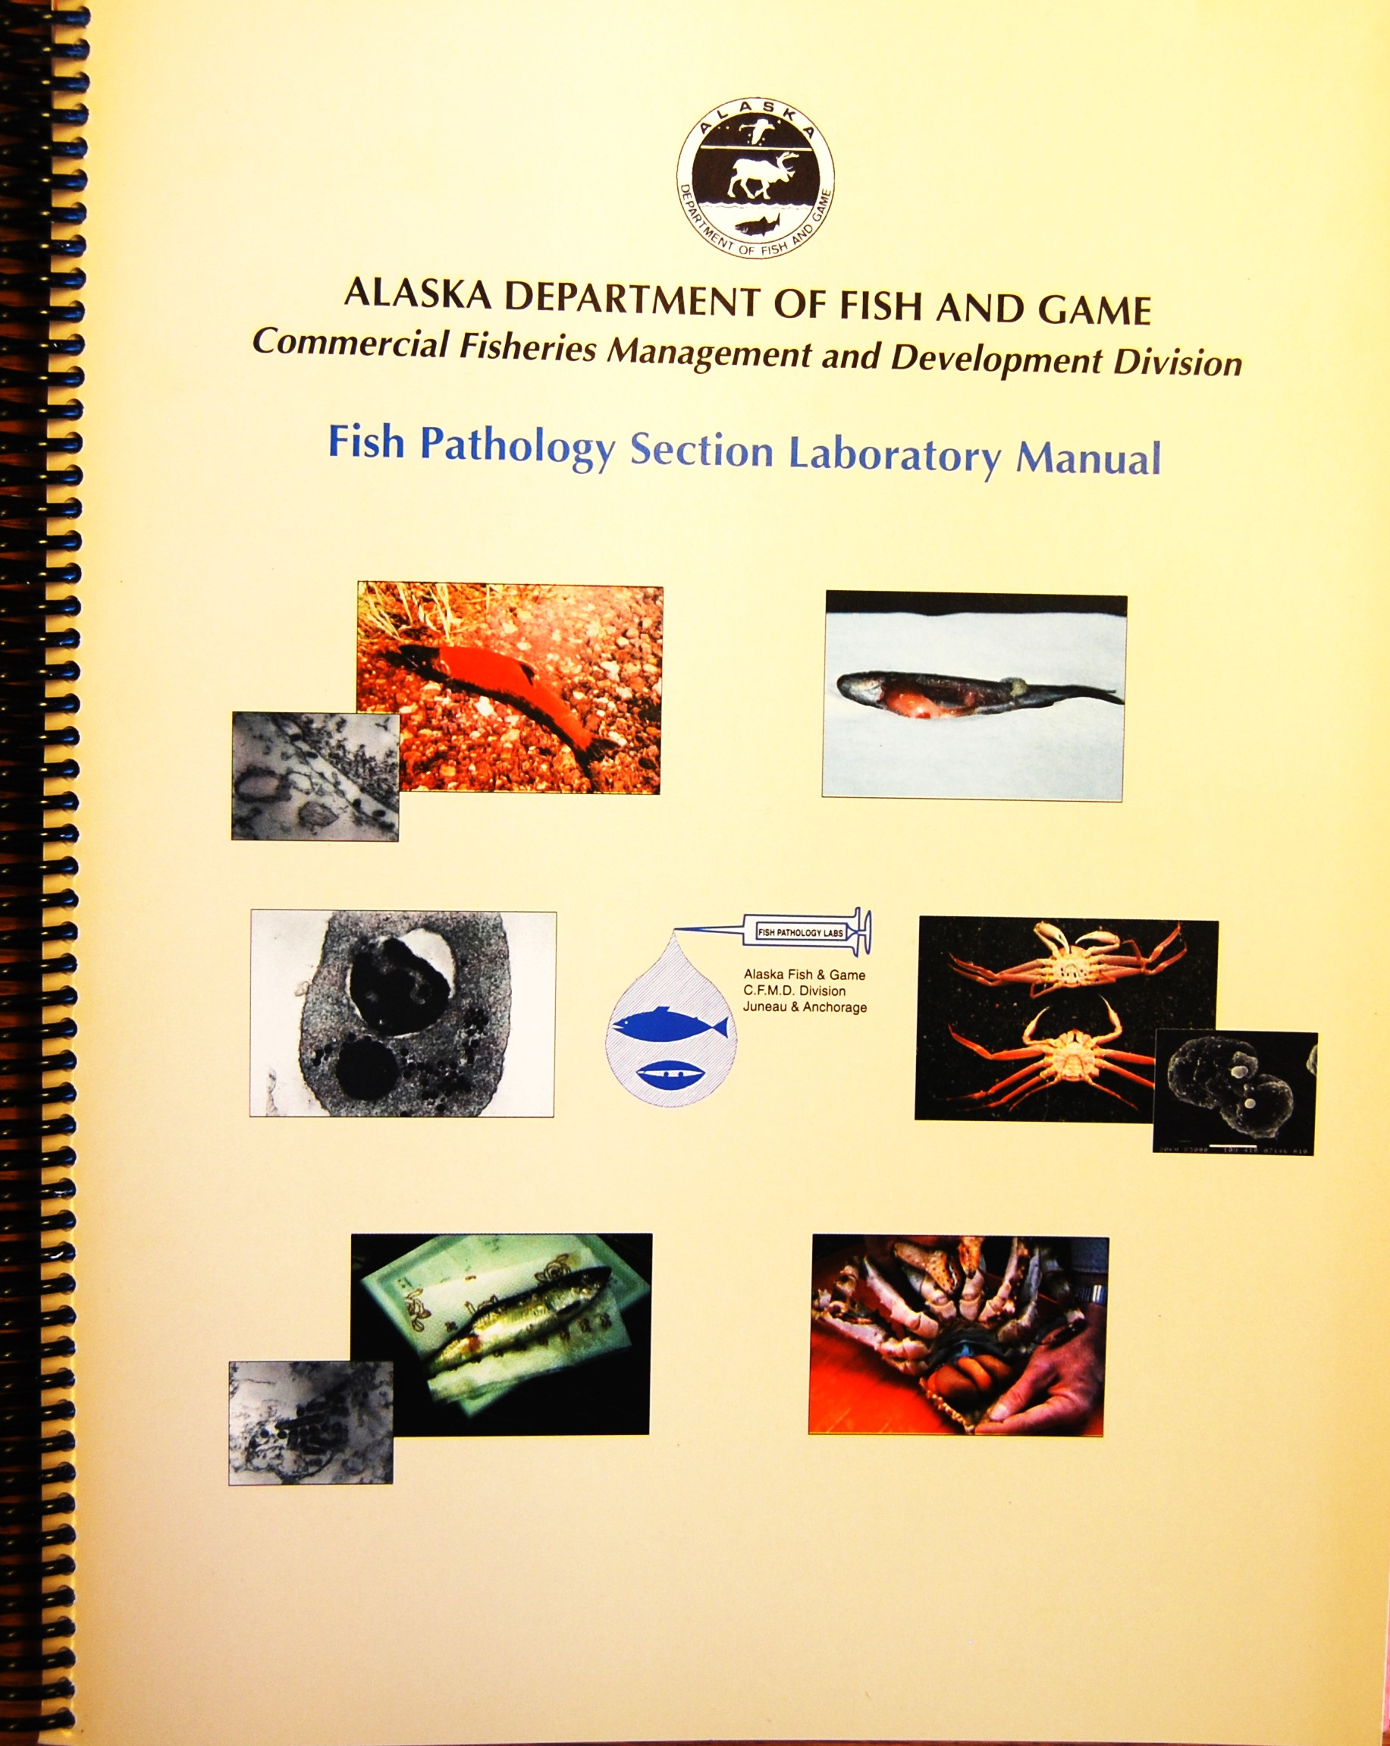
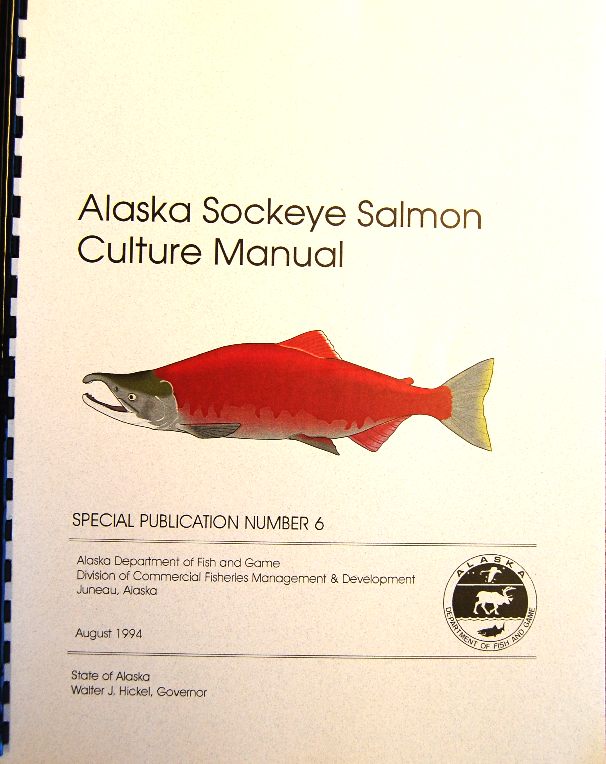
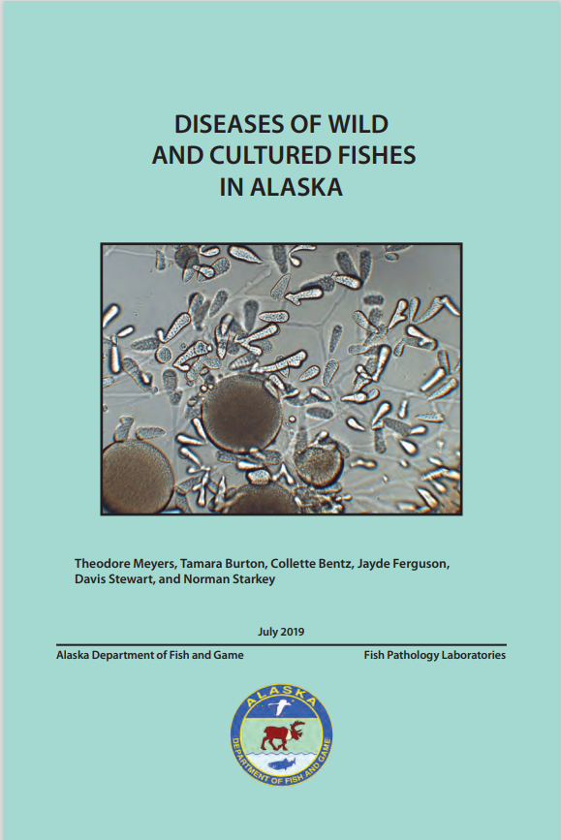
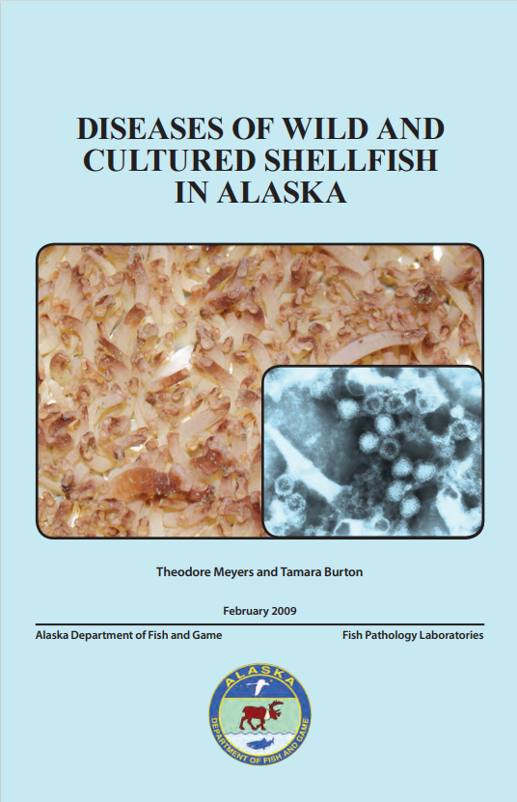
Resources
ADF&G Statewide Fish Health Website
http://www.adfg.alaska.gov/index.cfm?adfg=fishingpathologylab.main
Fish diseases field guide
http://www.adfg.alaska.gov/static/species/disease/pdfs/fish_disease_book.pdf
Shellfish diseases field guide
http://www.adfg.alaska.gov/static/species/disease/pdfs/shellfish_disease_book.pdf

Slide 7
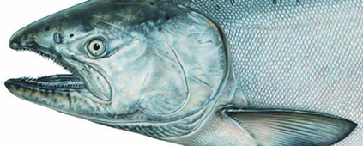
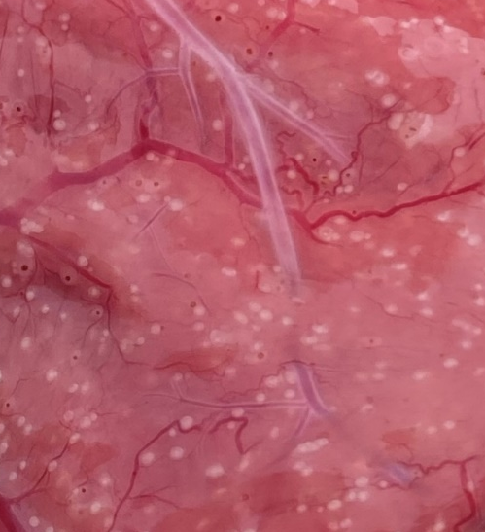
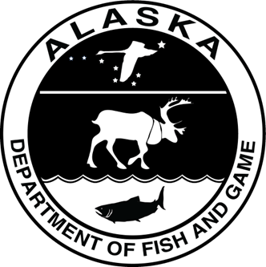
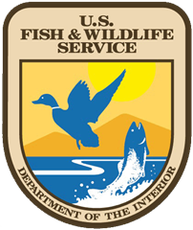
Investigating the impacts of Ichthyophonus on
Yukon River Chinook Salmon

Slide 8
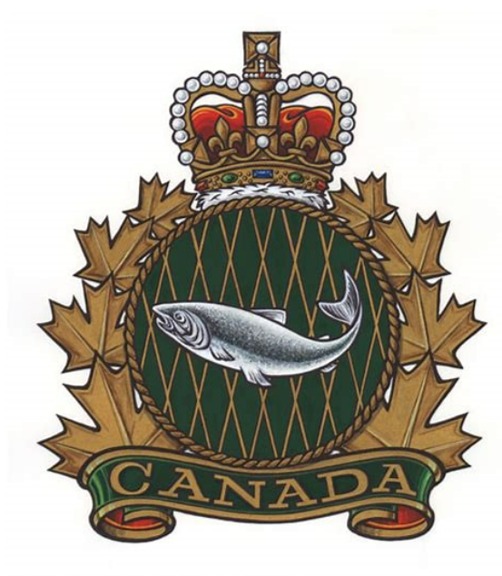
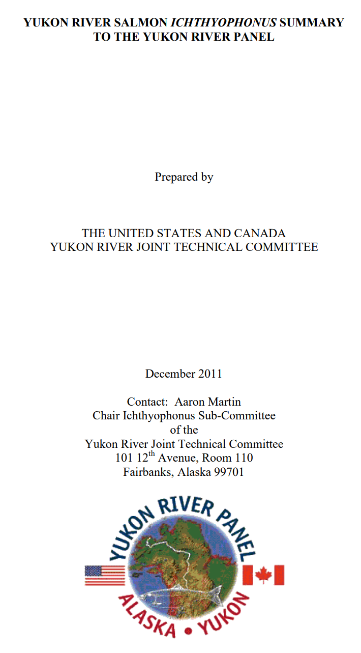
Ichthyophonus -associated mortality is the leading hypothesis to explain why the number of Chinook reaching spawning grounds has been so much smaller than the number assessed moving through the lower portion of the mainstem Yukon River
Bi-lateral and multi-agency acknowledgement that Ichthyophonus research is needed while prevalence is high
JTC guidance to re-initiate Ichthyophonus directed research when prevalence exceeds 25%

Slide 9
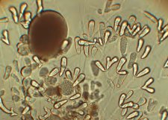
Ichthyophonus & Yukon Chinook
Ichthyophonus: Mostly a marine parasite
  Infects 150 species; several strains
  Bering Sea stocks more susceptible - experimentally shown
  Lifecycle not completely known - salmon eat infected prey
Yukon History:
  mid-1980s: 1st detected by local Yukon R. fishers and lab confirmed
  1990s & 2000s: concerns for impacts to harvest leading to research and fishery management considerations
  Rapids Research Center (Mr. Stan Zuray) bridged local and western science

Slide 10
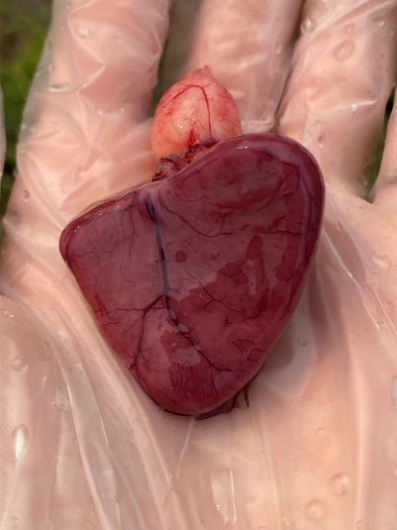
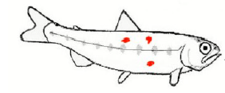
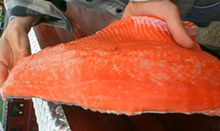
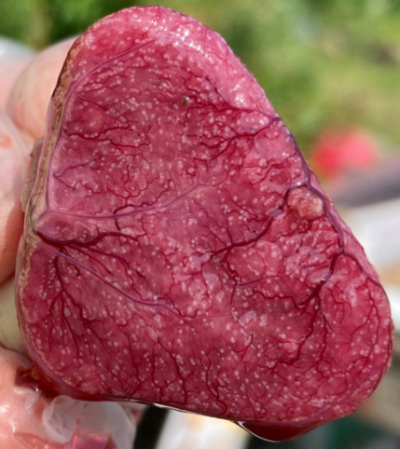
Local and Western Knowledge
No visible infection
Salmon infected in the marine environment
Infected fish enter river, but most are not yet diseased. Only lab tests can detect lightly infected fish in the lower river.
Visible infection
Disease appears to peak midriver with visible white spots in heart and muscle.
Disease progresses with migration. Fish may survive mild infections, but high burden and severe disease are fatal. Stress is an important factor.
Upriver fishermen report harvested Chinook rarely have visible signs of Ichthyophonus in heart or flesh
Lack of heavily infected fish in the upper river suggest en route mortality occurred downriver.
Notes:
Fortunately, we know quite a bit about Ichthyophonus from a combination of local and western science. We know that salmon become infected in the ocean by eating diseased prey. Those infected fish rarely show visible signs of being sick when they enter the Yukon River. The disease progresses as the fish continue their upriver migration, especially when the fish are under stress. By the time the fish reach the middle river, disease progression peaks before mortality and the fish often show visible signs of infection. Upriver fishermen rarely report seeing infected fish, which suggests that the most heavily infected fish died downriver.

Slide 11
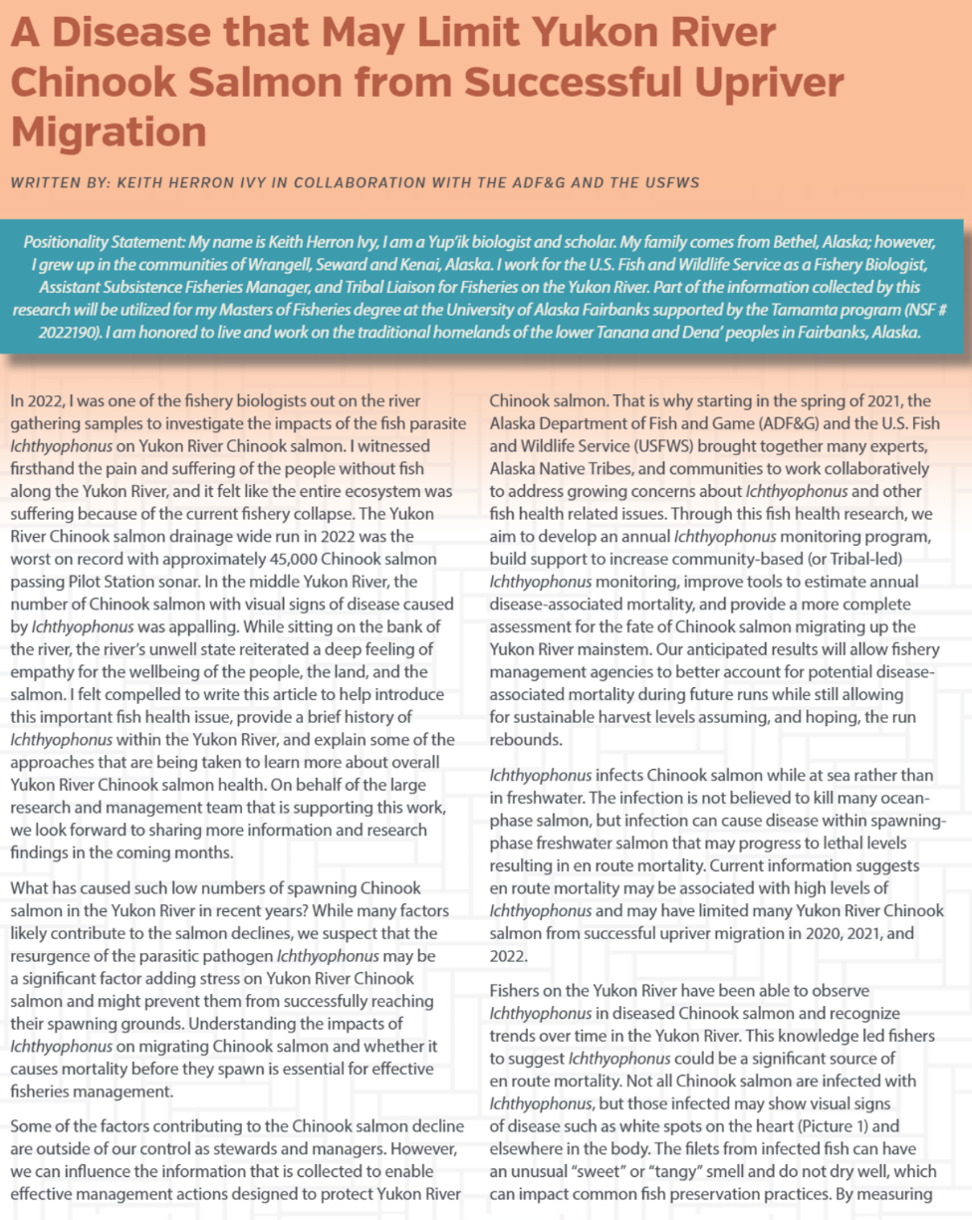
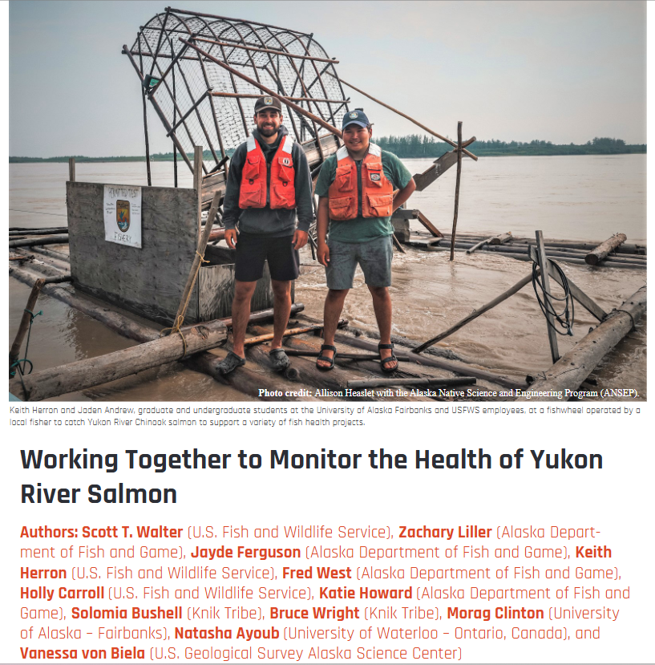
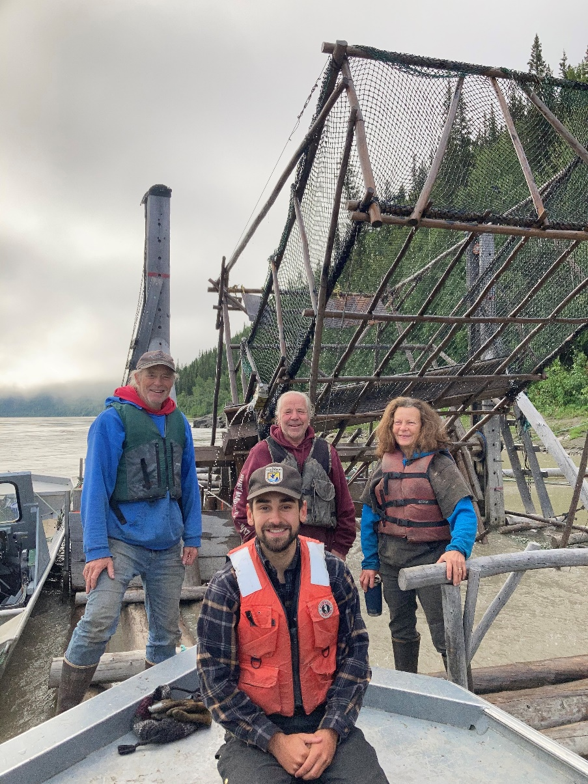
x
YRDFA Spring & Fall 2023 News Articles
Notes:
One of our goals in the project is to inform the people across the Yukon River drainage of this project and its goals. To do this, Keith Herron of the FWS, pictured here in front and center, published an article in the spring 2023 YRDFA newsletter that provides a history of Ichthyophonus, an overview of the study, and Keith’s experiences working on the project if you would like to read more about it.

Slide 12
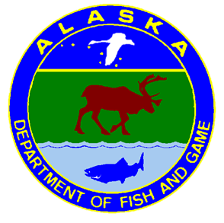


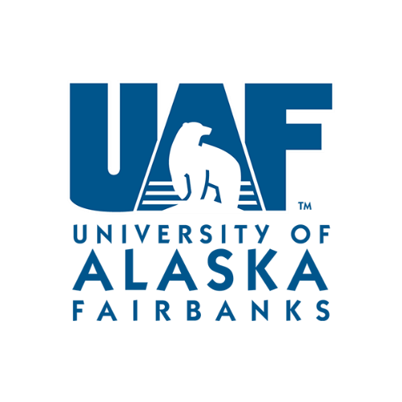

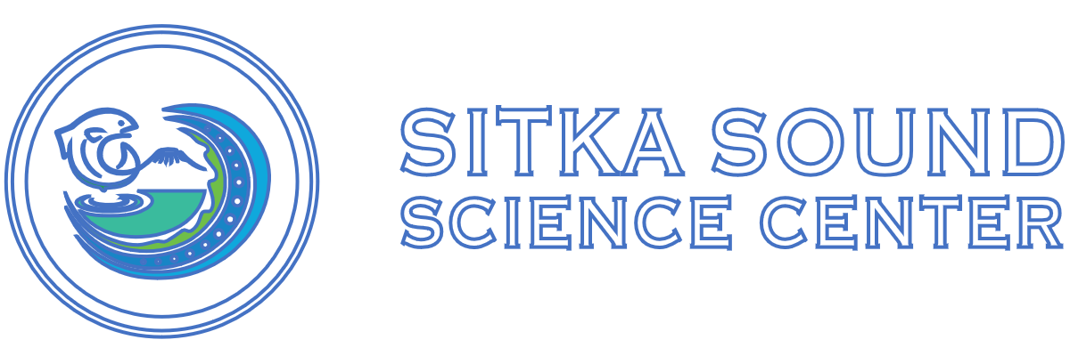

Opportunity to ENGAGE the scientific community as well
FWS and ADFG initiated study and decision to lethally sample fish
To gain most benefit, small organ or tissue samples taken for various studies before fish were distributed to communities
One of largest collective efforts to understand Yukon River Chinook salmon
Working Together to Monitor Health
of Yukon River Salmon
Community engagement
Ichthyophonus: River, marine, lab studies
Non-lethal Ichthyophonus method develop
Other disease and health screenings
Radio telemetry studies
Thiamine deficiency studies
Fecundity
Heat stress
Paralytic shellfish toxins
Heart stress
Notes:
The theme is “Working Together to Monitor Health of Yukon River Salmon”. While ADF&G and the FWS initiated the Ichthyophonus study and made the decision to lethally sample Chinook salmon in the short term, other agencies have subsequently joined for additional studies, including the:
- US Geological Survey
- the Knik Tribe
- the University of Alaska Fairbanks
- as well as the University of Waterloo in Ontario Canada
The idea is to investigate additional factors that may or may not be impacting Chinook salmon health.
[ANIMATE 1] Through engagement with Yukon River communities, and also the wider scientific community, a few additional small organ or tissue samples were taken from the same study fish to investigate this range of topics you see here to better understand what may be contributing to low Chinook salmon runs in recent years.

Slide 13
“Pus-pocket” Discussion
Statewide database
  Earliest reference on file is 1996, not present in sample
  Subsequent reports indicate likely Ichthyophonus or Henneguya
    “White pustules”
Catherine Montcrieff’s, YRDFA, interview work-
  Emmonak: first in 2018, yearly since
  Alakanuk: first 1980s Chinook & chum and since 2000s
    Also, soft flesh in mid-1990s and since 2000s- something else?

Slide 14
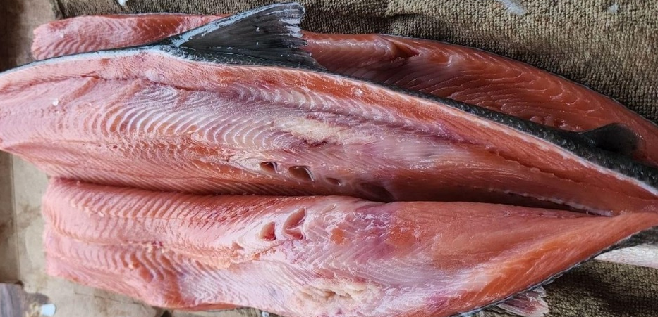
“Pus-pocket” – it could be several things
Soft Flesh (no white spots) = Kudoa
Firm white spots = Ichthyophonus
Cavitation/holes = atypical BKD or something else
= Lab submission requested
White spots that ooze = Henneguya

Slide 15
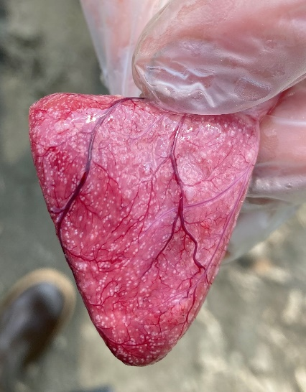
“Pus-pocket”: Ichthyophonus
Firm white spots hearts & flesh
  Fillet may smell fruity
Lifecycle- Marine; ingest infected prey
Potential for high mortality of some fish species
  Example: Yukon Chinook
  https://www.adfg.alaska.gov/static/species/disease/pdfs/fishdiseases/ichthyophonus.pdf

Slide 16
“Pus-pocket”: Henneguya
“Milky flesh” Disease- white fluid spores
oozes cysts during filleting
“Tapioca” Disease- many small cysts
in the flesh
Lifecycle- freshwater with “tiny earthworms”
Not associated with fish mortality
https://www.adfg.alaska.gov/static/species/disease/pdfs/fishdiseases/henneguya.pdf

Slide 17
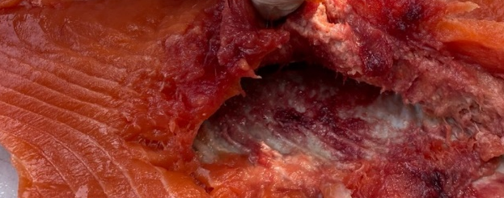
“Soft Flesh”: Kudoa (no white spots)
Soft Flesh Syndrome
  Releases enzymes after death that liquefies tissues
Lifecycle- Marine; with tiny earthworms
Not associated with mortality
https://www.adfg.alaska.gov/static/species/disease/pdfs/fishdiseases/kudoa.pdf

Slide 18

Russian Mission chum (2023) -
Kudoa or something else…

Slide 19
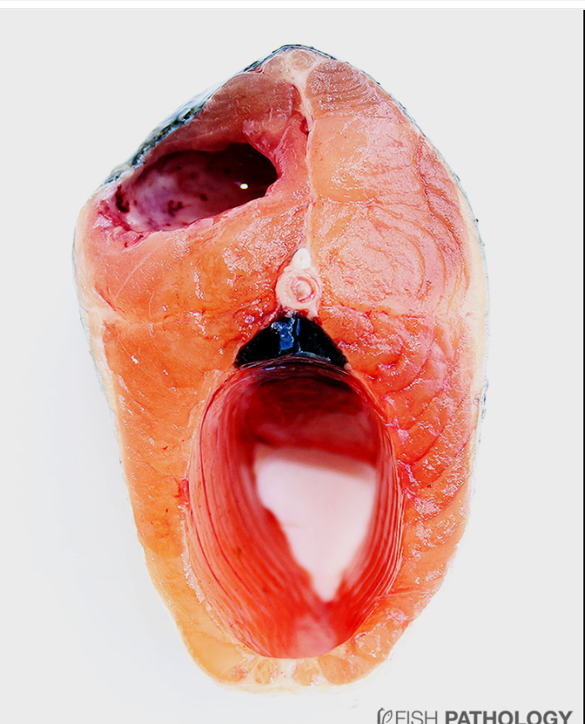
Bacterial Kidney Disease
Kidney disease - atypical form
Lifecycle direct - freshwater
All salmonids susceptible
High mortality
https://www.adfg.alaska.gov/static/species/disease/pdfs/fishdiseases/bacterial_kidney_disease.pdf

Slide 20
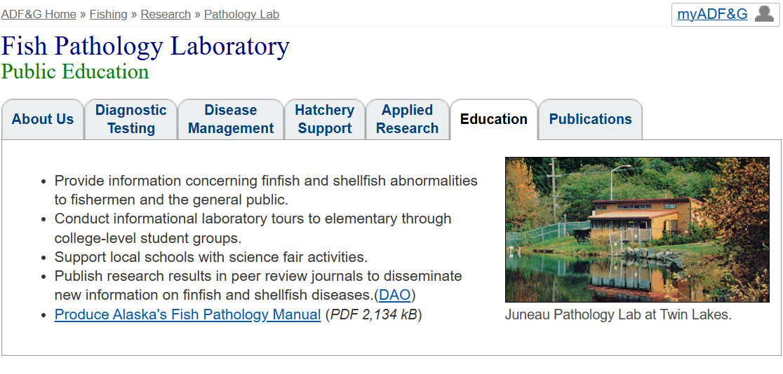
Requesting pus-pocket samples
Sample submission
  Fresh, chilled, non-frozen best
  Send to ADF&G Field Offices (Emmonak)
  Can send samples directly
  Please contact lab for prior consultation and shipping details
Anchorage Fish Pathology Lab: (907) 267-2394 or
Jayde.Ferguson@Alaska.gov

Slide 21
Thank you
Questions?
http://www.adfg.alaska.gov/index.cfm?adfg=fishingpathologylab.main

