Slide 1


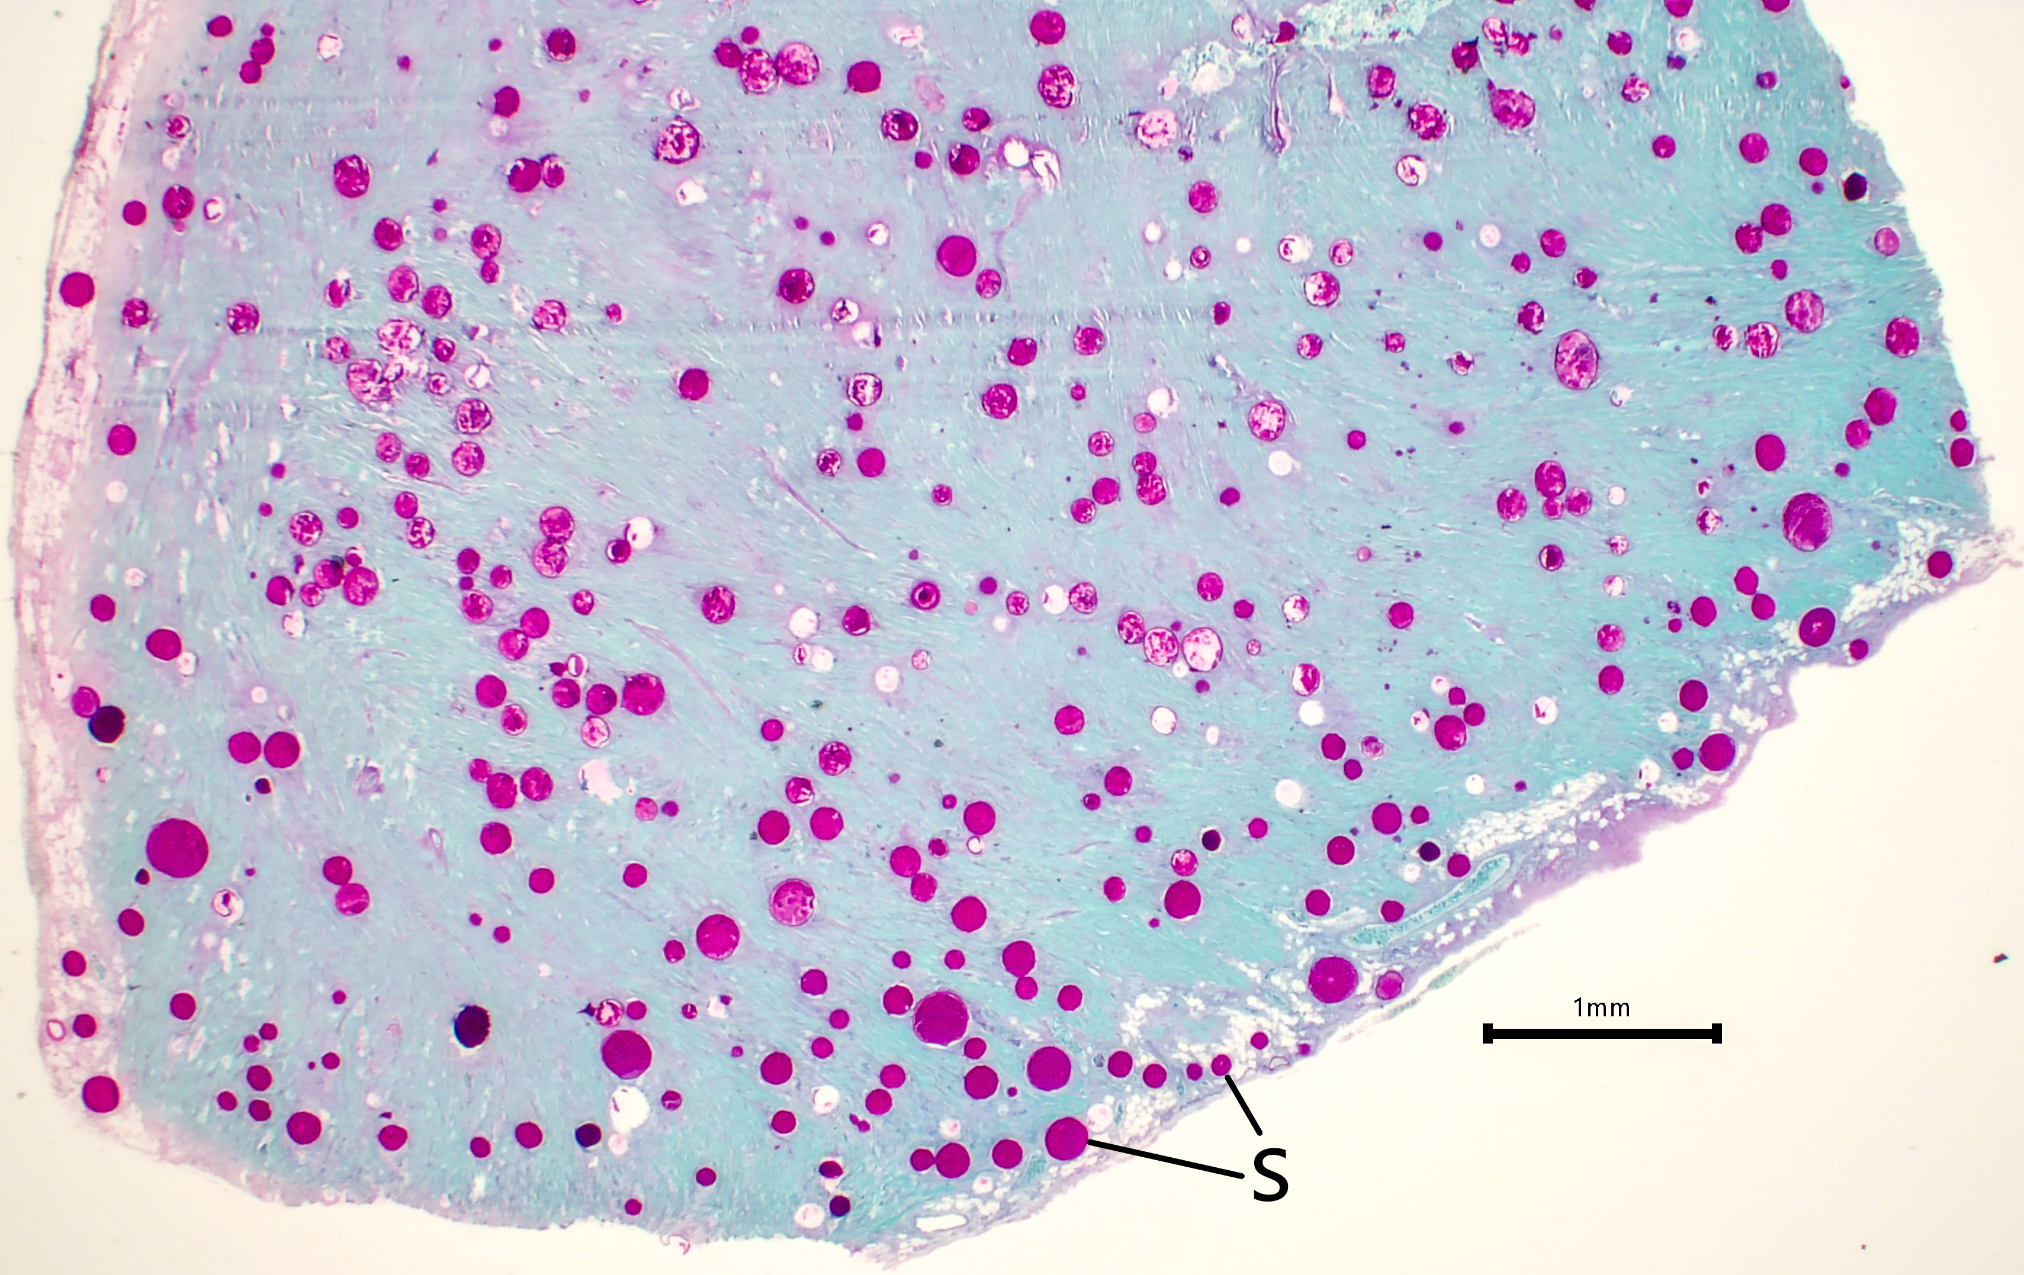
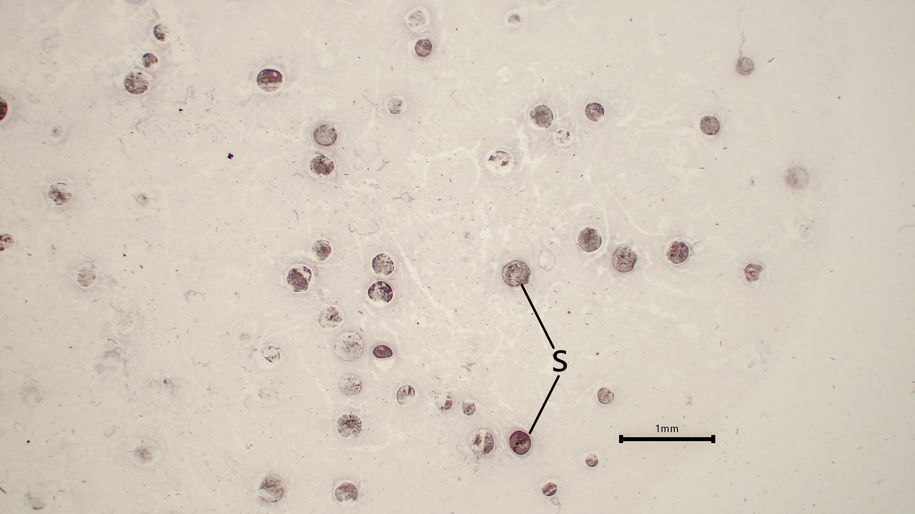
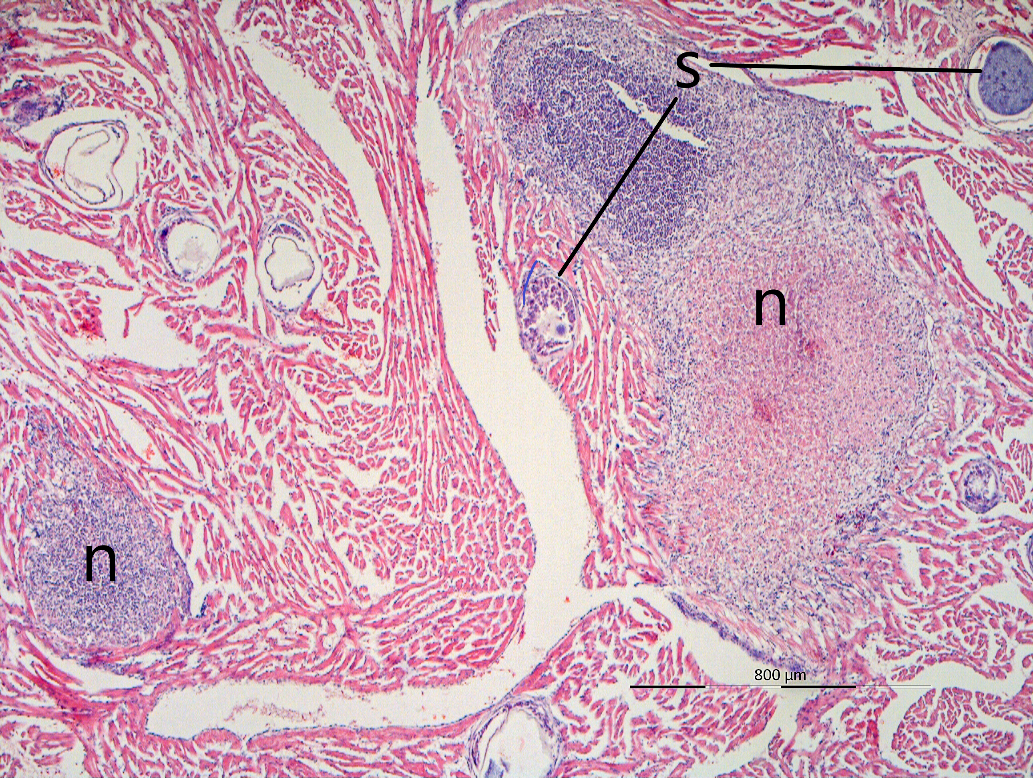
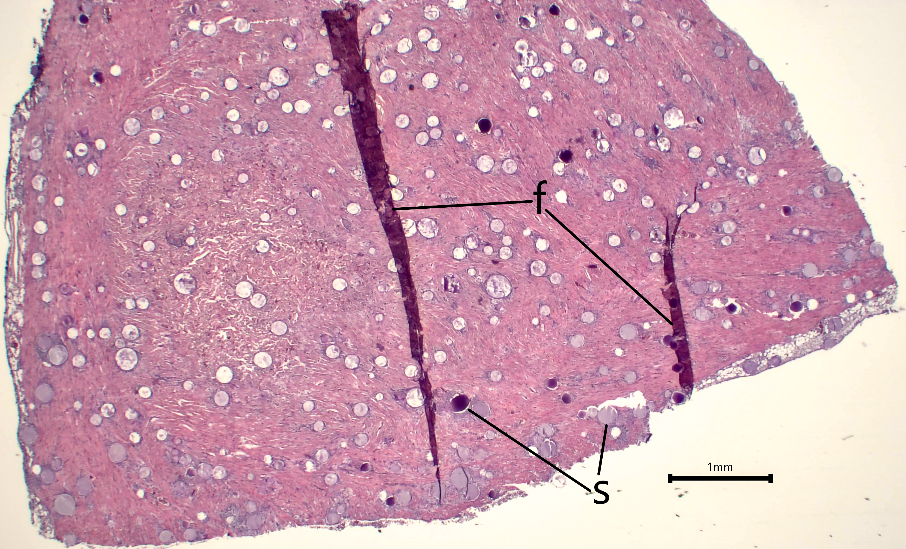
Use of multi-step serial sectioning histology for assessing Ichthyophonus infections in Yukon R. Chinook salmon
Franklin R. Woitel¹, Jayde A. Ferguson¹, Richard M. Kocan², Zach W. Liller³, and Theodore R. Meyers¹
¹Alaska Department of Fish and Game, Division of Commercial Fisheries, Anchorage and Juneau Fish Pathology Laboratories
²School of Aquatic and Fishery Sciences, University of Washington
³Alaska Department of Fish and Game, Division of Commercial Fisheries, Arctic Yukon Kuskokwim Region
Introduction:
Yukon River Chinook salmon have declined since 1998, with the first-ever closure of the subsistence fishery occurring in 2021 due to low abundance. The Yukon Chinook run is the longest salmon run by distance (~2,000 mi) and supports the world’s largest subsistence fishery; as such, harvest restrictions significantly impact food security and traditional culture. Ichthyophonus, a fungal-like (mesomycetozoan) parasite, has been implicated as a major driver of mortality among returning adult Chinook, with observed levels of infection reaching record levels in the 2020s. We are investigating the relationship between Ichthyophonus disease and mortality, using histology as one analytical component.
Figure 1: H&E-stained heart tissue, 40x magnification.
s = schizont (i.e., resting spore of Ichthyophonus),
n = tissue necrosis.
Figure 2: PAS stained heart tissue, 12.5x magnification. s = schizont.
Figure 4: CISH stained heart tissue, 12.5x magnification. s = schizont.
Results:
PAS is the most optimal method presented here for enumerating parasite schizonts, due to its high-contrast staining of polysaccharides associated with Ichthyophonus.
H&E, a standard histological stain, provides more information on in situ tissue pathology, co-morbidities and overall disease status.
CISH is highly specific, confirming parasite identity by hybridizing with target rRNA sequence.
Histology is labor-intensive and less sensitive for detecting low-level infections, but is an important tool for visualizing fish pathogens and associated disease.
Methods:
Hearts were collected from adult Chinook at sampling sites along the Yukon River in 2022-2023 and fixed in 10% neutral-buffered formalin.
Subsamples were collected using an 8mm biopsy punch prior to standard histological preparation. The apex of the heart was selected preferentially.
5 μm sections were cut in a stepwise serial pattern and stained with either Hematoxylin and Eosin (H&E) or Periodic Acid-Schiff reagent (PAS). Selected samples were also stained with a chromogenic in situ hybridization (CISH) for parasite identity confirmation following Conway et al. (2015).
Figure 3: H&E stained heart tissue, 12.5x magnification. s = schizont, f = fold in tissue section (artefact).
Acknowledgements: We wish to thank ADF&G staff Ryan Morrill and Keela Wiglesworth for sample collection assistance in the field. The work by ADF&G Fish Pathology Laboratory staff was supported with funds through the Commercial Fisheries and Sport Fish Divisions of the Alaska Department of Fish and Game and by the U.S. Department of Commerce, National Oceanic and Atmospheric Administration and ADF&G under award NA22NMF4380212.
Reference: Conway, C.M., Purcell, M.K., Elliott, D.G. and Hershberger, P.K. (2015), Detection of Ichthyophonus by chromogenic in situ hybridization. J Fish Dis, 38: 853-857. https://doi.org/10.1111/jfd.12300.

