Slide 1
[PHASE #1:]
Setting the Stage
START: 0 min

Slide 2
TITLE SLIDE:
LIVE:
YOUR EPIC WEBINAR PRESENTATION TITLE
A Great Tagline!
Your FULL NAME
TITLE

Slide 3
ADDRESS PAIN POINTS:
You’re in the right place if…
IDENTIFY CUSTOMER AVATAR #1 & INTERNAL PROBLEM #1
IDENTIFY CUSTOMER AVATAR #2 & INTERNAL PROBLEM #2
IDENTIFY EXTERNAL PROBLEM #1
INDENTIFY EXTERNAL PROBLEM #2

Slide 4
AGENDA & BENEFITS
Here’s what you’ll learn by hanging out today...
Bullet Point
ADD OUTCOME #1 (so that…)
Bullet Point
ADD OUTCOME #2 (so that…)
Bullet Point
ADD OUTCOME #3 (so that…)
Bullet Point
ADD OUTCOME #4 (so that…)

Slide 5
QUALIFY ATTENDEES
This Training is NOT for you if…
Add Description #1
Add Description #2
Add Description #3
You get upset or offended when someone gives +60 min of free content and makes an offer at the end.

Slide 6
ENCOURAGE “STAY TO THE END”
Two fun ‘Rewards’ for hanging out today, until the end...
BONUS
#1
BONUS
#2
Title or Image
Title or Image
Bonus #1
Add Description.
Bonus #2
Add Description.

Slide 7
[PHASE #2:]
Sharing Your Story
START: 4 min

Slide 8

DEMONSTRATE PROOF/OUTCOME
How [This knowledge/training] has changed my life and my business…
Add Description/Photo/Image
of your Success and Lifestyle
Add Description/Photo/Image
of your Success and Lifestyle
Add Description/Photo/Image
of your Success and Lifestyle

Slide 9
ADD STORY
A Quick Recap of My Story…
NOTE: This can take a few slides to share.
Demonstrate WHY you are qualified to teach this.

Slide 10
That’s When I Became OBSESSED,
and I did my research…
DEMONSTRATE HOW YOU MASTERED THIS
Add Graphic

Slide 11
DEMONSTRATE PROOF / RESULTS
Fast Forward to Today…
Add Photo/Graphic
Success #1
Success #2
Success #3

Slide 12
RECAP THE LESSON / MESSAGE / THEME
My entire business (life) changed (heck, it started!) the moment I chose [INSERT YOUR NICHE] as a [INSERT DESIRED RESULT].
And trust me, if I can do it, so can you!
I’m not an [insert Objection, ex: actor, professor, tech wiz, etc.]
And even though I may be more “[insert Experience]” than you, I still [insert Commonality]!

Slide 13
TRANSITION TO CONTENT
A Couple Things to
Keep in Mind...
Add Photo
Get Out of Your Own Way!
It’s about taking action…
even just one action (baby steps!)
Perfection is your enemy!
Develop “[insert Description]” first.

Slide 14
[PHASE #3]
THE CONTENT & TRAINING
START: 14 min

Slide 15
NOTE
One of the easiest ways to structure your webinar is to follow the 7-Step Process OUTLINE. You share the 7 Steps, then go DEEPER on three of the steps.
Your Offer then EXPANDS upon ALL SEVEN STEPS.
But you don’t have to formulate your content this way.

Slide 16
INTRODUCE 7 STEPS
The 7 Steps to [YOUR PROMISE/TOPIC]
Step #1: Add Copy
Step #2: Add Copy
Step #3: Add Copy
Step #4: Add Copy
Step #5: Add Copy
Step #6: Add Copy
Step #7: Add Copy Methodologies

Slide 17
Step #1: Add Copy
Add Description

Slide 18
Step #2: Add Copy
Add Description

Slide 19
Step #3: Add Copy
Add Description
Add Photo/Graphic

Slide 20
Step #4: Add Copy
Add Description

Slide 21
Step #5: Add Copy
Add Description

Slide 22
Step #6: Add Copy
Add Description

Slide 23
Step #7: Add Copy
Add Description

Slide 24
RECAP 7 STEPS
The 7 Steps to Profiting from [INSERT NICHE]
Step #1: Add Copy
Step #2: Add Copy
Step #3: Add Copy
Step #4: Add Copy
Step #5: Add Copy
Step #6: Add Copy
Step #7: Add Copy Methodologies

Slide 25
[PHASE #4]
TRANSISTION to OFFER
START: 50 min

Slide 26
I’m not sure why you showed up today…
Maybe you’re frustrated that [insert Pain Point].
It could be that you are [insert Pain Point].
Or maybe you’ve heard all the buzz and excitement around how others are having success with [insert Niche], and you wanted to see how you could make it work for you.
Or perhaps you were bored, and just wanted to hang out with me!

Slide 27
So…
[Insert TOPIC] Rocks!
And it can transform your entire business and your life!
I believe that if you’ve been on this call up to this point, you have what it takes to excel with [insert Niche]!
...and this is something you can get started with RIGHT NOW!

Slide 28
And Please Remember!
Nothing I’ve shared with you here today is theory or fluff that might work.
This is exactly what I’ve done in my business to generate [insert your Success/Results]!
And I’ve helped [insert Number of Students] to achieve [insert results]!
It doesn’t matter if you’re a [insert Description, ex: newbie, techno-phobe, etc.]. It’s all about baby steps, and taking action!
RIGHT NOW!

Slide 29
Some of the Big Benefits of [Insert TOPIC]…
Benefit #1
Benefit #2
Benefit #3
Benefit #4
Help, Move, and Inspire People!

Slide 30
If there is one thing to take away…
I have literally cracked the code and hacked [insert Niche] in order to show anyone how to [insert Description of Product/Service]!
And it has literally changed my world, and the world of my students!
It is very much a replicable system that you can apply (as proven by my students).
And you can make a lot of money doing this and transform yourself into [describe Desired Outcome].

Slide 31
[PHASE #5]
THE OFFER
START: 55 min

Slide 32
IDENTIFY PROBLEM & DESIRE FOR OFFER
So the obvious question is…
How can you apply this system for leveraging the power of, and profiting from, [insert Niche]?
You have a choice...
You can do it the slow way through trial and error by taking some of what I’ve given you here today.
Or you can do it quickly using my [insert Program].

Slide 33
INTRODUCE OFFER:
What is [insert Program]?
It’s my Complete, Step-by-Step [insert Description of Program].
Designed to take you by the hand to [insert Course Promise]! No missing steps, no confusion.
It’s the quickest and most effective way to get from Point A to Point B.
Add Product Image

Slide 34
What Exactly is it??
A [insert Program, ex: 6-Module Training Course] that walks you through the 7 Steps.
24/7 INSTANT and Lifetime Access (including updates).
Literally step-by-step. Nothing is left out!
Along with a growing community of smart and savvy [insert Group Description] to support you and encourage you along the way.

Slide 35
Imagine…
Description of Desired Outcome #1
Description of Desired Outcome #2
Add Graphic
Description of Desired Outcome #3
Description of Desired Outcome #4
Description of Desired Outcome #5

Slide 36
Add Graphic
All You Have to Do is Follow the Steps.
Here’s What I’ll Force You to Master…

Slide 37
Module Graphics or Descriptions
Add Module Description
Add Module Description
Add Module Description
Add Module Description
Add Module Description
Add Module Description

Slide 38
INTRODUCE PRICE
How Much Will This Cost Me?
You could hire a consultant or Done-4-You Service to implement this for you… but you and I know that would could THOUSANDS
My One-on-One Coaching starts at $$$$… and I’m not taking any more clients.
What are you going to be paying to MASTER this yourself?

Slide 39
How Much Will This Cost Me?
Not $$$$$
Not even $$$$
THE ENTIRE SYSTEM is just $$$$ and we have payment options so you can get access today for as little as just $$$.

Slide 40
STACK BONUSES
PLUS! [#] Essential Bonuses!
Add Graphic
Add Graphic
Add Graphic
Add Graphic
Add Description
Add Description
Add Description
Add Description

Slide 41
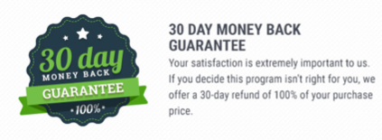
ADD GUARANTEE
My 100% Satisfaction 30 Day Guarantee…
[Insert Explanation of Guarantee. Include Support Email Address for Refund Requests.]

Slide 42
ADD THREE TESTIMONIALS
Success Stories
INSERT: Screenshots or Formatted Examples
(ex: for VideoROI, we included images of James’s videos ranked #1 on YouTube for specific search terms, and we used animation to highlight the exact video)

Slide 43
RECAP OFFER
Recap Modules and Bonuses
Module
Module
Bonus
Bonus
Program
Graphic
Module
Module
Bonus
Bonus
Payment Option #1
Module
Module
Payment Option #2

Slide 44
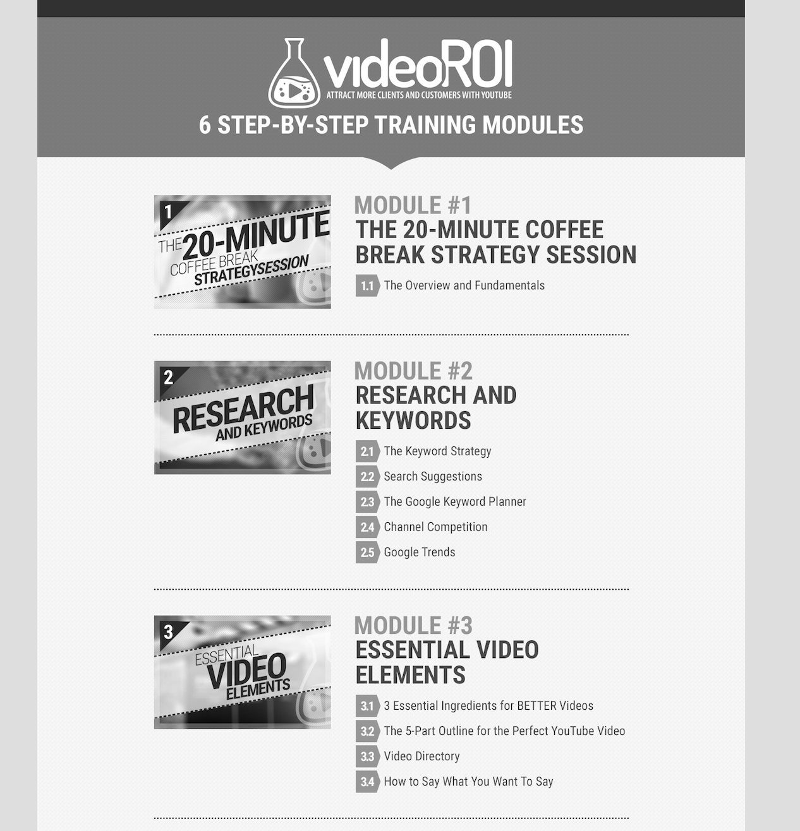
FAST ACTING BONUS
Sign up in the next 10 minutes and receive…
Bonus
Graphic
Bonus
Description
Payment Option #1
Payment Option #2

Slide 45
Recap Modules and Bonuses
Module
Module
Bonus
Bonus
Program
Graphic
Module
Module
Bonus
Bonus
Payment Option #1
Module
Module
Payment Option #2

Slide 46
[PHASE #6]
Question & Answer
START: 65 min

