Slide 1


Digestive
Health

Slide 2



Glorious Past – Prosperous Future
Heritage & Philosophy
More than 60 Years
Pioneers in Cellular Nutrition
Whole-Food-Derived Nutrition & Health
100’s of Milestone Achievements
CEO, Kendra Brassfield and Founder, Jerry Brassfield
Notes:
A company with a glorious past --- and a very prosperous future ahead of us.
Our company has a rich heritage and philosophy, and you have helped make it what it stands for today - a company with integrity, highest quality products with strong scientific underpinnings, a pioneering position in nutritional research & innovation, and most knowledgeable distributors providing outstanding customer service.
This is what has made NeoLife a strong global force to reckon with for over 60 years - since 1958; and now in over 50 countries around the world. We have been able to harness the healing properties of whole foods to provide cellular nutrition --- for daily vitality and lifelong health.
Our products are represented by our brands - NeoLife Nutritionals, Golden Home Care and Nutriance Skin care -- all from the parent company NeoLife.

Slide 3
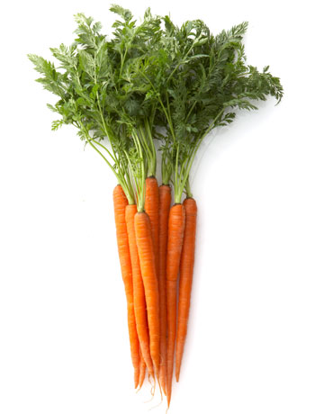
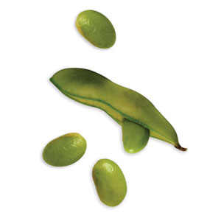
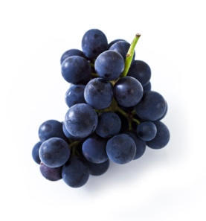

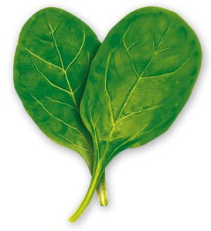

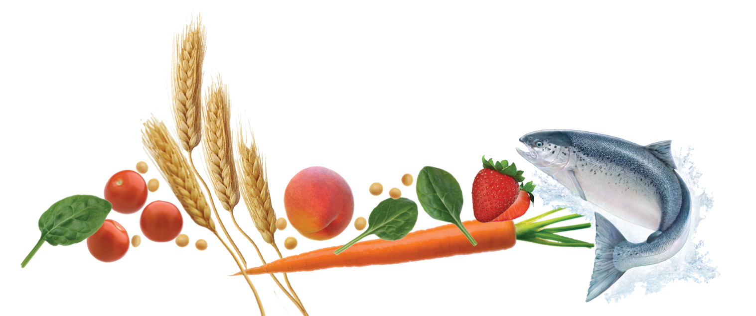
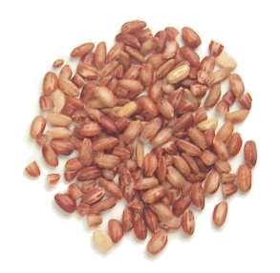
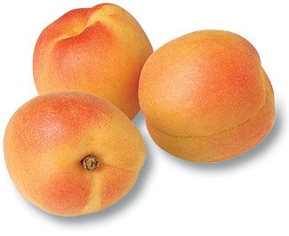


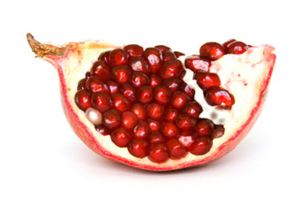
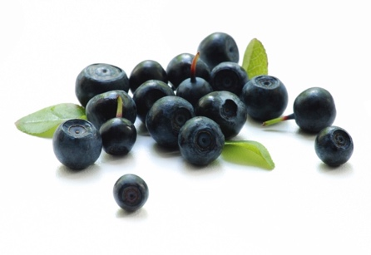
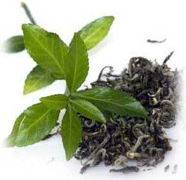
Whole-Food-Derived Nutrition

Slide 4












RICH SCIENTIFIC HERITAGE
Scientific Advisory Board
World Renowned Scientists & Nutrition Experts Active, Published, Respected
Arthur Furst
1914-2005
Founding Member Emeritus, SAB
Ph.D., Sc.D., D-A.T.S.,
Toxicologist, Pharmacologist
Liz Applegate
Ph.D., Nutritional Scientist, Sports Nutritionist
Susan Beck
Head of the SAB, Ph.D., L.Ac., Dipl. O.M., CNS, Nutritional Scientist
Ariana Carughi
Ph.D., C.N.S., Nutritional Scientist, Researcher
Diane E. Clayton
Ph.D., RNutr., Biochemist, Health Practitioner
Fred G. Hooper
Ph.D., Biochemist, Nutritionist
Mark Lowman
C.F.S., Food Scientist, Quality Expert, Formulator
John R. Miller
Director of the SAB, Product Technologist, Researcher
Todd Miller
Ph.D., Exercise & Sports Scientist, Researcher
David Shepherd
Ph.D., Microbial Biochemist, Food Technologist
Abbie Smith-Ryan
Ph.D., Exercise Physiologist, Nutrition Scientist
Notes:
The NeoLife Scientific Advisory Board --- which was started by the world renowned toxicologist and cancer researcher Dr. Arthur Furst is deeply rooted in that same heritage and philosophy. For decades NeoLife products have represented the latest frontiers of nutritional science and technology and we continue to bring forward that same legendary heritage and philosophy that we have been known for. The SAB today is comprised of some of the world’s most renowned scientists, researchers and nutritional experts with an unrelenting commitment to product excellence and to your health. The SAB stands firmly behind every NeoLife product.

Slide 5
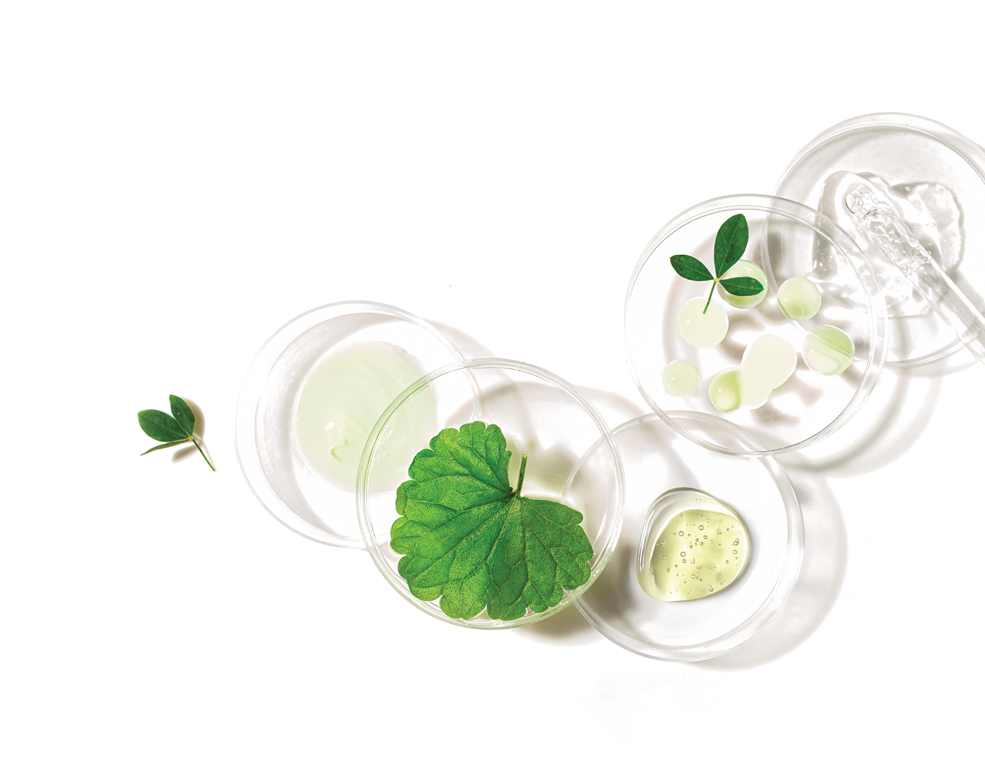

Based in Nature, Backed by Science
Based in Nature
Includes both whole food-derived and bioactive nutrients to support your health*
Backed by Science
Delivered in highly bio-efficient forms in exclusive formulas
– Maximum nutrient absorption
– Utilization
– Benefits
Notes:
These are products that are based in nature and backed by the highest quality science.
We bring to you the finest natural nutrients from whole food sources to help you achieve optimal health.
And after these nutrients are identified and isolated, we deliver them to you in highly bio-efficient forms. What this means is that these products that are in tablets, capsules, powders and liquids -- whatever the product form may be --- but when you take them and they get in your body --- these nutrients are going to be absorbed and they are going to be utilized and will bring you the desired benefits that you took them for. That is what NeoLife products have always been about. And the proof is in the millions and millions of satisfied users we have in over 50 countries around the world. And we have done that not just today -- but for more than 60 years in NeoLife history.
Our approach to nutrient selection, their sources, their forms and how they impact your health has been very unique.
We focus on getting these nutrients down to the cells in your body -- on cellular nutrition.

Slide 6

Personalized Nutrition
START:
Core Nutrition – Foundation Products
ADD:
Personalized Targeted Solutions for specific health needs

Slide 7
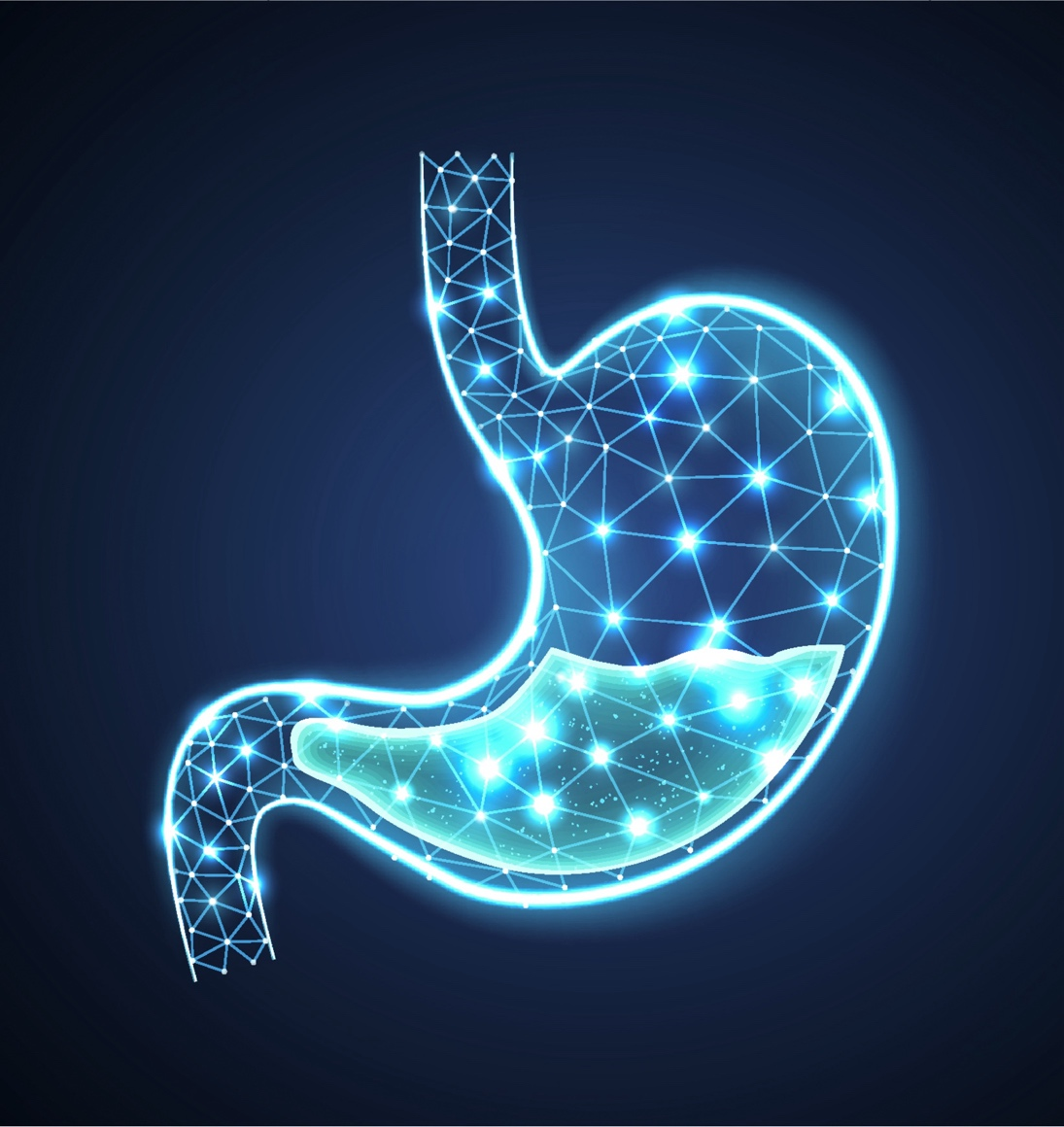
Targeted Solutions
Digestive Health

Slide 8
Diet
Digestion
Absorption
Circulation
Assimilation
Elimination
Six Stages of Nutrition
Notes:
Diet is what we eat, but nutrition is what our cells and tissues actually receive. Nutrients pass through six separate and distinct stages as our body works to support nutrition in each cell. Each of these stages must operate efficiently to attain optimum nutrition for the entire body. With this in mind, NeoLife’s Scientific Advisory Board formulates each NeoLife nutritional supplement to support one or more of these vital stages so cells may receive the balanced nutrition they need.
THE SIX STAGES OF NUTRITION
DIET
A good diet is the first step to ensuring our bodies receive the proper balance of nutrients necessary for optimal health. Diet consists of all the foods, liquids, and supplements that we consume daily. Our diets sometimes fall short of the nutritional ideal. The goal of NeoLife’s nutritional supplement program is to improve the overall quality of the diet so that the basic nutrients important for good health are available in abundance and inbalance every day. Supplementation can go a long way towards filling dietary “gaps.”
DIGESTION
Digestion begins with chewing and includes the action of acids and enzymes. It is the process by which complex foods are broken down into simple substances that the body can use for energy and support of cells and tissues. For instance, lipids, proteins, and carbohydrates are broken into fatty acid, amino acid, and simple sugar building blocks, respectively. Each NeoLife product is formulated for easy and complete digestion. Specific ingredients, such as enzymes or nutrients that improve digestion, are included in our products. Additionally, our tableting technologies assure rapid disintegration and dissolution, making tablet digestion easier. NeoLife has also formulated a line of digestive supplements to support efficient digestion naturally and to avoid or relieve the discomfort that can accompany incomplete digestion.
ABSORPTION
Absorption is the process by which the products of digestion — simple sugars, amino acids, fatty acids, vitamins, minerals, phytonutrients, etc. — pass through the lining of the intestinal wall and are taken directly into the body’s circulatory system. While most nutrients are taken directly into the bloodstream, lipids and lipid-soluble nutrients take a less direct path to the circulatory system. These nutrients are first absorbed into the circulation via the lymphatic system. Each NeoLife product is formulated for easy absorption, providing essential nutrients to the bloodstream where they are then carried to all the cells of the body.
CIRCULATION
Transporting the absorbed nutrients to each cell of the body is the role of the circulatory system. We may be eating properly, digesting properly and absorbing nutrients properly, but if our circulation is impaired, nutrients may not reach their cellular destinations. NeoLife’s Scientific Advisory Board recognizes the crucial role the blood and circulatory system play in assuring cells receive good nutrition. They have formulated NeoLife nutritional supplements to support optimal functioning of the body’s lifeline to health.
ASSIMILATION
Assimilation is the delicate process by which nutrients are passed through the membranes which surround each living cell. For the body’s cells to grow, repair, and rebuild themselves, proper assimilation is essential. For this process to take place, cells —especially their membranes — must be healthy. Many scientists believe that aging of organs and tissues occurs when cells deteriorate faster than the body can repair them. Proper assimilation of nutrients is essential for cellular repair. NeoLife incorporates vital lipids and sterols into its formulations to support the cells’ ability to assimilate nutrients. The familiar phrase “you are what you eat” can be more properly restated as “you are what your cells actually assimilate.”
ELIMINATION
The final stage of nutrition is the efficient elimination of wastes from the body. Elimination begins at the cellular level and is completed through many other metabolically-active areas such as the skin, kidneys, lungs, and colon. It is essential that wastes are completely and regularly eliminated from the body. NeoLife products have been formulated to help the cells and the body eliminate wastes efficiently and naturally.

Slide 9
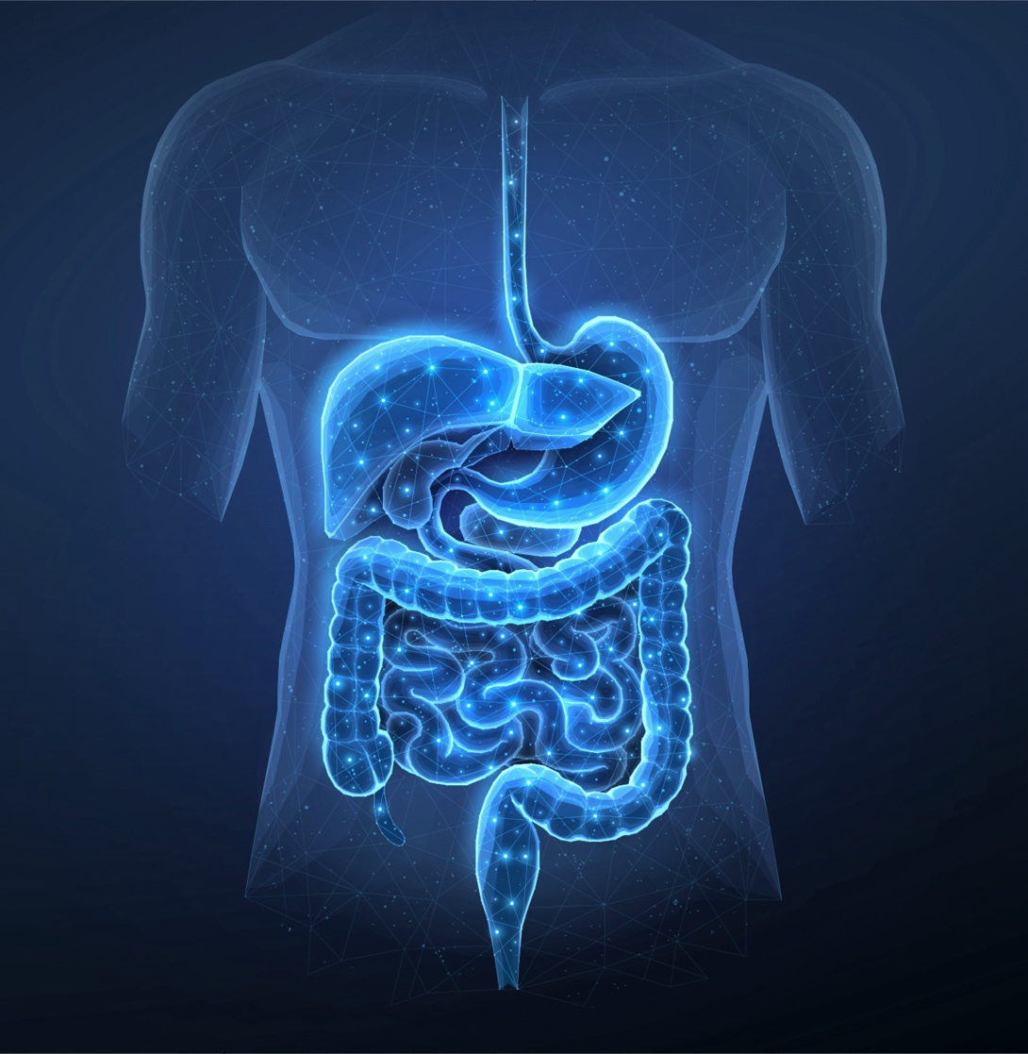
The Digestive System
Mouth
Esophagus
Stomach
Small Intestine
Colon
Rectum
Anus
Notes:
Here’s what happens to food as it travels through the digestive system:
THE MOUTH
Digestion starts in the mouth, where chewing breaks large pieces of food into smaller ones and mixes them with saliva, which contains enzymes that begin to break down carbohydrates.
THE STOMACH
In the stomach, food is broken down into smaller and smaller particles by mechanical, chemical, and enzymatic means. The stomach secretes hydrochloric acid and protein digesting enzymes (acid-stable proteases). The hydrochloric acid “opens up” protein molecules so that protein — digesting enzymes can work on them. It also transforms inactive pepsinogen into active, protein-digesting pepsin. Working together, acids and enzymes convert food into a semi-fluid paste of partially digested nutrients called chyme.
THE SMALL INTESTINE
Next the chyme moves into the small intestine, where digestion is completed and absorption begins. Here the environment of the digestive tract undergoes a dramatic change: Whereas the stomach is strongly acidic, the small intestine secretes bicarbonate and has a neutral to slightly alkaline pH. As different enzymes are triggered by different pH levels, different enzymes are active at different sites throughout the digestive tract. The pancreas and intestinal walls secrete enzymes to digest carbohydrates, proteins, and fats. Moreover, 90-95% of all nutrient absorption occurs in the small intestine.
THE COLON
Food then moves to the colon (large intestine), where water is removed and wastes (both food wastes and metabolic wastes from cells) are concentrated, stored, and excreted. Because most of the food has already been digested and absorbed in the small intestine, the only nutrients left are small amounts of carbohydrates, non-digestible protein residues, and fiber. The dense population of “good” bacteria resident in the colon subsists on these food residues and helps keep the digestive tract healthy by inhibiting the growth of “bad” bacteria.

Slide 10
The Digestive System
Digestive Secretions
Salivary glands
Gall Bladder
Liver
Pancreas
Notes:
The salivary glands, gall bladder, liver and pancreas provide essential secretory products for digestion.
Salivary glands make our saliva, which contains enzymes that start the break down of carbohydrates.
The liver produces bile, essential for the break down of fats, and the bile is then stored in the gall bladder.
The pancreas secretes digestive enzymes to help with the digestion of fats (lipase), starches (amylase) and proteins (proteases such as trypsin and chymotrypsin). It also secretes an aqueous bicarbonate solution to help neutralize the stomach acid entering the small intestine.

Slide 11


Digestive Process
Mechanical breakdown of food
Chewing
Churning
Physical & chemical breakdown of food
Mouth – salivary juices
Stomach – gastric juices
Intestine – enzymes & bile salts, beneficial microorganisms
Notes:
Digestion, the second of the Six Stages of Nutrition, is the process by which foods are broken down into nutritional “building blocks” small enough to be absorbed through the intestinal wall and into the bloodstream for distribution and utilization for energy and cellular support. Complex foods — lipids, proteins, and carbohydrates — are broken down into simpler substances — fatty acid, amino acid, and simple sugar “building blocks,” respectively.
The digestive system uses different means to break down foods into useable nutrients:
Physical — The body mechanically breaks down food in the mouth with chewing and in the stomach and intestines with churning.
Chemical — Throughout the digestive tract, different chemicals (hydrochloric acid in the stomach, bicarbonate in the small intestine, bile salts and acids, etc.) and biochemicals (enzymes such as amylase to digest carbohydrate, lipase to digest fat, and protease to digest protein) act on foods to break them down.
Beneficial microorganisms - Intestinal Flora — Beneficial intestinal bacteria (“good” bacteria) free some nutrients from food. They also produce small amounts of vitamin K and B-vitamins. In addition, they discourage the growth of disease-causing (“bad”) bacteria and pathogenic fungi, and improve the balance of microorganisms that normally inhabit the intestines. If digestion is inefficient, your body cannot extract the full nutritional value from the foods you eat. If even part of the digestive system is not functioning properly, digestion, absorption, and elimination may become compromised.

Slide 12

Digestive Health
Optimal health depends on:
Good food choices
Proper breakdown of nutrients and absorption
Good balance of healthy gut flora
Healthy elimination

Slide 13
Factors that Impact/Impair
Healthy Digestion
Poor eating habits
Aging
Stress
Excess alcohol consumption, smoking
Illness/disease
Use of certain drugs such as antibiotics
Genetics
Notes:
The factors that impact and can impair healthy digestion include –
Poor eating habits – poor food choices
Aging – digestive functions tend to slow down as we age
Stress
Excess alcohol consumption, smoking
Illness/disease
Use of certain drugs such as antibiotics – create flora imbalances
Genetics – certain autoimmune digestive illnesses such as Crones Disease are hereditary

Slide 14

Common Problems with Digestion Include Occasional:
Heartburn
Flatulence
Bloating
Diarrhea
Constipation
Upset stomach
Notes:
The common symptoms of digestive distress include –
Heartburn
Flatulence
Bloating
Diarrhea
Constipation
Upset stomach

Slide 15


Common Reasons for Digestive Concerns
Too little HCl
Overburdened enzyme supplies
Too little lactase
Unbalanced intestinal flora
Not enough fiber
Stress induced imbalance
Notes:
COMMON PROBLEMS WITH DIGESTION
PROBLEM #1: TOO LITTLE HYDROCHLORIC ACID
Hypochlorhydria — too little hydrochloric acid in the stomach — is a common digestive disorder. Around age 30, the stomach begins to secrete less hydrochloric acid. This decline continues over the years. Overeating, excessive alcohol, or the habitual use of antacids may also dilute the concentration of stomach acid, reducing the total amount of hydrochloric acid available for digestion. Without sufficient hydrochloric acid, most foods cannot be broken down enough to release certain nutrients for absorption. Or nutrients whose carriers require an acid environment in the stomach may not be absorbed efficiently later on in the intestines. The result may be wasted nutrients, intestinal discomfort, or medical problems. Therefore, even if the diet is nutrient-rich, incomplete digestion can contribute to a nutrient deficiency. Many people believe that indigestion results from excess stomach acid, an assumption that is understandable given the “burning” sensation often associated with stomach distress. Acid insufficiency, however, is a much more common cause of indigestion. Food that is only partially digested is hindered in its movement through the digestive tract.
PROBLEM #2: OVERBURDENED ENZYME SUPPLIES
At times we overindulge in the wrong kinds of foods. Or we eat too fast. Too much food may overburden the capacity of a limited supply of digestive enzymes to break down complex foods into their simpler components.
PROBLEM #3: TOO LITTLE LACTASE
Lactose is a sugar found in milk and other dairy products. The digestive enzyme that breaks it into components small enough to absorb and utilize is called lactase. Insufficient lactase may result in lactose malabsorption, or intolerance, characterized by abdominal pain, bloating, flatulence, and diarrhea. The severity of the symptoms varies depending on the amount of lactose ingested and the degree of the enzyme deficiency. Lactase added to foods may reduce discomfort associated with lactose malabsorption.
PROBLEM #4: UNBALANCED INTESTINAL FLORA
When beneficial good bacteria are destroyed by poor diet choices, use of antibiotics and other prescription and OTC pharmaceuticals, stress, and poor health, disease-promoting microorganisms can take over and wreak havoc on the digestive and immune system. A yeast infection is a good example of this.
PROBLEM #5: NOT ENOUGH FIBER
A high-fiber diet helps keep intestinal function smooth and regular and supports optimal health. Dietary fiber does more than just contribute to the feeling of “fullness.” It increases the bulk of the intestinal contents, speeding their transit through the intestines and increasing the frequency of elimination. It also supports the metabolic activities of “good” bacteria and binds bile acids and cholesterol. Populations consuming high fiber diets have a low incidence of intestinal disorders such as diverticulitis, polyps, colitis, hemorrhoids, and cancer. However, despite fiber’s many proven benefits, most people don’t get anywhere near the 20-35 gm of dietary fiber recommended by the National Cancer Institute. The average person only consumes 12 gm of fiber per day.
PROBLEM #6: Stress induced imbalance
Stress is a major cause of digestive imbalance and digestive system illness.

Slide 16
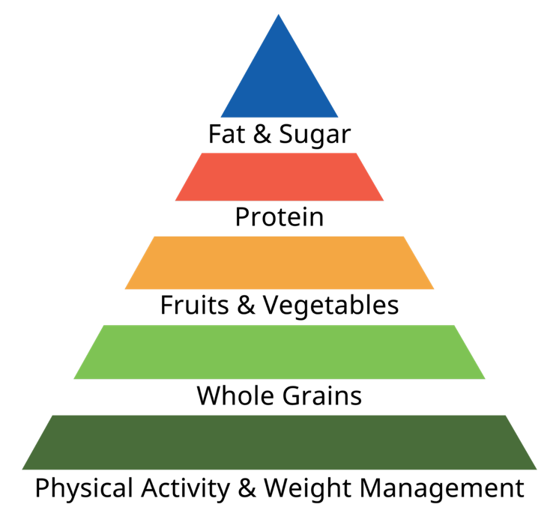
Approaches to Healthy Digestion
Well Balanced Diet
High in:
Fresh fruits & vegetables
Legumes
Whole grains
Low in:
High fat foods
Preserved, cured & salted foods
Red meat
Problem foods
Protein
Carbs
Fat
Notes:
Digestive health can be improved with a well balanced diet high in fresh fruits and vegetables, legumes, healthy fats, and whole grains.
A healthy diet should be low in or ideally devoid of high fat foods, preserved, cured and salted foods, red meat and problem foods.

Slide 17
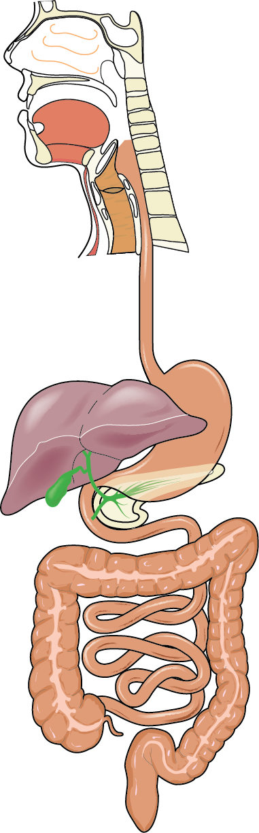
Approaches to Healthy Digestion
Promoting healthy digestive process
Stomach
Intestine
Colon
Notes:
EXCLUSIVELY FROM GNLD: DIGESTIVE SUPPLEMENTS YOU CAN STOMACH
Safe and gentle, NeoLife’s digestive supplements are formulated to support the natural activities of the digestive system. Based in nature and backed by Science, they address the underlying causes of digestive troubles, not just the symptoms. Along with appropriate food choices, they contribute to the stability of the gastrointestinal environment and promote optimal digestive function in the stomach, intestine and colon.
NeoLife has formulated a series of leading-edge products to address the most common “problem areas” within the digestive tract. Employing the most recent scientific findings and selecting only the finest natural ingredients, the NeoLife Scientific Advisory Board has created a product line of digestive aids to provide complete and balanced support for the entire system. To support the natural balance of the digestive tract, our products provide vital acids, enzymes, “good” bacteria, fiber, and other healthful factors. Plant-sourced and naturally derived ingredients work with the body to enhance digestion so that you are able to unlock the complete nutritional power of the foods you eat.

Slide 18
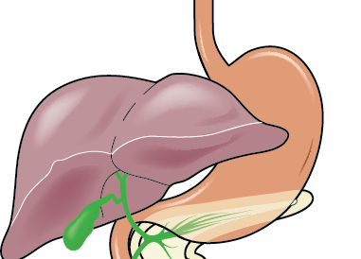
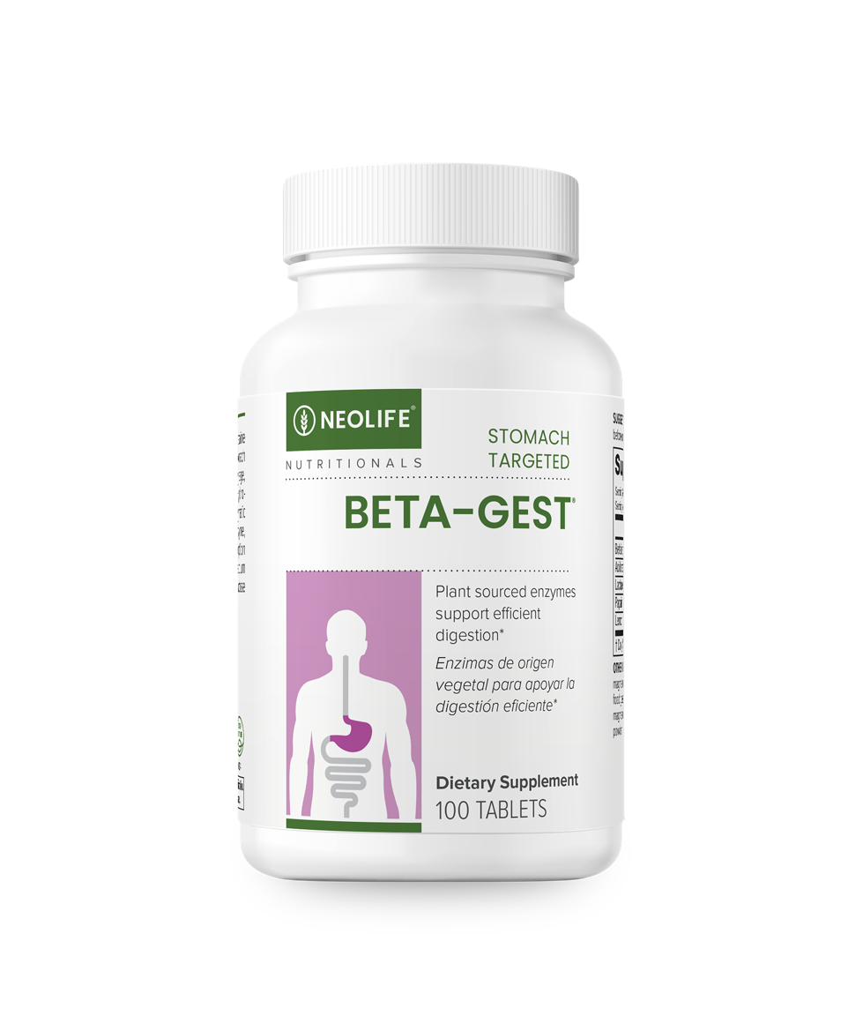
Beta-Gest® Digestive Aid
STOMACH TARGETED
Supports the body’s natural digestive process*:
Controlled release HCl
100% plant-sourced, acid-stable enzymes that break down protein and lactose
Addresses causes of occasional indigestion, not just symptoms*
Maximizes digestive potential and absorption of nutrients*
Notes:
Without ample acid and enzymes, the digestive system can become stressed beyond capacity and unable to do its best job.
Addresses the causes of indigestion, not just the symptoms
100% plant sourced, natural digestive supplementation in a base of dried beet, licorice root and lemon; no animal ingredients
Complete formula of hydrochloride (Betaine HCL) plus lactase and protein-digesting enzymes that supplement the normal body secretions required for healthy digestion
Enzymes
Acid stable protease and papain for protein digestion
Lactase to help digest lactose in milk products
Supports protein digestion with acid-stable, acid-activated proteases including papain (from papaya)
Assists in lactose digestion for the lactose intolerant
Non-habit forming like antacids

Slide 19
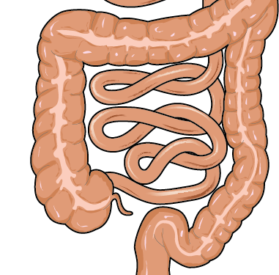
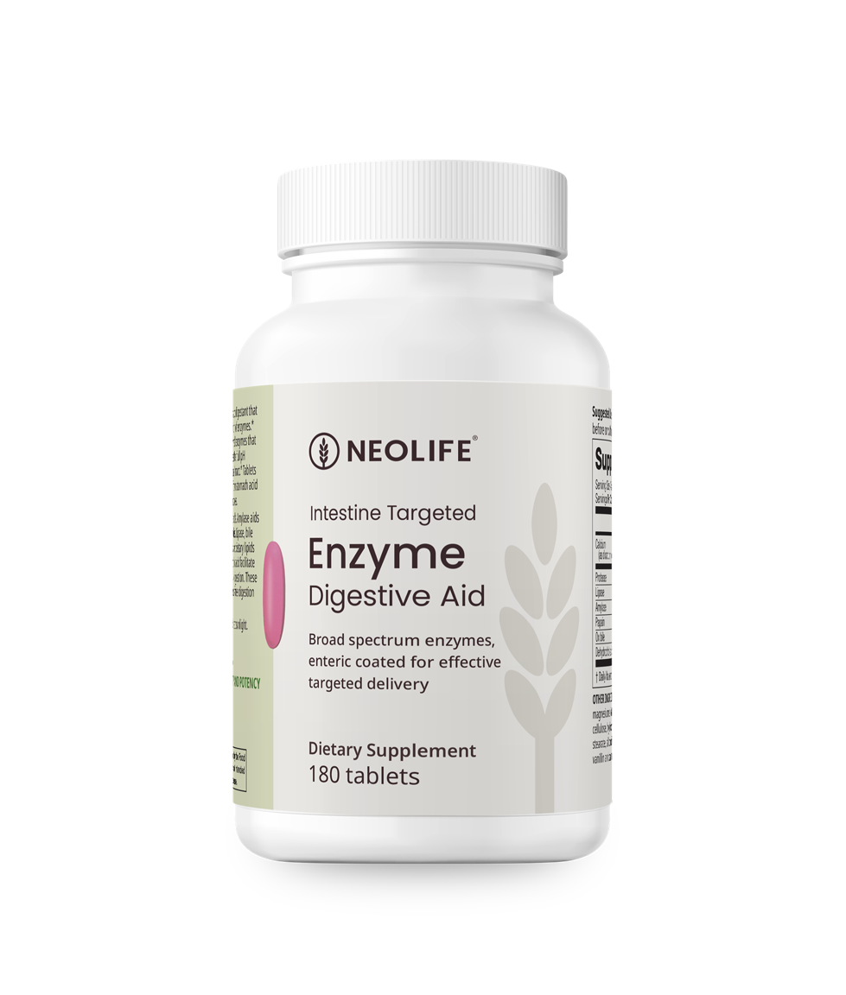
Enzyme Digestive Aid
INTESTINE TARGETED
Supports the body’s natural digestive process with*:
Potent, broad-spectrum, plant-sourced digestive enzymes
Targeted delivery enteric coating technology
Addresses causes of occasional intestinal indigestion, not just symptoms*
Notes:
Efficient special formula works within pH of the intestinal tract to enhance digestion and improve nutrient absorption
Broad spectrum formula supplies all three enzyme types – proteases, amylases and lipases
Powerful microplant enzymes are combined with bile salts and dehydrochloric acid for enhanced fat digestion
Targeted ‘enteric coated’ technology ensures efficacy
Non-habit forming like antacids; addresses not just the symptoms but the cause
Protease for protein digestion
Amylase for carbohydrate digestion
Lipase, bile salts and dehydrocholic acid for fat digestion

Slide 20
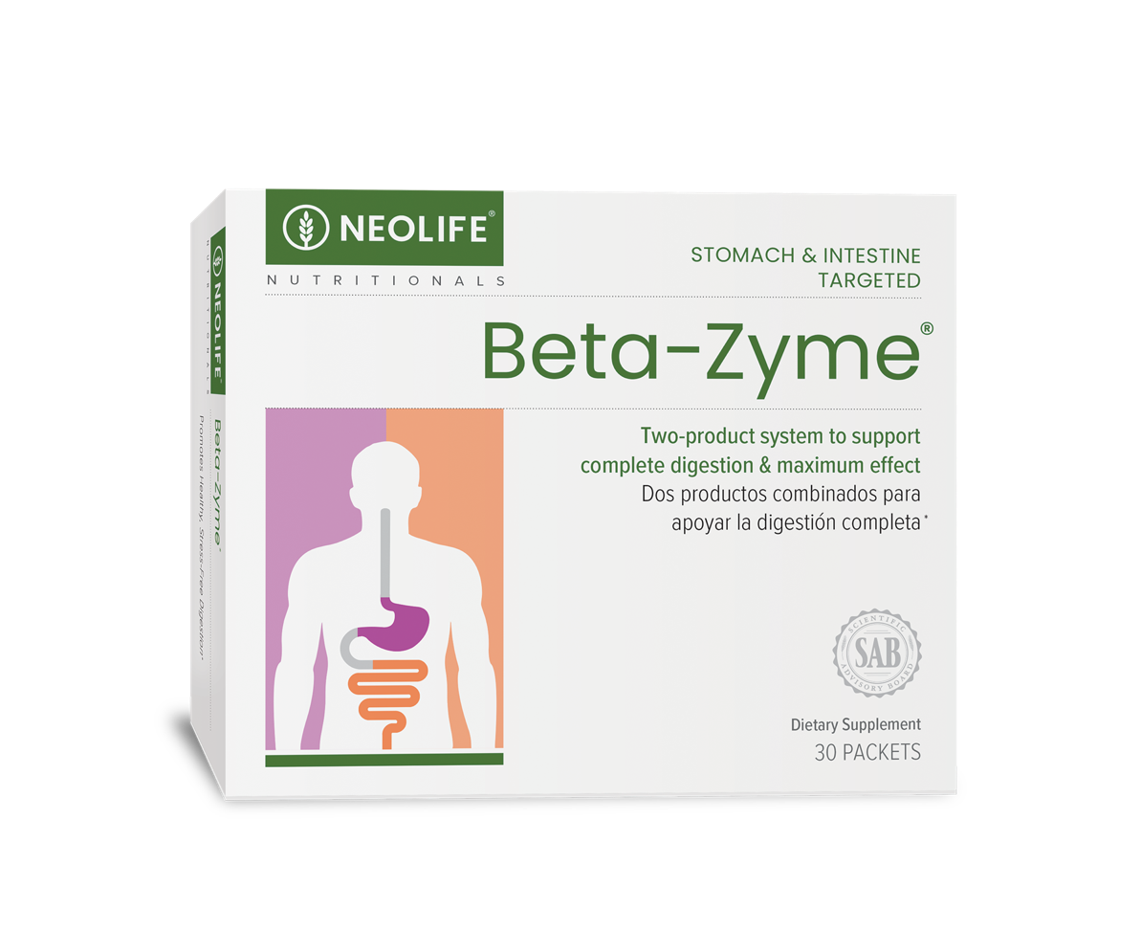
Beta-Zyme® Digestive Aid
The combination of Enzyme Digestive Aid and Beta-Gest®
Convenient packets
Plant-based enzymes
Targeted Delivery
Broad-spectrum
Notes:
Beta-Zyme has a “one-two” punch that attacks digestive ailments where they begin, in the stomach and the intestine. Beta-Zyme contains enzymes that support the body’s ability to digest carbohydrates, fats and proteins. Composed of two different NeoLife digestive aides, Beta-Zyme attacks the cause of digestive discomfort, not just the symptoms.

Slide 21
Healthy Gut Flora - Probiotics
Regulate intestinal function
Aid in digestion
Improve lactose intolerance
Inhibit growth of pathogenic bacteria
Aid in the absorption of minerals
Prevent diarrhea
Notes:
Beneficial (“good”) intestinal bacteria promote health, discourage the growth of disease-causing (“bad”) bacteria and pathogenic fungi, and improve the balance of microbes which normally inhabit our intestines. Many beneficial bacteria transform naturally occurring sugars, especially lactose, into lactic acid, promoting a more balanced and stable intestinal environment. As one of the most abundant sources of lactose is milk, these beneficial bacteria have been used for thousands of years to produce yogurt, cheese, and fermented milks. Both science and folklore support healthful roles for these foods. NeoLife’s supplement of beneficial bacteria, Acidophilus Plus, combines potency with technology to guarantee that live organisms survive the stomach acid and reach the intestines to deliver five billion viable organisms capable of supporting optimal digestive tract function.

Slide 22
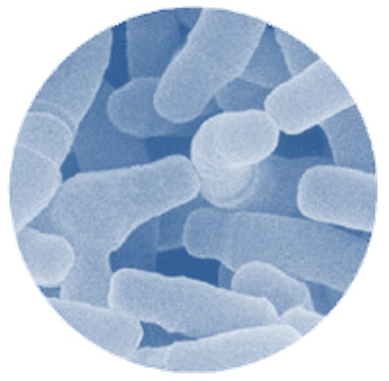
Benefits of Probiotics
Promote colon health
Detoxification
Support healthy colon cells
Support a balanced immune response
Improve gut barrier function
Naturally guards against infection

Slide 23


More Benefits of a Healthy Gut Microbiome
A Foundation for Good Health
Nutrition
Physiological Function
Immune Response
Indigestion
Infection
Diarrhea, IBS, IBD
Notes:
The human gastrointestinal tract contains more than 500 types of bacteria – both beneficial and potentially harmful.
Beneficial bacteria also known as probiotics - are a group of naturally occurring intestinal bacteria that participates in and protects human health and well being.
When beneficial bacteria are in short supply the undesirable bacteria can multiply causing an unhealthy balance.
The result – digestive discomfort or more serious problems such as gastrointestinal disease.
Probiotics: A foundation for good health
Strengthen Immunity
Improve innate immunity
Produce antibiotic substances
Discourage growth of disease causing bacteria
Reduce food allergy symptoms in children
Prevent infection naturally
Support Efficient Metabolism
Aid in absorption of minerals
Synthesize B-vitamins
Lower levels of toxic/mutagenic compounds
Help release nutrients from food
Promote colon health
Reduce risk of colon cancer
Support healthy colon cells
Bacterial enzymes detoxify cancer-causing substances
For anyone wanting to ensure an intestinal abundance of good bacteria or to re-colonize the intestinal tract following:
Antibiotic treatment
Excess alcohol intake
Food poisoning
Traveler’s diarrhea

Slide 24
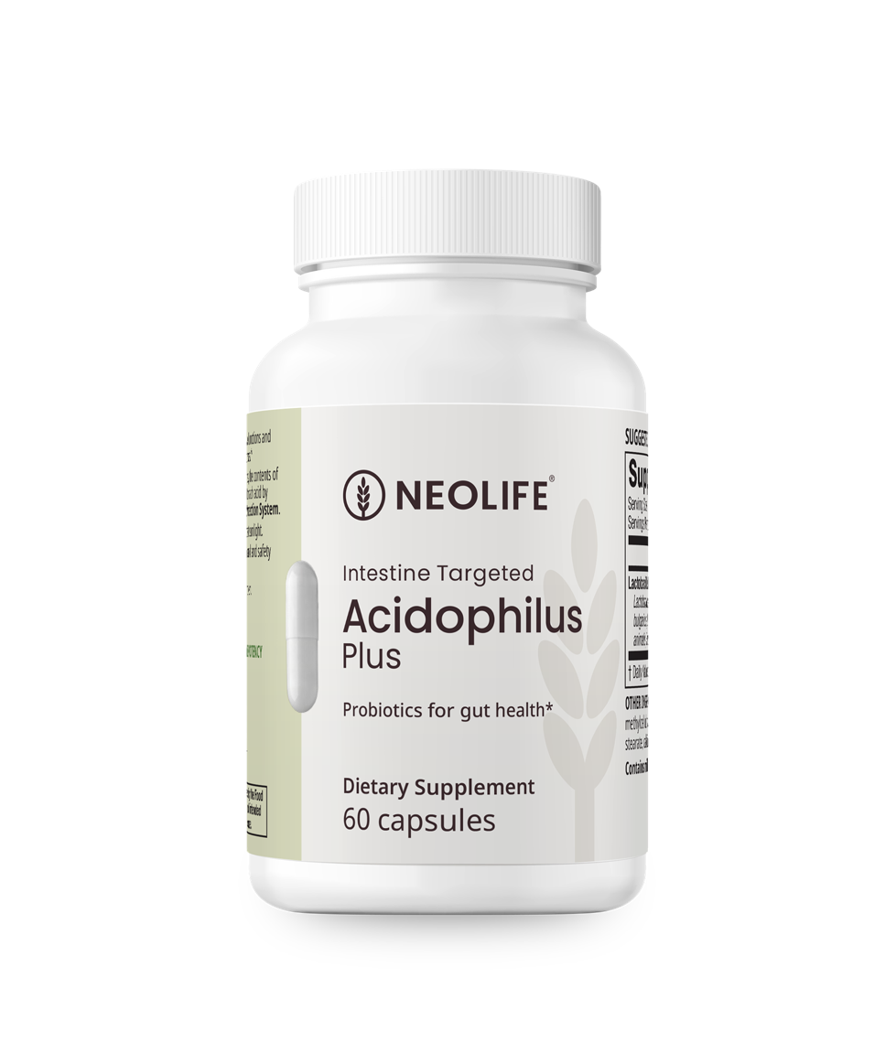
Acidophilus Plus
Promotes healthy gastro-intestinal balance of “good” bacteria while helping keep “bad” bacteria in check*
Guaranteed ‘live’ active cultures
Notes:
Acidophilus Plus –
A comprehensive Pro-Biotic supplement to support natural digestive tract harmony, comfort and efficiency.
Regulate intestinal function
Inhibit growth of pathogenic bacteria
By producing “lactic acid” probiotics create an “acidic” intestinal environment where pathogenic organisms such as E. coli can not exist.
Prevent diarrhea
By assuring an abundance of “good” bacteria, “bad” bacteria can not overwhelm the intestinal tract.
Control irritable bowel disease (IBD) and irritable bowel syndrome (IBS)
By creating intestinal harmony, susceptibility to upset by those with such gastric sensitivities can be reduced.
Improve Digestion:
Probiotic bacteria assist the body in the production and utilization of important enzymes within the digestive tract.
One in particular is the enzyme LACTASE which is critical for the digestion of the “milk sugar” LACTOSE.
When adequate lactase is present lactose intolerance, gas, flatulence and bloating are minimized.

Slide 25


Acidophilus Plus
Concentrated active cultures
Each capsule is filled with 5 billion live organisms and protected for maximum delivery to the intestines
Five Clinically Studied Strains, shown to:
– Support gut health and microbiota diversity*
– Promote abdominal comfort*
– Help reduce occasional bloating*
– Support healthy immune function*
Notes:
NeoLife’s Acidophilus Plus:
To support a healthy digestive system supplementing with NeoLife’s Acidophilus Plus can assure delivery of live organisms to the intestines and promote a healthy and harmonious gastro-intestinal balance of “good” bacteria while helping keep “bad” bacteria at bay.
Each capsule filled with 5 billion active cultures.(remove -Contains concentrated active cultures, each capsule contains 5 billion beneficial bacteria.)
Whole food derived – Contains beneficial bacteria isolated from cultured dairy foods.
When beneficial bacteria are in short supply the undesirable bacteria can multiply causing an unhealthy balance.
The result – digestive discomfort or more serious problems such as gastrointestinal disease.
Acidophilus Plus –
A comprehensive Pro-Biotic supplement to support natural digestive tract harmony, comfort and efficiency.
Regulate intestinal function
Inhibit growth of pathogenic bacteria
By producing “lactic acid” probiotics create an “acidic” intestinal environment where pathogenic organisms such as E. coli can not exist.
Prevent diarrhea
By assuring an abundance of “good” bacteria, “bad” bacteria can not overwhelm the intestinal tract.
Control irritable bowel disease (IBD) and irritable bowel syndrome (IBS)
By creating intestinal harmony, susceptibility to upset by those with such gastric sensitivities can be reduced.
Improve Digestion:
Probiotic bacteria assist the body in the production and utilization of important enzymes within the digestive tract.
One in particular is the enzyme LACTASE which is critical for the digestion of the “milk sugar” LACTOSE.
When adequate lactase is present lactose intolerance, gas, flatulence and bloating are minimized.

Slide 26
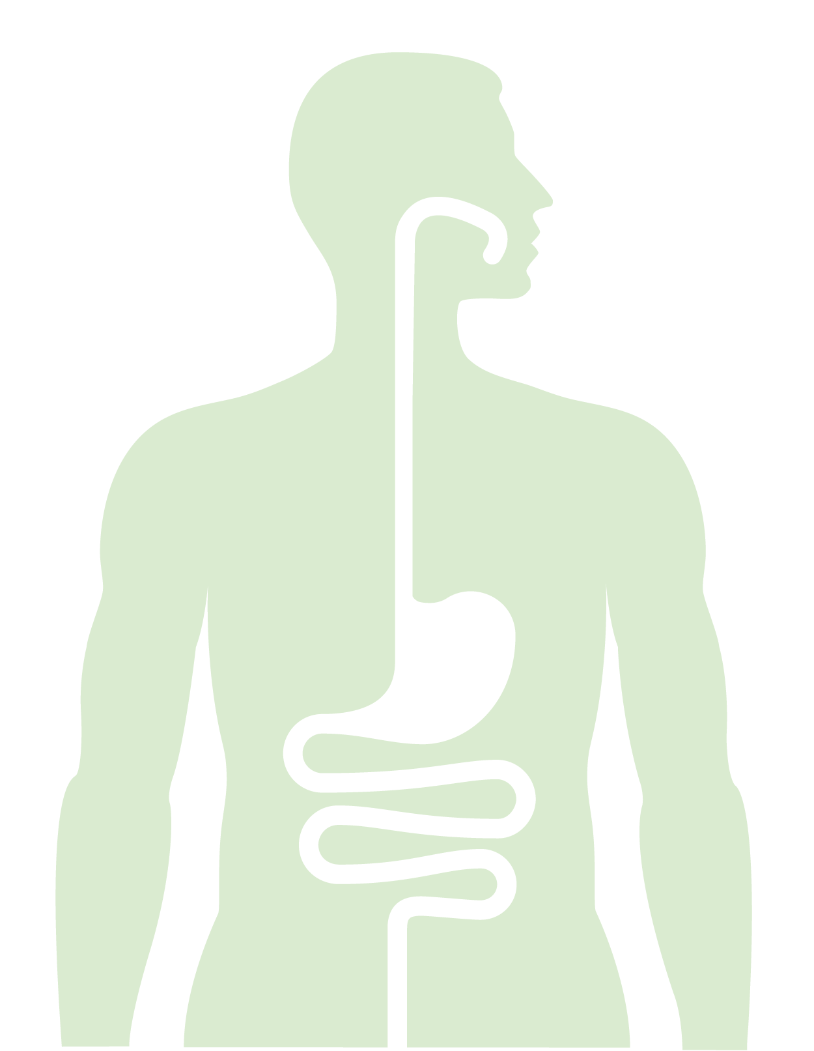
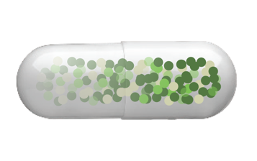
The NeoLife Difference
Unique ‘Gel-Gard’ Protection System
Hardshell capsule
Filled with 5 billion live microorganisms
'Gel-Gard' protects bacteria until they reach the intestines
Protects live micro-flora through stomach acid
Ensures maximum numbers of live bacteria are delivered to the intestines to support digestive balance*

Slide 27

Stress-Induced Digestive Discomfort
Caused by:
Occasional excess stress
Poorly managed stress
Stress from:
External factors – work, home, money
Internal factors – nutrition, fitness, rest, emotional
May lead to digestive challenges!
Notes:
Stress is a fact of nature
External factors - work, relationships, home, money … life’s daily situations, challenges, difficulties, and expectations
Internal factors determine your body's ability to respond to and handle stress - nutritional status, overall health and fitness levels, emotional well-being, and amount sleep and rest
Excess stress → sleep disturbances, muscle tension, headache, gastrointestinal disturbances, fatigue, nervousness, anxiety, loss of appetite or overeating, loss of enthusiasm or energy, and mood changes.
Chronic, unmanaged stress → alcohol and drug abuse, anxiety disorders, depression, high blood pressure, cardiovascular disease, certain gastrointestinal diseases, some cancers, and premature aging.
Psychological stress makes one more prone to develop colds and other infections.
Stress must therefore be managed!

Slide 28

Aloe Vera Plus
Aloe Vera Plus contains the highest quality aloe vera gel, known for its antioxidant properties
Aloe Vera juice from ‘gel only’ for optimal taste and efficacy
Infused with black tea, energizing Panax ginseng, soothing chamomile and a hint of tangy, lemon flavor
Notes:
Aloe Vera Plus – The Great Stress Soother…
Exclusive formulation for stress and immune system support
Naturally sweetened for a ‘glycemic edge’ for both quick and sustained energy
Natural lemon flavor adds to great taste
Only 16 calories per 2-ounce serving

Slide 29

Elimination
Problems:
Poor food choices
Diets low in fiber
Constipation
Irregularity
Discomfort
Notes:
Remind what it is
Discuss problems

Slide 30
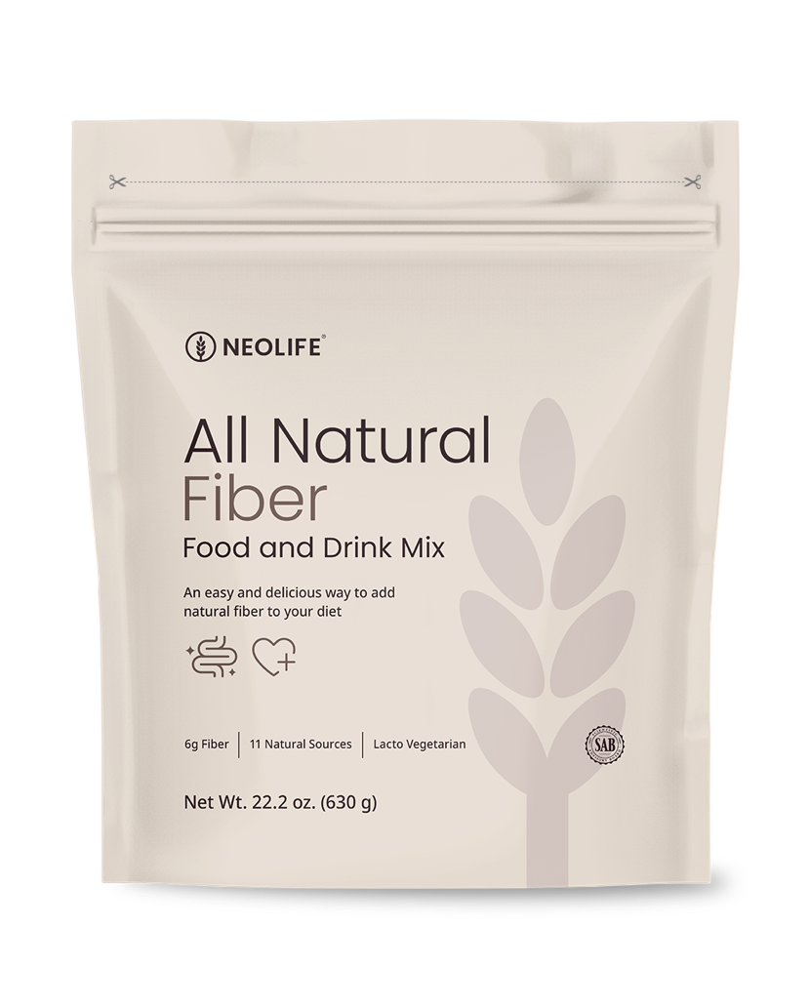
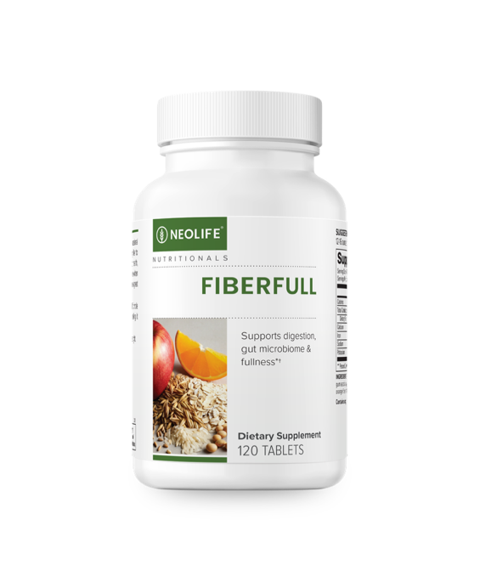
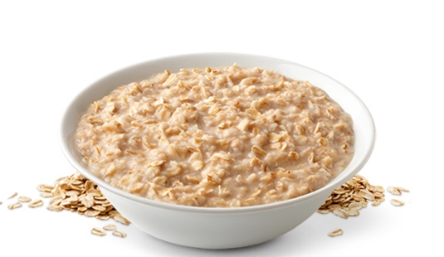
Fiber
Over 90% of us don't get enough fiber
Benefits:
Supports gastrointestinal health*
Helps maintains regularity*
Concentrated & convenient sources of whole-food-derived fibers
Notes:
The presence of fiber in the GI tract increases fecal bulk, which may dilute the concentration of cancer-causing substances in some foods. Fibers actually reduce the amount of time fecal bulk is present in the GI tract, which reduces the length of time the GI tract is exposed to harmful substances. In addition, fiber-rich diets can reduce intestinal pressure, which can lead to diverticulosis, a condition marked by small inflammations within the GI tract.
Fiber is also helpful in preventing constipation. Because fiber attracts and holds water in the GI tract, fecal bulk increases and as a result, keeps you “regular”.

Slide 31
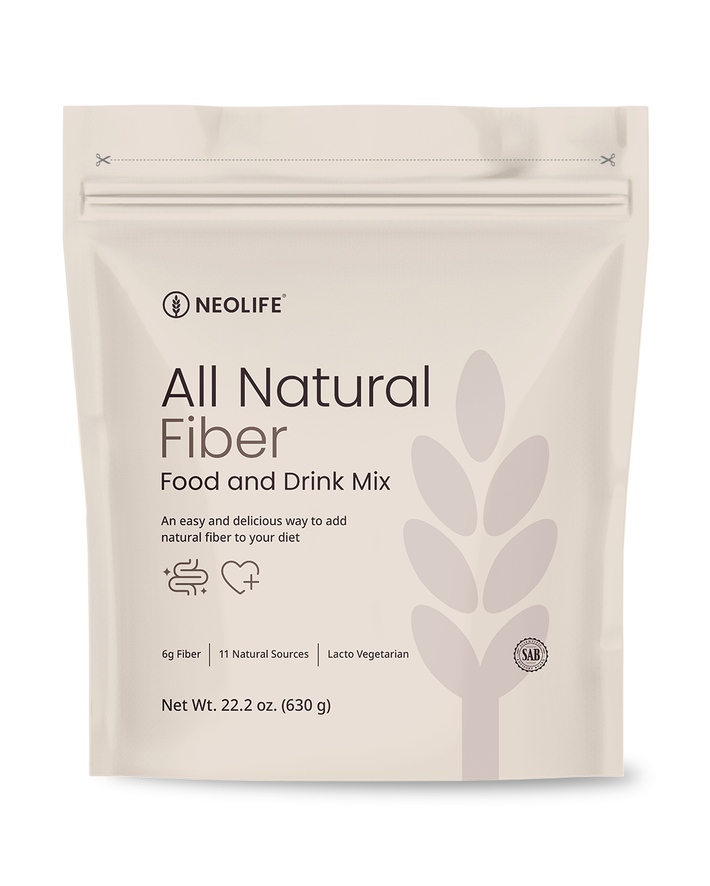
All Natural Fiber
A balance of 5 forms of soluble and insoluble fibers from whole-food-derived sources:
– Cellulose, hemi-cellulose, gums, pectin, lignin
Smooth and tasty
Concentrated fiber in a convenient form
21g serving provides:
– Soluble fiber: 1g
– Insoluble fiber: 5g
Notes:
NeoLife All-natural Fiber Food and Drink Mix:
Complete fiber—blend of soluble and insoluble fibers from 12 natural, whole-food sources including whole oats, fruits and vegetables.
Provides cellulose, hemicellulose, gum, lignin and pectin (all 5 types of dietary fiber necessary to maintain good health)
Concentrated and delicious--> 6g of dietary fiber plus added protein, fructose and complex carbohydrates
Exclusive Neo-Polyfibe: soy polysaccharide blended with specially selected whole oat and acerola cherry fiber to help absorb cholesterol and carry it out of the body without robbing trace nutrients
Contains no corn or wheat proteins, no preservatives and no sulfites
Less than 1 g of fat per serving, no cholesterol and no added salt. Naturally sweetened and flavored.
Promotes gastrointestinal health
Supports heart health
Lowers blood cholesterol levels
Reduces blood pressure
Helps regulate blood sugar
Helps control weight by promoting satiety

Slide 32
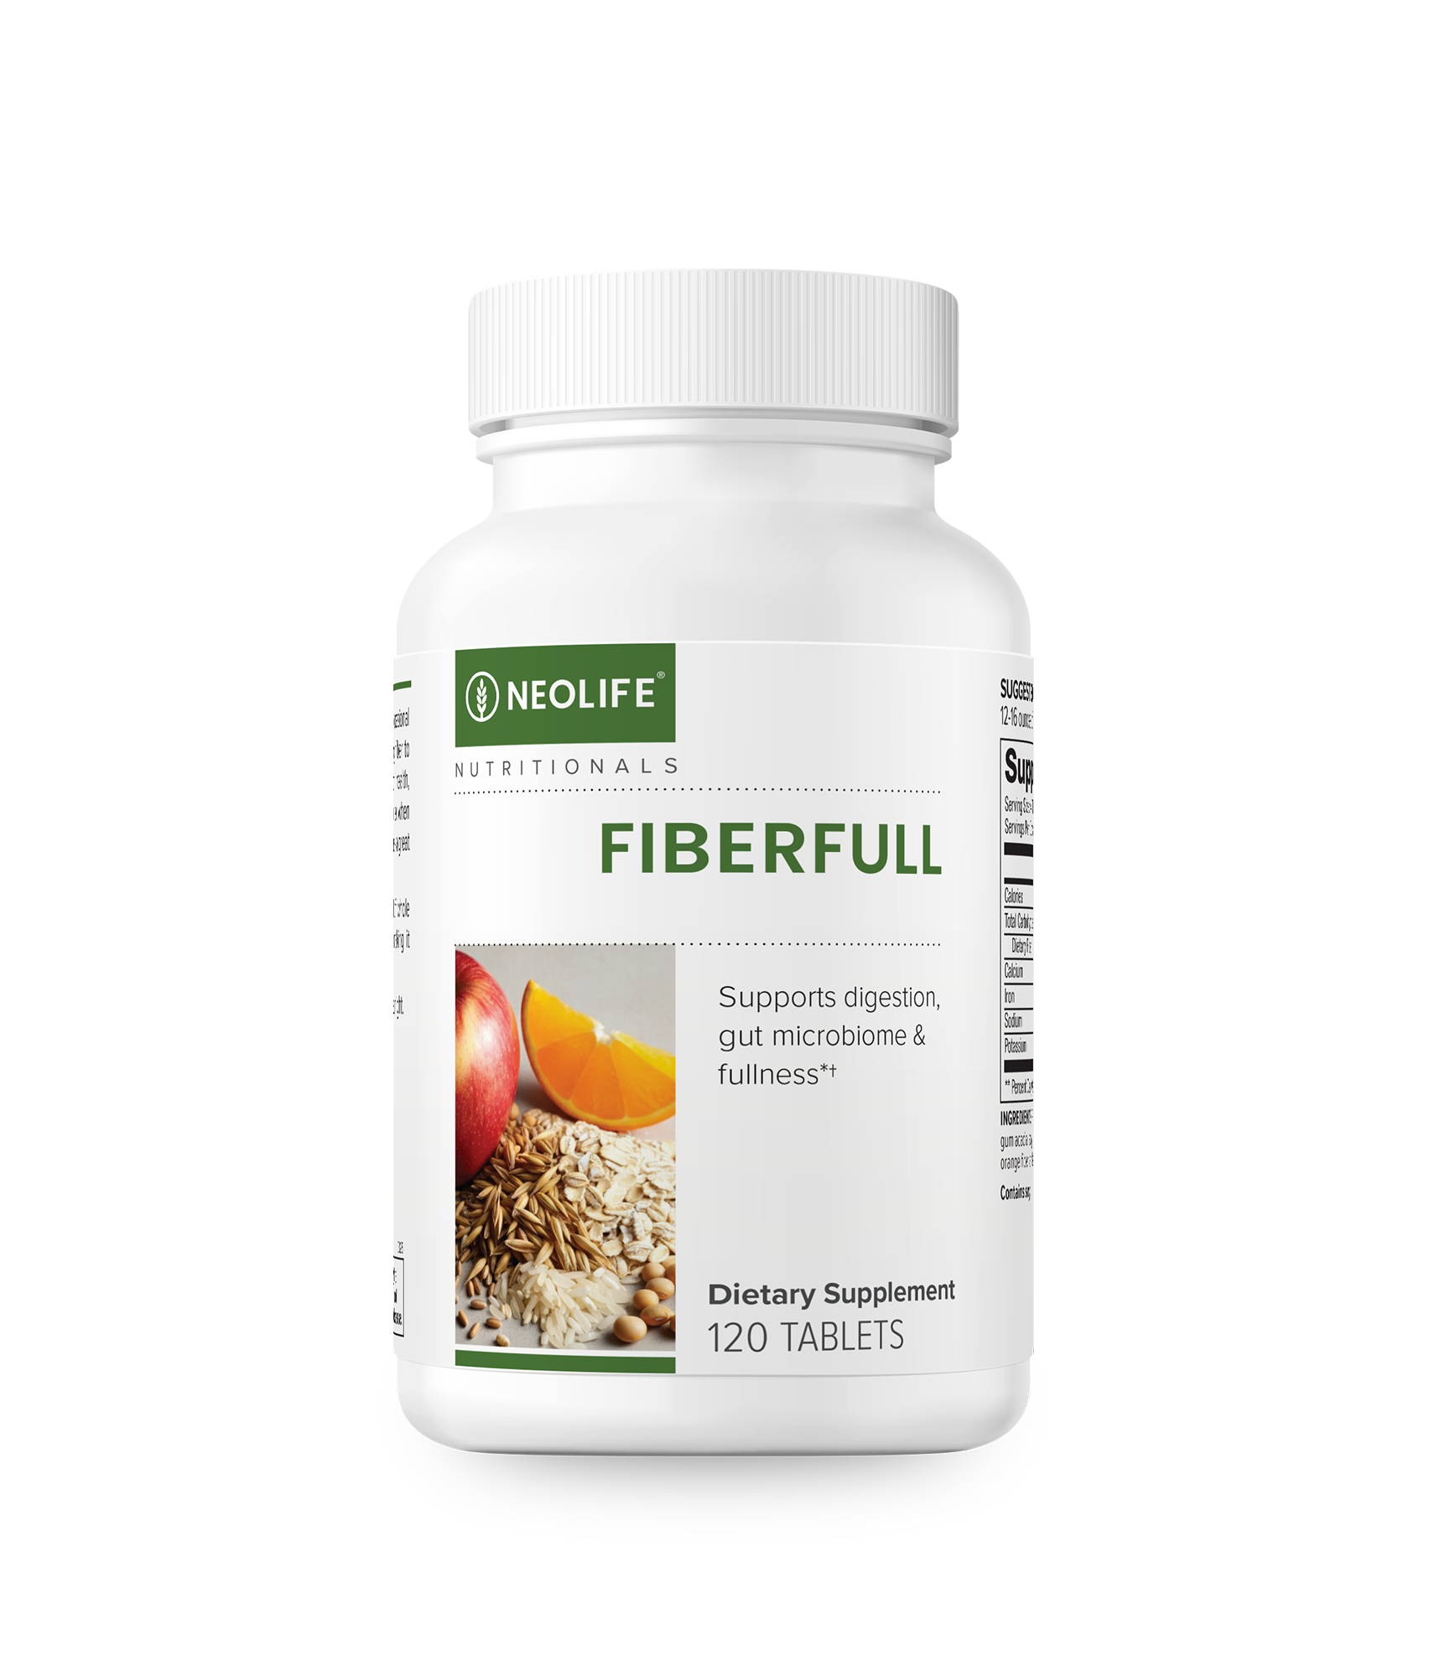
FiberFull
Convenient, Whole Food-Based Fiber Tablets
Designed for daily life – just grab & go
Fiber from whole food-based sources: rice, oat, barley, soy, apple, and orange
Soluble & insoluble fiber for complete gut support*
Supports healthy appetite†, regularity & digestion*
†Fiber can help you feel fuller when taken with a large glass of water before a meal.*

Slide 33
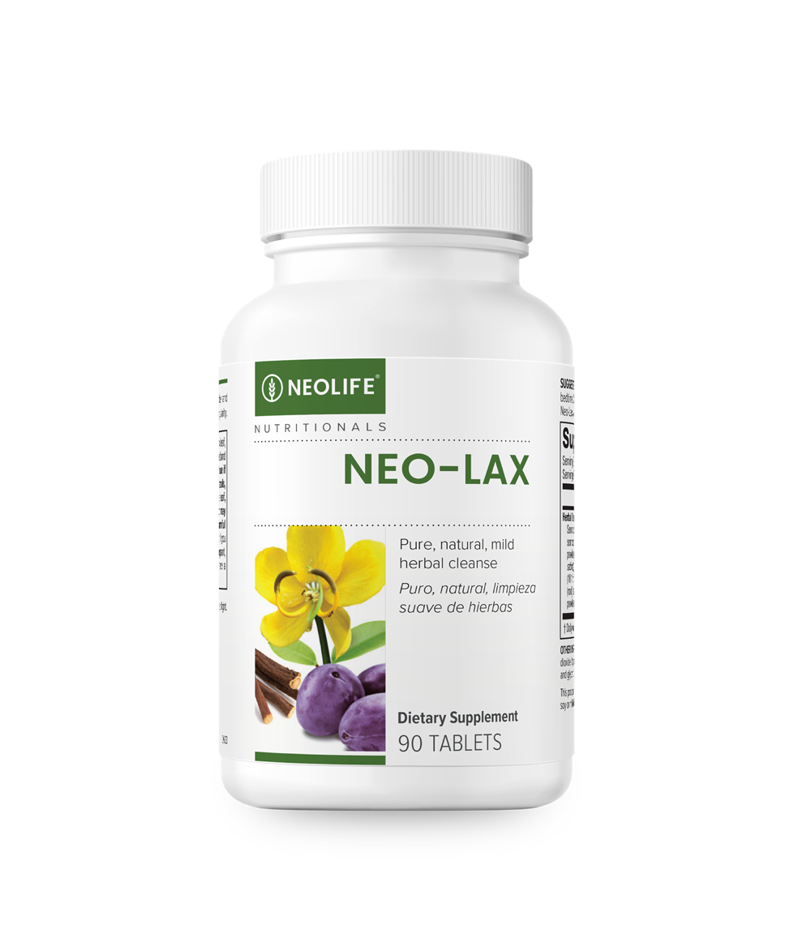
Neo-Lax
Additional support for occasional bouts of constipation*
Contains Senna, Buckthorn bark, and Licorice root
Guaranteed purity, potency and consistency
Pure, Natural, Mild Herbal Cleanse
Notes:
Senna—encourages softening of the stool and natural peristaltic action of the colon
Buckthorn bark– assists softening of the stool. Supports blood cleansing and kidney function
Licorice root– adds moisture to the stool. Promotes liver health and blood cleansing. Calms and soothes tissues in the digestive tract.

Slide 34
Neo-Lax
Comprehensive Formula from Global Traditions
The following herbs have been traditionally used for these benefits:
Senna leaf – softens stool and encourages peristaltic motion*
Buckthorn bark – Traditionally used to assist softening of the stool and relieve occasional constipation.*
Licorice root – adds moisture to the stool, promotes liver health *
Prune powder – promotes regularity of bowel function *
Alfalfa leaf – Naturally contains beneficial phytonutrients and believed to have purifying properties.*
Rhubarb root – digestive tonic, cooling effect *
Asparagus – Believed to promote kidney and liver health.* Also used to support movement of stool.*
Anise seed – Traditionally used to alleviate occasional gas and promote healthy, calm digestion.*

Slide 35
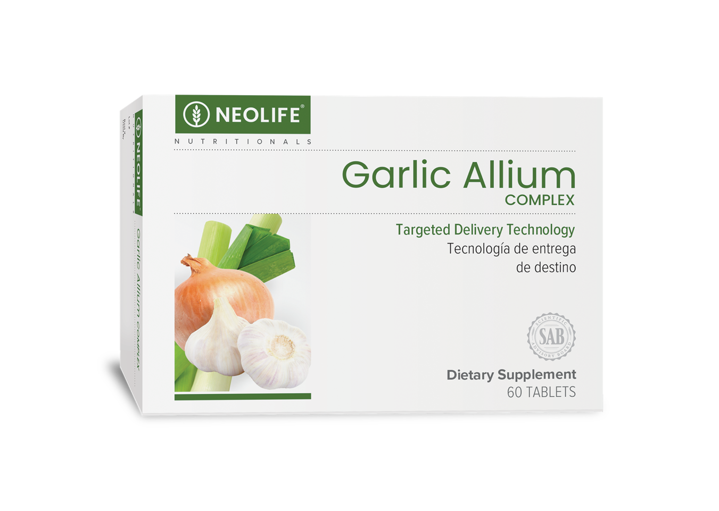
Garlic Allium Complex
A Complete Blend of Powerful Garlic and Allium Food Factors
Broad spectrum whole-food-derived extracts and concentrates
Targeted Delivery Technology
– Enteric-coated capsule to protect contents from stomach acid
Guaranteed high potency
– 4,200mcg of active allicin per 2-tablet serving
All the benefits of fresh raw garlic with minimal garlic breath!
Notes:
Why Garlic Allium Complex?
Broad spectrum whole-food extracts and concentrates from garlic, onions, chives and leeks
Unique process to protect natural enzymes
Guaranteed high potency. One serving = 4,200 mcg of active allicin = 1 clove fresh garlic
Nutrient family approach—not only contains allicin, but also bother bioactive compounds
Targeted delivery technology - enteric coating maximizes absorption
Contains rosemary—potent antioxidant herb
Does not cause garlic breath
Functions as a natural antibiotic in the gut
Helps detoxify carcinogens
Supports healthy immune responses
Promotes normal cell growth and renewal (esp. in GI tract)

Slide 36
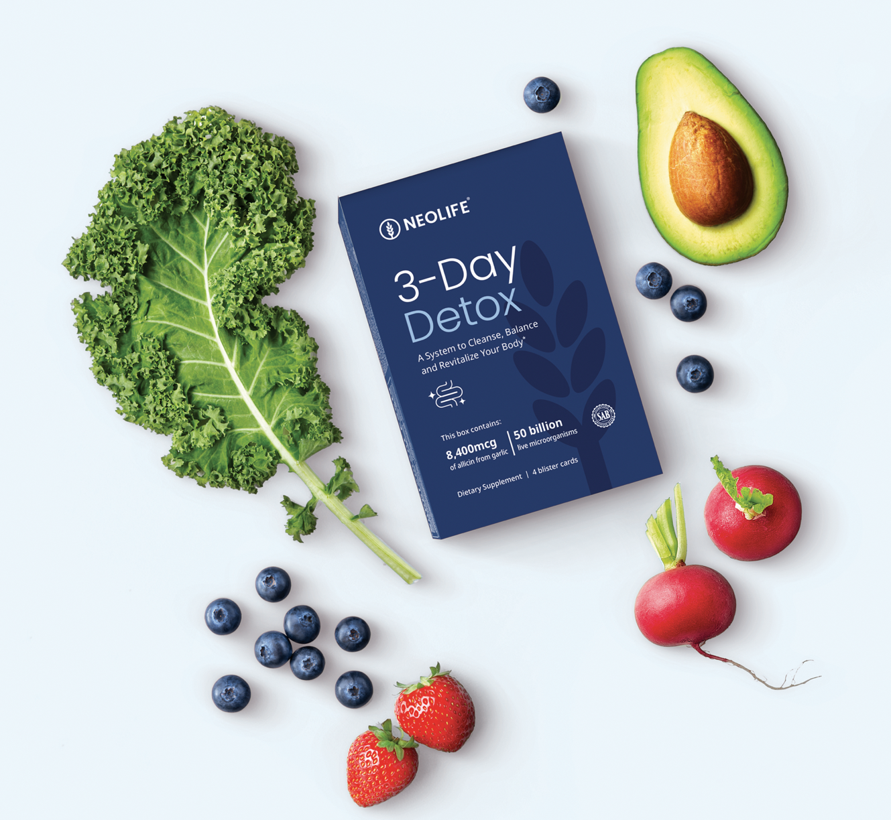

3-Day Detox
Cleanse* | Balance* | Revitalize*

Slide 37
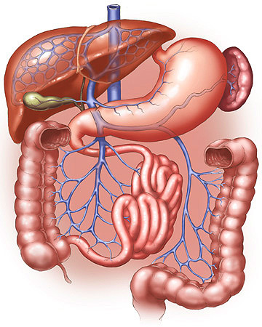
What is Elimination?
Elimination is the process of eliminating waste from the body… detoxification
All waste products of metabolism are toxic to the body
Constipation worse than starvation

Slide 38

Where do these toxins come from?
In addition to metabolism…
Toxins are coming from:
– Our environment
– Our lifestyle
Toxins need to be eliminated in order to maintain our health

Slide 39

Top 5 Reasons to Detox

Slide 40

#1 Remove Toxins
HAZARDS ARE ALL AROUND US!
Air we breathe
Foods we eat
Water we drink
Prescription medicines
Alcohol
Stress

Slide 41
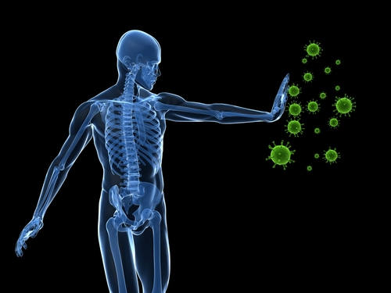
#2 Healthy Immune Function
Detoxification followed by probiotic supplementation improves gut health which is connected to functions in the body like:
Immune function
Nervous system
Hormones
Mood
Weight
Brain
Energy
Heart

Slide 42

#3 Jump Start Weight Loss
Fat cells are notorious for storing toxins, which can also affect the body’s ability to burn fat efficiently.
Detox to jump-start a new or ongoing weight loss program.

Slide 43

#4 Slow Premature Aging
Free radicals and heavy metals can accelerate the aging process.
Detoxing helps increase the body’s ability to use nutrients more efficiently, thereby enabling antioxidants from our diet to combat oxidative stress from free radicals.

Slide 44

#5 Increase Energy
Removing toxins from the body helps bring its systems back in balance helping you feel your energetic best!

Slide 45


Cleanse & Revitalize the Healthy Way!*
Easy
Only 2 steps
Quick
Just 3 days
Whole
food-derived
Effective
Scientifically formulated products

Slide 46
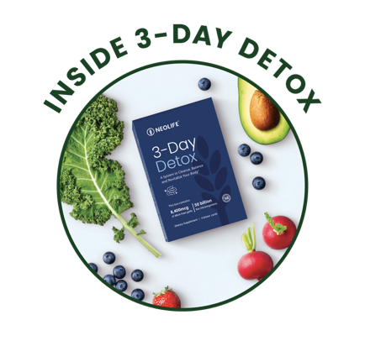
Neo-Lax
Supports Healthy Elimination*
Formulated with 8 different herbs that
work synergistically
Natural, gentle cleansing and elimination*
Encourages normal bowel function*
Pure and mild herbal cleanse*
Non-habit forming
Pure, Natural, Mild Herbal Cleanse

Slide 47

Garlic Allium Complex
Supports Immune Health and Heart Health*
Supports healthy immune responses*
Broad spectrum whole-food-derived extracts and concentrates
Targeted Delivery Technology
– Enteric-coated capsule to protect contents from stomach acid
Guaranteed high potency
– 4,200mcg of active allicin per 2-tablet serving
Each tablet provides as much allicin as approximately 1 clove of fresh garlic

Slide 48
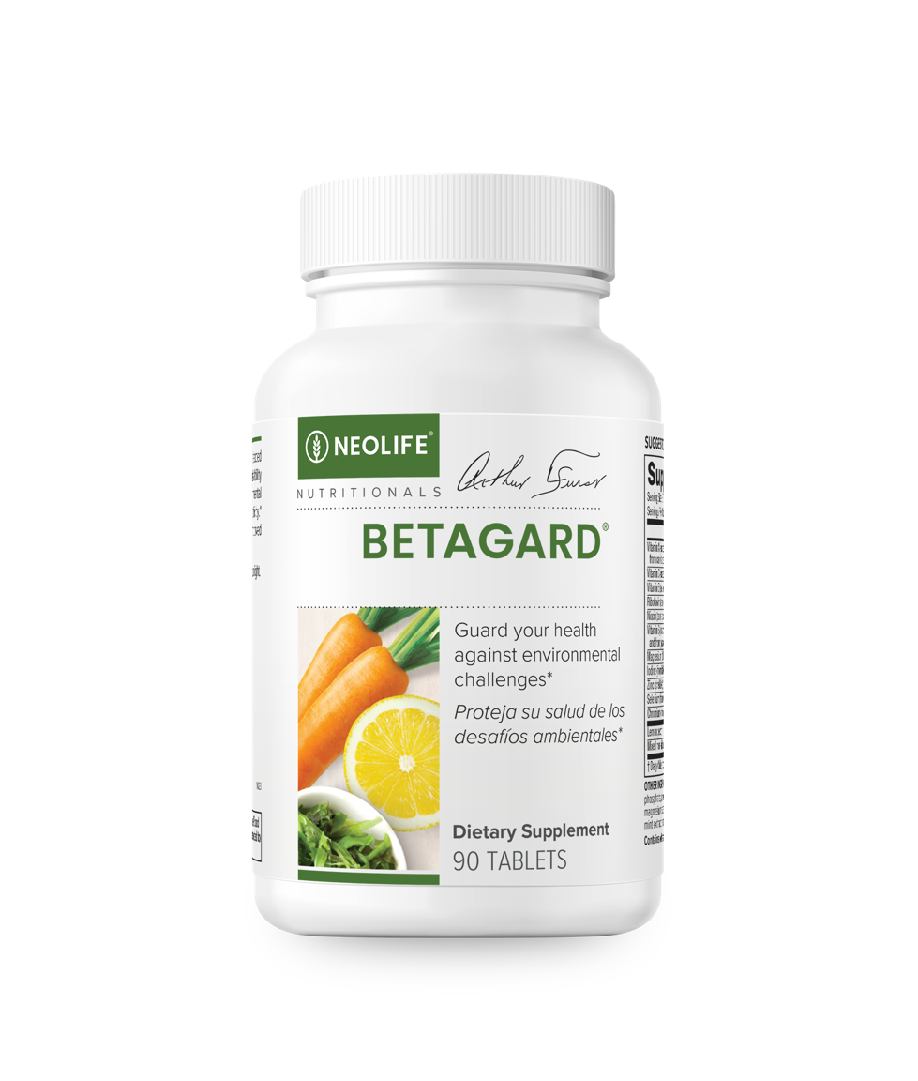
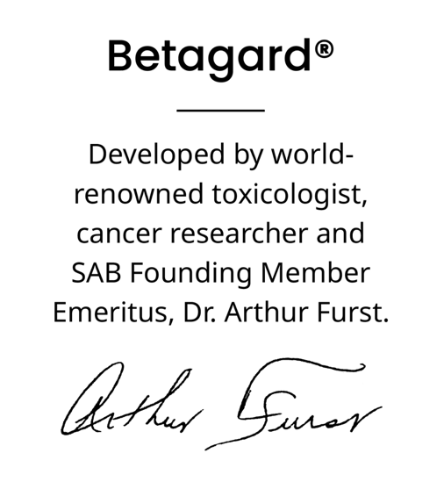
Betagard®
Defend Yourself Against Environmental Toxins*
Defend against damaging free radicals in environment*
Supports your body's natural detoxification process*
Proprietary formulation of vitamins, minerals and carotenoids
Exclusive amino acid chelation

Slide 49
Acidophilus Plus
Probiotics For Healthy and Harmonious Gastro-intestinal Balance*
Concentrated active cultures
5 types of beneficial bacteria
Great value

Slide 50
Unique ‘Gel-Gard’ Protection System
Guarantees delivery of beneficial cultures
Hardshell capsule
Filled with 5 billion live microorganisms
'Gel-Gard' protects bacteria until they reach the intestines
Protects live micro-flora through stomach acid
Ensures maximum numbers of live bacteria are delivered to the intestines to support digestive balance*

Slide 51
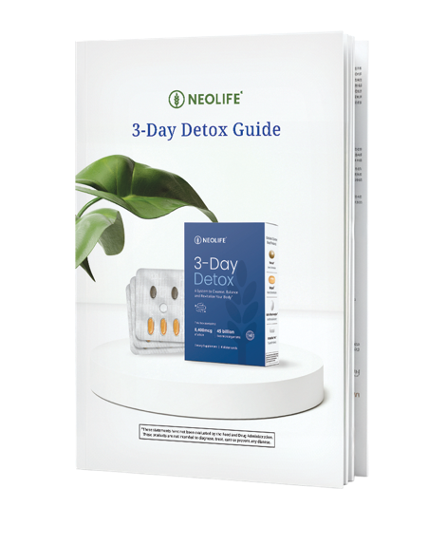
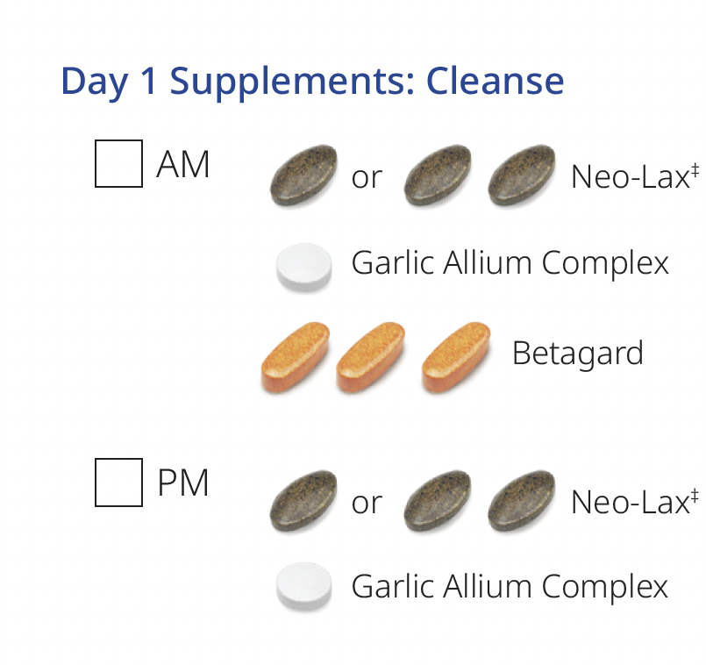
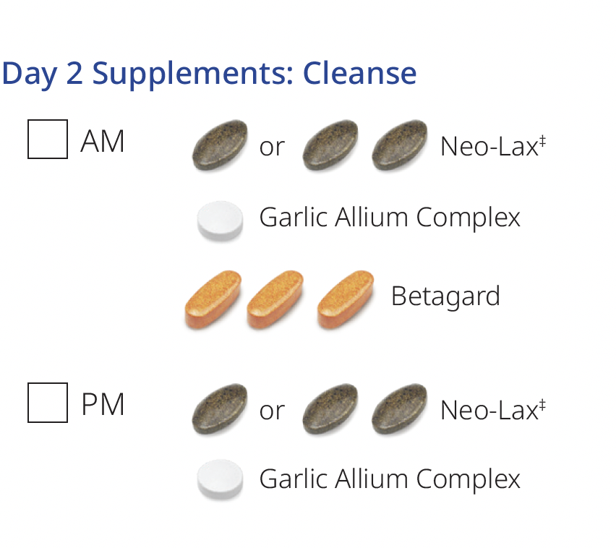
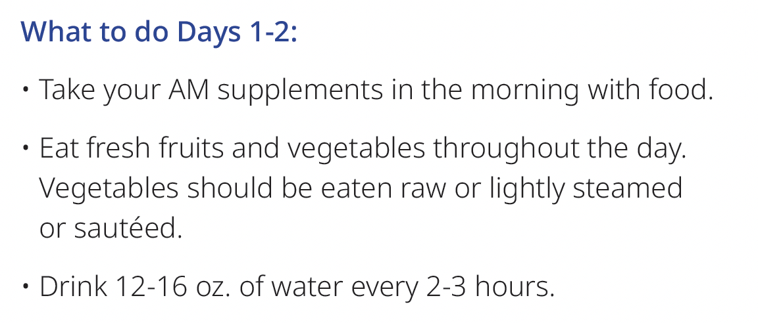
How to 3-Day Detox
Includes a simple,
easy-to-follow Detox Guide
Guarantees delivery of beneficial cultures
‡Take 1 Neo-Lax tablet if you weigh less than 150 lbs. or 2 Neo-Lax tablets if you weigh more than 150 lbs
Do not use Neo-Lax if you currently suffer from diarrhea, loose stools or abdominal pain because it may worsen these conditions.
Please consult with your Physician before performing any detoxification program.

Slide 52
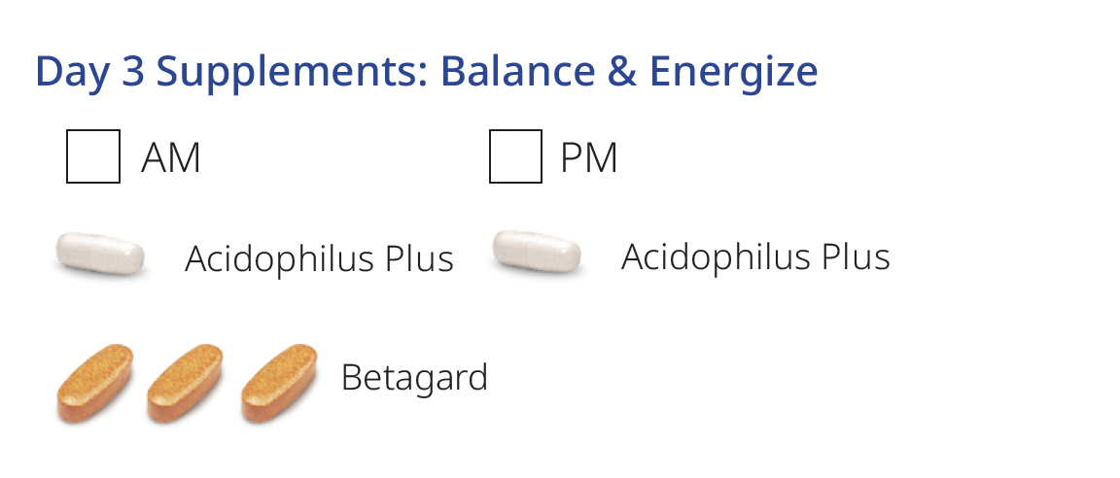
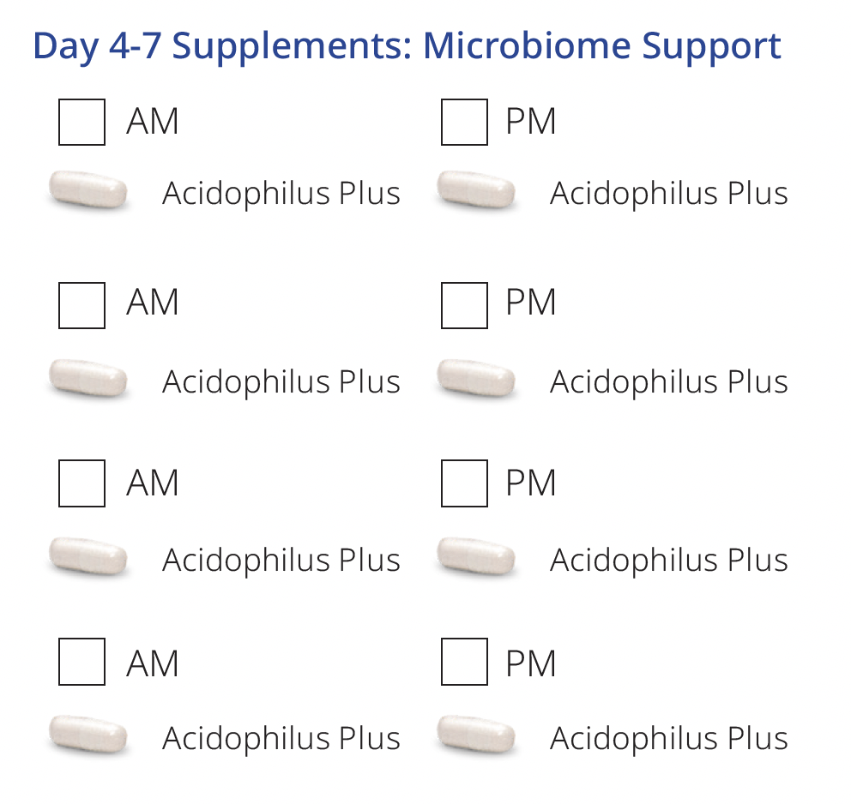
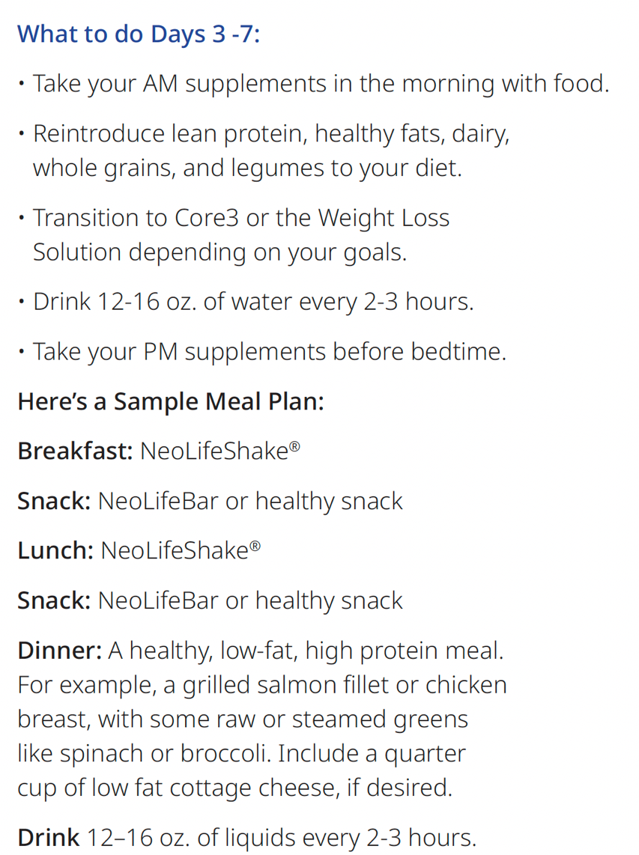
How to 3-Day Detox
Please consult with your Physician before performing any detoxification program.

Slide 53


Based in Nature, Backed by Science

Slide 54
Thank You!

