Slide 1
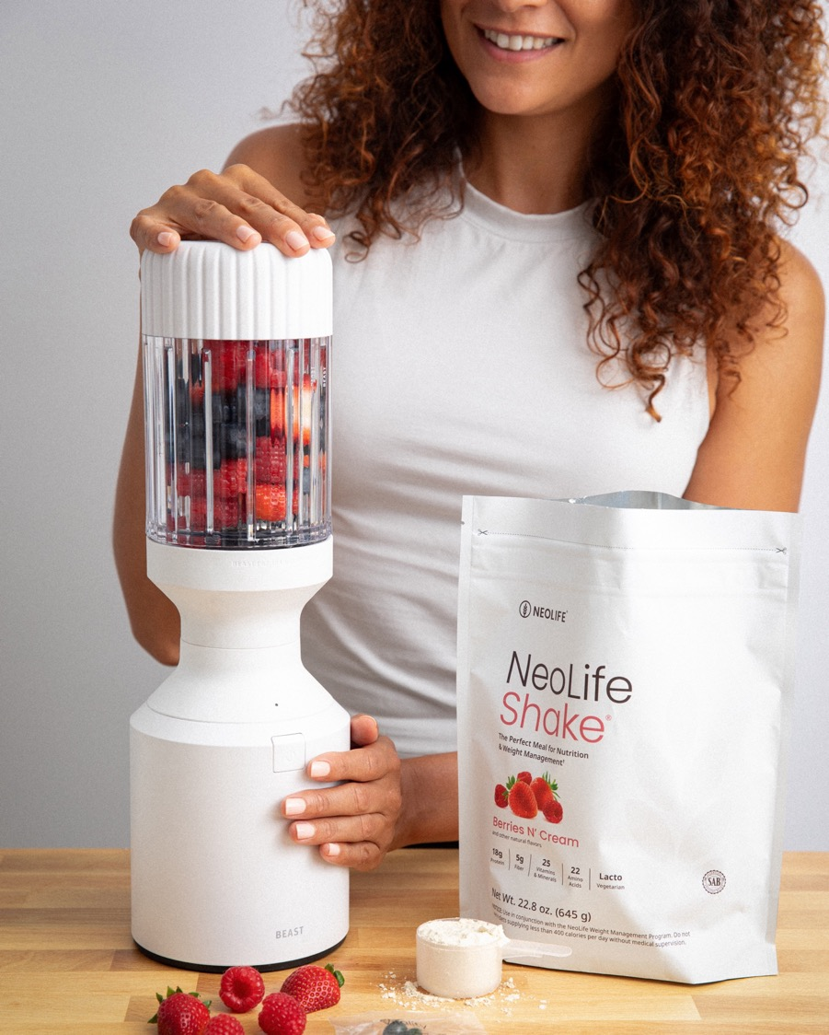

Discover More

Slide 2


WHO WE ARE
A world-wide wellness company
operating in 50+ countries
in business since 1958

Slide 3
OUR MISSION
To give everyone the power to live
Healthier and Happier Lives
Creating a movement to make our nations, communities, and families healthy again.

Slide 4

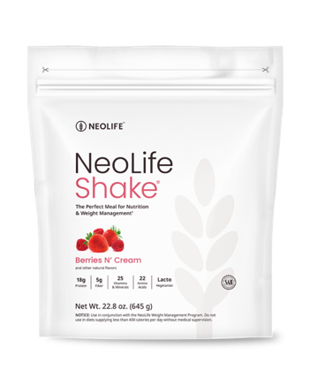
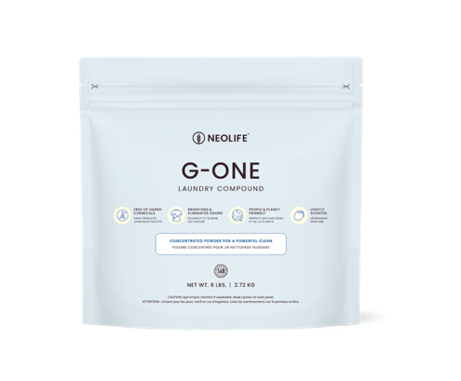
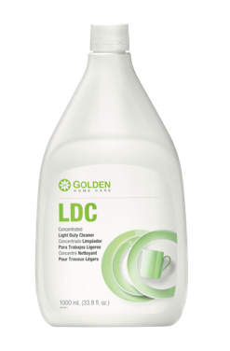
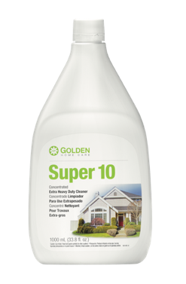
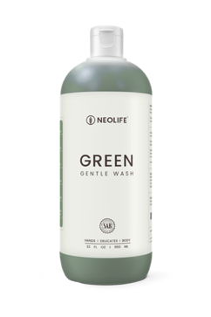
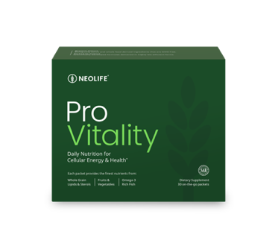
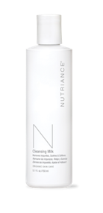
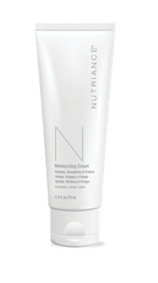
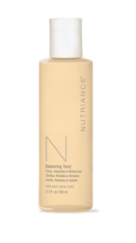

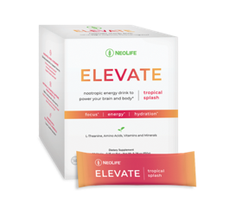

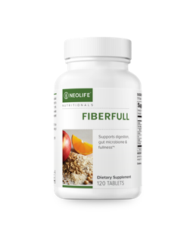
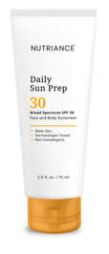


Complete Wellness,
Backed by Science
Feel better, Look better, Live better – with products based in nature, backed by science.

Slide 5









Guaranteed Quality
Without Compromise
Created by Doctors and Scientists
Pharmaceutical License for Manufacturing
Whole Food Based Cellular Nutrition
Clinically Proven Human Clinical Studies
GMO Free and Full Traceability
Published Clinical Studies

Slide 6

The NeoLife Difference
Full Supply Chain Control
Relentless focus on sourcing the finest ingredients for our proprietary formulas
Dedicated Quality Teams
Tests and retests all raw materials and finished products
Scientific Advisory Board
Active, published, respected doctors, scientists and experts in nutrition
Published Clinical Studies
Clinical studies on select products published in some of the most prestigious scientific journals

Slide 7

OUR VALUES
ABSOLUTE INTEGRITY
PEOPLE ARE NUMBER ONE
PRODUCTS THAT WORK
LONG RANGE VISION
EQUAL OPPORTUNITY FOR ALL

Slide 8


“Now I feel confident again!”
Lost over 40 lbs.†
“I felt like a prisoner in my own body, until I committed to taking NeoLife products daily. They helped me lose weight and give me the energy to get active. I even ran over 600 miles in a year. I feel confident again!”
Dakota King
2023 NeoFit90 Champion
BEFORE
†Results are not typical. In an open label clinical study participants lost an average of 5.27 lbs. over a 12 week period.

Slide 9

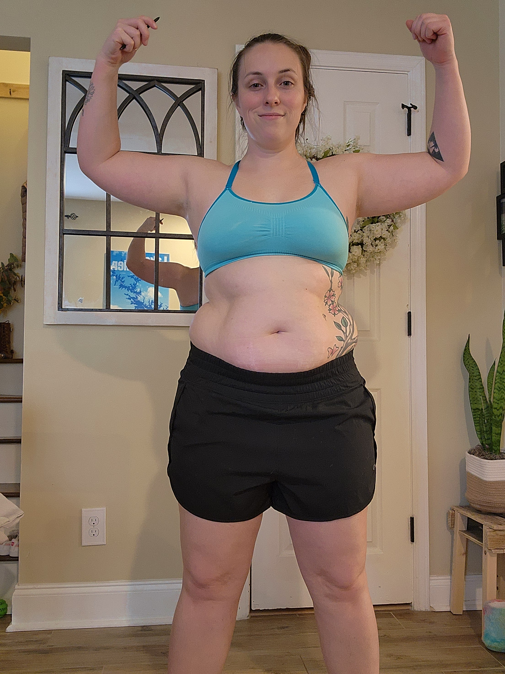
“I feel strong and energized!
Lost 35 lbs.†
“As a wife and mom of 3 kids I was pulled in every direction. I was convinced there was something wrong with me and didn’t know how to break the cycle. I leaned into NeoLife. The key was using it consistently! I found the support of an encouraging community, and everything started to shift. Now I feel strong, energized, and equipped for the long haul.”
Skyler Jackson
2025 NeoFit90 Champion
BEFORE
†Results are not typical. In an open label clinical study participants lost an average of 5.27 lbs. over a 12 week period.

Slide 10
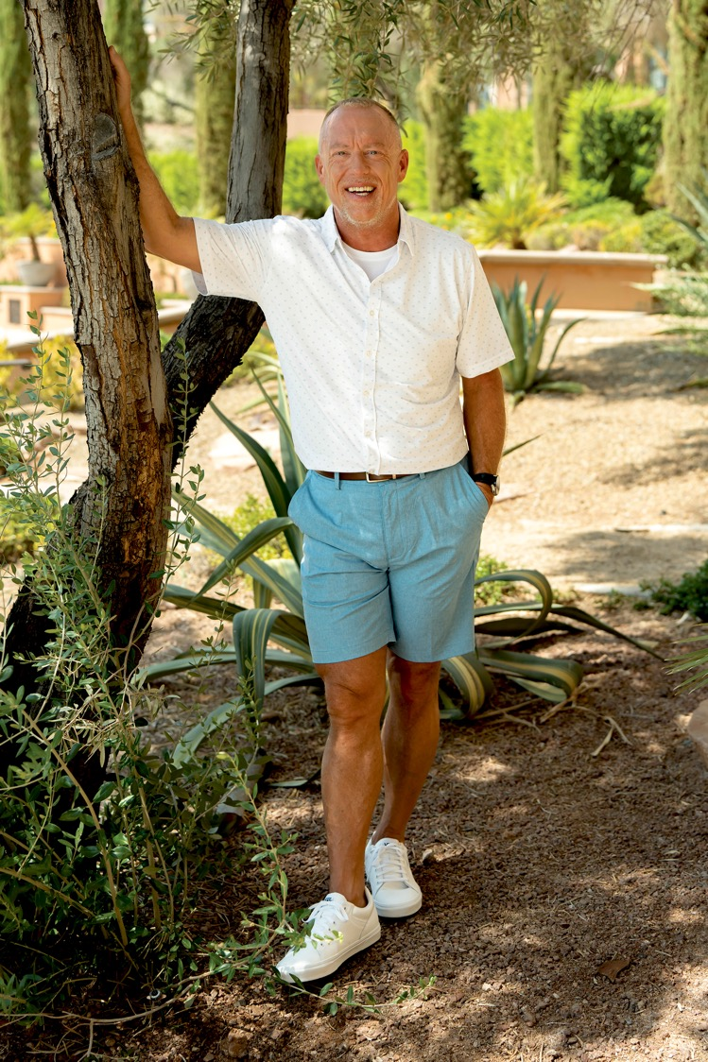
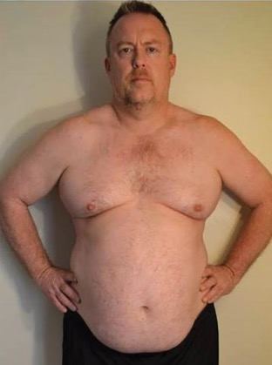
“People tell me I’m aging in reverse.”
Lost nearly 100 lbs.†
“I was reaching 300 pounds and did not want to cross that line. I was under stress from work and eating for comfort. With NeoLife I regained my energy and my motivation. Now I’m riding my bike, running and lifting weights. The weight is coming off and I’m building muscle. People tell me I’m aging in reverse.”
Jon Scaman
2-Time NeoFit90 Champion
BEFORE
†Results are not typical. In an open label clinical study participants lost an average of 5.27 lbs. over a 12 week period.

Slide 11

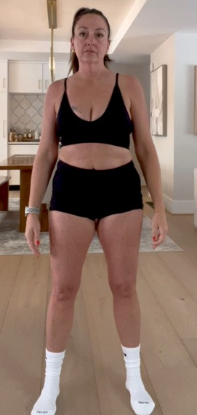
“I feel like I’m in my 20’s!”
Lost 7% Body Fat†
“I was going through the rollercoaster of perimenopause and felt uncomfortable in my own skin. With NeoLife I started losing weight within a week, and in 2 weeks had energy that I hadn’t had in a long time. I’m almost 50 and feel like I’m in my 20’s.”
Celina Frank
2025 NeoFit90 Champion
BEFORE
†Results are not typical. In an open label clinical study participants lost an average of 5.27 lbs. over a 12 week period.

Slide 12
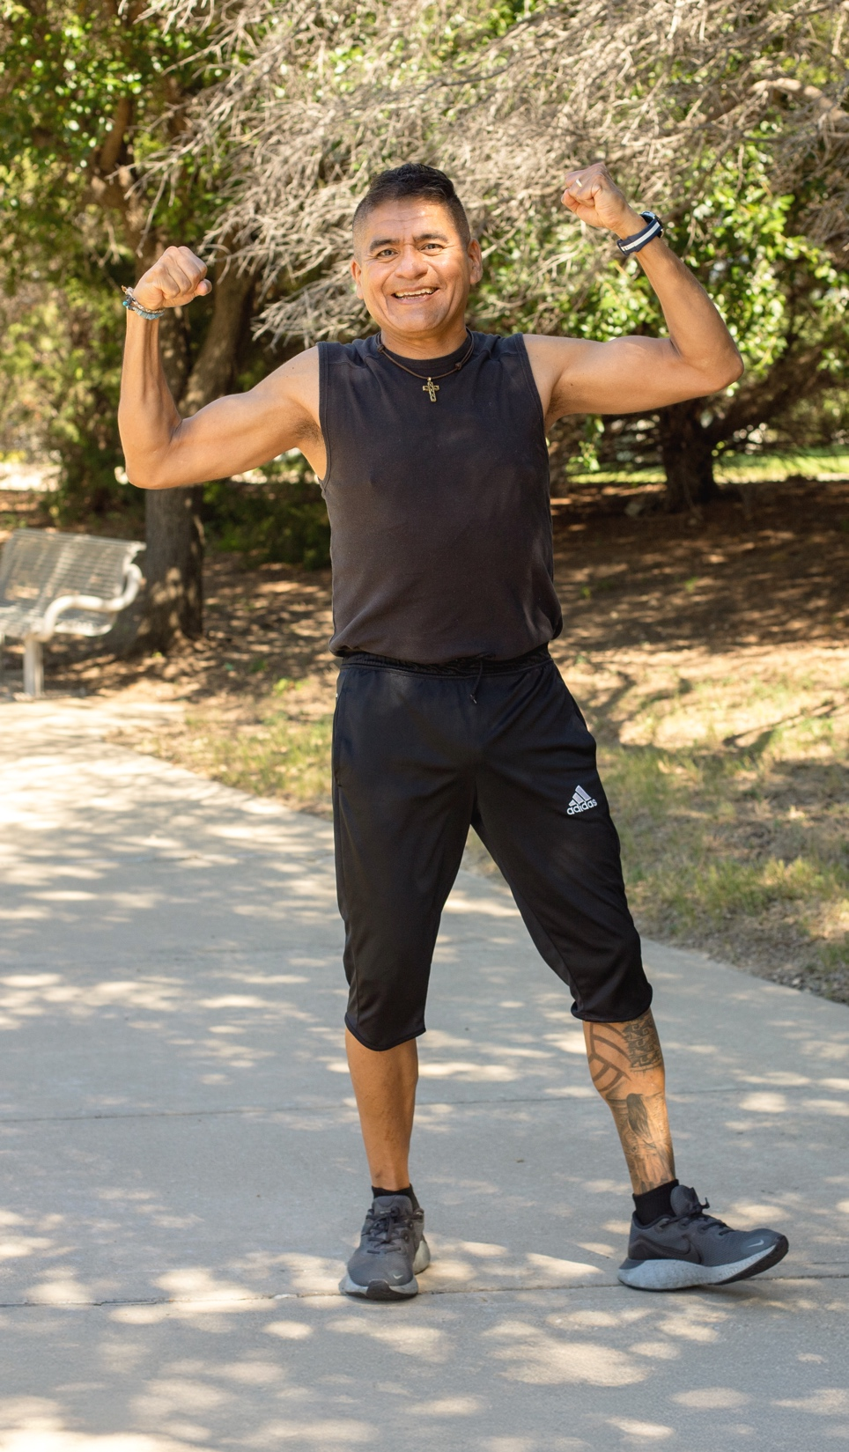
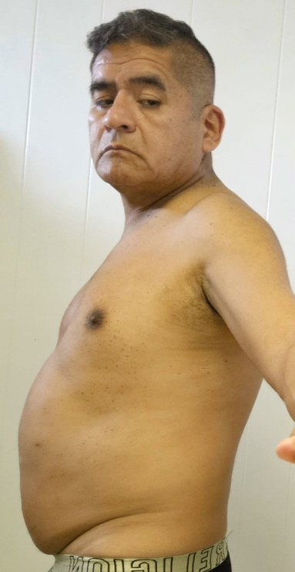
“I feel stronger than ever!”
Lost over 40 lbs.†
“Before NeoLife, every day was a struggle. I ate without control and found excuses to drink. I hardly slept. I felt hopeless. I was inspired by my wife, Claudia’s results (a 2024 Champion). I slowly found the spirit and energy to move again. Now I’ve lost 3 shirt sizes and 4 inches in my waist. I feel stronger than ever!”
Jesus Guzman
2025 NeoFit90 Champion
BEFORE
†Results are not typical. In an open label clinical study participants lost an average of 5.27 lbs. over a 12 week period.

Slide 13
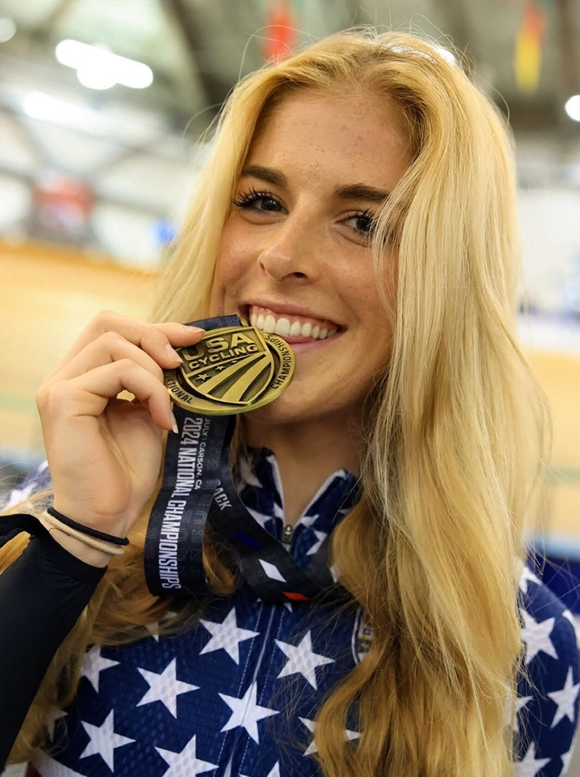




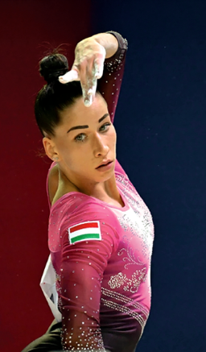
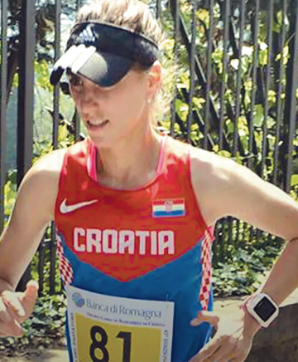

ATHLETES POWERED BY NEOLIFE

Slide 14


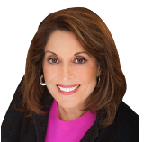

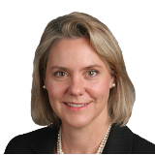



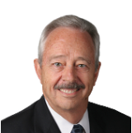



Meet The Drivers
Behind Our Difference
Arthur Furst
1914-2005
Founding Member Emeritus, SAB
Ph.D., Sc.D., D-A.T.S.,
Toxicologist, Pharmacologist
Liz Applegate
Ph.D., Nutritional Scientist, Sports Nutritionist
Susan Beck
Head of the SAB, Ph.D., L.Ac., Dipl. O.M., CNS, Nutritional Scientist
Ariana Carughi
Ph.D., C.N.S., Nutritional Scientist, Researcher
Diane E. Clayton
Ph.D., RNutr., Biochemist, Health Practitioner
Fred G. Hooper
Ph.D., Biochemist, Nutritionist
Mark Lowman
C.F.S., Food Scientist, Quality Expert, Formulator
John R. Miller
Director of the SAB, Product Technologist, Researcher
Todd Miller
Ph.D., Exercise & Sports Scientist, Researcher
David Shepherd
Ph.D., Microbial Biochemist, Food Technologist
Abbie Smith-Ryan
Ph.D., Exercise Physiologist, Nutrition Scientist

Slide 15
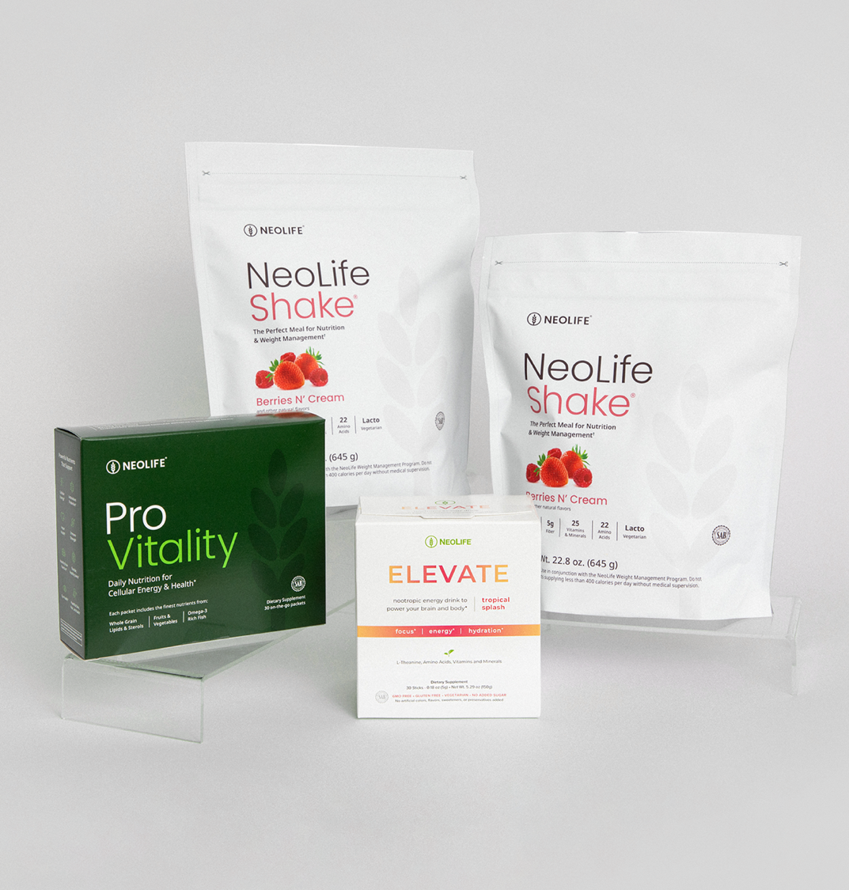

Core3
The Ultimate Daily Trio For Total Wellness
Your all-in-one health solution for total wellness, weight management, and peak performance.*

Slide 16
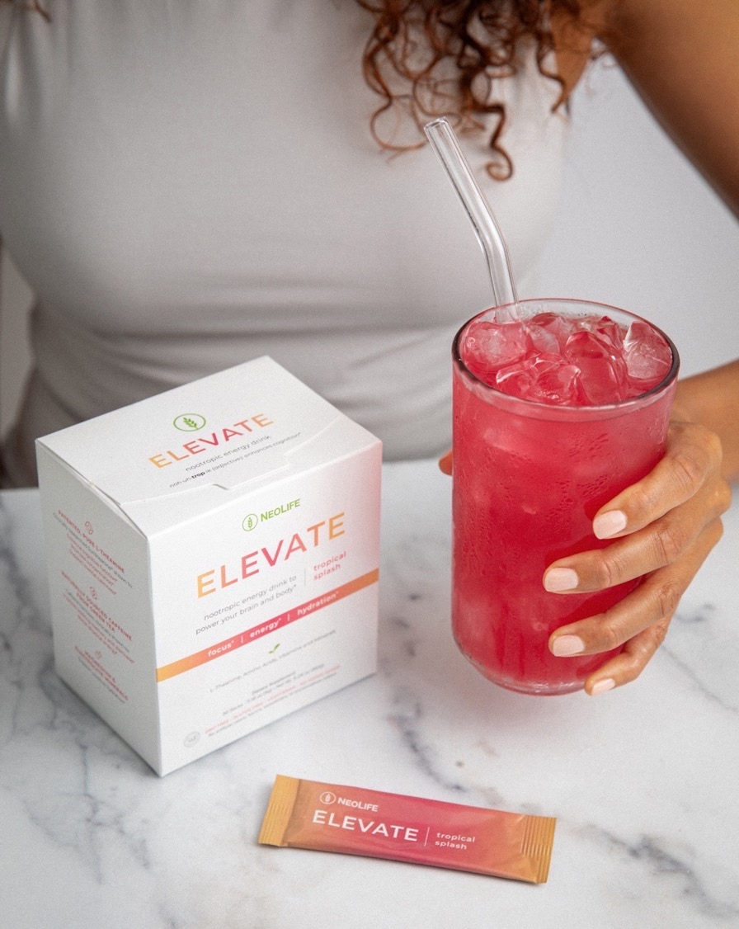



Power Your
Brain and Body
A Delicious Nootropic Energy Drink
Ingredients to boost physical energy, improve mental focus, support balanced mood, and hydration.*
200 mg Pure L-Theanine (clinically supported amount)
120 mg Caffeine from Green Tea
Magnesium & Electrolyte Minerals

Slide 17
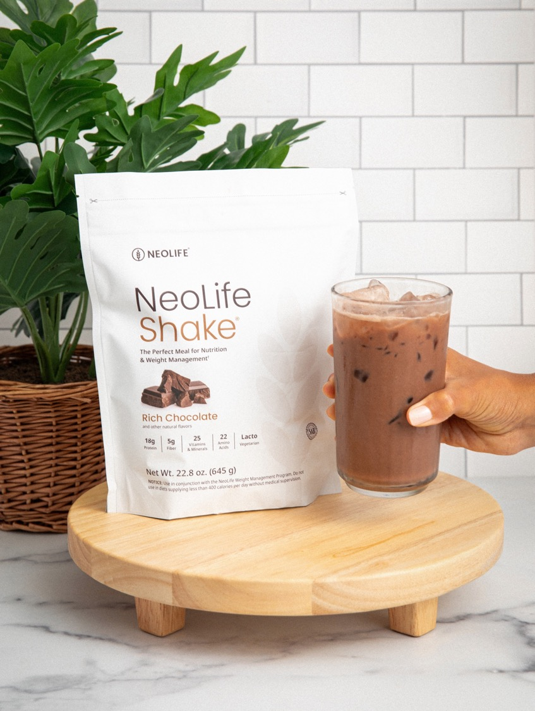
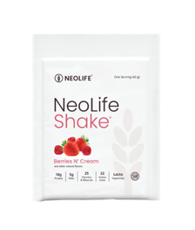
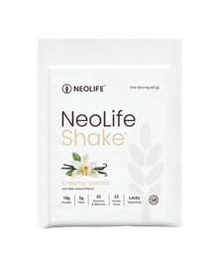
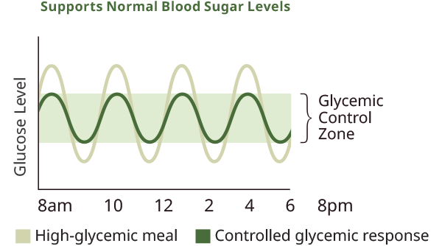
Delicious Daily Nutrition
18g Protein | 25 Vitamins & Minerals
Includes Muscle-Retaining BCAAs
(Branched-Chain Amino Acids)
Glycemic Response Controlled
Minimizes fat storage and promotes fat burning*
Clinically Studied Benefits
Weight Loss†
Cardio Protective*
Lowered Body Mass Index (BMI) †
v
NeoLifeShake also available in Creamy Vanilla and Berries n’ Cream
†Results are not typical. In an open label clinical study, healthy overweight participants lost an average of 5.27 lbs. over a 12-week period when replacing 2 meals per day with NeoLifeShake.

Slide 18
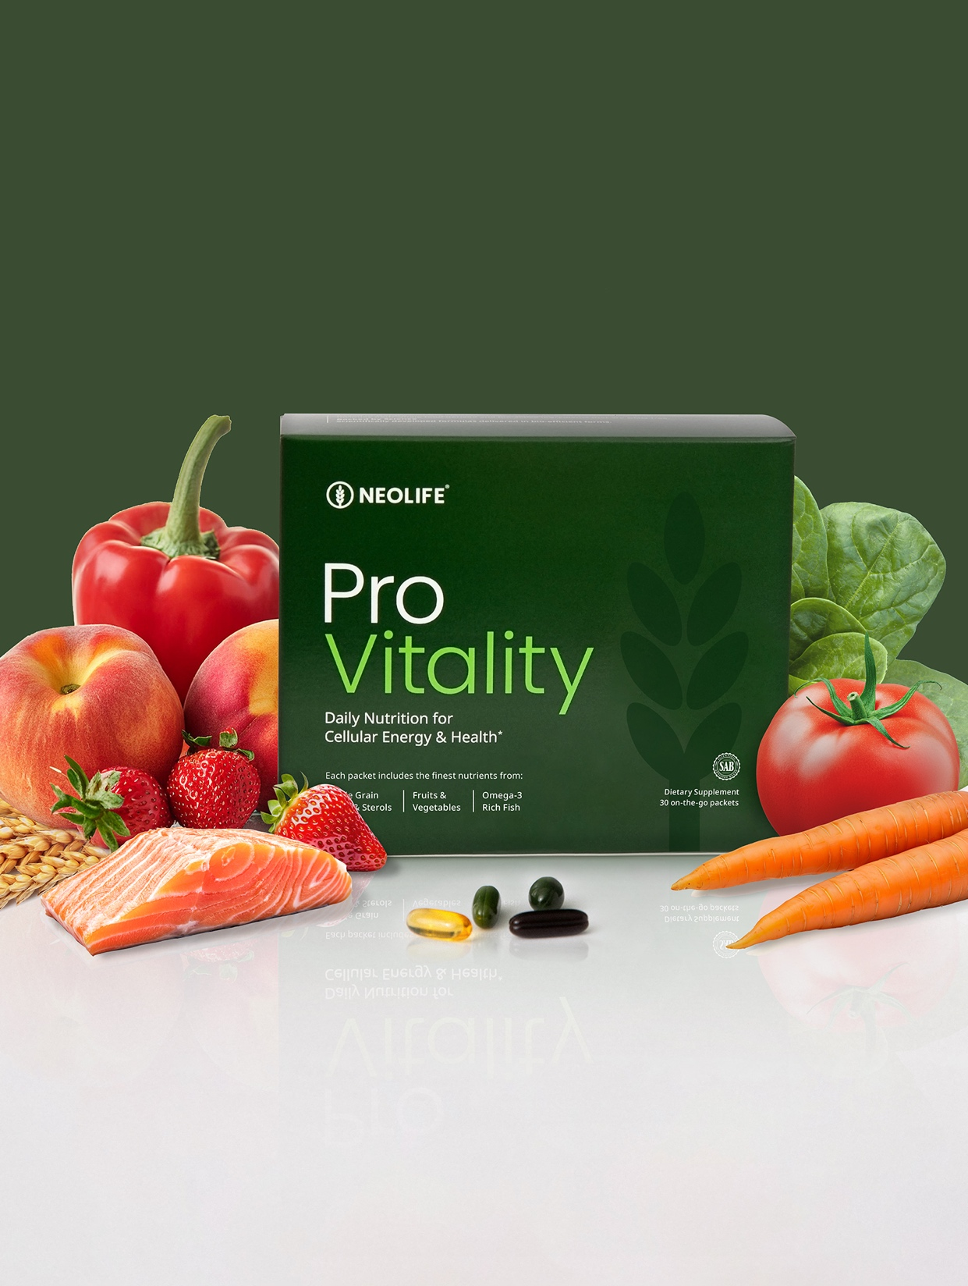








Four Essentials, One Solution
Your Foundation for Cellular Energy and Optimal Health
Abundant
Energy*
Antioxidant
Protection*
Heart
Health*
Immune
Strength*
Brain
Function*
Healthy
Joints*
Clear
Vision*
Youthful Skin,
Hair, and Nails*

Slide 19


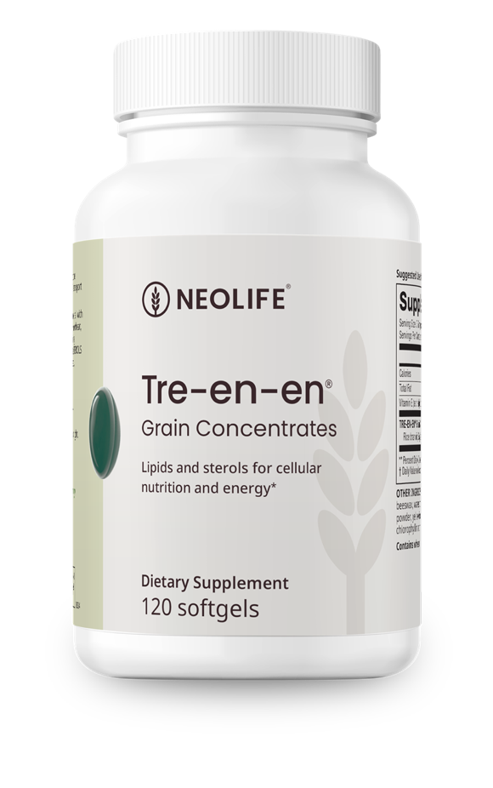


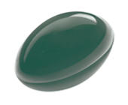
Feed Your Cells
Scientifically Studied Performance for Cellular Membrane Health
When present in the diet, Tre-en-en improved*:
Nutrient utilization efficiency
Overall growth and development
Cardiovascular development
Unhealthy Cell
Nutrients can’t get in,
waste can’t get out
Healthy Cell with Tre-En-En®
Nutrients get in,
waste gets out*

Slide 20

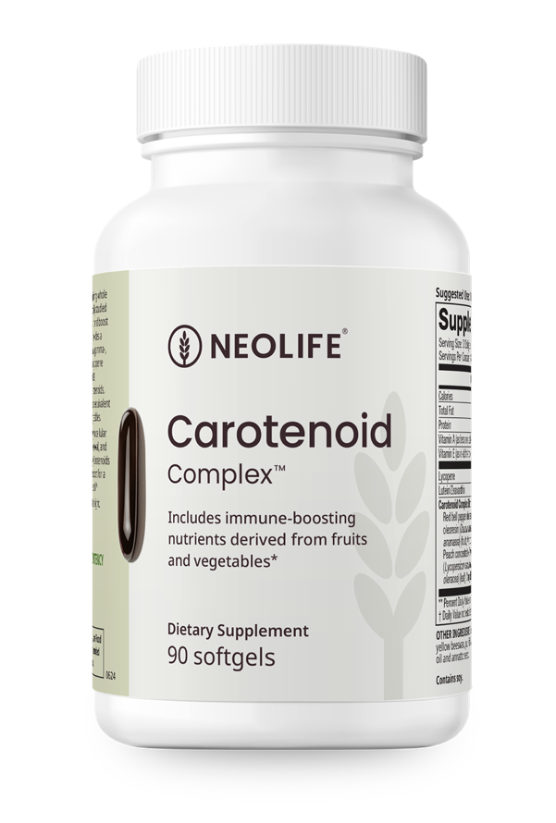
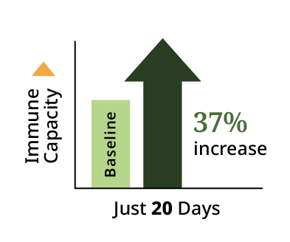
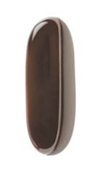
Protect Your Cells
Boost overall immune function* by 37% in just 20 days **
Almost 90% of Americans do not meet vegetable intake recommendations.
**Compared to values measured after a carotenoid depletion period where participants consumed a low-carotene diet low in fruits, vegetables, and their products. Immune function measured as an increase in overall lymphocyte proliferation, a recognized standard for measuring immune competence and capacity to respond to an immune challenge.

Slide 21
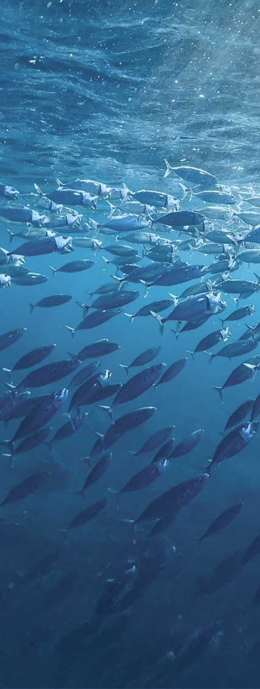
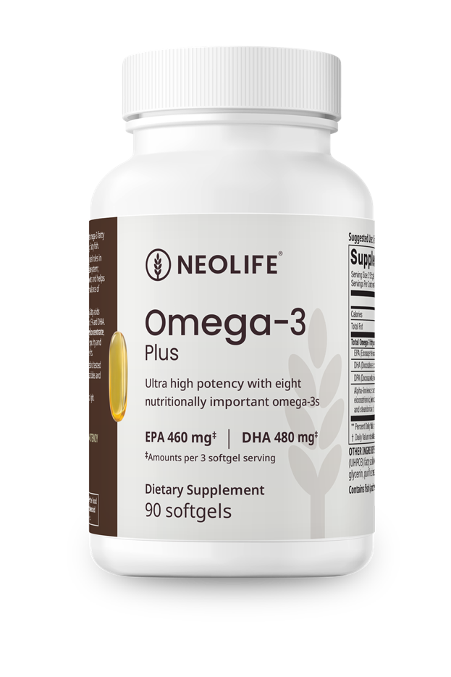
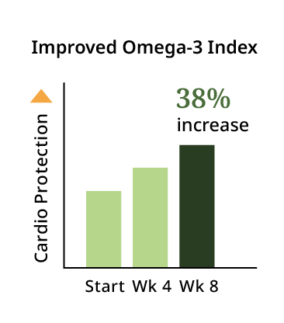
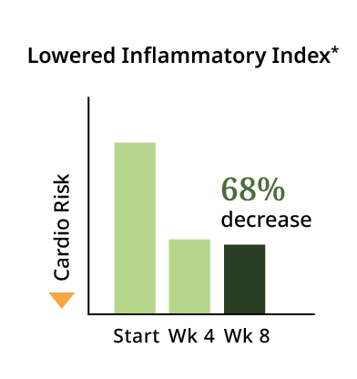

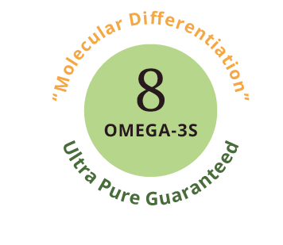

Balance Your Cells
An ultra high potency, 100% wild-caught and certified sustainable fish oil. Complete with standardized amounts of eight nutritionally important omega-3s, with guaranteed purity.
Tested for 200+ contaminants

Slide 22
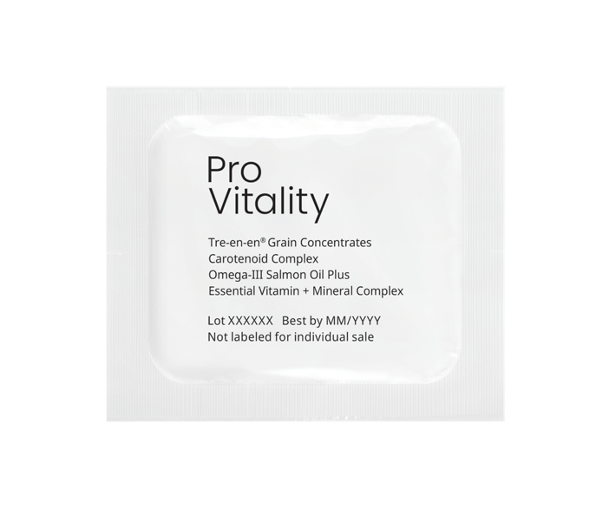
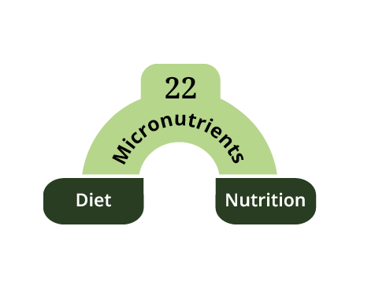
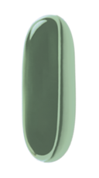
Nourish Your Cells
Essential Vitamin & Mineral Complex provides 22 essential vitamins and minerals to fill the dietary gaps often found in today’s diets:
Vitamins A, B₆, B₁₂, C, D₃, E, K
Thiamin
Riboflavin
Niacin
Folate
Biotin
Pantothenic acid
Iron
Magnesium
Iodine
Zinc
Selenium
Copper
Manganese
Chromium
Molybdenum
“Essential” = The human body can't make them, and our cells & organs can't function normally without them.

Slide 23
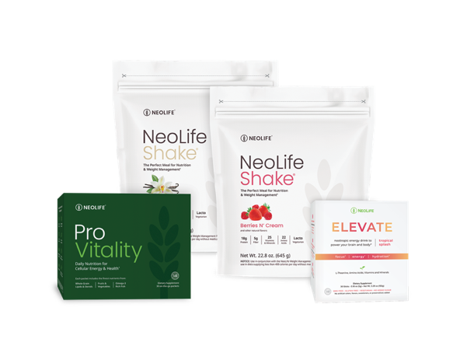
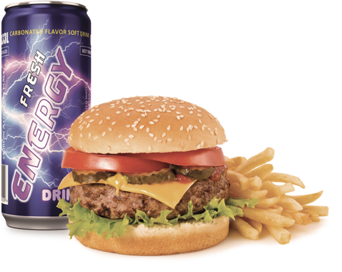
Price Per Day Comparison
For just $6.77 per day, Core3 offers you delicious and essential nutrition. In contrast, spending $13 daily on an unhealthy energy drink and fast food meal provides zero core nutrition and is more expensive.
Core3 Health Solution
Price Per Day: $6.77
Core3 Price: $203.14
Fast Food Meal + Energy Drink
Price Per Day: $13
Average Fast Food Meal: $10
Average Energy Drink: $3
30 Day Cost: $390
VS
Includes:
1 Perfectly Balanced Meal
1 Clean Nootropic Energy Drink
Daily Core Nutrition
Includes:
1 Fast Food Meal
1 Unhealthy Energy Drink
Zero Core Nutrition

Slide 24





Channels of Distribution
Traditional Retail
Manufacturer
Retailer
Customer
Online Retail
Manufacturer
Online Store
Customer
Direct Selling
Manufacturer
Direct Seller
Customer

Slide 25





Our Financial Solution
Superior Products
Not all supplements are created equal and educated consumers want the best. That is why the NeoLife Promise.
Profitability
You can earn income by sharing NeoLife. You are in business for yourself, but never by yourself.
Impact Lives
Work to make a living and live to make a difference.
Ultimate Flexibility
Build your NeoLife business wherever and whenever is best for YOU!

Slide 26

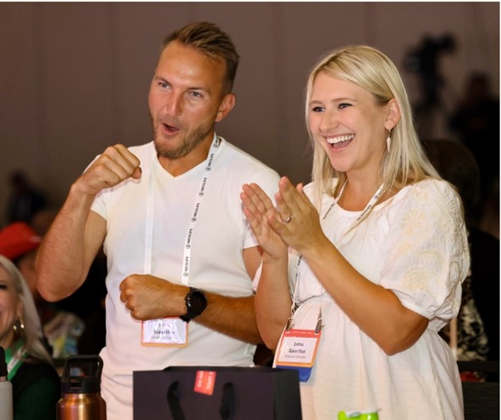
Advantages of the
NeoLife Opportunity
LOW START-UP COST
DEFINE YOUR OWN SUCCESS
WORK WITH A TRUSTWORTHY COMPANY

Slide 27

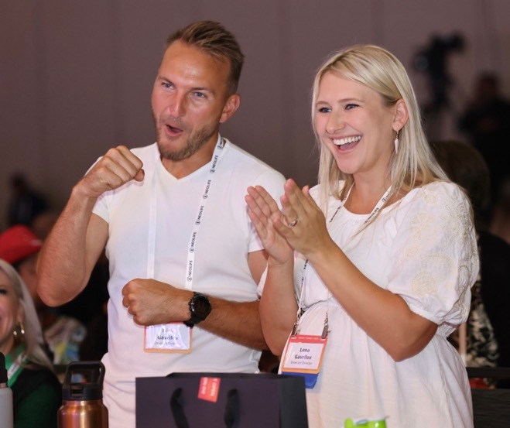
The Way We Live is
Changing…

Slide 28










PAST VACATIONS
JAMAICA | 2024
WAIKIKI BEACH | 2023
PUNTA CANA | 2022
CANCUN | 2021
NAPLES | 2020
LOS CABOS | 2018
*Qualifying for this vacation is an amazing achievement attained by hard work, skill and dedication from our top Promoters. This is not typical. See Statement of Average Gross Compensation at ShopNeoLife.com.
Notes:
Incentive Trips

Slide 29

October 15–18, 2026
Secrets Vallarta Bay Puerto Vallarta
Scan for Incentive Flyer to learn how to earn this trip.
*Qualifying for this vacation is an amazing achievement attained by hard work, skill and dedication from our top Promoters. This is not typical. See Statement of Average Gross Compensation at ShopNeoLife.com.
Notes:
Incentive Trips

Slide 30
















Notes:
Impact Summit

Slide 31
heartfelt closing slide / quote

Slide 32



How To Get Started
MEMBER: FREE
10% Discount
Additional Savings & Perks with NeoShip
Earn FREE products with referrals
PROMOTER: $75 $98
25% Discount
Earn Commissions and Bonuses
Personal Website & Digital Tools
Access to Vacation & Travel Incentives*
*Qualifying for a NeoLife vacation is an amazing achievement attained by hard work, skill and dedication from our top Promoters. This is not typical. See Statement of Average Gross Compensation at ShopNeoLife.com.

Slide 33
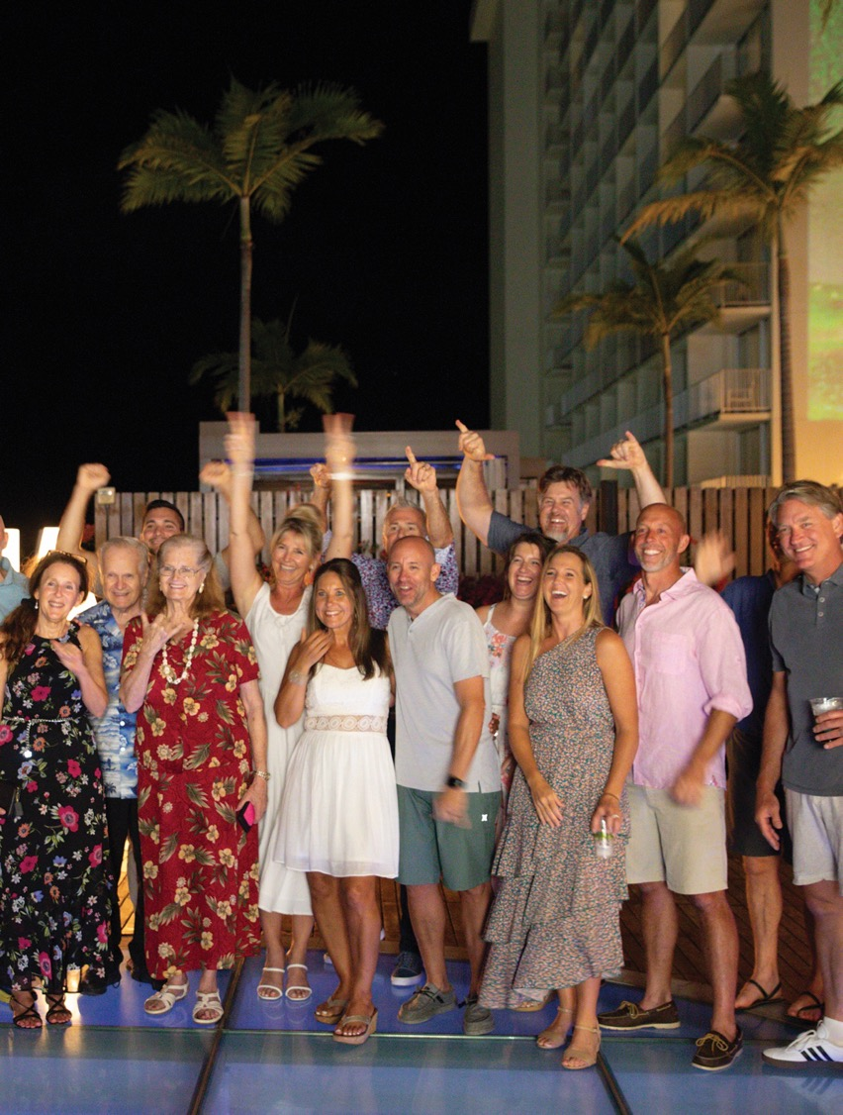
5 Ways to Earn
As you grow your business, you open up access to profits, bonuses, and exclusive incentives:
RETAIL & MEMBER PROFITS
SALES VOLUME BONUS
INCENTIVES: TRIPS & CAR BONUSES
LEADERSHIP DEVELOPMENT BONUS
NETWORK DEVELOPMENT BONUS

Slide 34
Thank you for joining us
to Discover More

