Slide 1


FiberFull Launch

Slide 2



Susan Beck, PhD
LAc, Dipl. OM, CNS
NeoLife Chief Science Officer
Head of the Scientific Advisory Board

Slide 3
YOUR NEW FAVORITE “F” WORD

Slide 4

FIBER
=
SUPERFOOD

Slide 5
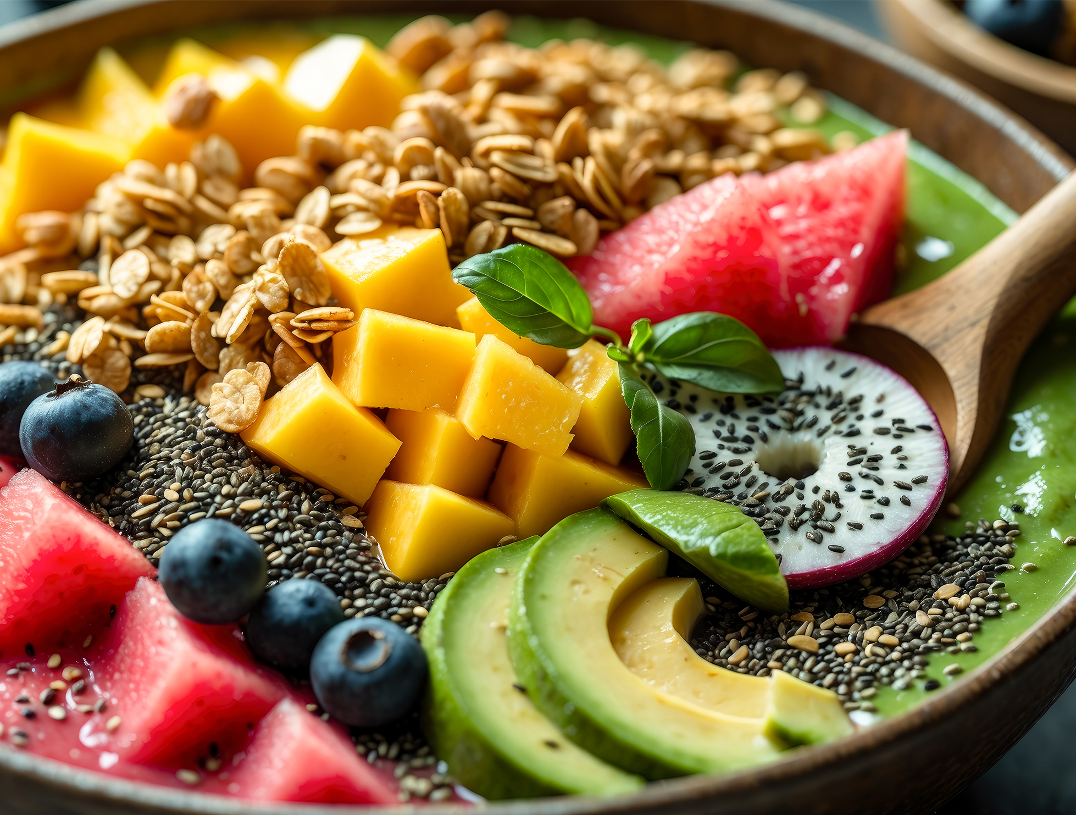
Fiber to the Rescue!
Supports Healthy Heart
Helps keep blood pressure in the normal range
Helps maintain normal cholesterol levels

Slide 6
Fiber to the Rescue!
Supports healthy blood sugar levels
Improves our gut microbiome
Helps support healthy weight maintenance

Slide 7


Most Americans & Canadians Do Not Get Enough Fiber
Women should get 25 grams per day
Men should get 38 grams per day

Slide 8

9.0%
Over 90% of Americans & Canadians Do Not Get Enough Fiber
91.0%

Slide 9

Surveys Show Americans Are Confused About Fiber
I bought a cereal that says “whole grain” — will that give me enough fiber?

Slide 10

Our Digestive Systems Created to Eat Fiber
Our ancient diets contain copious amounts of fiber
Processed or ultraprocessed foods have been created only recently — the last 100 years

Slide 11
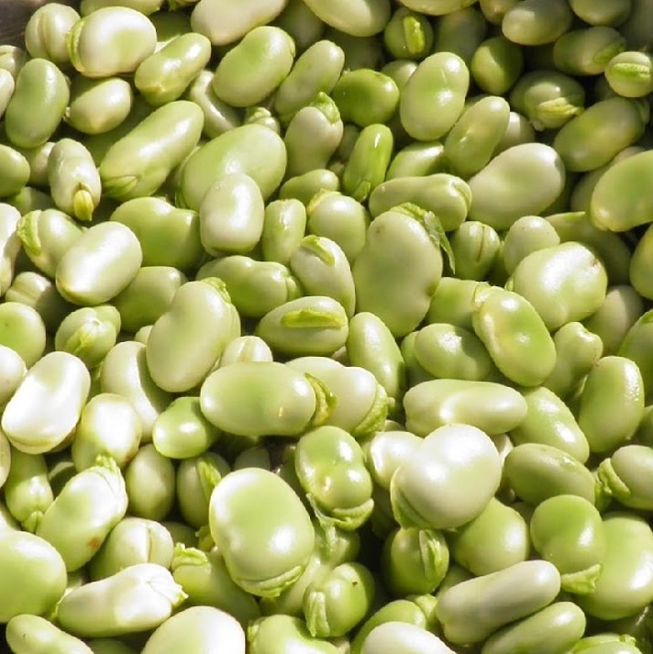
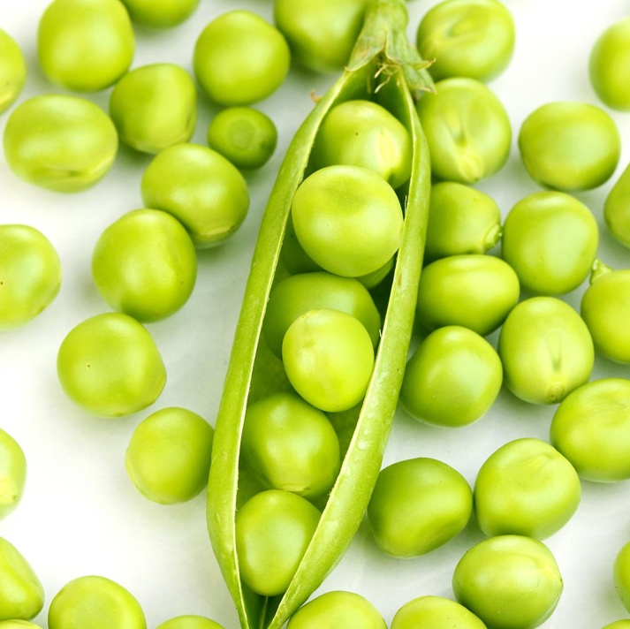
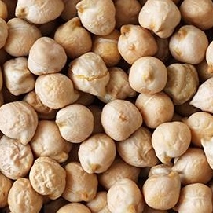
What Is Fiber?
Fiber is a fundamental part of a healthy diet if people are eating whole grains, legumes, fruits, and vegetables.
HOWEVER:
More people are eating processed foods which strip away fiber.

Slide 12
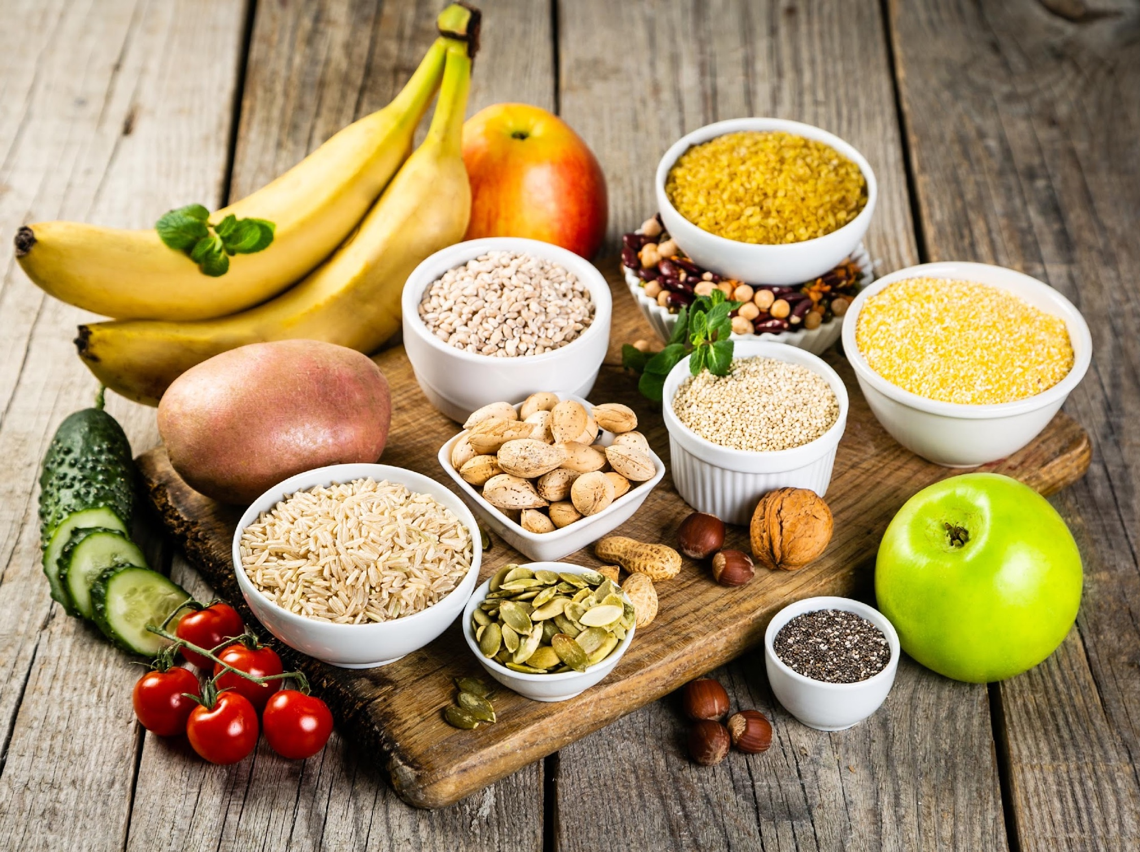
Insoluble &
Soluble fiber
We need both types of fiber in our diet
Insoluble – cannot dissolve in water
Soluble – can dissolve in water

Slide 13

Insoluble fiber
Draws fluid into the intestines and adds bulk to stool, helps prevents constipation
Has the ability to bind with toxins and other harmful chemicals that we are exposed to or are in our food

Slide 14
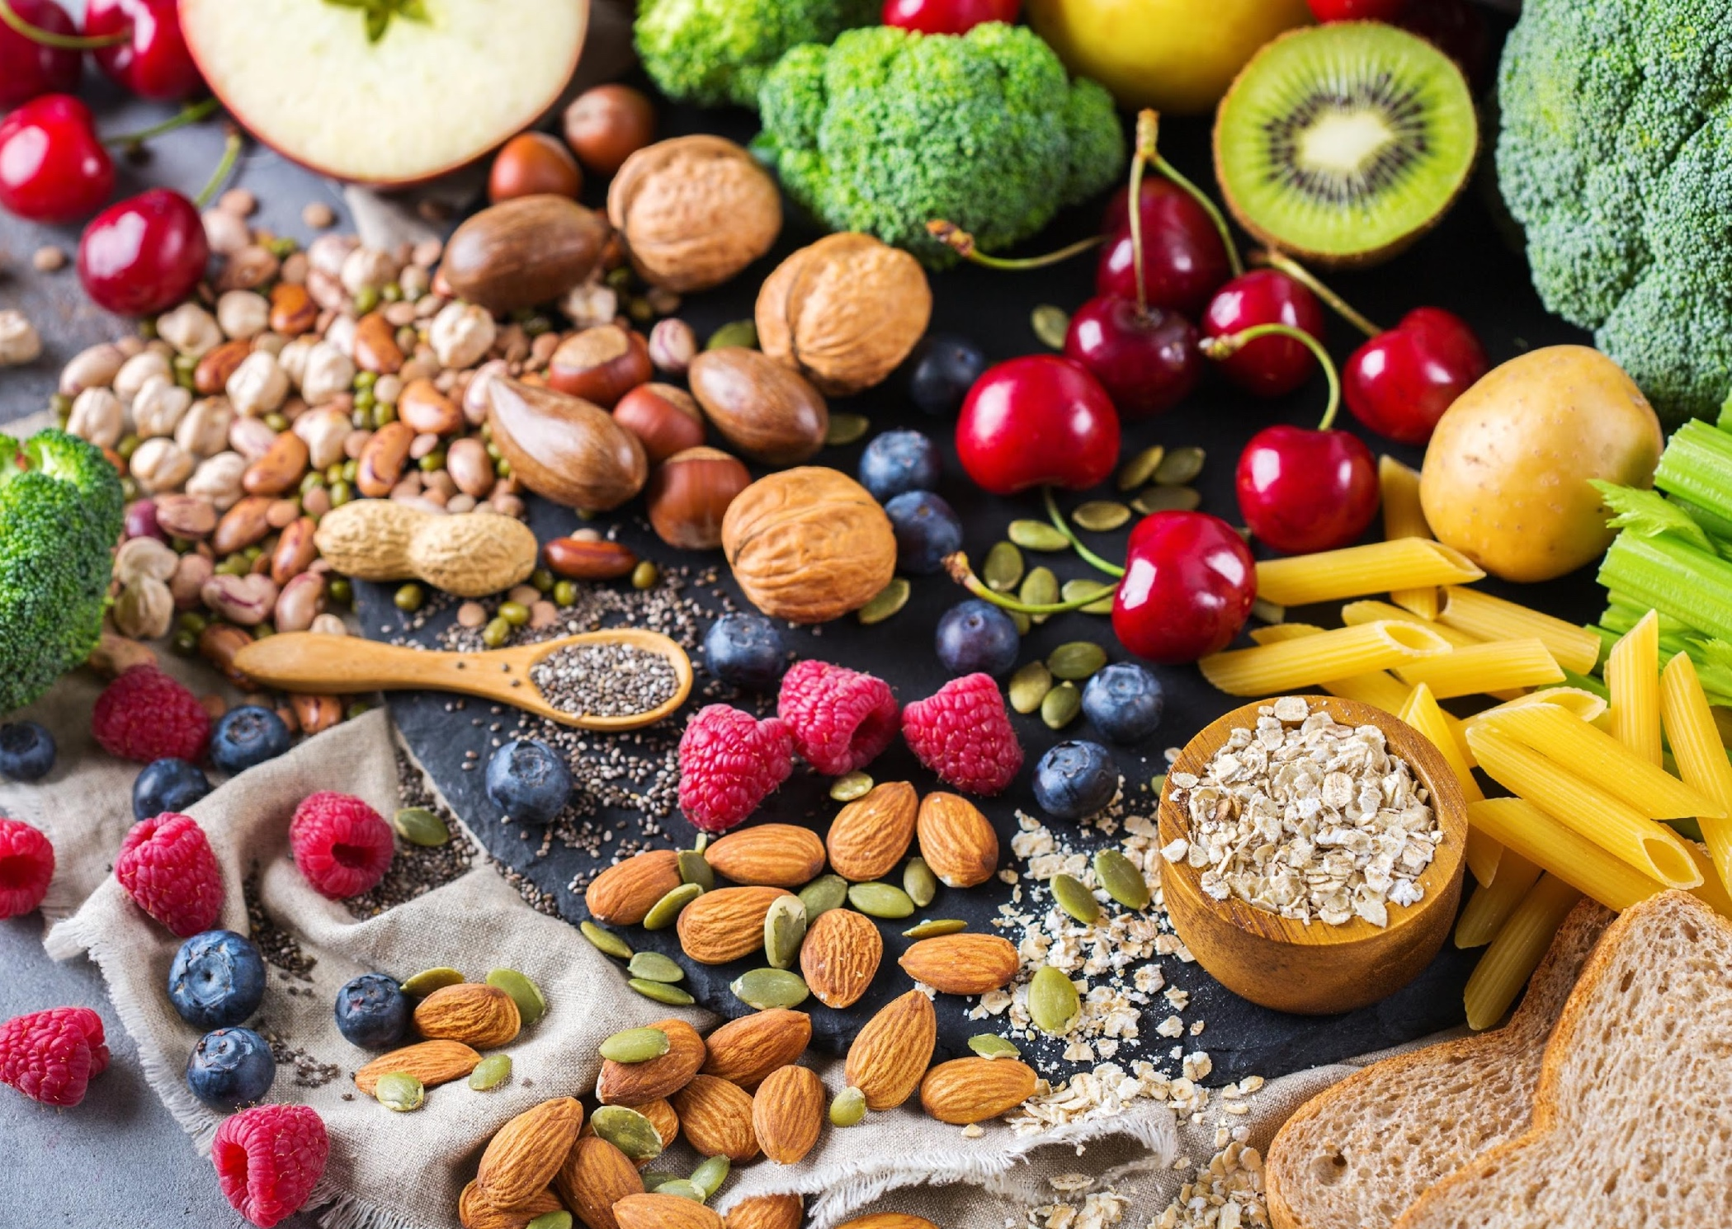
Soluble fiber
Dissolves in water to form a gel-like material
Slows down how quickly foods are digested so we stay full longer

Slide 15
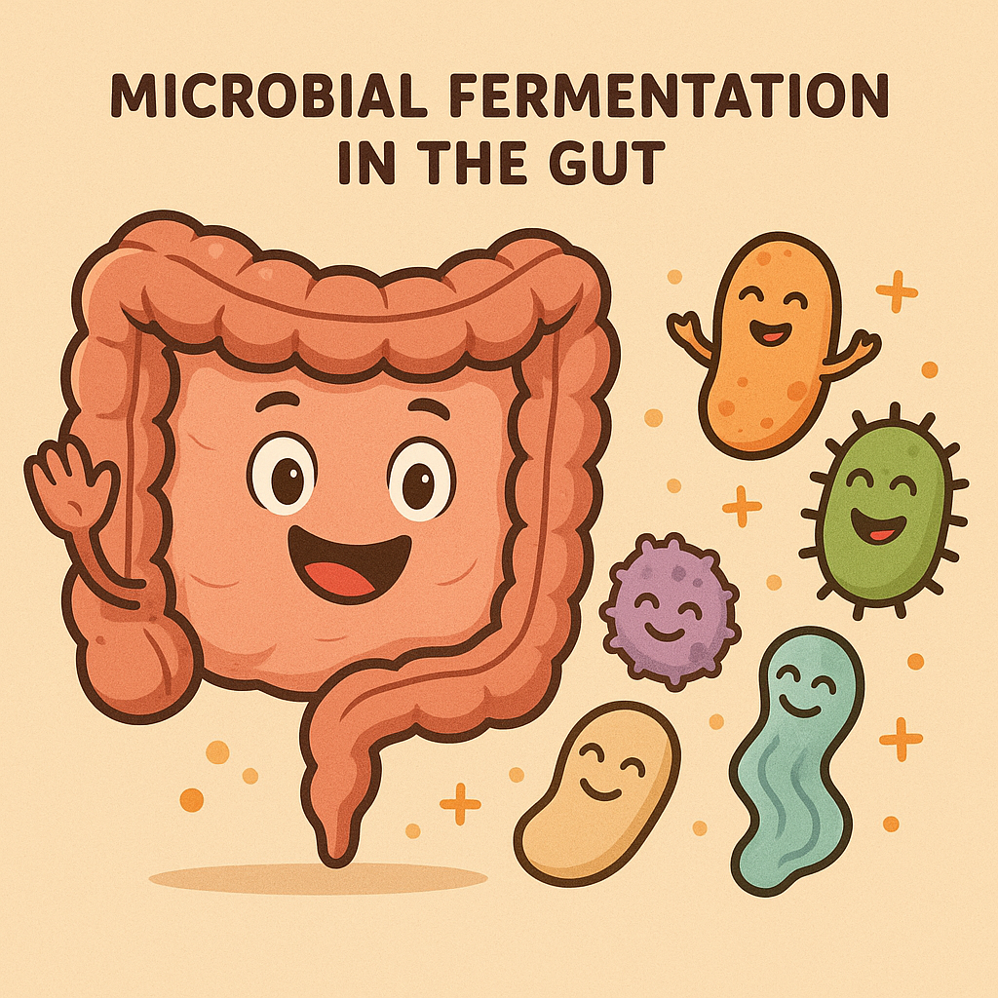
Soluble fiber
Fermented by beneficial microorganisms in our gut
Acts as a prebiotic or a ”good food” for microorganisms in our gut

Slide 16
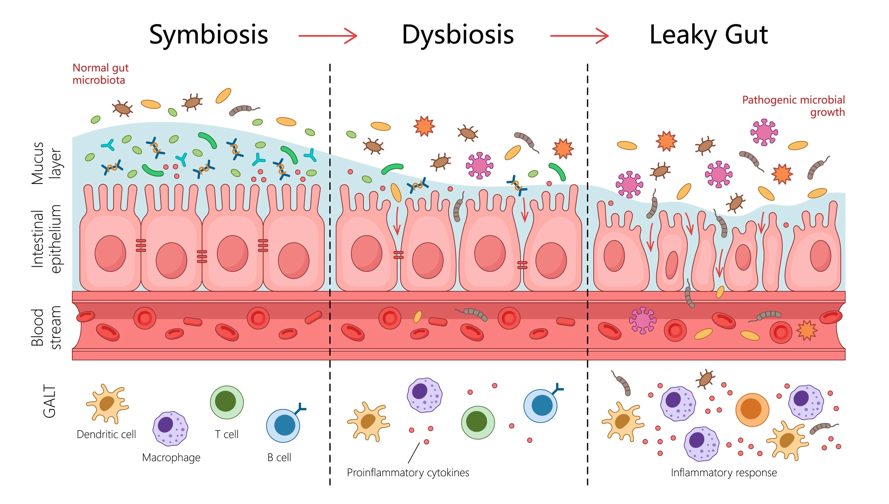
Soluble fiber
Critical for a healthy gut barrier by promoting the growth of beneficial gut microorganisms

Slide 17
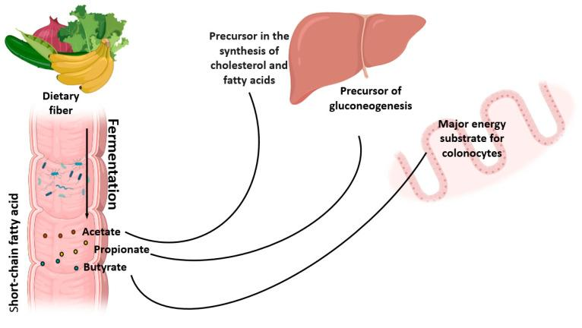
Soluble fiber
Microbial fermentation in the gut causes soluble fiber to break down into short-chain fatty acids (SCFA)
Ioniță-Mîndrican, et al., 2022.

Slide 18
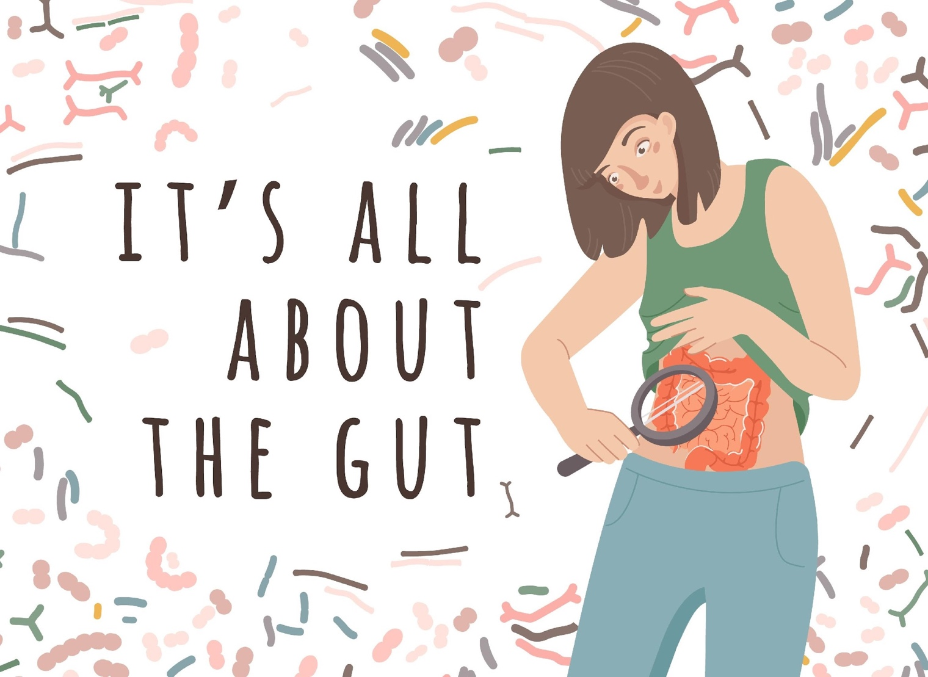
Short Chain Fatty Acids
Used by the cells in our intestines as energy
Supports a healthy inflammatory response
Produces protective mucus in the gut

Slide 19

Fiber Helps with Healthy Weight Maintenance
The net calories absorbed from fiber-rich foods are much lower than foods that do not contain fiber.
Fiber slows down the rate in which food is absorbed, making us feel full longer.

Slide 20

Fiber Helps Maintain Healthy Blood Pressure
A Recent Global Study Researchers concluded:
Dietary fiber is a cost-effective way to help people maintain healthy blood pressure levels.

Slide 21
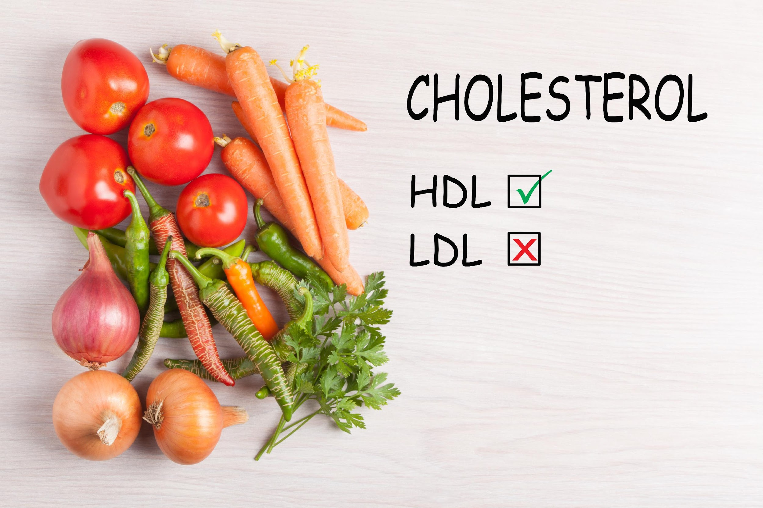
Fiber Helps Maintain Healthy Cholesterol Levels
Soluble dietary fiber:
Binds to cholesterol in the small intestine
Produces SCFAsa creates a healthy microbiome, which in turn helps maintain healthy and normal cholesterol levels

Slide 22

Fiber Helps Support Healthy Blood Sugar Levels
The body does not absorb and break down fiber
Fiber does not cause a spike in blood sugar like other carbohydrates

Slide 23

Fiber Is A Superfood
Supports healthy weight maintenance
Improves our gut microbiome health
Helps maintain healthy blood sugar levels
Helps maintain normal blood pressure levels
Helps keeps cholesterol levels within the normal range
Helps eliminate toxins from the body

Slide 24
9.0%
Over 90% of Americans & Canadians Do Not Get Enough Fiber
91.0%

Slide 25
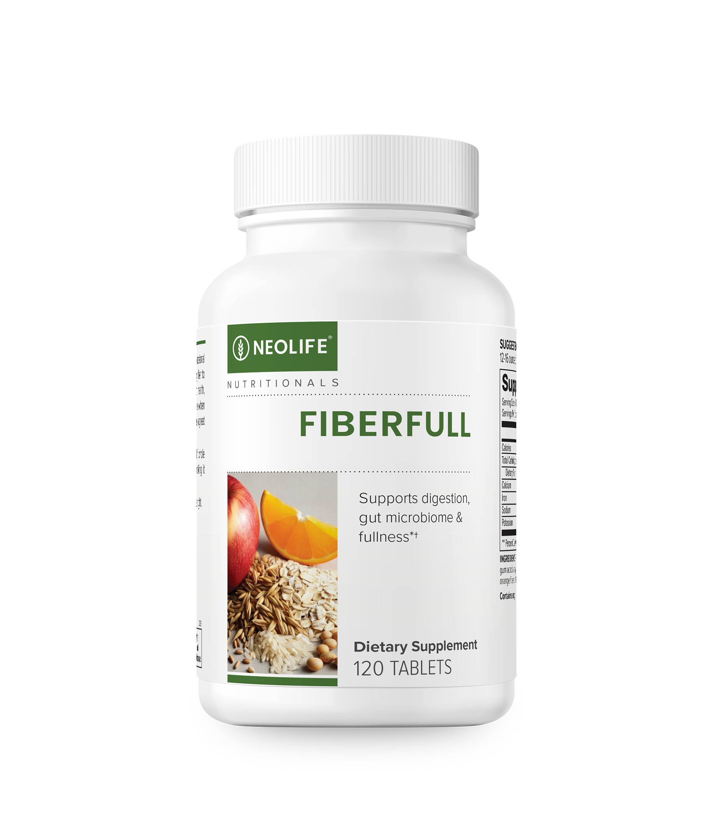
NeoLife FiberFull
FiberFull helps keep us regular*
FiberFull helps us feel fuller when taken prior to a meal†
FiberFull acts as a prebiotic for our gut microbiome*
† When taken with a large glass of water before a meal

Slide 26
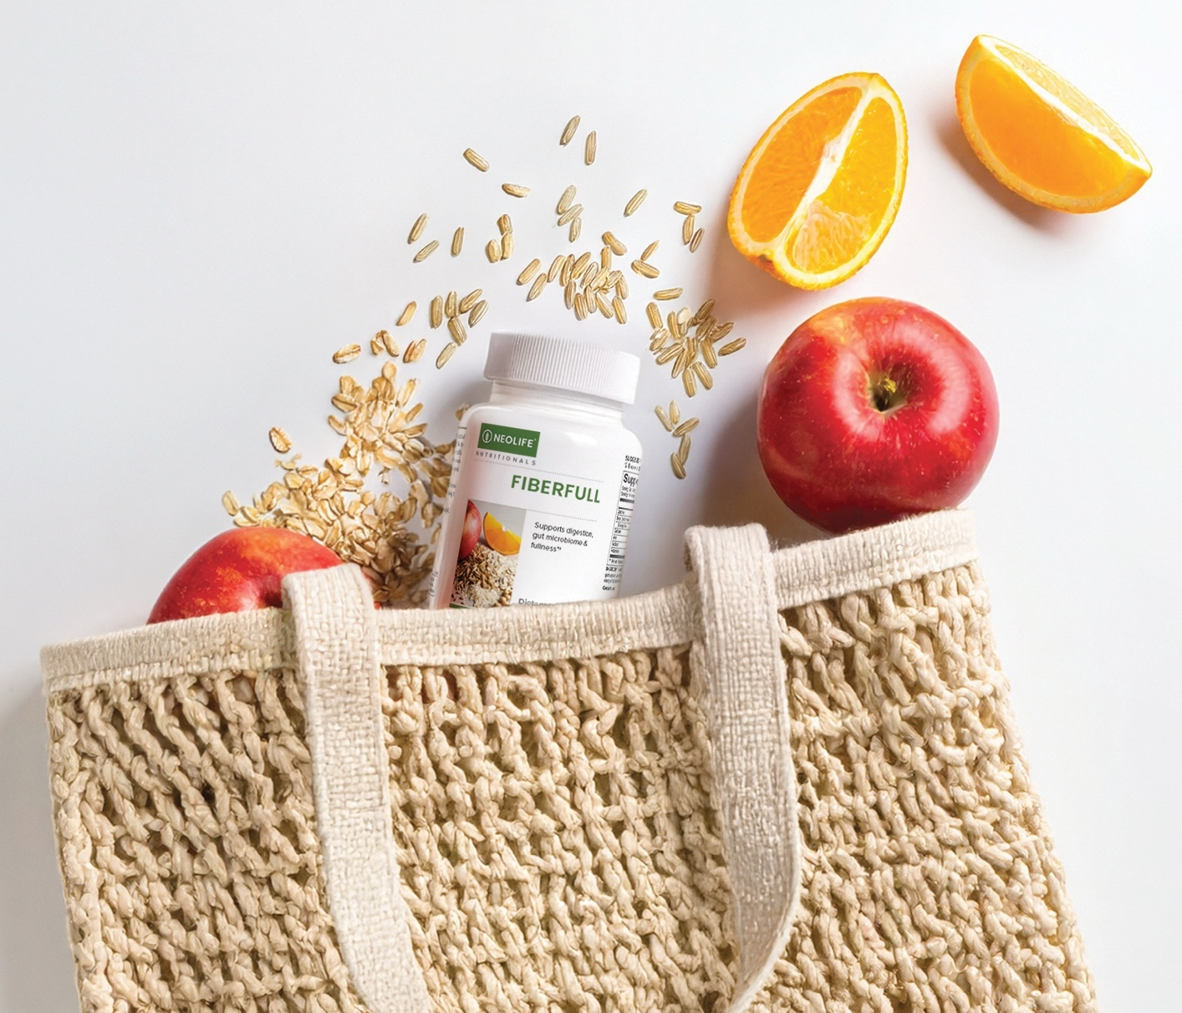
NeoLife FiberFull
Whole food-derived fiber - rice fiber, oat fiber, barley flour, gum arabic (from the Acacia tree), soy fiber, apple pectin and orange fiber
GMO Free, Vegan, Dairy Free
Every Batch Tested For Purity & Potency

Slide 27
NeoLife FiberFull
Designed for daily life — just grab & go
2 grams fiber per 4 tablets
Contains both insoluble and soluble fiber
Whole food-derived sources of fiber

Slide 28
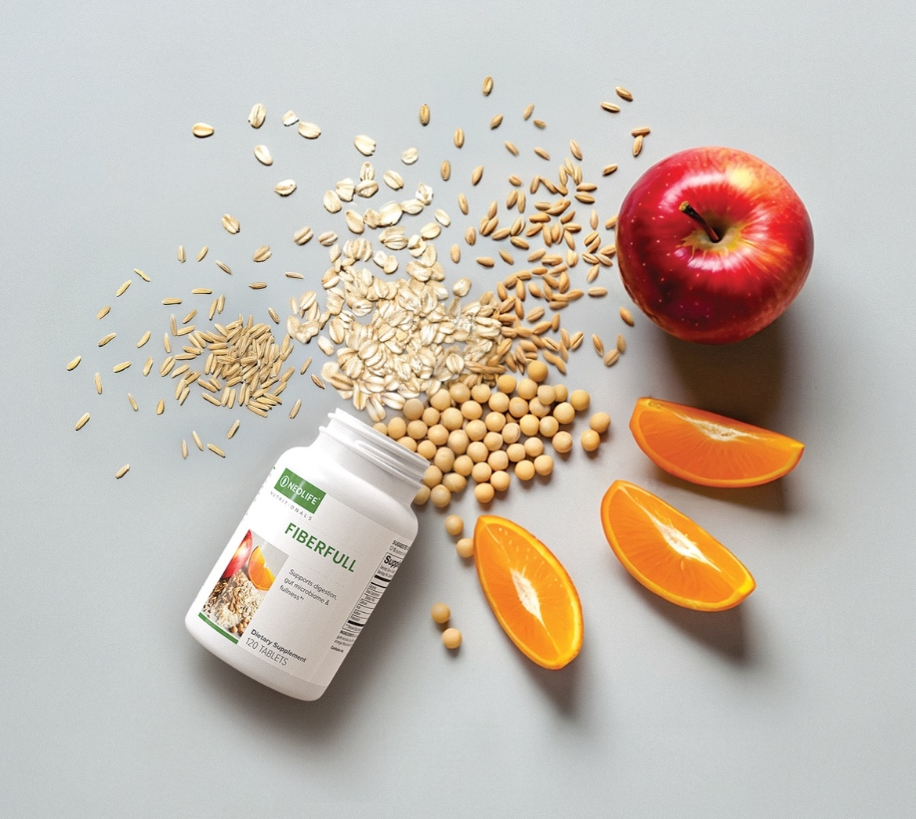
NeoLife FiberFull
Most fiber supplements contain only one type of fiber instead of mimicking the different types of fiber we get from food in our diet.

Slide 29
Your New Favorite Travel Companion
Take them anywhere – restaurants or traveling
When traveling FiberFull will:
Help you stay regular*
Help protect your gut* by providing prebiotics for your gut microbiome

Slide 30
Your New Favorite “F” Word
A global best-selling product with impactful testimonials

Slide 31

NeoLife FiberFull
FiberFull tablets — your new protective travel companion
Easiest way to take fiber — take them with you everywhere
Easiest way to stay regular, feel more full†, and protect your gut*
Easiest way to give yourself a fiber boost right before meals
† When taken with a large glass of water before a meal

Slide 32
Thank You!

