Slide 1

ATTENTION
ALL PROMOTERS
FOR
3 MONTHS
ONLY
Earn an EXTRA 20% on the first order of new starts!
Incentive Period:
January – March 2026

Slide 2

First Order Bonus
Incentive Period:
January – March 2026
How It Works
1. Personally sponsor a new Member or Promoter with 100 PV or more in their first order
2. Earn an extra bonus of 20% on the PV of their First Order
Your New Start’s
Your
PV of First Order x 20% = First Order Bonus
• You must be an Active Promoter with a minimum of 100 Personal PV in the sales month to earn a First Order Bonus
• Earn up to a $200 First Order Bonus per qualifying order
• Regular compensation plan commissions will be calculated at 90% of BV on qualifying orders
• Promoter Upgrades from Member are not eligible for First Order Bonus

Slide 3
First Order Bonus
You can earn up to a $200 First Order Bonus per new start.
YOUR PERSONAL NEW START’S
FIRST ORDER PV AMOUNT
YOUR FIRST ORDER BONUS
< 100 PV
No Bonus
100 PV
$20 + Compensation Plan Earnings
250 PV
$50 + Compensation Plan Earnings
500 PV
$100 + Compensation Plan Earnings
1,000 PV
$200 + Compensation Plan Earnings
> 1,000 PV
$200 + Compensation Plan Earnings

Slide 4
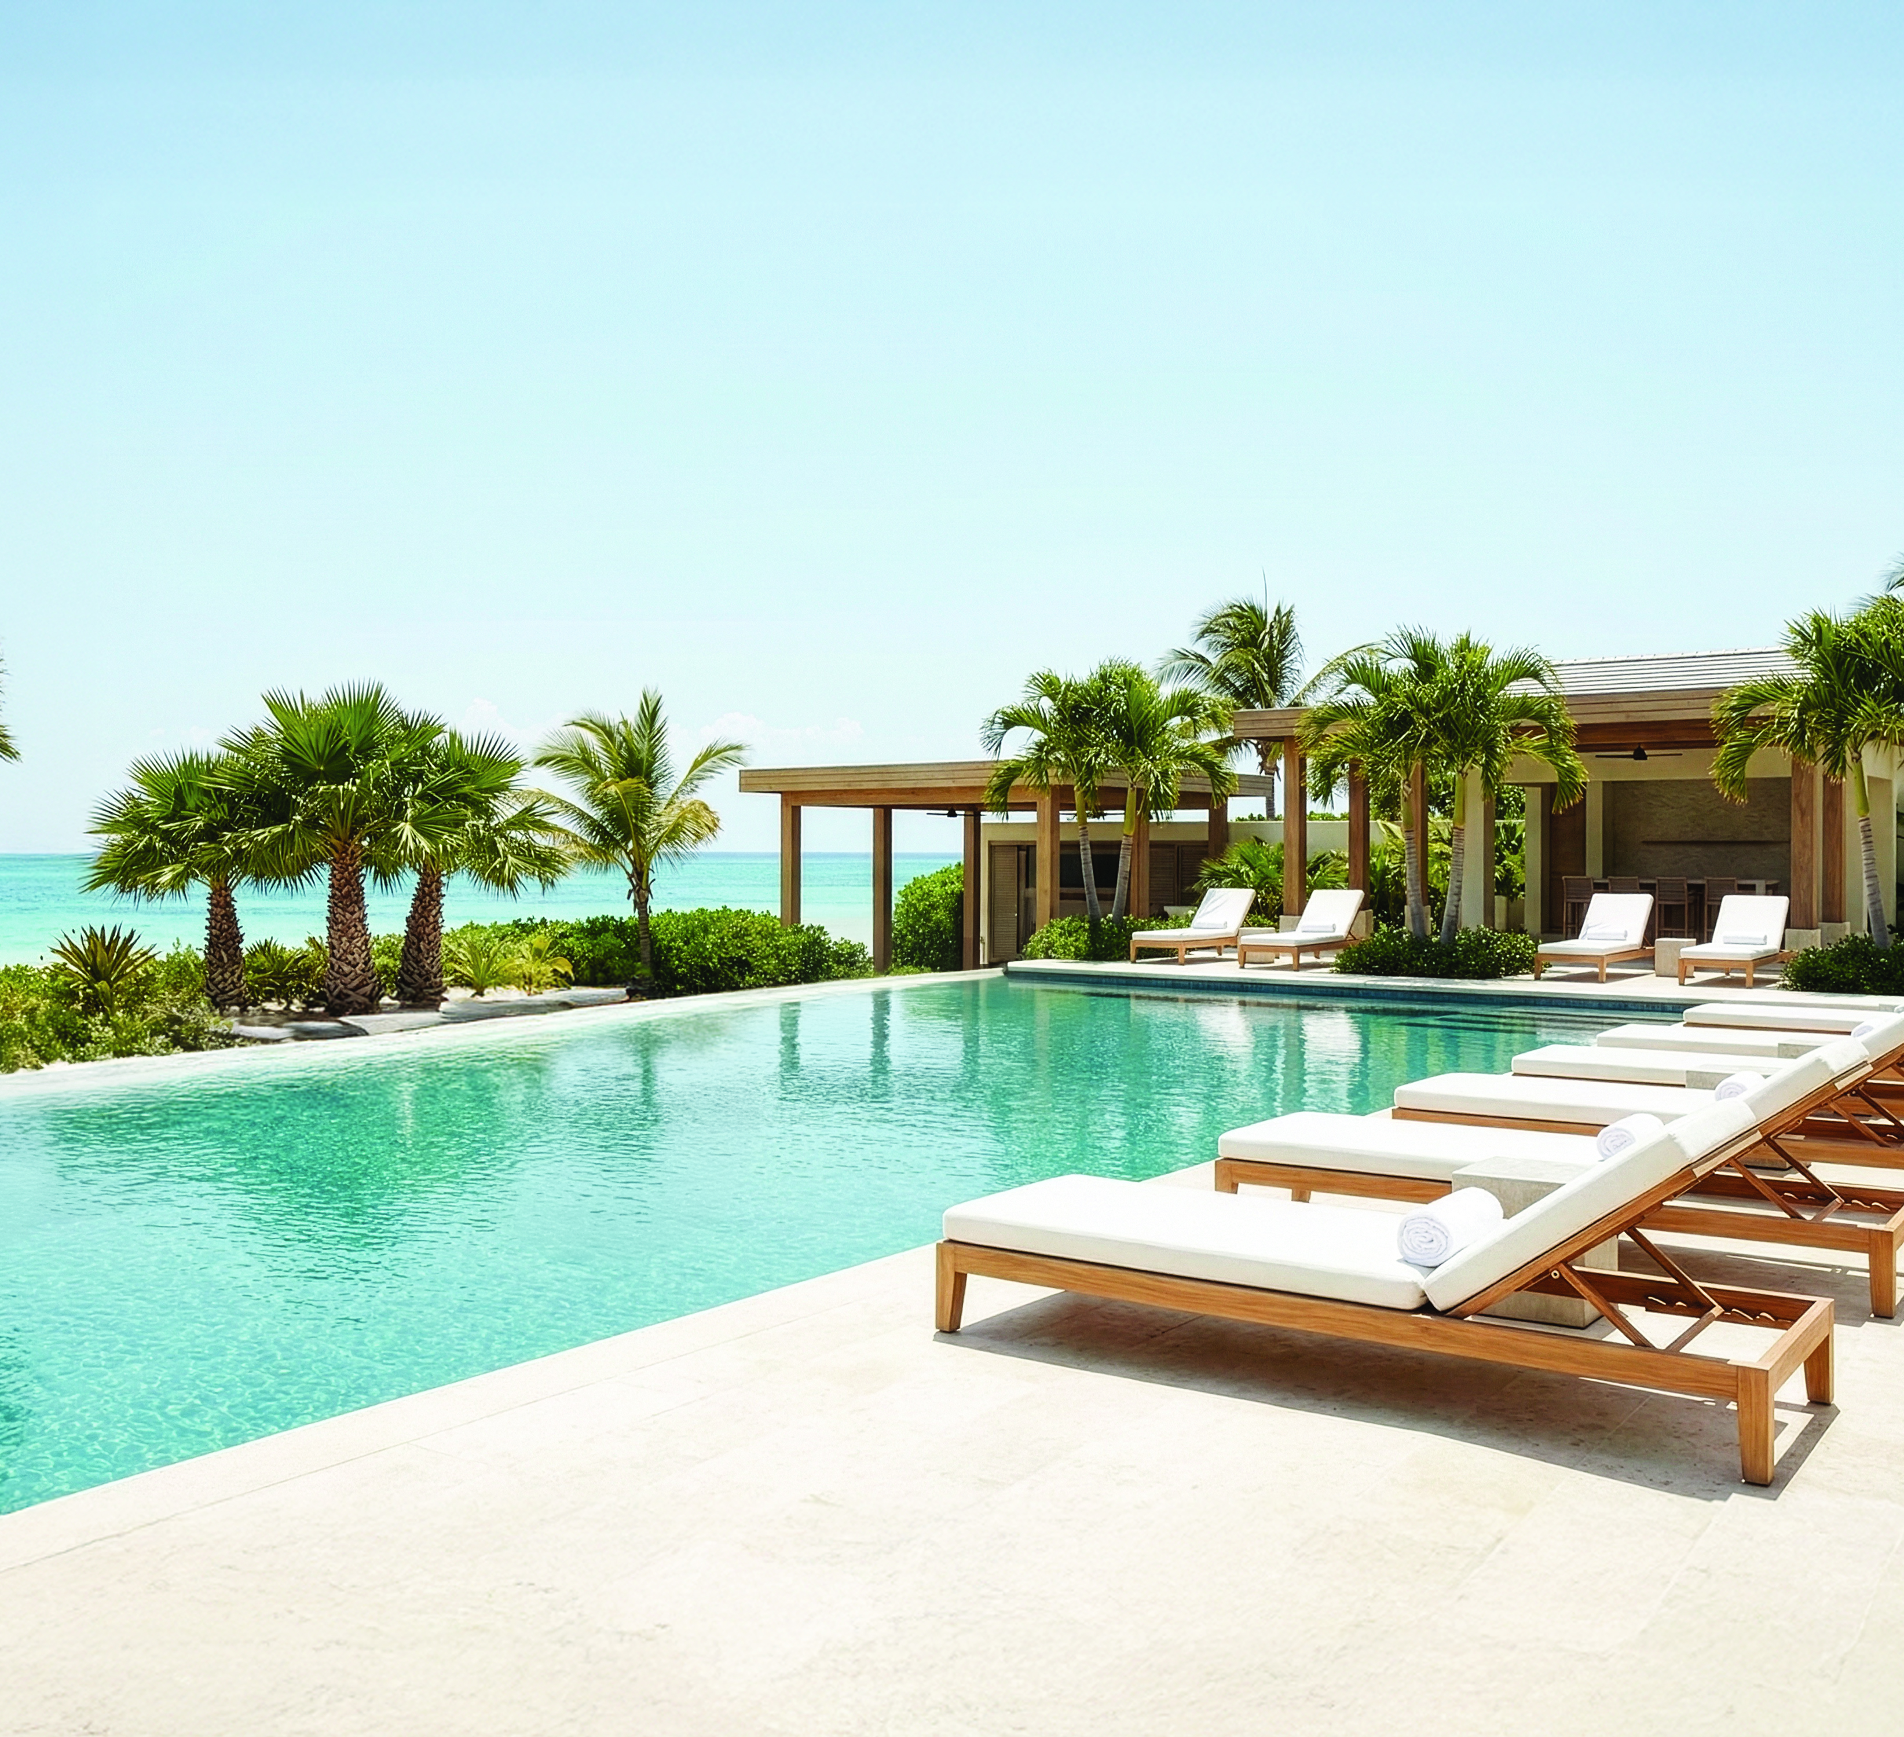


2026
USA / CANADA

Slide 5
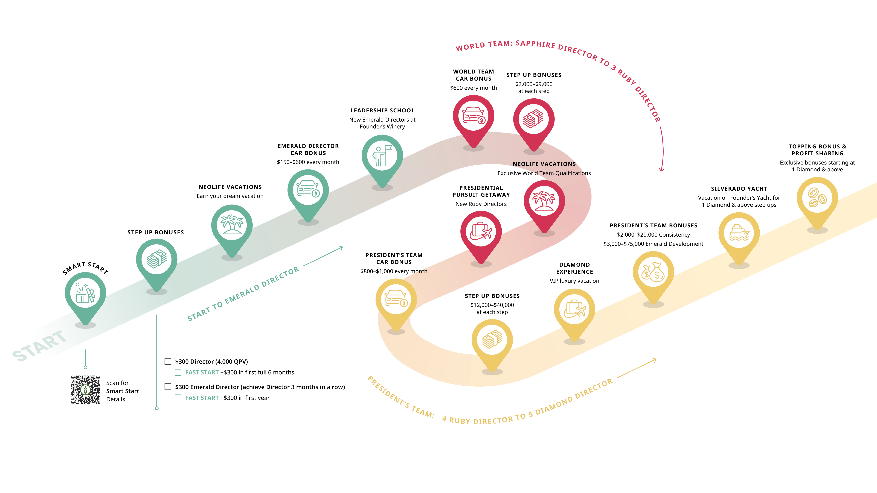
Success has it’s perks
Enjoy exclusive trips and bonuses as you grow and achieve your goals.

Slide 6
NEW PRESIDENT’S TEAM
Step Up Bonuses
NEW WORLD TEAM
Bonuses earned as you step up to higher ranks.
Bigger earnings beginning in January 2026.
NEW DIRECTORS

Slide 7


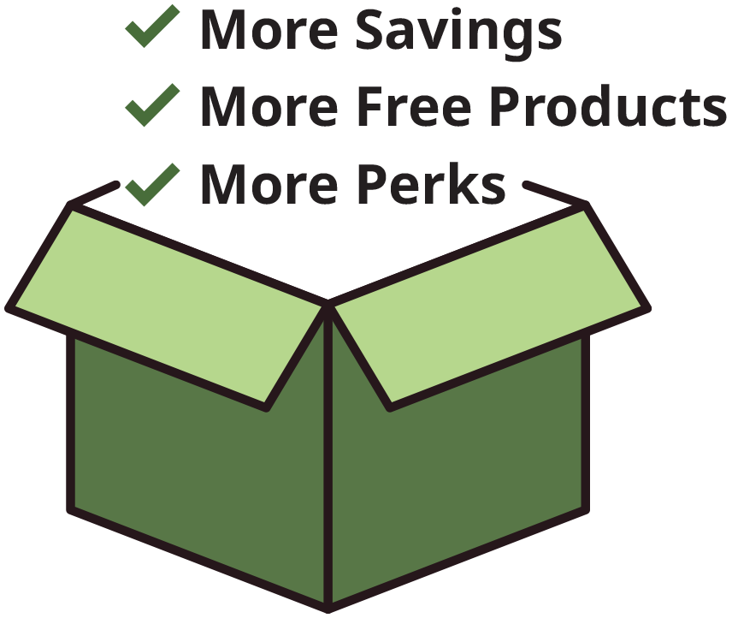
Limited-Time Offer for New Promoters!
Exclusively available on beta.neolife.com
You get one shot during your First Full Month to place a single order of 250 PV or more and unlock massive rewards. Don’t miss it.
The Larger the Order, The Greater the Rewards
The Larger the Order, The Greater the Rewards

Slide 8
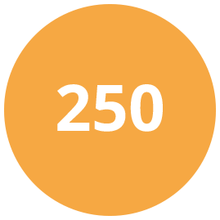
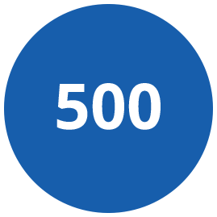
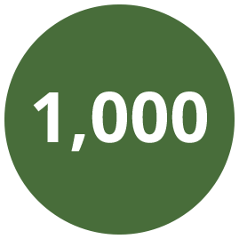
Place a Single Order of 250+ PV and Get:
Extra 3%
Smart Start Discount*
50 PV FREE
Product Bundle
Place a Single Order of 500+ PV and Get:
Extra 5%
Smart Start Discount*
100 PV FREE
Product Bundle
Place a Single Order of 1,000+ PV and Get:
Extra 10%
Smart Start Discount*
150 PV FREE
Product Bundle
1 FREE
Impact Summit Ticket†
*Smart Start Discount is calculated as a percentage of total BV of your order. Instead of receiving this amount in your
monthly bonus check, you’ll receive it as an upfront discount on your qualifying Smart Start order.
250-499 PV = 3%, 500-599 PV = 5%, 1,000-1,999 PV = 10% discount, 2,000-3,999 PV = 15% discount, 4,000+ PV = 20% discount
†Free Impact Summit tickets are non transferrable.

Slide 9

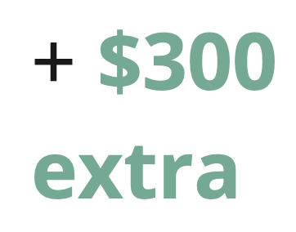
Step Up Bonuses
NEW DIRECTORS (4,000 QPV)
1. Achieve Qualified Director for the first time
$300
2. Complete a second month of Qualified Director
within the next 6 months
Double your bonus to $600 total if you step up to Director within your first full 6 months

Slide 10
Step Up Bonuses
NEW EMERALD DIRECTORS
Step up to Emerald Director for the first time
(by achieving Qualified Director 3 months in a row)
$300
Double your bonus to $600 total if you step up to Emerald Director within your first full year

Slide 11
Step Up Bonuses
NEW WORLD TEAM
Step up to & maintain for 3 consecutive months
3 Ruby Director $9,000
2 Ruby Director $7,000
1 Ruby Director $5,000
Sapphire Director $2,000

Slide 12
Step Up Bonuses
NEW PRESIDENT’S TEAM
Step up to & maintain for 3 consecutive months
5 Diamond Director $40,000
4 Diamond Director $35,000
3 Diamond Director $30,000
2 Diamond Director $25,000
1 Diamond Director $20,000
5 Ruby Director $16,000
4 Ruby Director $12,000

Slide 13


Every Promoter Can Earn
4 Days & 3 Nights All-Inclusive
in Puerto Vallarta
October 15-18, 2026
Secrets Vallarta Bay Puerto Vallarta
Every Promoter has the chance to earn their spot and escape to an all-inclusive resort in Mexico!
Incentive Period: July 2025– June 2026

Slide 14
3 Ways to Earn Your Invite
Top 30 Promoters
World Team & President’s Team Step Up
World Team / President’s Team Consistency and Director+ Development
1
2
3
PLUS #1 President’s Team & #1 World Team earn 100% paid travel and accommodation.*
*#1 President's Team and #1 World Team announced at Impact Summit.

Slide 15


Slide 16
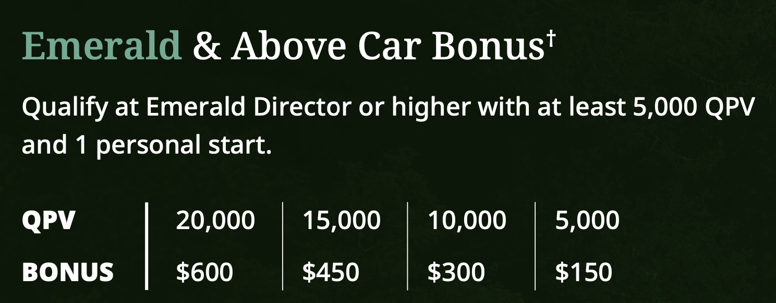

Slide 17
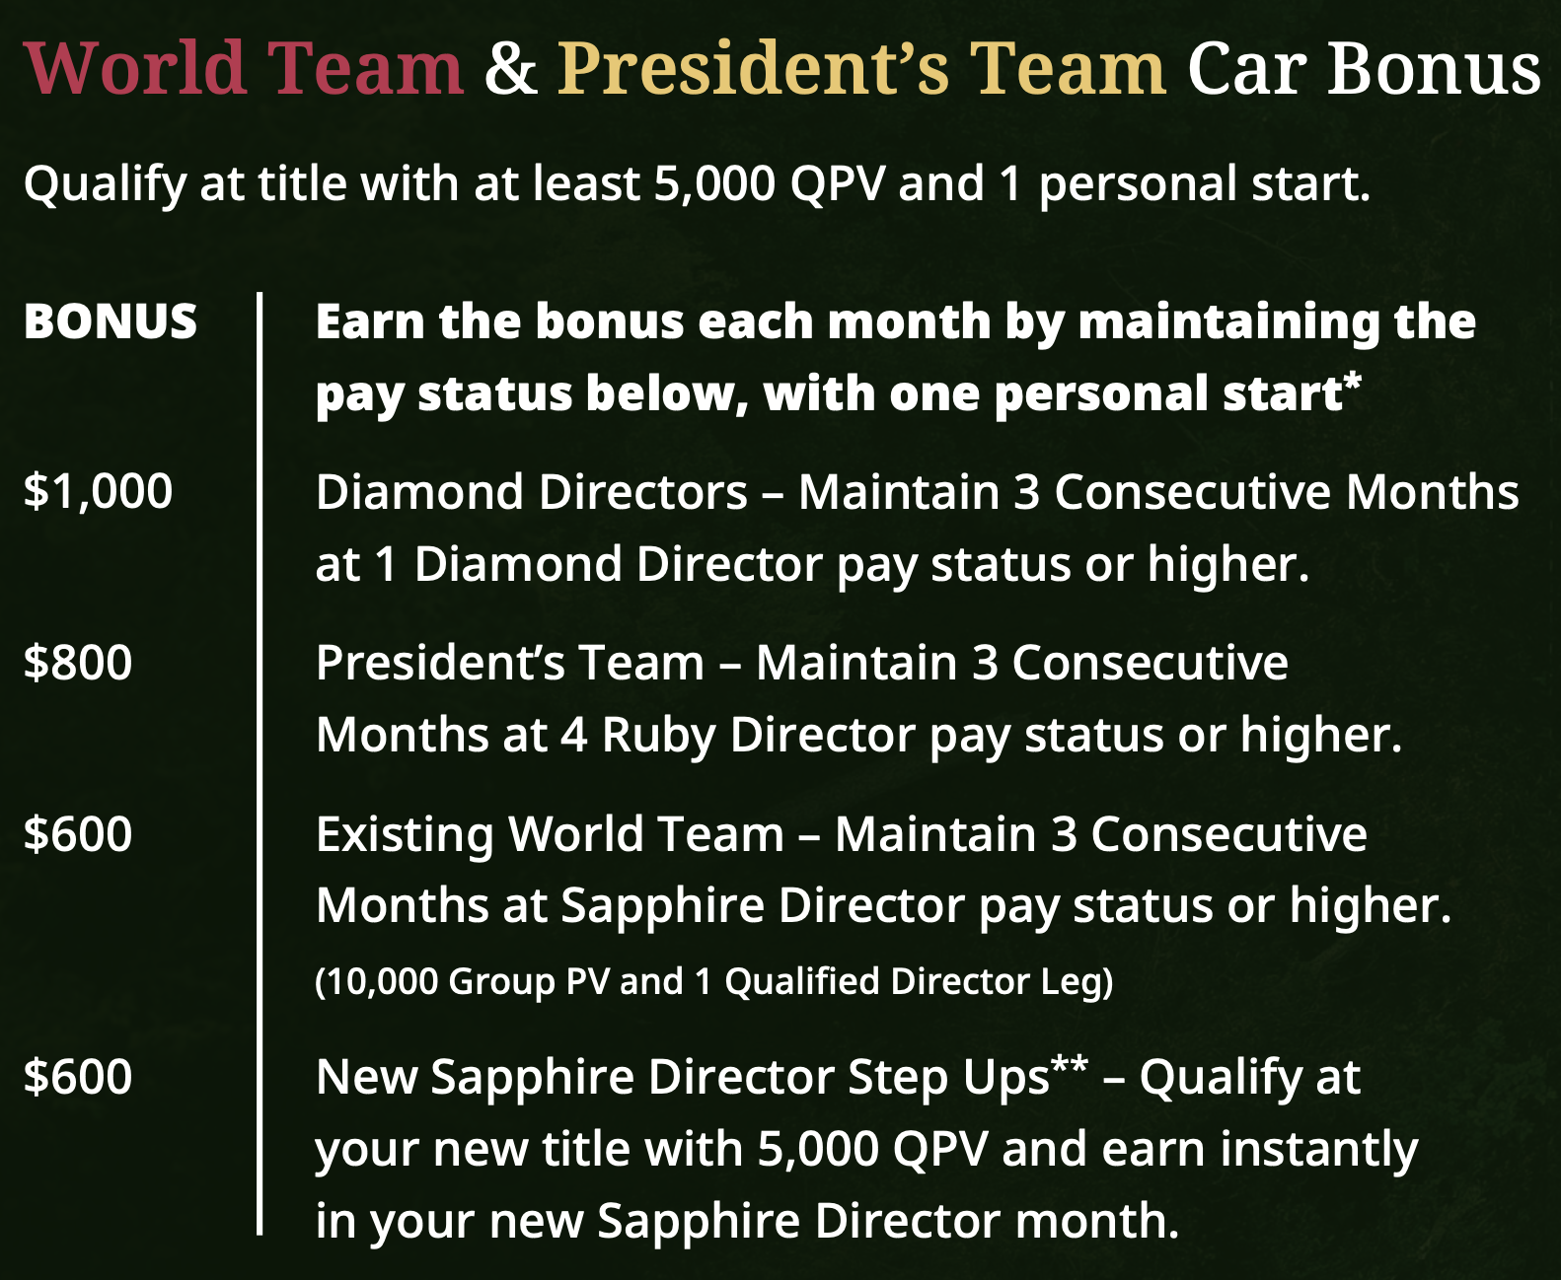

Slide 18


Slide 19
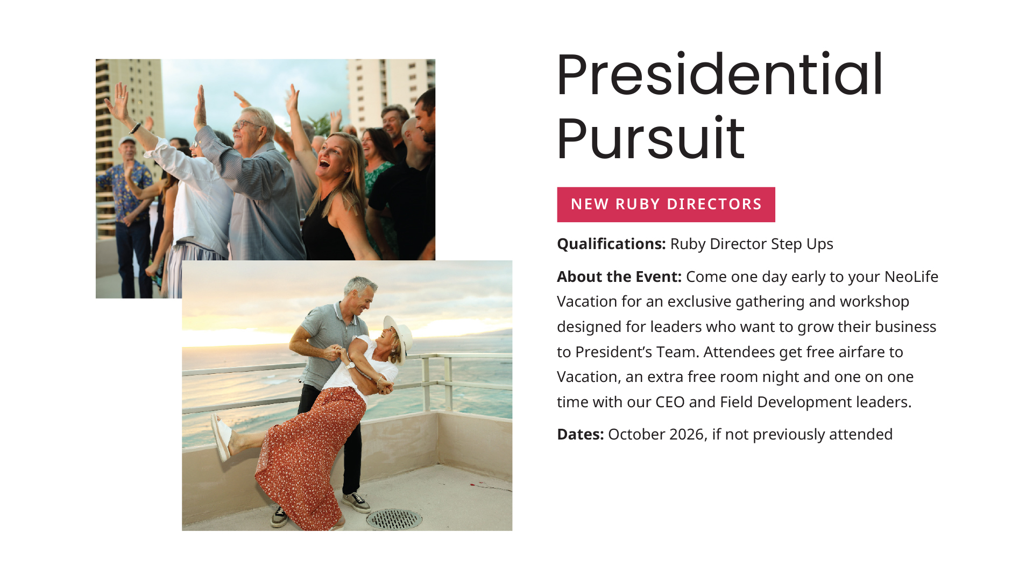

Slide 20
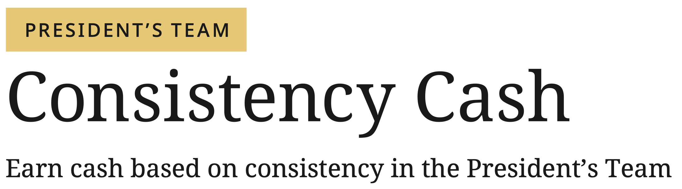
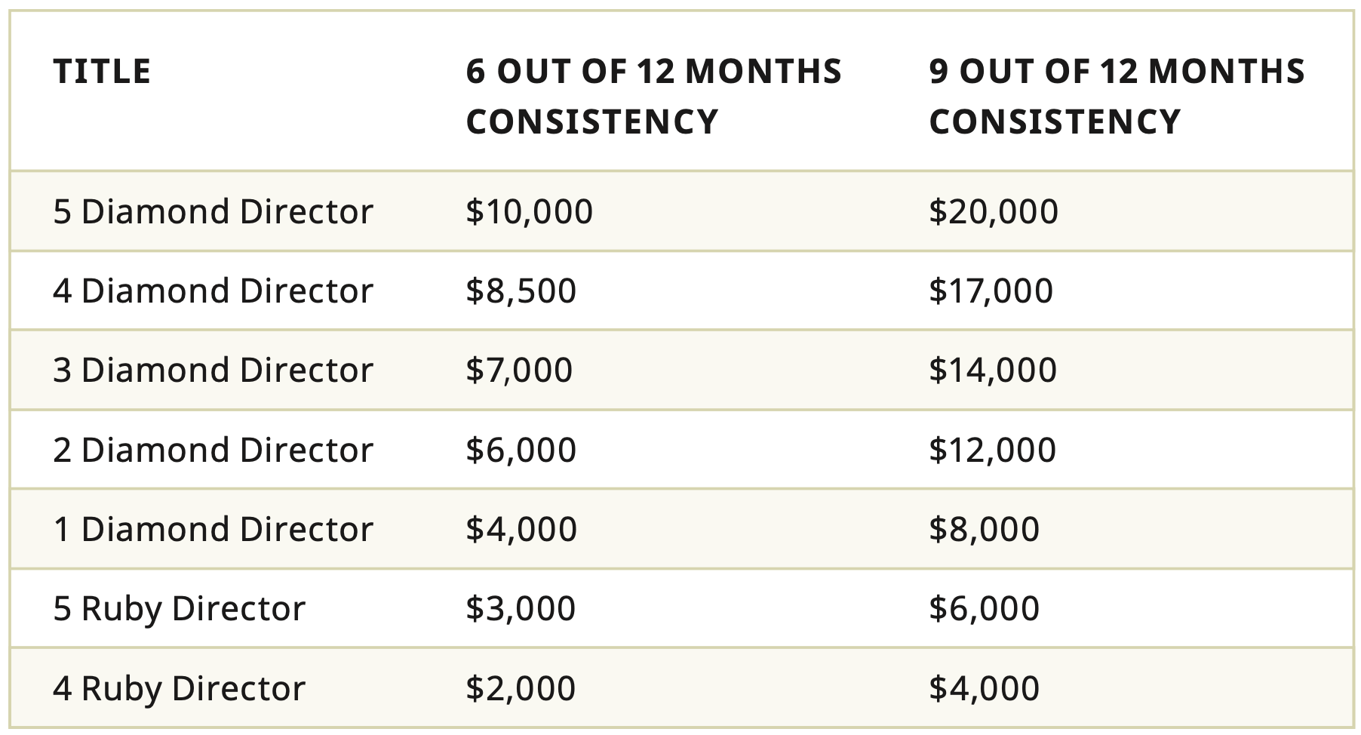
Requires that you develop 6 or more New Emerald Directors within your President’s Team Developing Group (PTDG).

Slide 21
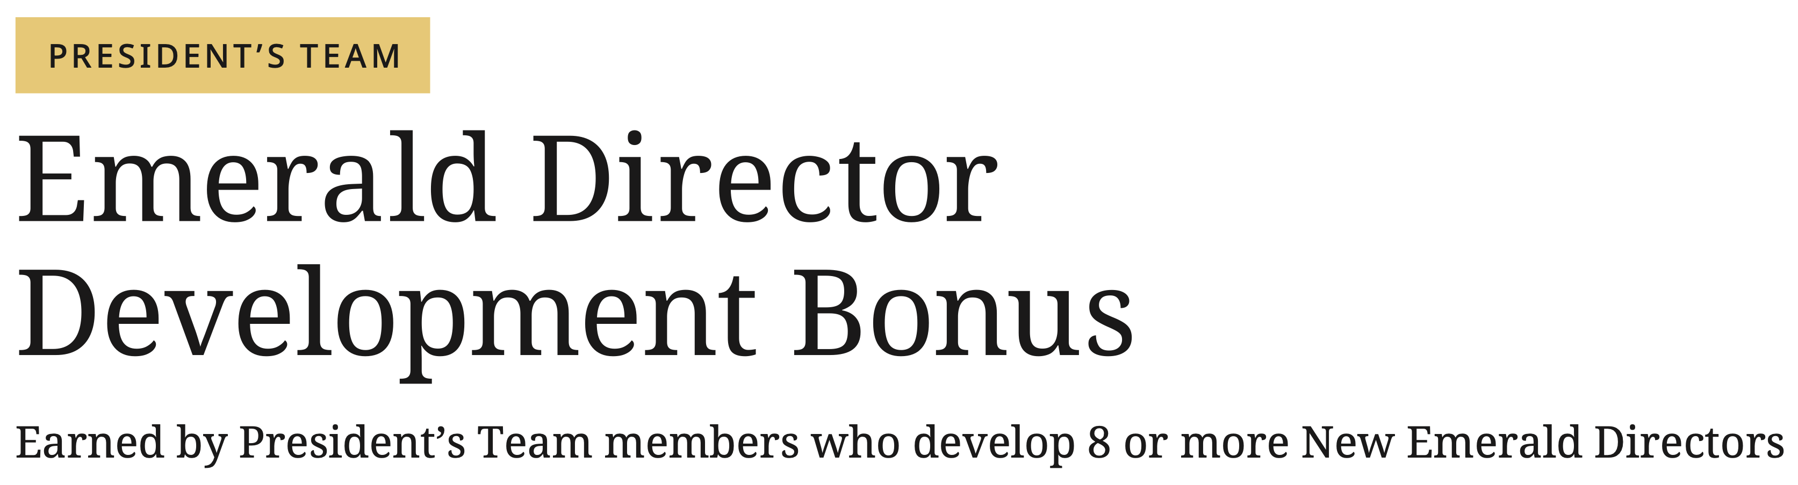
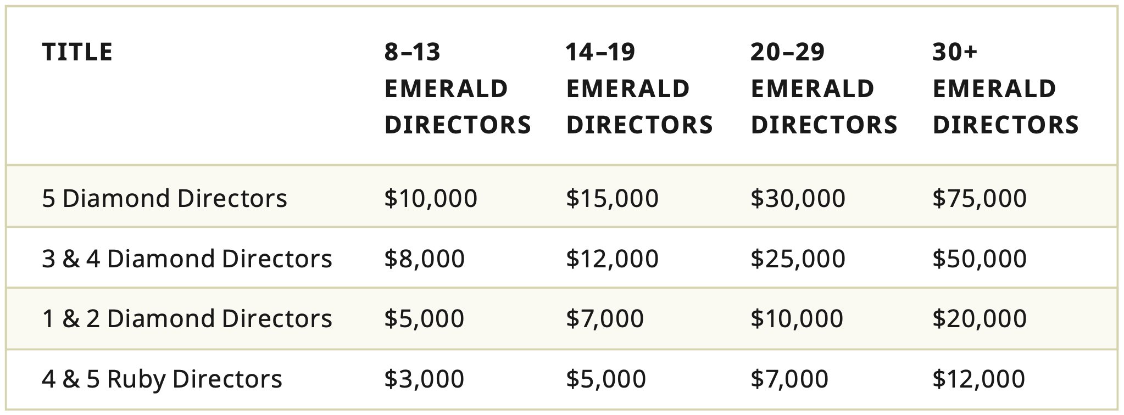

Slide 22


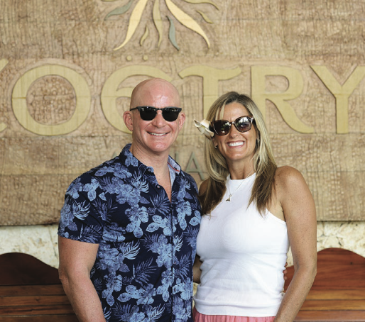
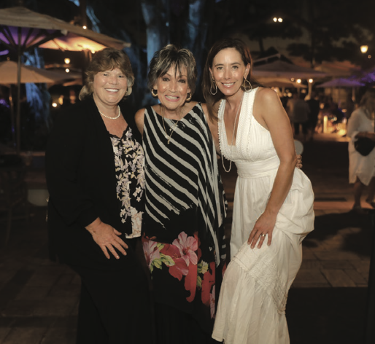

Slide 23
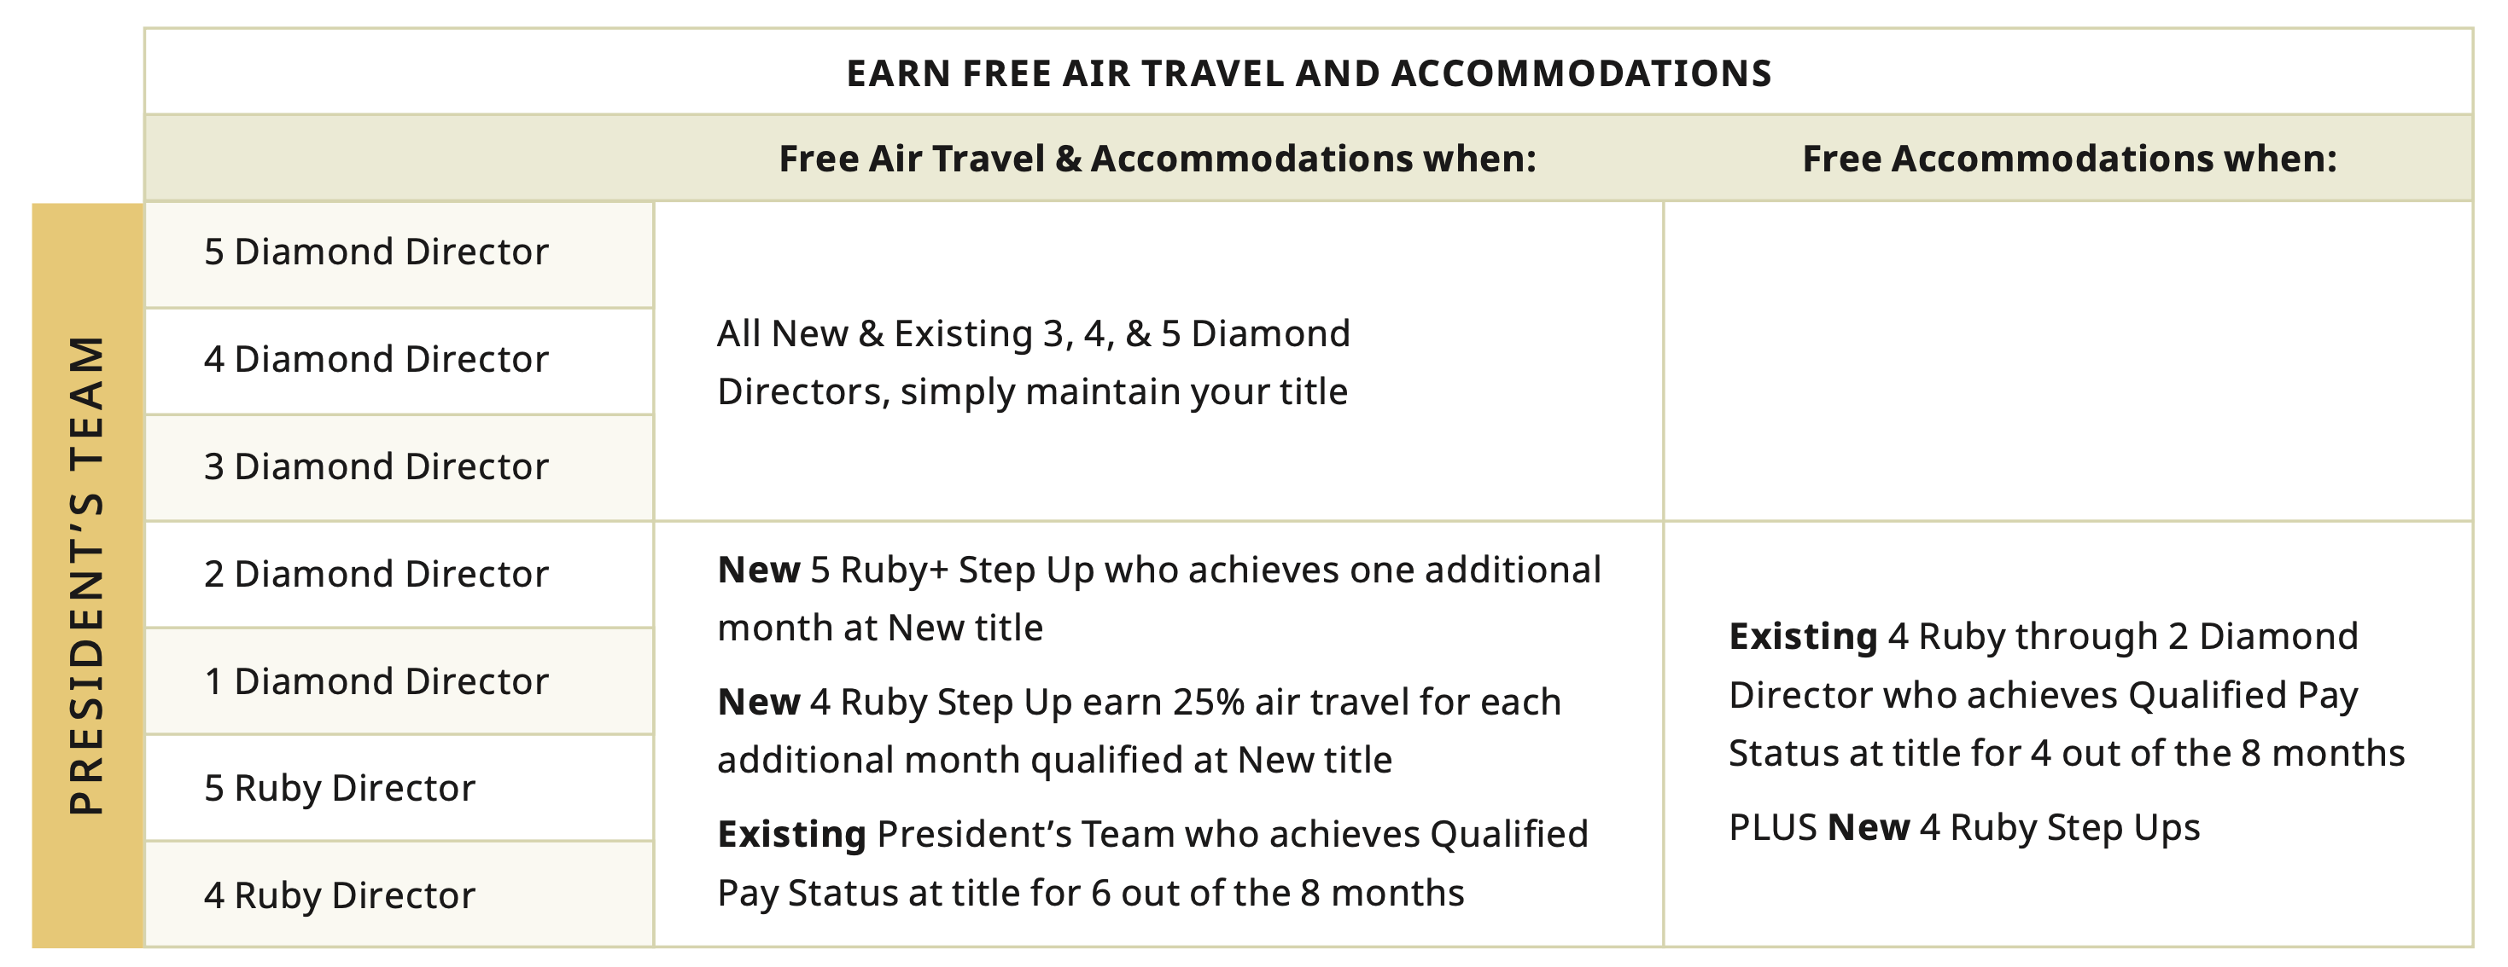

Slide 24
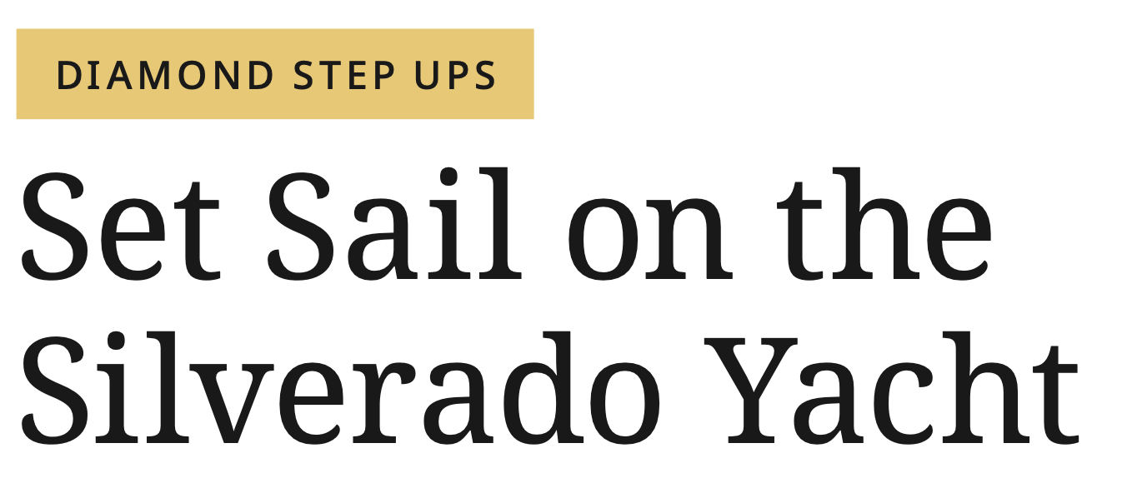
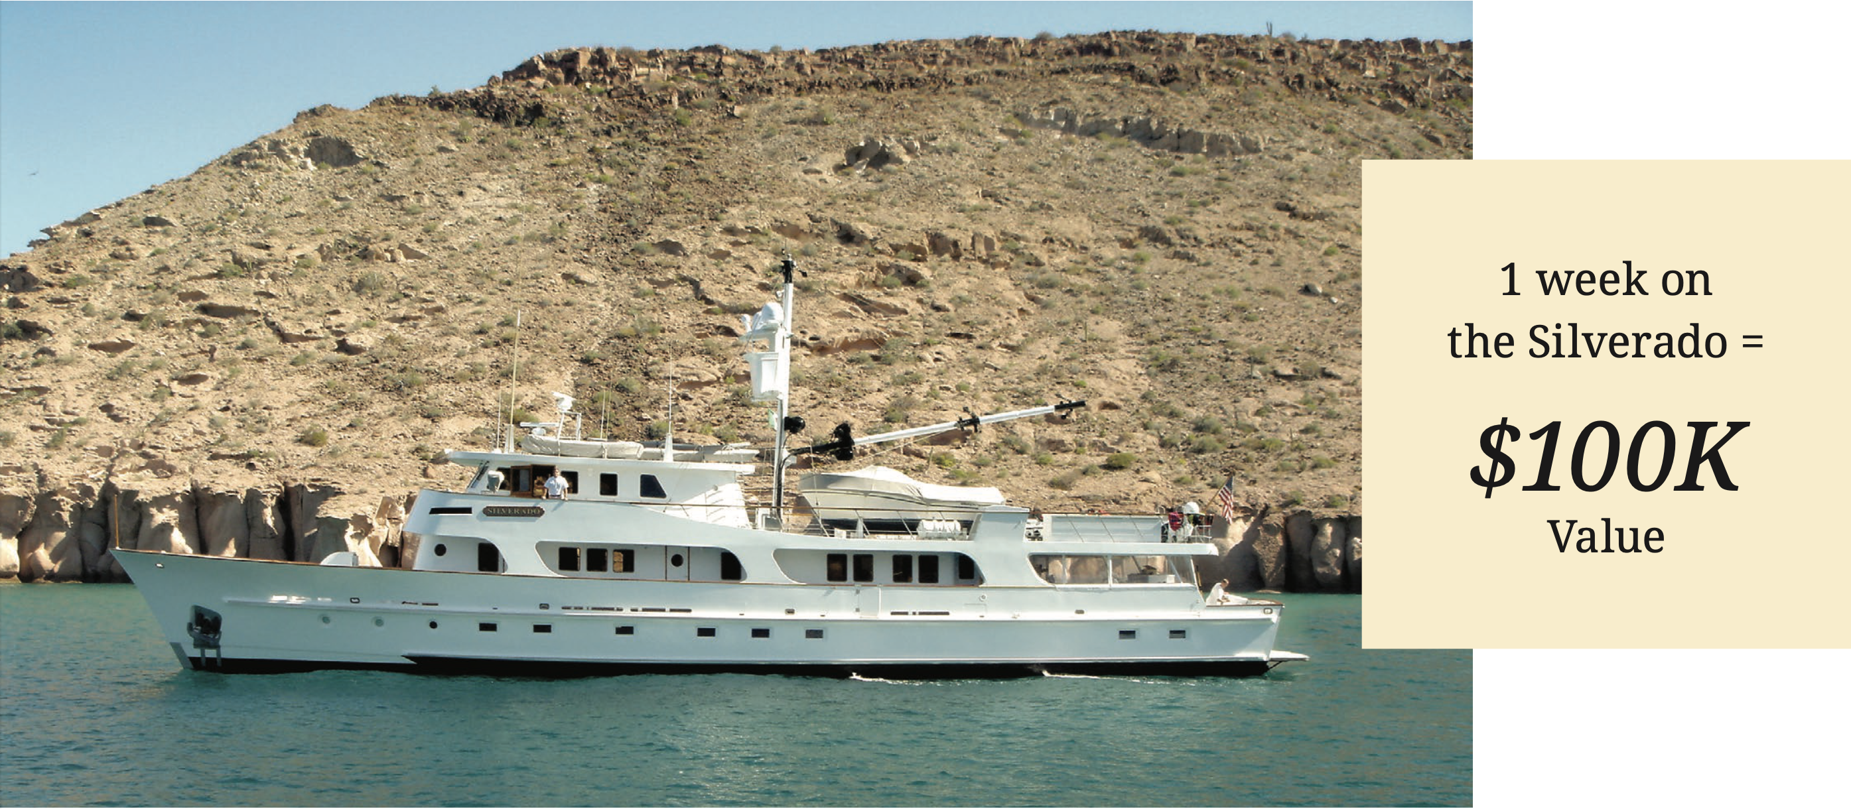

Slide 25


Slide 26
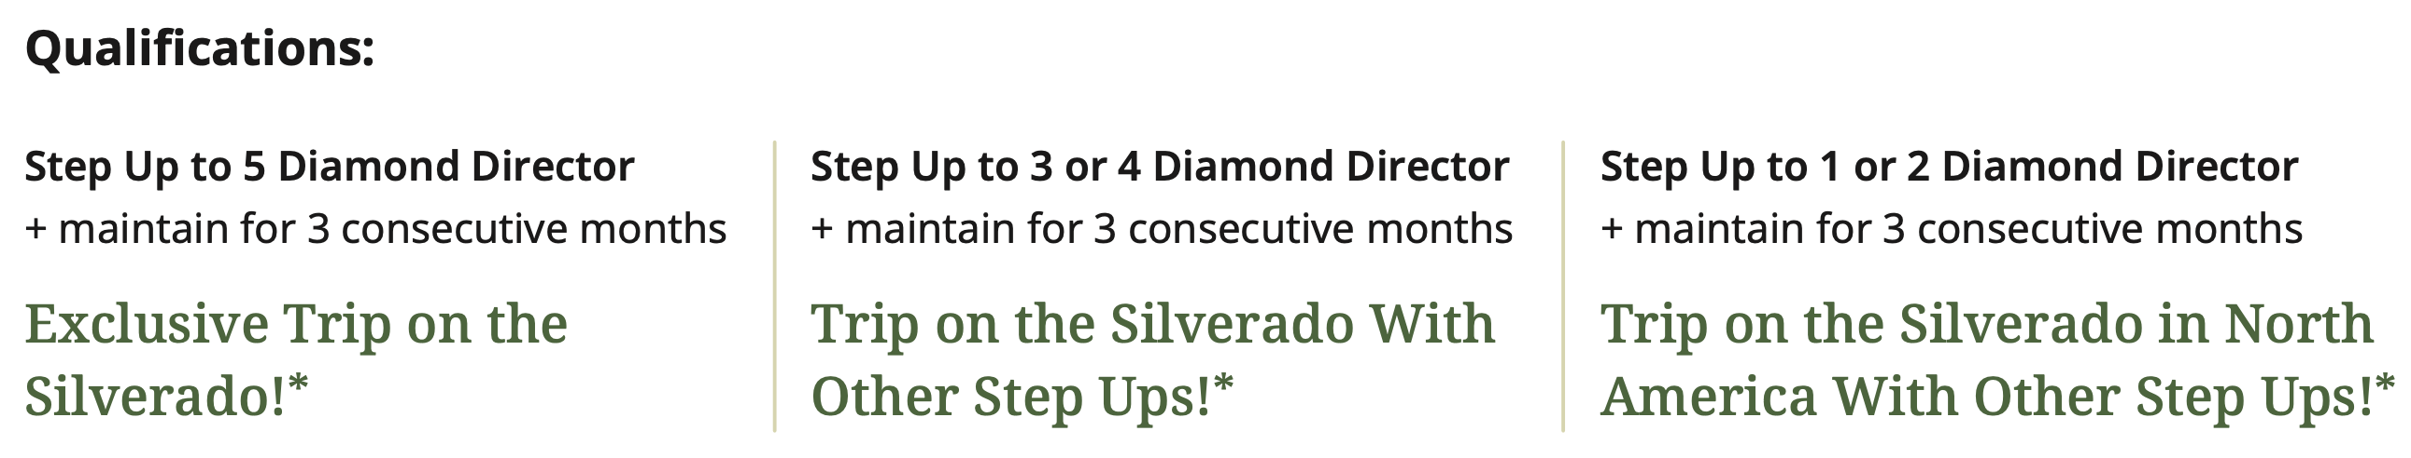

Slide 27
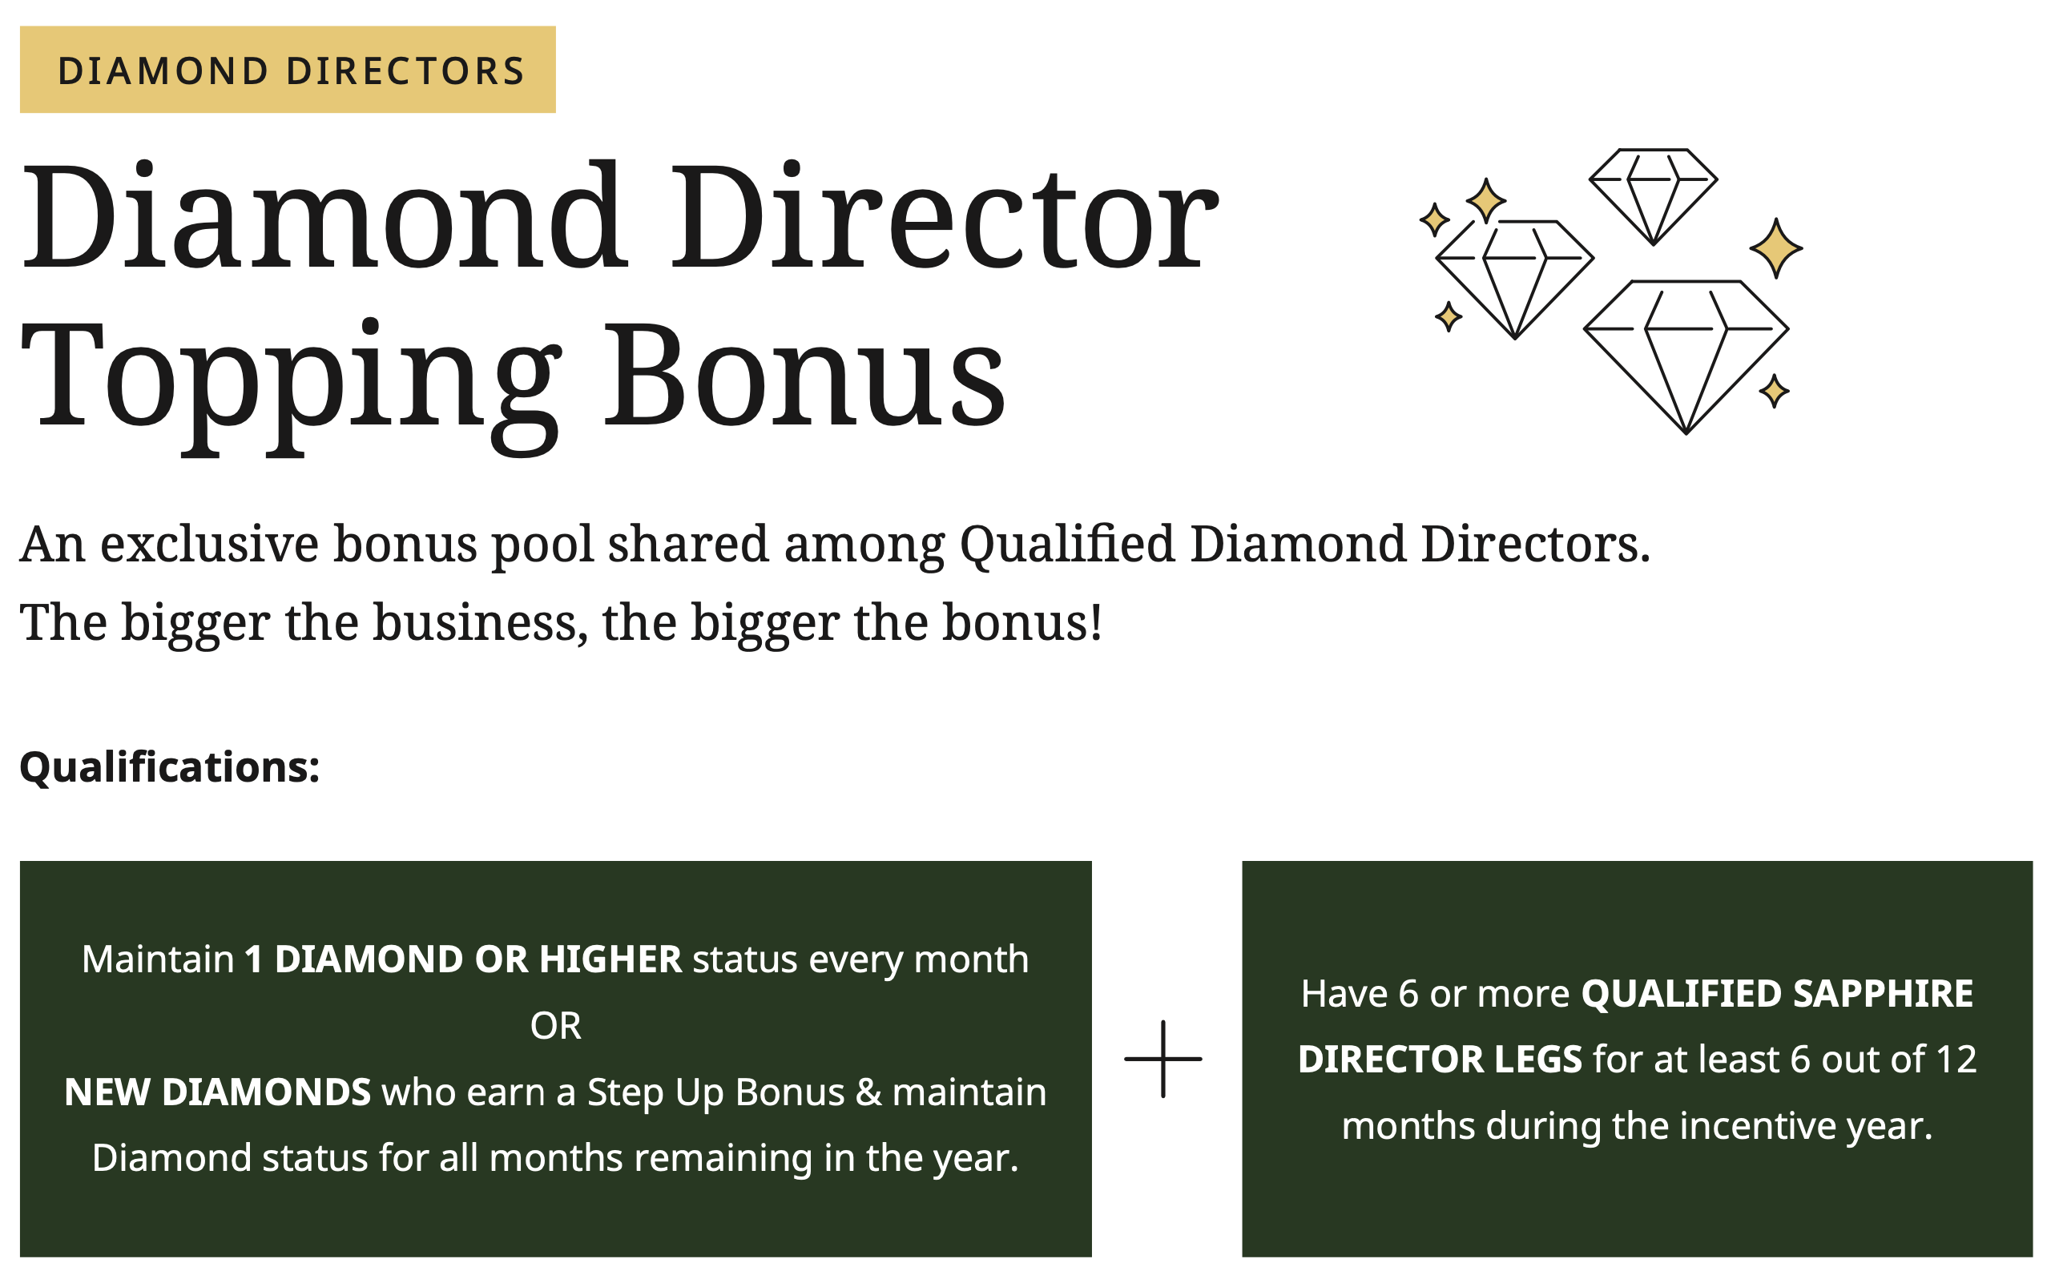

Slide 28
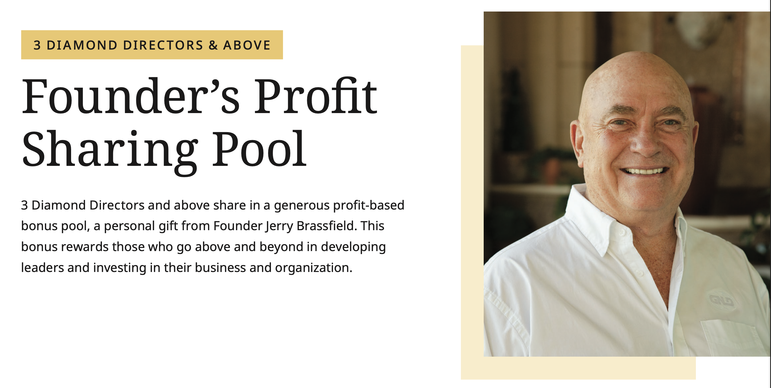

Slide 29
Thank You!
Incentives are subject to change at the discretion of the company.
Please see statement of Average Gross Compensation in your NeoLife Back Office
© 2026. NeoLife International. All Rights Reserved.

