Slide 1

PROMOTER TRAINING: THE 6 P’S

Slide 2
01
THE 1ST P:
PURPOSE

Slide 3
01
THE 1ST P:
PURPOSE
ACTION STEP
PROMOTER RANK
TOTAL MONTHLY QVP
SALES VOLUME BONUS
Understand how to grow your sales volume bonus
Directors
Executive Managers
Senior Managers
Managers
Promoters
4,000
2,000
1,000
500
250
20%
15%
10%
5%
3%
Once you reach 250 PV in a month, you automatically get a 3% rebate on your own orders as well as a 3% bonus on your team members’ orders.

Slide 4

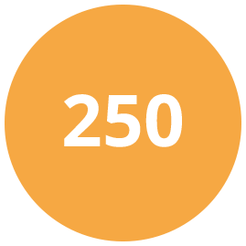


01
THE 1ST P:
PURPOSE
Place a single order of 250+ PV and get:
Extra 3%
Smart Start Discount*
50 PV FREE
Product Bundle
Place a single order of 500+ PV and get:
Extra 5%
Smart Start Discount*
100 PV FREE
Product Bundle
Place a single order of 1,000+ PV and get:
Extra 10%
Smart Start Discount*
150 PV FREE
Product Bundle
1 FREE
Impact Summit Ticket†
*Smart Start Discount is calculated as a percentage of total BV of your order.
Instead of receiving this amount in your monthly bonus check, you’ll receive it as an upfront discount on your qualifying Smart Start order.
250-499 PV = 3%, 500-599 PV = 5%, 1,000-1,999 PV = 10% discount, 2,000-3,999 PV = 15% discount, 4,000+ PV = 20% discount
†Free Impact Summit tickets are non transferrable.

Slide 5
01
THE 1ST P:
PURPOSE
ATTENTION
ALL PROMOTERS
FOR
3 MONTHS
ONLY
Earn an EXTRA 20% on the first order of new starts!
Incentive Period:
January – March 2026

Slide 6
01
THE 1ST P:
PURPOSE
First Order Bonus
Incentive Period:
January – March 2026
How It Works
1. Personally sponsor a new Member or Promoter with 100 PV or more in their first order
2. Earn an extra bonus of 20% on the PV of their First Order
Your New Start’s
Your
PV of First Order x 20% = First Order Bonus
• You must be an Active Promoter with a minimum of 100 Personal PV in the sales month to earn a First Order Bonus
• Earn up to a $200 First Order Bonus per qualifying order
• Regular compensation plan commissions will be calculated at 90% of BV on qualifying orders
• Promoter Upgrades from Member are not eligible for First Order Bonus

Slide 7
01
THE 1ST P:
PURPOSE
First Order Bonus
You can earn up to a $200 First Order Bonus per new start.
YOUR PERSONAL NEW START’S
FIRST ORDER PV AMOUNT
YOUR FIRST ORDER BONUS
< 100 PV
No Bonus
100 PV
$20 + Compensation Plan Earnings
250 PV (Smart Start)
$50 + Compensation Plan Earnings
500 PV (Smart Start)
$100 + Compensation Plan Earnings
1,000 PV (Smart Start)
$200 + Compensation Plan Earnings
> 1,000 PV
$200 + Compensation Plan Earnings

Slide 8
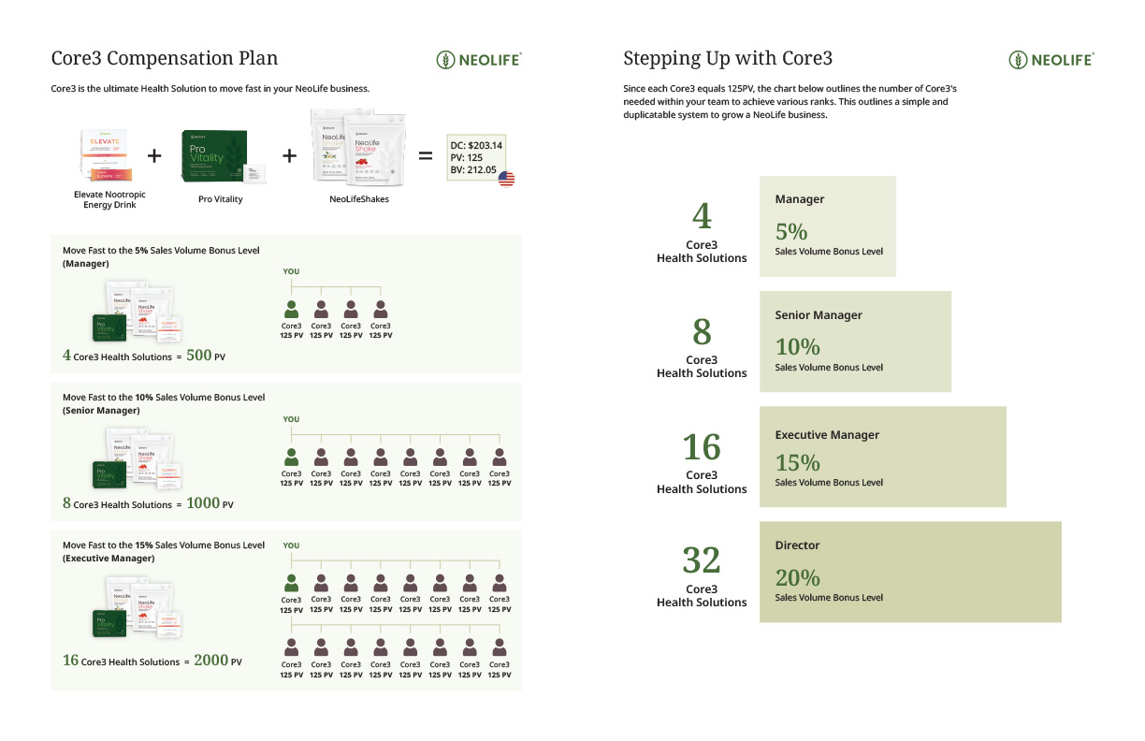
01
THE 1ST P:
PURPOSE

Slide 9
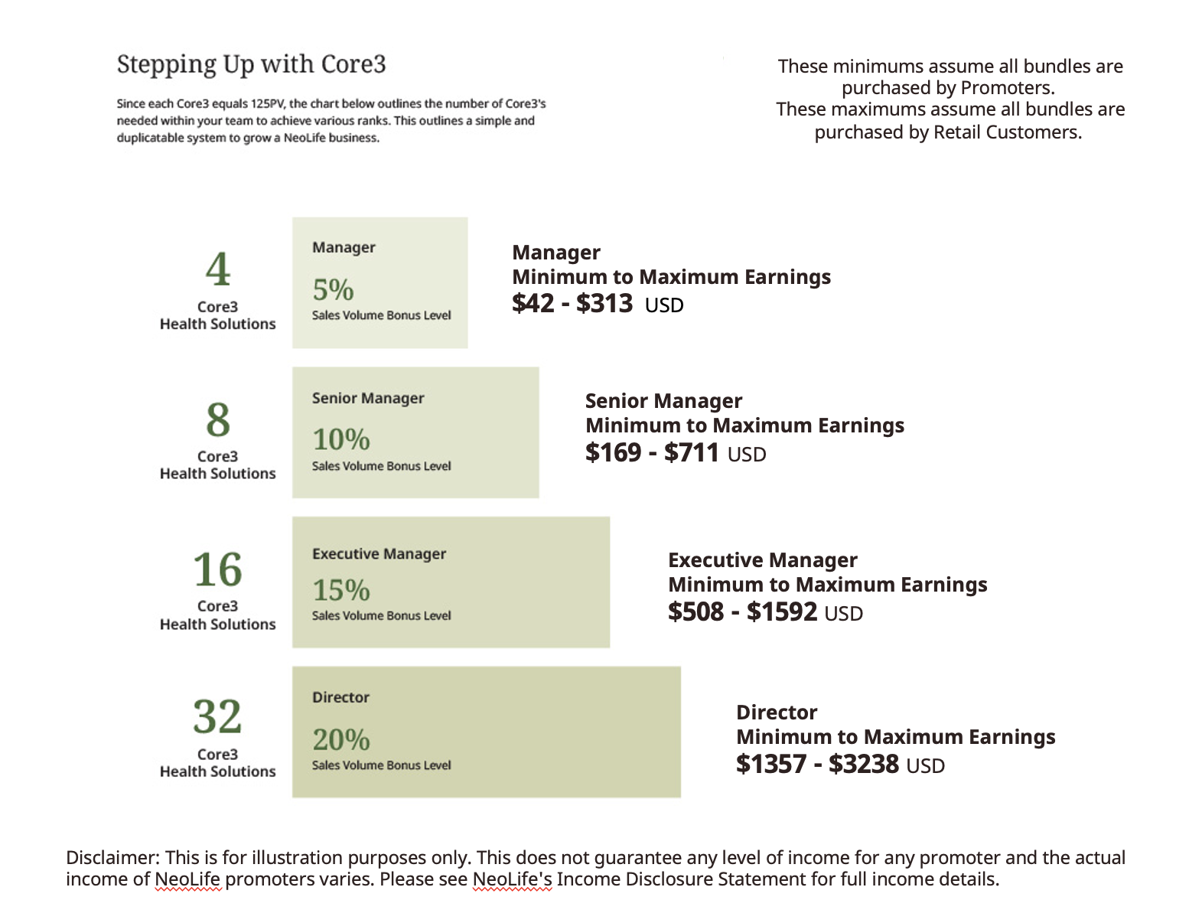
01
THE 1ST P:
PURPOSE

Slide 10
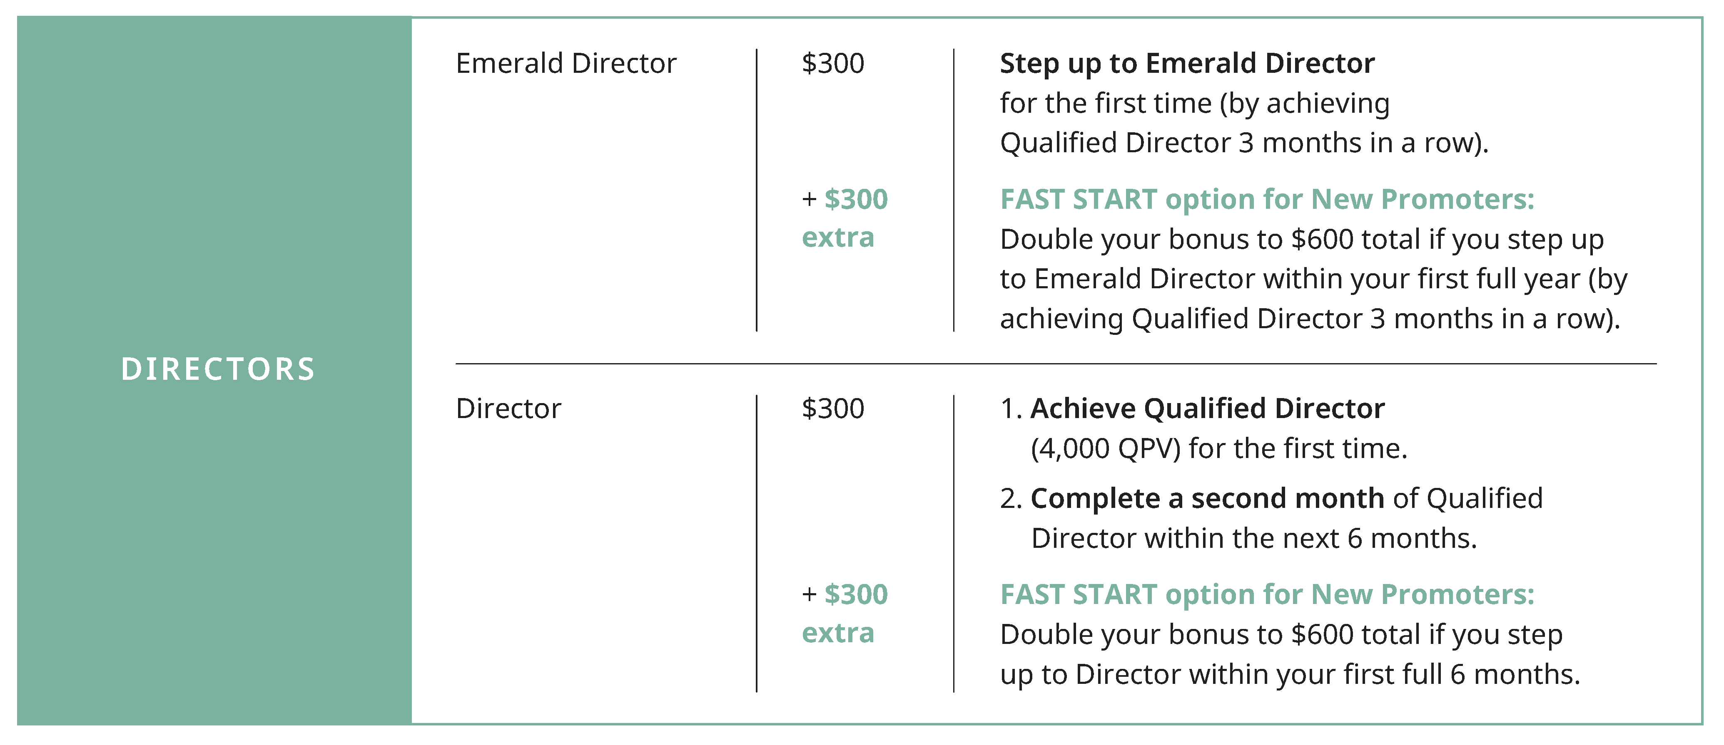
01
THE 1ST P:
PURPOSE
Step Up Bonuses

Slide 11

01
THE 1ST P:
PURPOSE
Step Up Bonuses

Slide 12
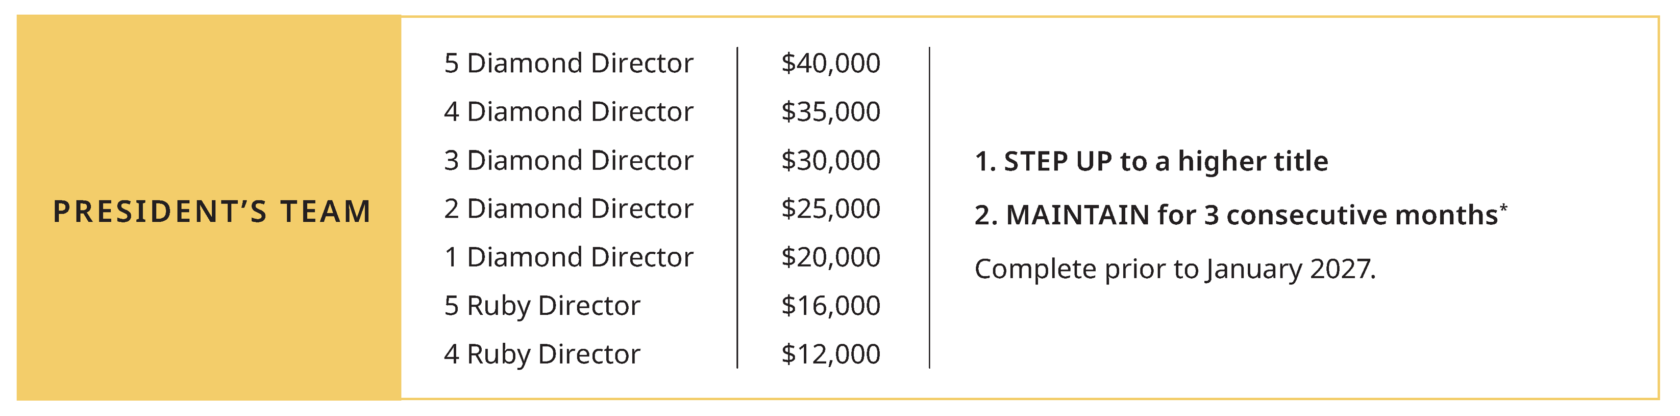
01
THE 1ST P:
PURPOSE
Step Up Bonuses

Slide 13

01
THE 1ST P:
PURPOSE
October 15–18, 2026
Secrets Vallarta Bay Puerto Vallarta
Scan for Incentive Flyer to learn how to earn this trip.
*Qualifying for this vacation is an amazing achievement attained by hard work, skill and dedication from our top Promoters. This is not typical. See Statement of Average Gross Compensation at ShopNeoLife.com.

Slide 14
01
THE 1ST P:
PURPOSE
ACTION STEPS
Get off to a Smart Start Yourself
Know your SVB & Fast Start Bonus Targets

Slide 15
02
THE 2ND P:
PRODUCTS

Slide 16

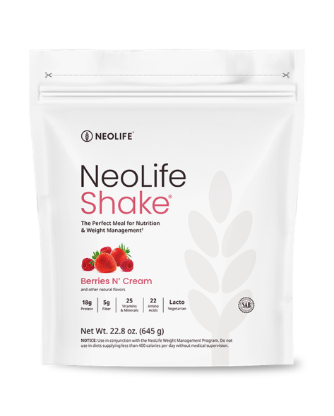
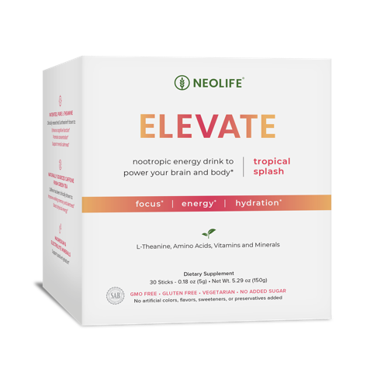
02
THE 2ND P:
PRODUCTS
Pro Vitality
A core nutrition packet featuring 4 first and only products designed to feed, protect, balance & nourish you at the cellular level
CORE 3 PRODUCTS
Consistency & Knowledge
NeoLifeShake
Scientifically the perfect meal. Clinically proven for weight loss, lean muscle protection, heart health & more! Added bonus: It tastes delicious!
Elevate
A true quadruple threat: Energy, focus, hydration, and better mood

Slide 17
02
THE 2ND P:
PRODUCTS
ACTION STEPS
Be a Product of the Products
Be able to speak about the Core Products

Slide 18
03
THE 3RD P:
PEOPLE

Slide 19
03
THE 3RD P:
PEOPLE
ACTION STEP
Make your 5-List of 10
If making a long list overwhelms you initially, focus on:
Who are you talking to NOW?
Who are you talking to NEXT?
1. 10 People That Need More Energy
2. 10 People That Desire Weight Loss
3. 10 People Who Already Work out
4. 10 People That Like/Want/Need Money
5. Your Top 10 Dream Team

Slide 20
03
THE 3RD P:
PEOPLE
Ideas for Your List
Family & Friends
Childhood Friends
Co-Workers
Neighbors
Church/Social Club Members
Service Providers
Community Professionals
Gym Members
Kids Activities
Social Media Followers

Slide 21
04
THE 4TH P:
PACKAGE YOUR STORY

Slide 22
04
THE 4TH P:
PACKAGE YOUR STORY
ACTION STEP
Package Your Story & Share it with 1 Person
Where you WERE
What you SAW
What you DID
Your STRUGGLE
Your SOLUTION
Your SUCCESS
OR
This is your chance to demonstrate how NeoLife has made a genuine difference in your life. Your goal is to create curiosity!
Always End With Your Excitement & A Question
Always End With Your Excitement & A Question

Slide 23
05
THE 5TH P:
PROCESS

Slide 24
05
THE 5TH P:
PROCESS
1-on-1 Conversations
3rd Party Credibility
Texts/Phone/Zoom
The Success System
This system yields success for new & seasoned Promoters with less frustration and delay. It is designed to give someone multiple exposures, voices, faces and visions of NeoLife. It also allows the new Promoter to get started sharing faster without feeling the need to know everything.
Impact Summit
Group Events Virtual or In-Person

Slide 25
05
THE 5TH P:
PROCESS
Learn
Grow
Sharpen
Share
ACTION STEP
Invite Them to Discover More
Learn more to sharpen your skills & share to grow faster
Message your upline, local leaders or the Corporate leader in your region for help and dates of upcoming events.

Slide 26
06
THE 6TH P:
PLUG-IN

Slide 27
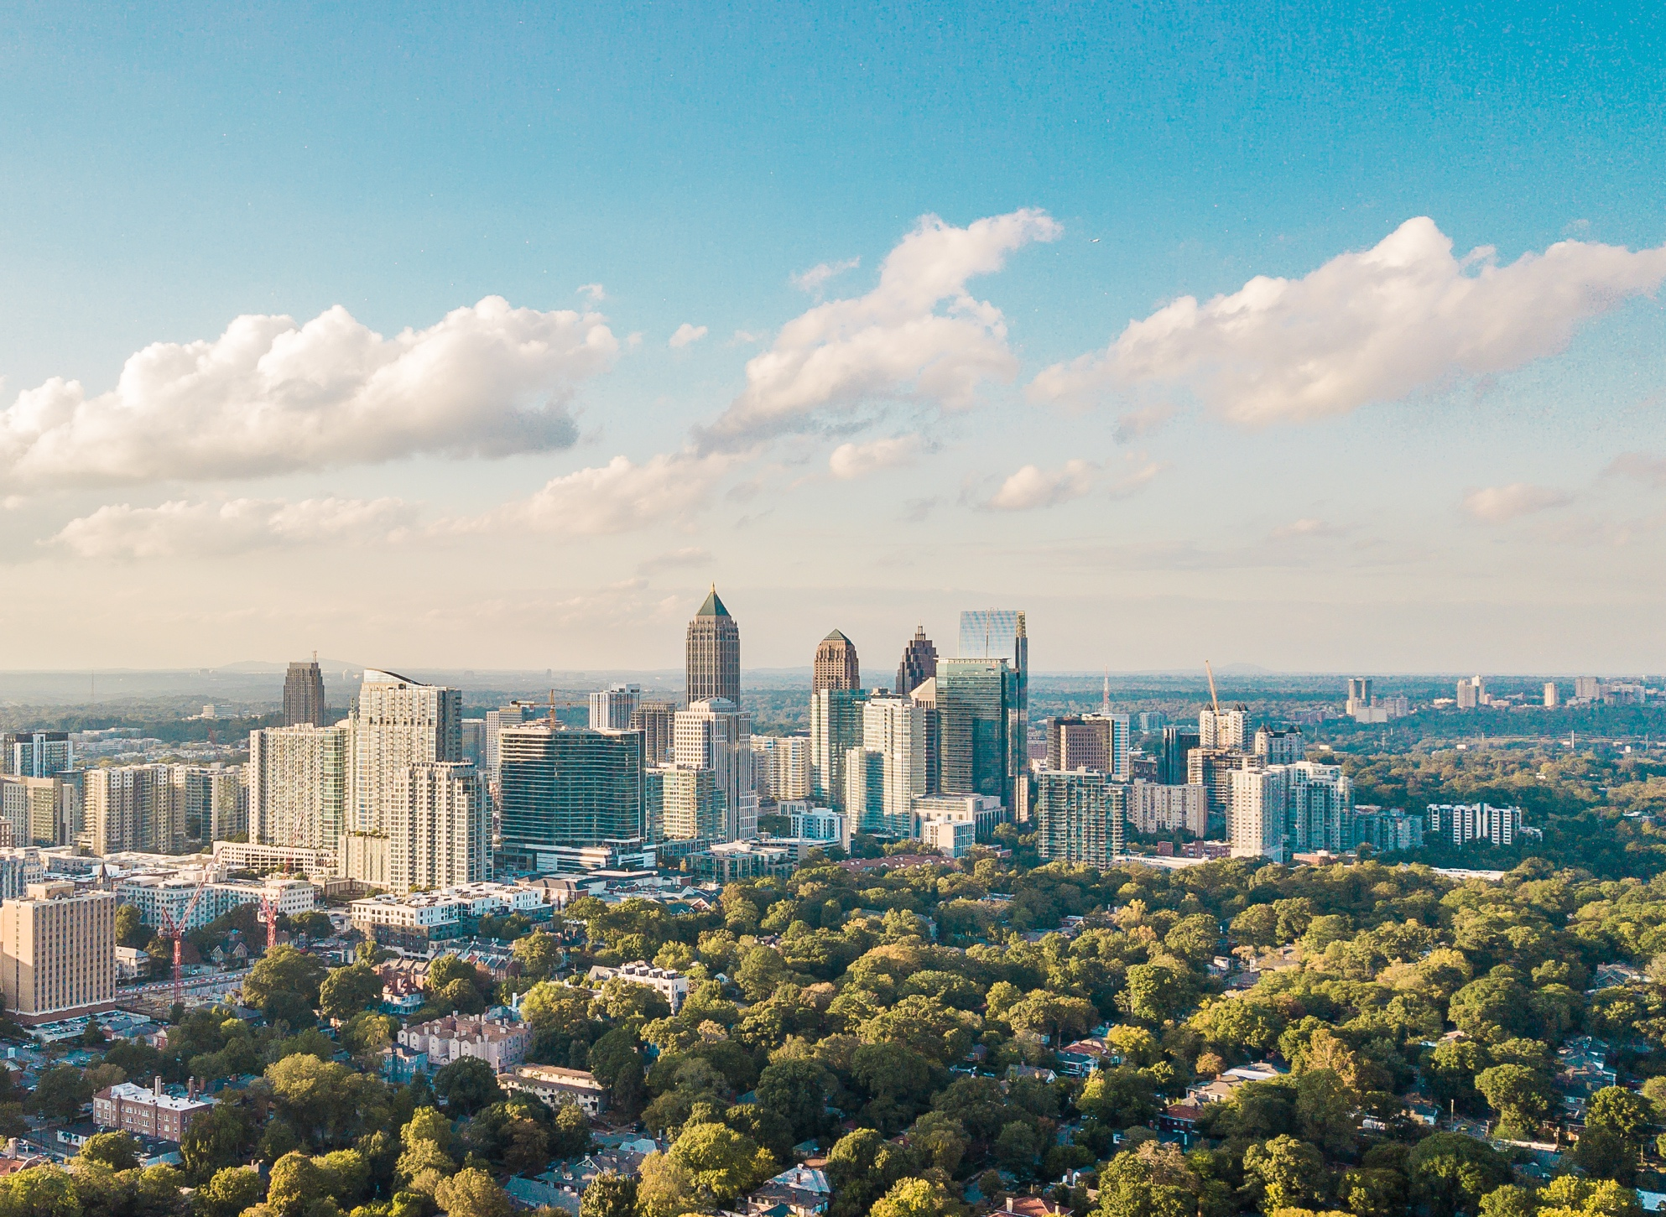
06
THE 6TH P:
PLUG-IN
ACTION STEP
Get Your Impact Summit Ticket & Invite Others To Join
Join us for a transformative experience at Impact Summit! Discover the keys to unlocking success in both your business and personal wellness journey.

Slide 28

06
THE 6TH P:
PLUG-IN
The 6 P’s
The Fundamentals
Purpose
Product
People
Package Your Story
Process
Plug-In

Slide 29
Thank You!

