Slide 1
Most Important Aspect to Building Your Business
Getting New Promoters Started!

Slide 2


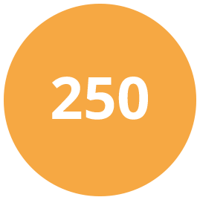



Slide 3
What is Smart Start?
Your new business building tool for creating Growth FAST!

Slide 4

The Key to Smart Start
Increase the number of New Promoters
Increase PV Order Size
Increase Business Building Activity
Increase Duplication

Slide 5

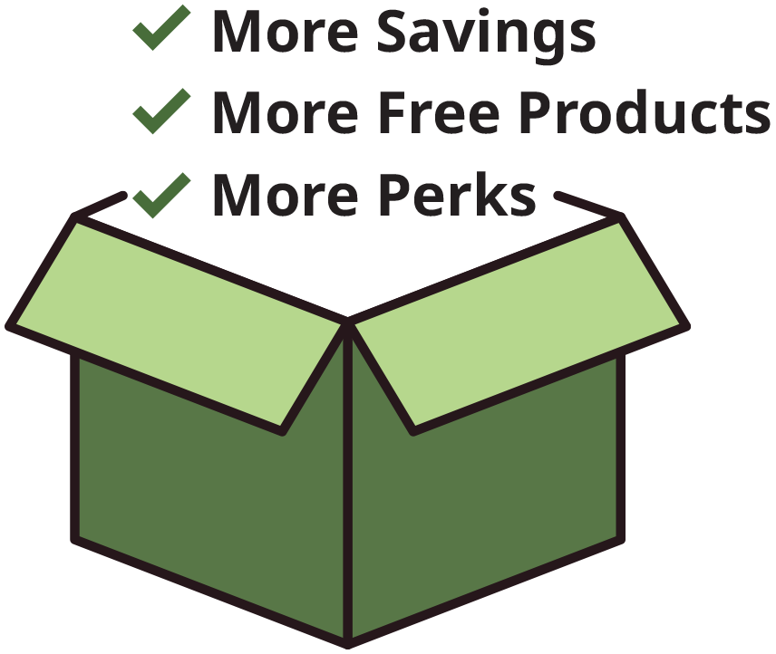
Limited-Time Offer
for New Promoters!
Exclusively available on beta.neolife.com
You get one shot during your First Full Month to place a single order of 250 PV or more and unlock massive rewards. Don’t miss it.
The Larger the Order, The Greater the Rewards

Slide 6
PLACE A SINGLE ORDER OF 250–499 PV AND GET:
Extra 3%
Smart Start Discount*
50 PV FREE
Product Bundle
PLACE A SINGLE ORDER OF 500–999 PV AND GET:
Extra 5%
Smart Start Discount*
125 PV FREE
Product Bundle
PLACE A SINGLE ORDER OF 1,000–1,999 PV AND GET:
Extra 10%
Smart Start Discount*
250 PV FREE
Product Bundle
1 FREE
Impact Summit Ticket†
*Smart Start Discount is calculated as a percentage of total BV of your order. Instead of receiving this amount in your
monthly bonus check, you’ll receive it as an upfront discount on your qualifying Smart Start order.
250-499 PV = 3%, 500-599 PV = 5%, 1,000-1,999 PV = 10% discount, 2,000-3,999 PV = 15% discount, 4,000+ PV = 20% discount
†Free Impact Summit tickets are non transferrable.

Slide 7
Why It’s A Smart Start
Automatic rewards when you order 250+ PV during enrollment or anytime during your first full month.
More Savings with instant discount at checkout— no waiting for rebates!
Free Product = Extra value
More Perks to launch faster
Smart Start orders must be placed on the new NeoLife website beta.neolife.com
U.S. & Canada only

Slide 8
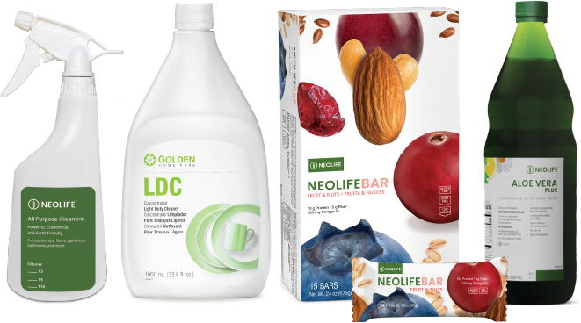
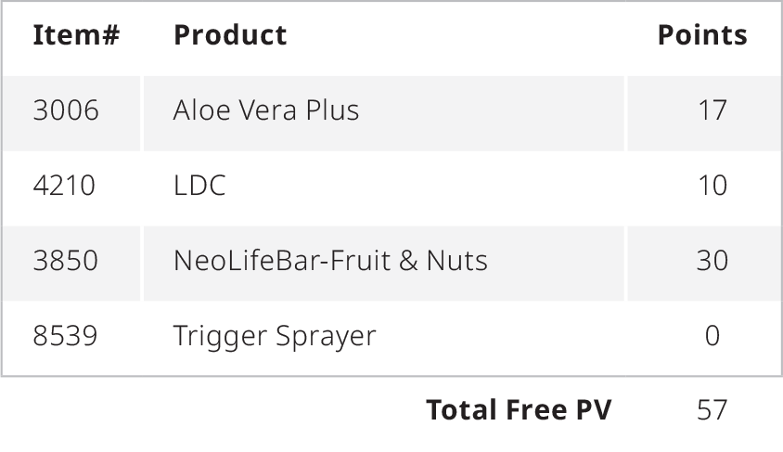
Extra 3%
Smart Start Discount*
50 PV FREE
Product Bundle
($135 Retail Value)
+
*Smart Start Discount is calculated as a percentage of total BV of your order. Instead of receiving this amount in your
monthly bonus check, you’ll receive it as an upfront discount on your qualifying Smart Start order.

Slide 9
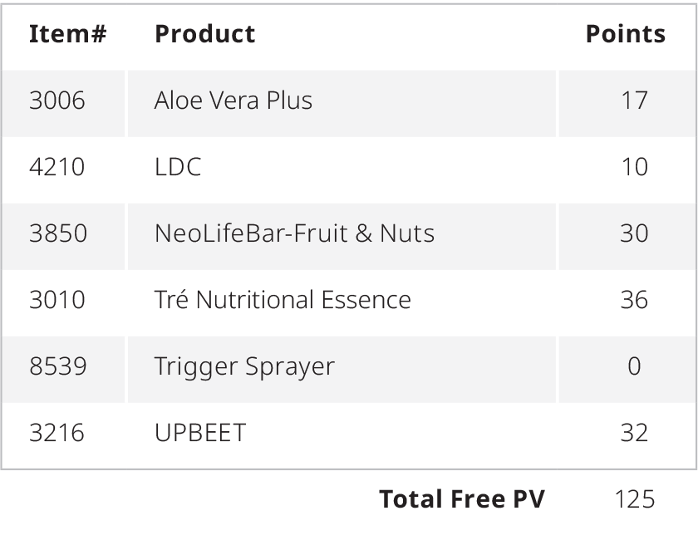
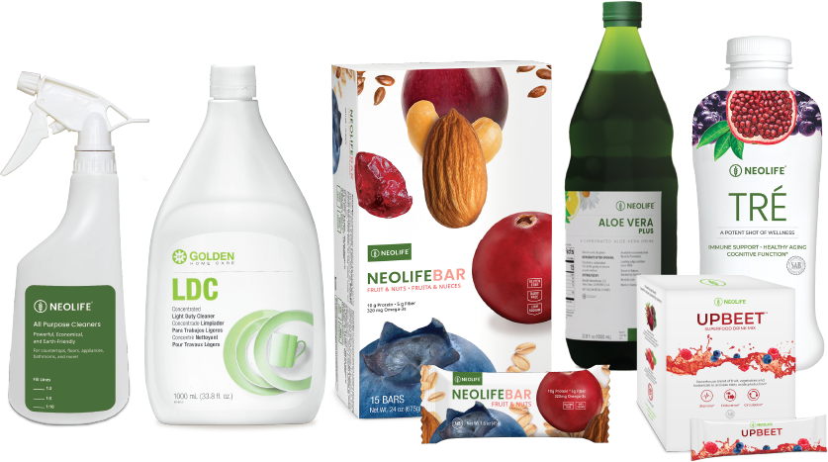
Extra 5%
Smart Start Discount*
125 PV FREE
Product Bundle
($270 Retail Value)
+
*Smart Start Discount is calculated as a percentage of total BV of your order. Instead of receiving this amount in your
monthly bonus check, you’ll receive it as an upfront discount on your qualifying Smart Start order.

Slide 10
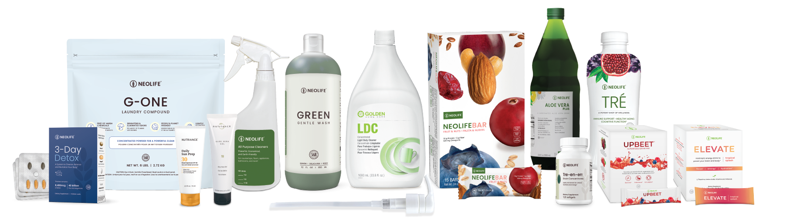
Extra 10%
Smart Start Discount*
250 PV FREE
Product Bundle
($610 Retail Value)
FREE
Impact Summit Ticket†
+
+
*Smart Start Discount is calculated as a percentage of total BV of your order. Instead of receiving this amount in your
monthly bonus check, you’ll receive it as an upfront discount on your qualifying Smart Start order.
250-499 PV = 3%, 500-599 PV = 5%, 1,000-1,999 PV = 10% discount, 2,000-3,999 PV = 15% discount, 4,000+ PV = 20% discount
†Free Impact Summit tickets are non transferrable.

Slide 11
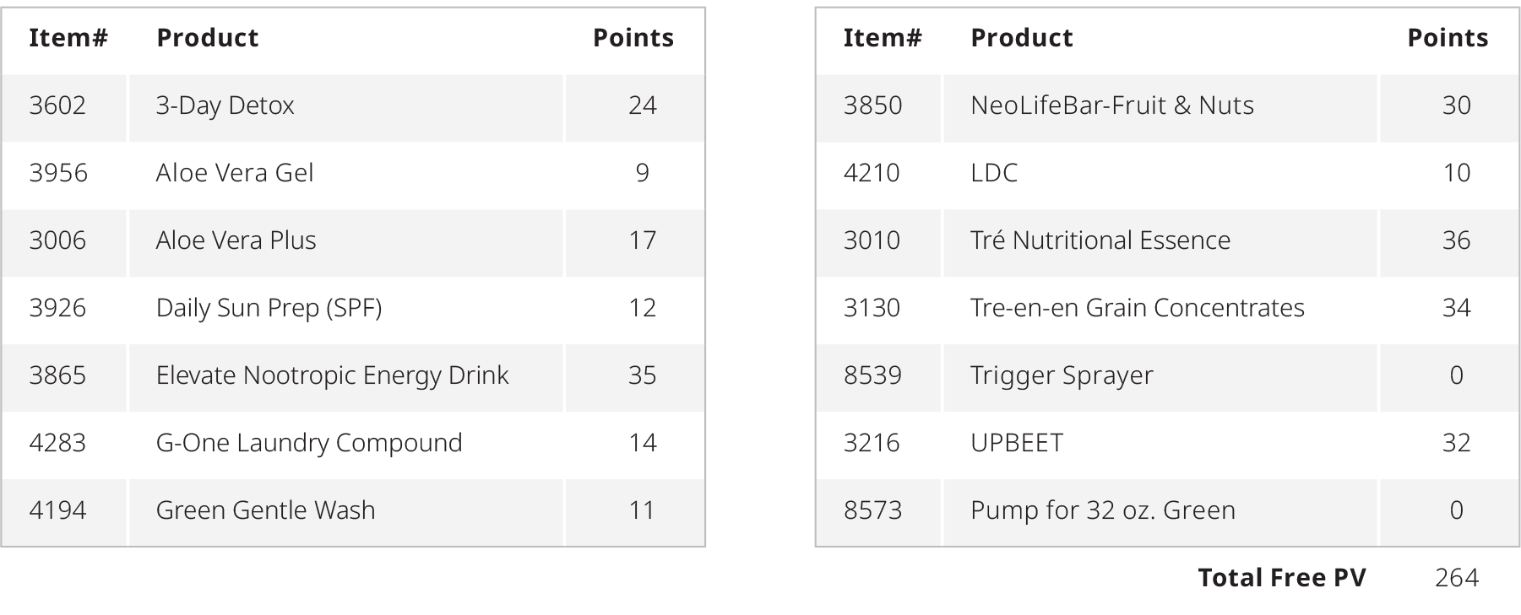
Extra 10%
Smart Start Discount*
250 PV FREE
Product Bundle
($610 Retail Value)
FREE
Impact Summit Ticket†
+
+
*Smart Start Discount is calculated as a percentage of total BV of your order. Instead of receiving this amount in your
monthly bonus check, you’ll receive it as an upfront discount on your qualifying Smart Start order.
250-499 PV = 3%, 500-599 PV = 5%, 1,000-1,999 PV = 10% discount, 2,000-3,999 PV = 15% discount, 4,000+ PV = 20% discount
†Free Impact Summit tickets are non transferrable.

Slide 12
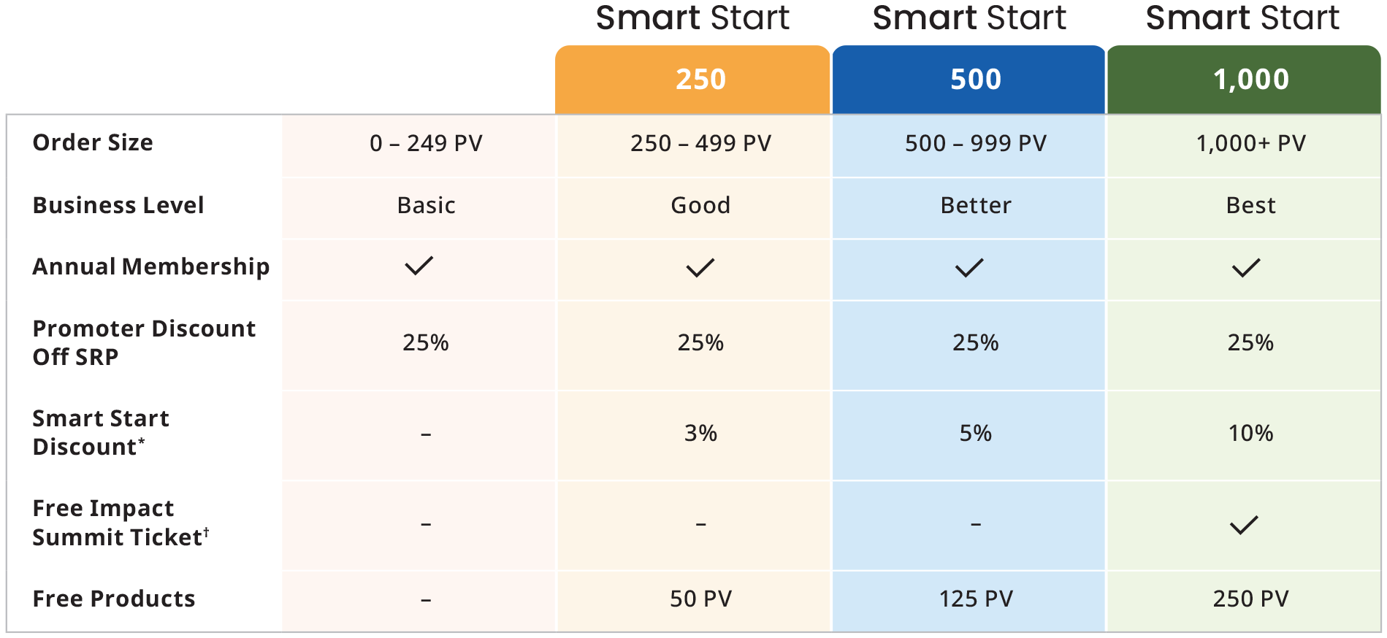
The Larger Your Order, The Greater Your Rewards

Slide 13
FAQs
Q: Where and how do I place my order?
A: Smart Start qualifying orders must be placed on the new NeoLife website beta.neolife.com, either as your first
order at time of enrollment or as a single order during your first full month. Rewards will automatically be applied
to your order and reflected in your cart at checkout.
Q: Can I have more than one Smart Start order? If I first place a 250 PV order and then a 500 PV order, will I
receive both free product bundles and benefits?
A: No, the Smart Start free products and discount will only apply to your first qualifying Smart Start order. In this case,
it would apply only to your first 250 PV order.
Q: Can I choose the products in my single order, or are they pre-selected?
A: Yes, you choose the products included in your single Smart Start order. However, the free product bundles are
pre-selected and cannot be customized, returned or exchanged.
Q: Is the program available to existing Promoters?
A: No. Smart Start begins July 28, 2025 and is available to New Promoters starting in July and beyond.
(U.S. and Canada) and can only be earned during their first full month.

Slide 14

Start Building SMARTER

Slide 15
Making it work for you!

Slide 16
Starting Strong with Smart Packs
This strategy will work optimally if we use these Smart Start bundles as the very first order.

Slide 17
Good, Better, Best Approach
When closing and enrolling a new Promoter, focus on the 3 SMART options as if they were the only options.

Slide 18
The Larger Your Order, The Greater Your Rewards

Slide 19
F.O.M.O. & Sense of Urgency
“This is the only time you will ever be able to benefit from this incredible offer. You will never, ever, get better value for money on these products!”

Slide 20
The Speed of the Leader, Determines the Speed of the Pack!
”Which Pack Did You Get Started With?”
Another selling point is to explain how duplication will operate in their organization…
Good ON-BOARDING has never been more important!

Slide 21

Last Call
At the end of each month, look out for those in your team who didn’t SMART START the month before.
Contact them a few days before month end to explain the benefits of placing a 250, 500 or 1,000 PV order.

Slide 22

“3 in 30”
in their first month
+
= MAGIC

Slide 23
1,000 PV
250
Month 1
250
250
250
Based on everyone starting with a 250 PV order and doing 100 PPV every month afterwards

Slide 24
2,650 PV
100
Month 2
100
100
100
250
250
250
250
250
250
250
250
250

Slide 25
7,750 PV
100
Month 3
100
100
100
100
100
100
100
100
250
250
250
250
250
250
250
250
250
250
250
250
250
250
250
250
250
250
100
100
100
100
250
250
250
250
250
250
250
250
250

Slide 26
2,000 PV
500
Month 1
500
500
500
Based on everyone starting with a 500 PV order and doing 100 PPV every month afterwards

Slide 27
4,900 PV
100
Month 2
100
100
100
500
500
500
500
500
500
500
500
500

Slide 28
14,800 PV
100
Month 3
100
100
100
100
100
100
100
100
250
250
250
250
250
250
250
250
250
250
250
250
250
250
250
250
250
250
100
100
100
100
250
250
250
250
250
250
250
250
250

Slide 29
4,000 PV
1,000
Month 1
1,000
1,000
1,000
Based on everyone starting with a 1,000 PV order and doing 100 PPV every month afterwards

Slide 30
9,400 PV
100
Month 2
100
100
100
1,000
1,000
1,000
1,000
1,000
1,000
1,000
1,000
1,000

Slide 31
28,300 PV
100
Month 3
100
100
100
100
100
100
100
100
1,000
1,000
1,000
1,000
1,000
1,000
1,000
1,000
1,000
1,000
1,000
1,000
1,000
1,000
1,000
1,000
1,000
1,000
100
100
100
100
1,000
1,000
1,000
1,000
1,000
1,000
1,000
1,000
1,000

Slide 32
One More Point...

Slide 33
Even More Rewarding
Get a Step-Up Bonus on Top of Rewards
Someone starting with 1,000+ PV only needs to sponsor 3 people with 100+ PV and will be eligible for a $150 Senior Manager Step Up Bonuses

Slide 34
Start Building SMARTER

Slide 35
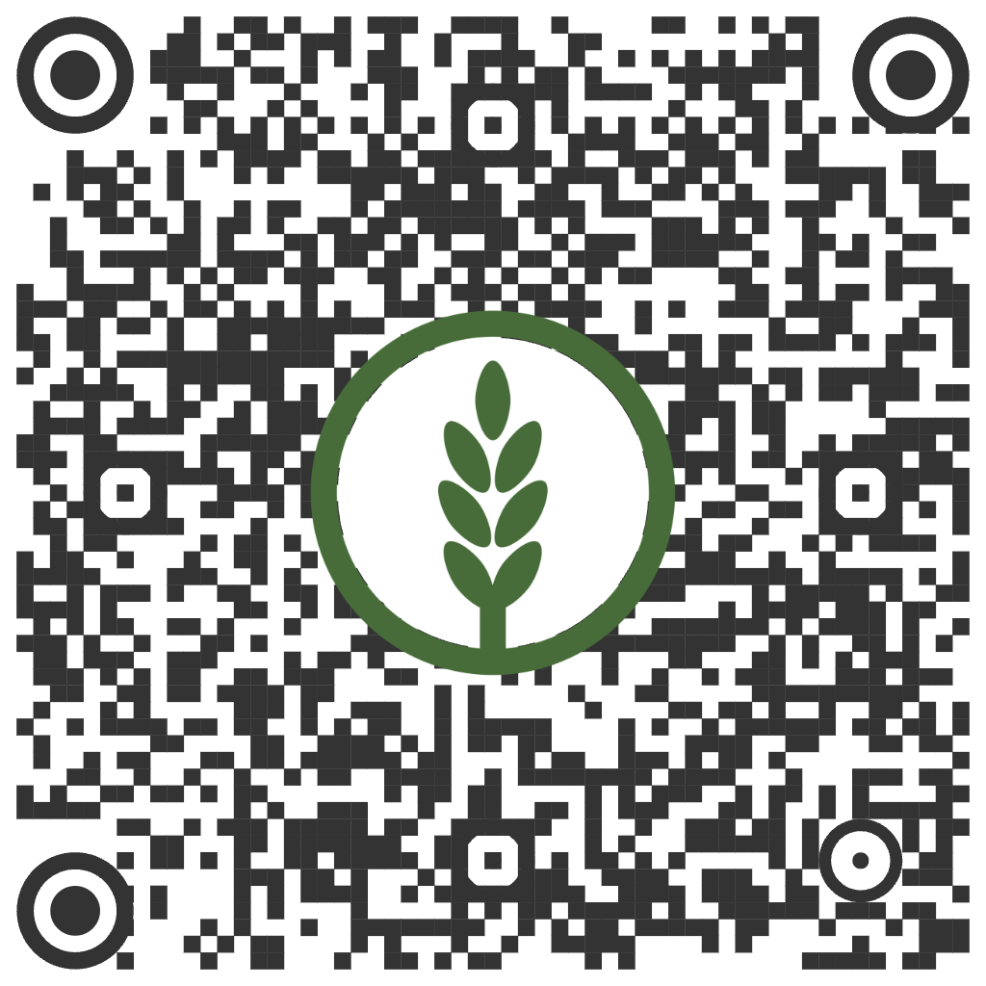
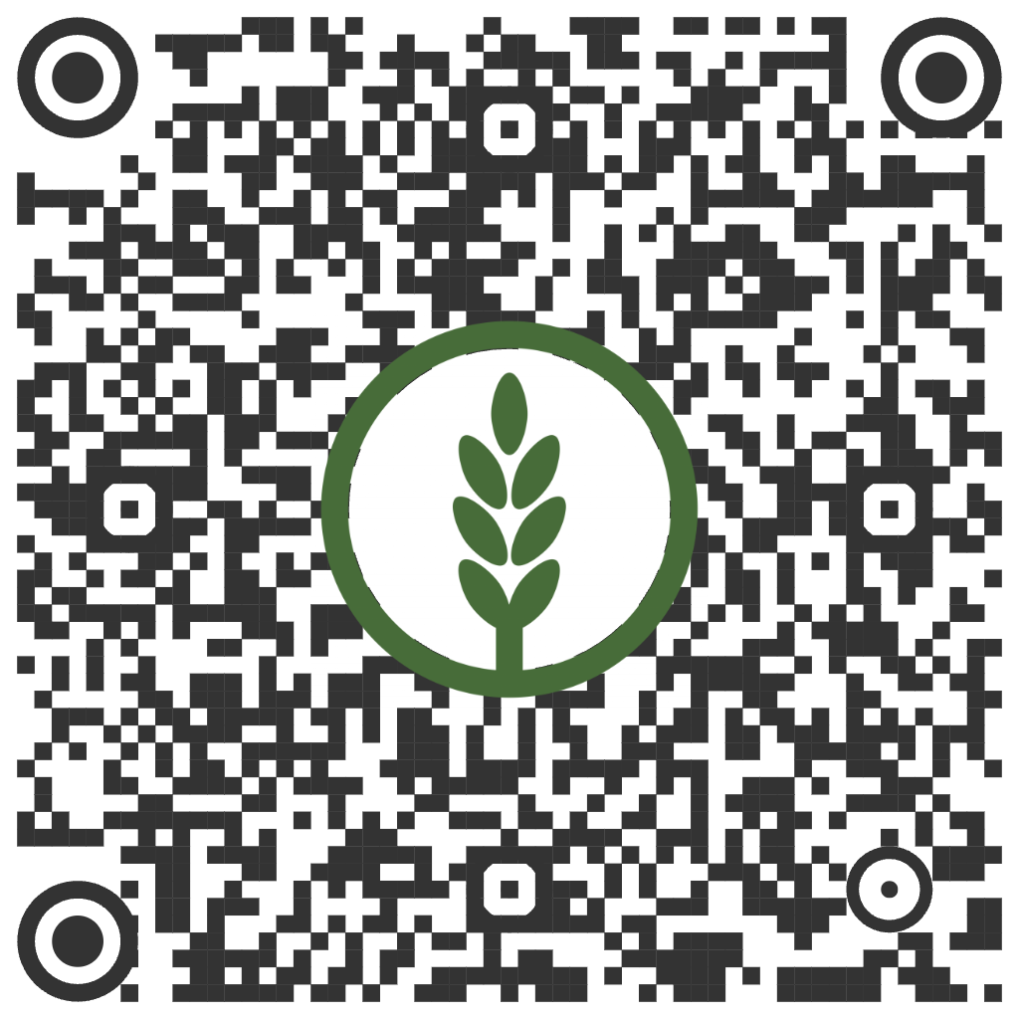
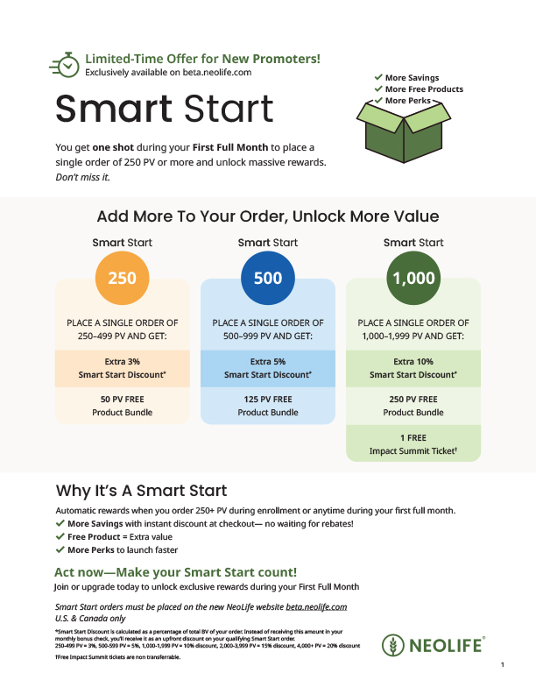
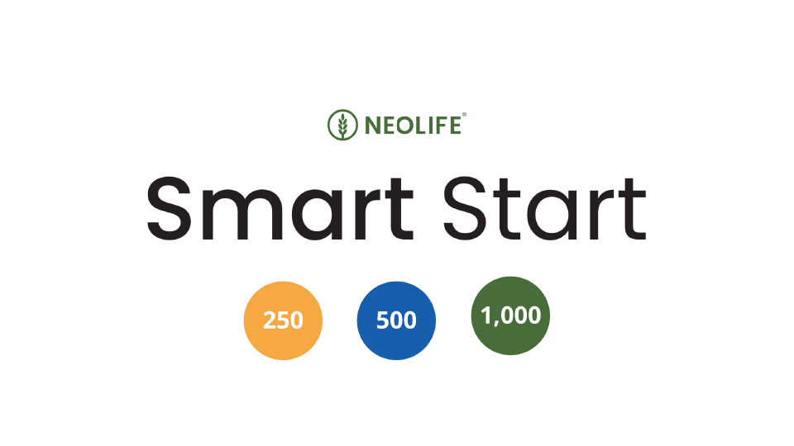
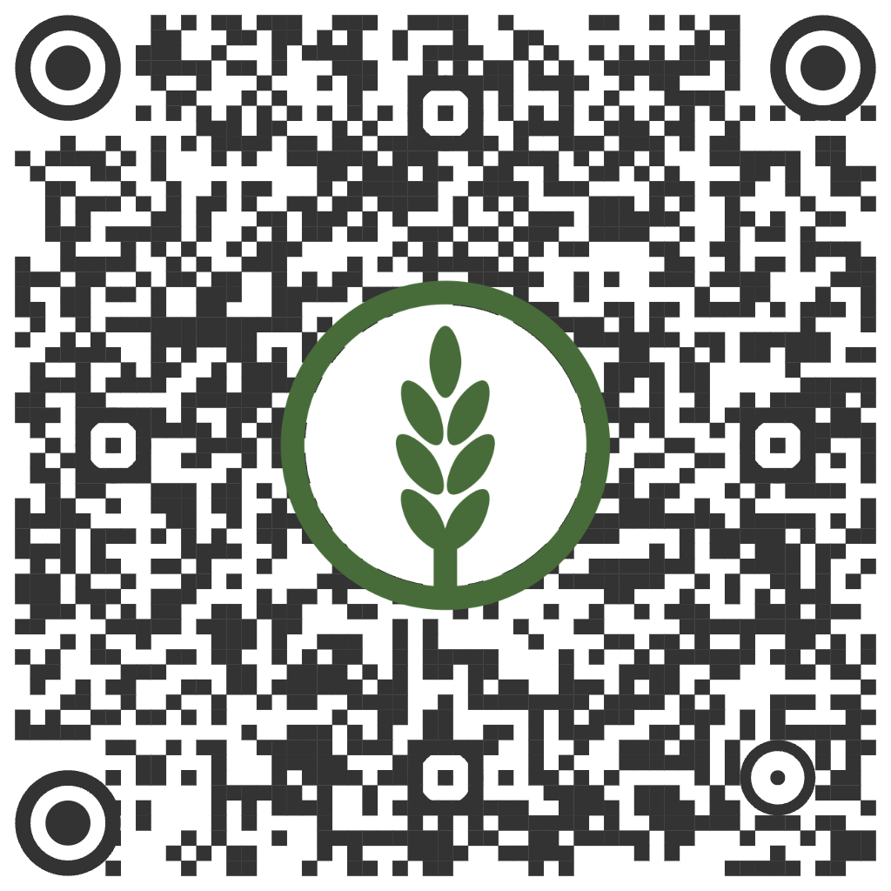
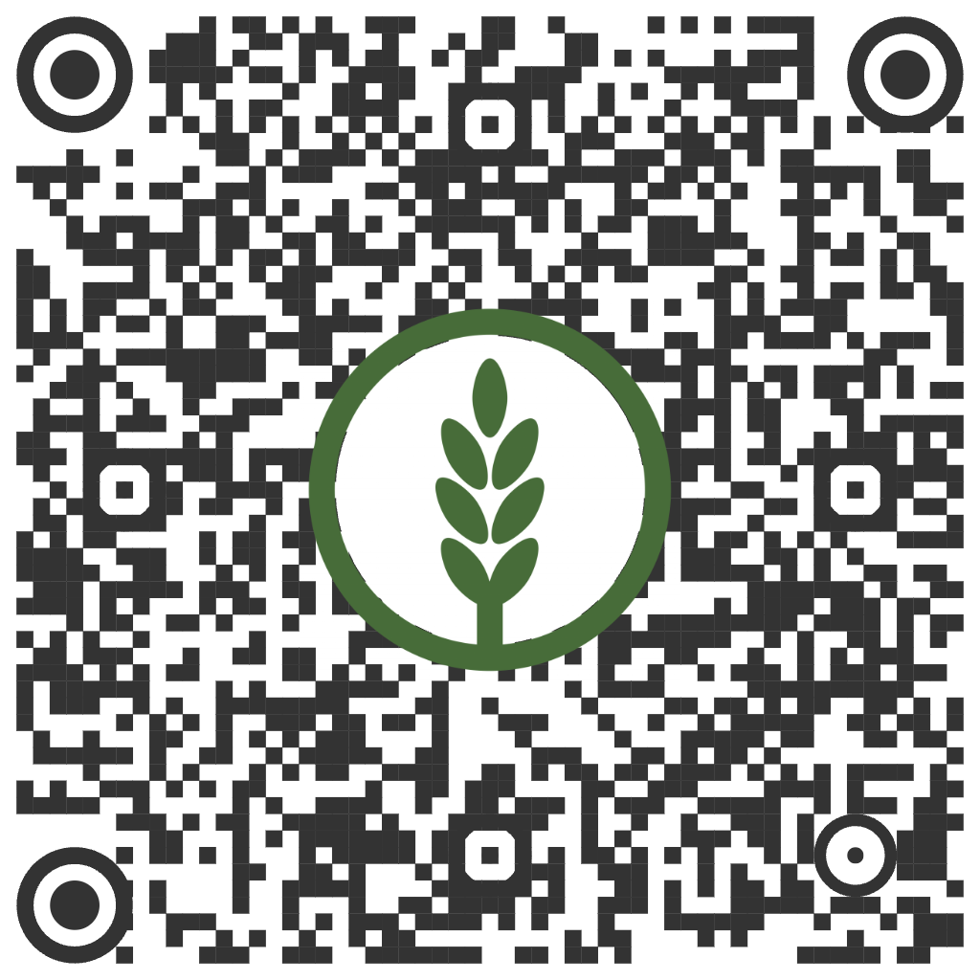
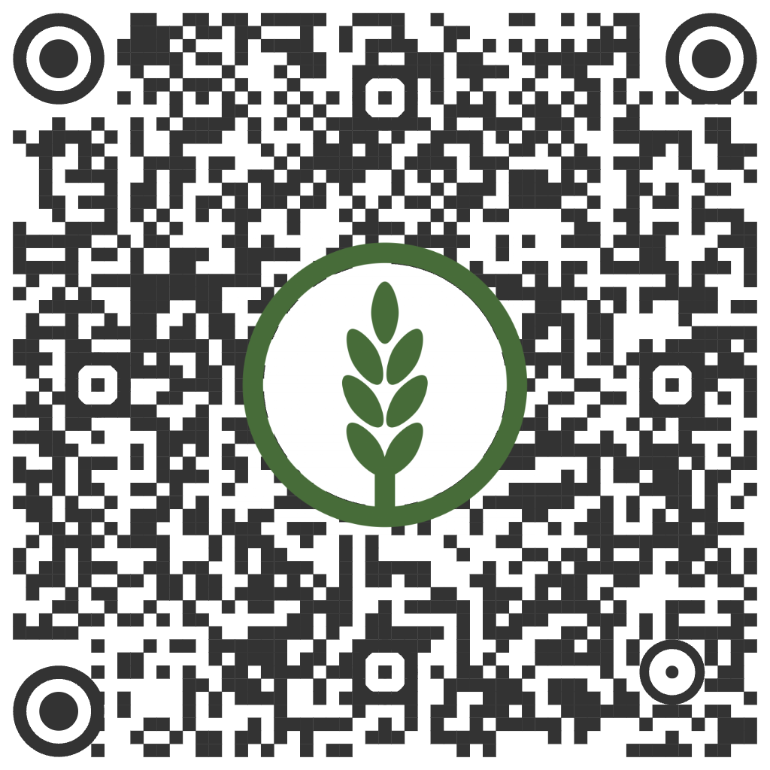
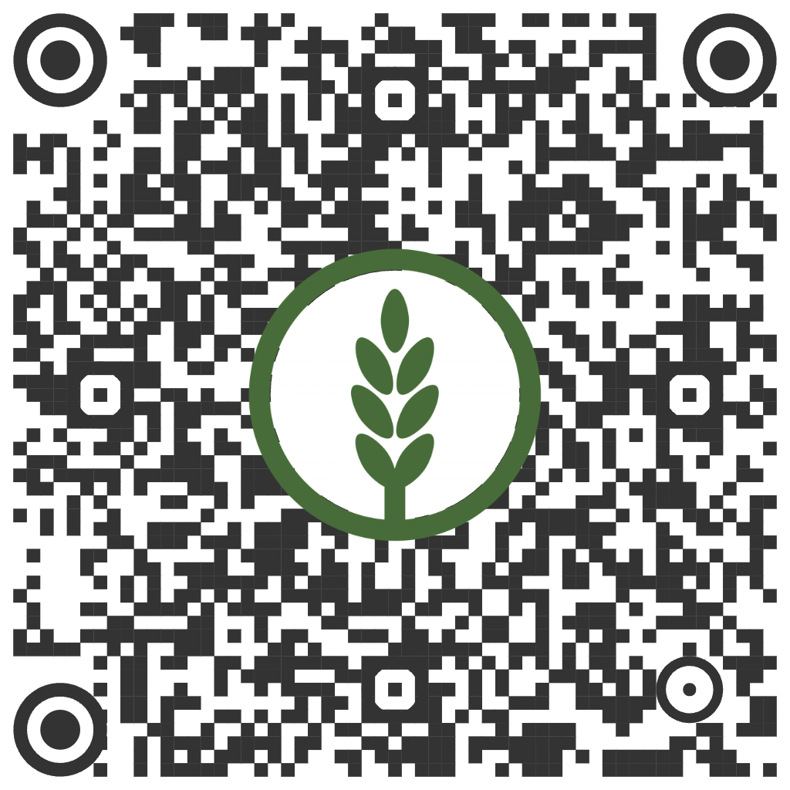
Download Resources
English
Smart Start Flyer
Smart Start PPT
English
Spanish
Spanish
Canada
Canada

