Slide 1

Lesson 1
Around the Middle Eastern Jewish World

Slide 2

Main Questions
1) Who are Sephardi and Mizrahi Jews?
2) Where do they come from and what are their traditions?
Notes:
Write the Main Questions on the board:
“Who are Sephardi and Mizrahi Jews?"
“Where do they come from and what are their traditions?”
PPT SLIDE #2 - Show this slide and discuss the lesson aim and main questions with the students.
Note to Facilitator:
Background Information about Sephardi Mizrachi and Ashkenazi :
To help students understand the definition of Sephardi and Mizrachi Jews, you can create “information cards” that students can read or simply explain the definitions of these terms to the group. You can use the following quotes/ sources that give a general description of the terms Ashkenazi, Sephardi and Mizrachi.
“Many researchers believe the term "Sephardic" originally referred to Jews living in and later expelled from Spain in 1492. Today the term "Sephardic" has come to be accepted as a reference to the Jewish exiles and their descendants who settled in countries along the Mediterranean Sea, North Africa, the Balkans, Italy, Syria and Palestine, as well as indigenous Jews who already lived in these places. Some of these Jews fled to Brazil, Holland and the Jewish communities of the New World, including New Amsterdam (New York), Mexico and Curacao in the Caribbean. Sephardim of the Iberian Peninsula (what are now Portugal and Spain), spoke Ladino, a combination of Hebrew and Spanish....
...The official definition of Sephardic according to Rabbi Marc Angel of Sephardic House, is "almost any Jew who is not Ashkenazi. Although there are wide cultural divergences within the Sephardic world, common liturgy and religious customs constitute underlying factors of unity."
...Daniel Elazar, the first President of the American Sephardi Federation and a distinguished scholar, said
"For Jews, what is most important as a distinguishing characteristic is not the specific culture acquired in any particular country of exile by any particular Jewish population but the broader issues of halakhah and mishpat (Jewish law), community organization, and cultural patterns from food to synagogue rituals. In these respects, the Sephardi world is one, from the Atlantic to the Indian Oceans, significantly influenced by its location within Islamic civilization."
Source: The Term Sephardic Jew by Sarina Roffé http://www.jewishgen.org/Sephardic/sephardic_roffe.HTM
A great source for understanding these differences between Sephardic Mizrachi and Ashkenazi Jews can be found on pages 2-6 of Zvi Zohar’s essay “A Global Perspective on Sephardic and Mizrachi Jewry”
https://nyupress.org/webchapters/0814797059chapt1.pdf
There are also other groups of Jews that do not fit into these three categories namely Ethiopian Jews and Jews of Color. For more information about these groups, you can visit these links:
http://www.myjewishlearning.com/article/the-history-of-ethiopian-jewry/
http://www.tabletmag.com/tag/jews-of-color

Slide 3

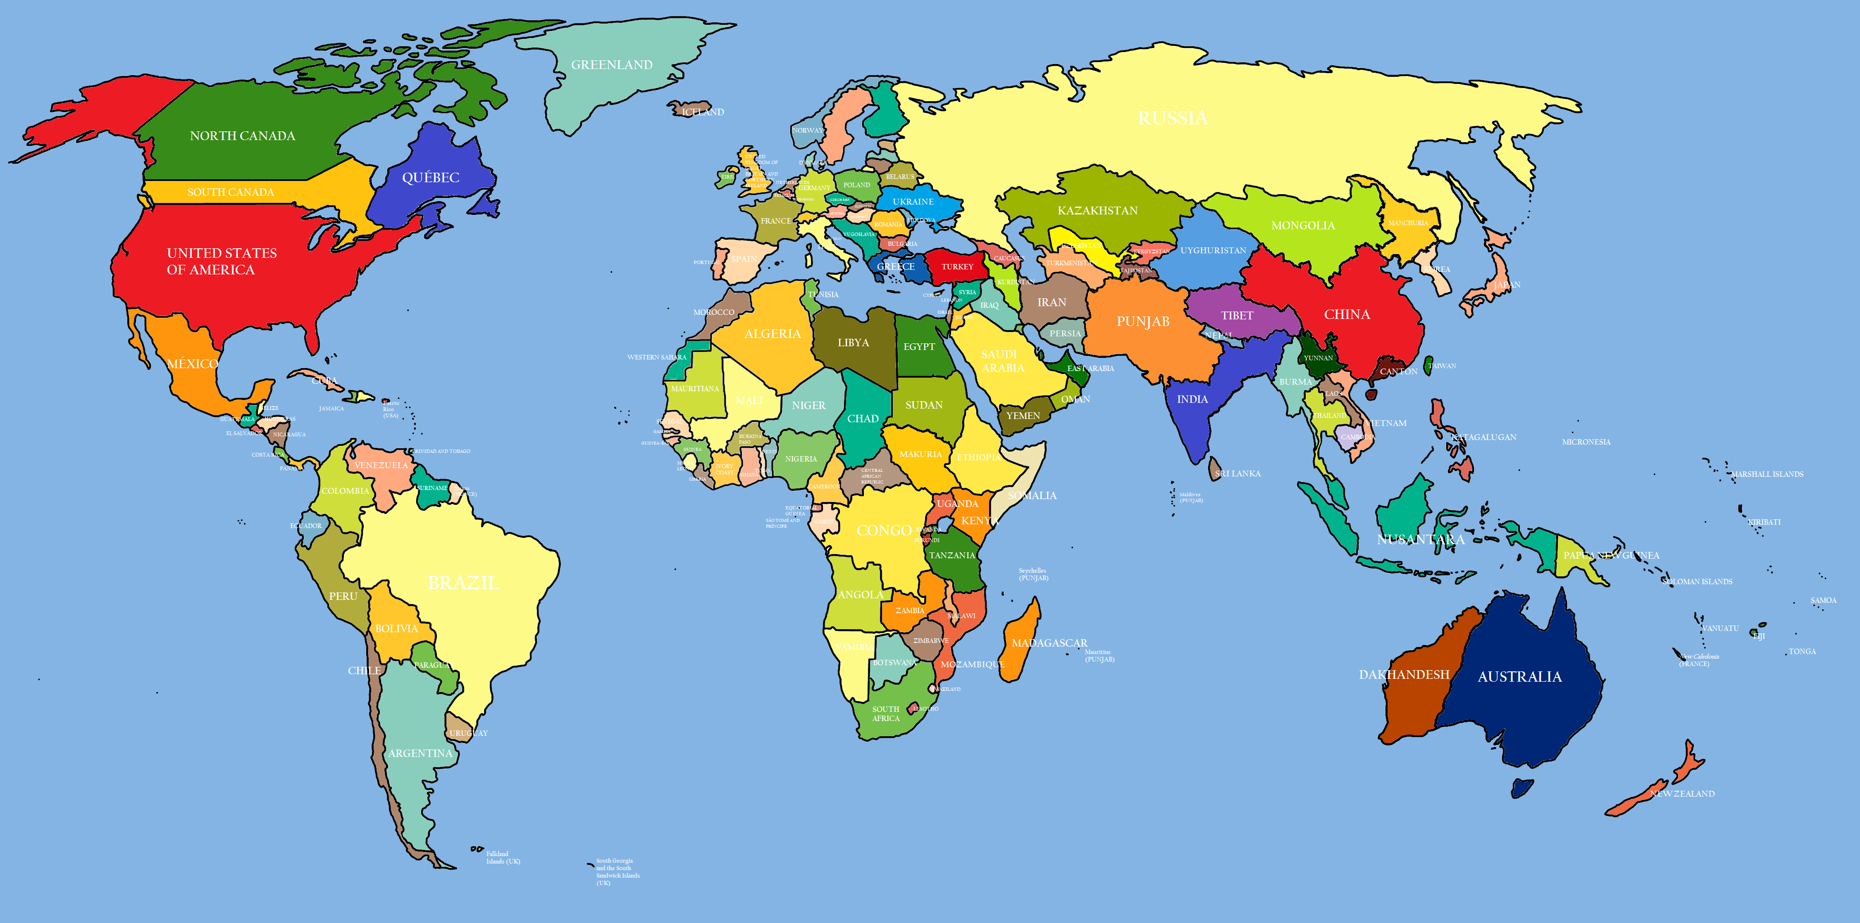

Where do Jews live in the world?
Notes:
PPT SLIDE #3 - (A map of the world). Show this slide and ask the students: Where do Jews live in the world today? Have students look at the map of the world and name countries they know. Ask students to go to the board and point to the continent they think Jews live on.
Teacher may ask students to go to the board and point to the continent the Jews live on. (Extra/additional idea: Then, the facilitator can write the names of the places students call out on the board. After this brainstorming introduction, the facilitator will write 3 words on the board: Ashkenaz, Sepharad and Mizrach.
Citation for the Map www.freelarge-images.com/wp-content/uploads/2014/11/World_map-12.png

Slide 4
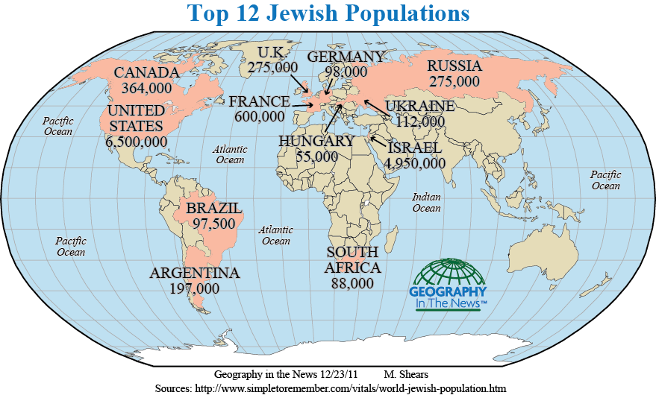
World Jewry Today
Where do most Jews live in the World today?
Notes:
PPT SLIDE #4: This slide illustrates a map of the places with the highest Jewish populations around the world since 2011. Discuss with the students where most Jews live today. On the board, the facilitator will write 3 words: Ashkenaz, Sepharad and Mizrach. Explain that these three words describe regions: Europe, Spain, Middle East/North Africa.
As the students call out different countries, the facilitator categorizes them. For example, if they mention places in Eastern and Central Europe, they can go under Ashkenaz, if they mention Spain, the can go under Sepharad, if they mention Iraq or Iran they go under Mizrach. If they mention Morocco, Tunisia, Algeria, the facilitator can say: Is this Mizrach? Are these countries east or west of the Land of Israel? For older students this can be a way of introducing the politicized meaning of the term Mizrachi and how inaccurate it really is as a word to describe Jews in Arab and Muslim lands.
Citation for Map
https://blog.education.nationalgeographic.org/2014/12/17/geography-in-the-news-hanukkah-a-jewish-celebration/

Slide 5


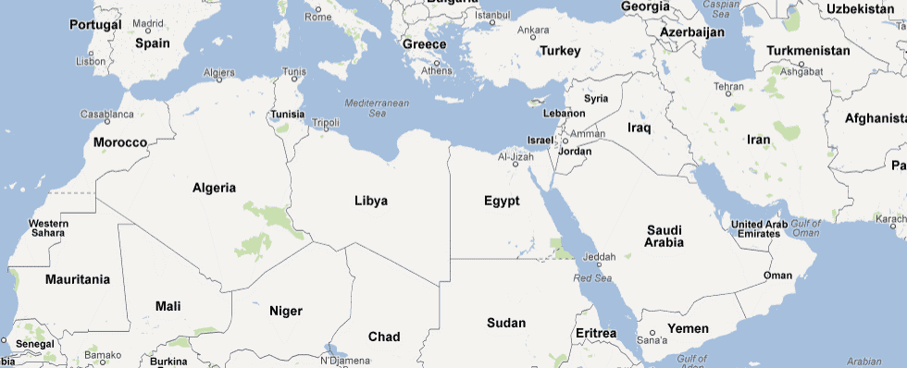

World Jewry of the Middle East
and
North Africa
Notes:
PPT SLIDE #5: (Map of the Middle East and North Africa) Today we are going to learn about the Jews in the Middle East and North Africa. Ask the students to identify Middle Eastern countries on the map. Ask: Do you know if any Jews lived in these regions? How do you know?
Keep this map projected on the board for the class activity.
Citation for Map https://legacy.lib.utexas.edu/maps/middle_east_and_asia/n_africa_mid_east_pol_95.jpg

