Slide 1
Designing A Killer Sales Process
Brady Hawkins
Infusionsoft Direct Sales Manager

Slide 2

Objectives and Agenda
Understanding the difference between Sales Process vs. Sales Methodology
Defining your Sales Process
Developing a Sales Methodology
What doesn’t work & mistakes I see made too often

Slide 3
Efforts and courage are not enough without purpose and direction.
-John F. Kennedy
Notes:
Have you ever heard the saying, a man without a purpose is like a ship with out a rudder?
This is the same

Slide 4
The method behind the madness
Sales Process vs. Sales Methodology

Slide 5
Are they the same thing?
Process
Methodology
A series of actions or steps taken in order to achieve a particular end.
A body of methods, rules, and postulates employed by a discipline. The analysis of the principals and procedures of enquiry in a particular field

Slide 6
A process is operational and tactical. Conversely, a methodology is a set of guiding principals that align three vital strategies in a process.
When a particular tactic or process should be executed
How to execute a particular tactic or process
Why a particular tactic or process should be executed

Slide 7

“In anything we do, any endeavor, it’s not what you do it’s WHY you do it.”
— Howard Scultz, Starbucks
Notes:
This is Howard Schultz of Startbucks
A quote from him and something I’d like you to think about is:
In anything we do, it’s not what you do it’s WHY you do it.

Slide 8
Define your Sales Process

Slide 9
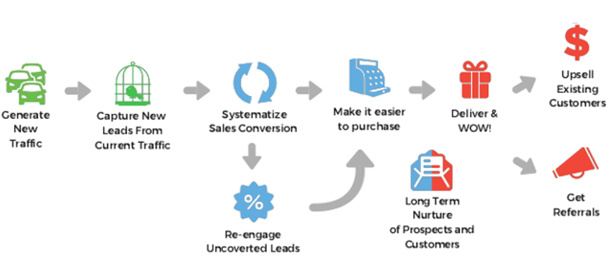





The Perfect Customer Lifecycle
Notes:
We start with re-engagment…. Why??
Lowest risk- highest return
Great place to test
Quick wins
Better Leads, in higher volume at a lower cost
Conversion process
Deliver, Wow and get referrals (Even more high quality leads)
Up-sell, Cross Sell, win-back

Slide 10
Developing the Methodology

Slide 11
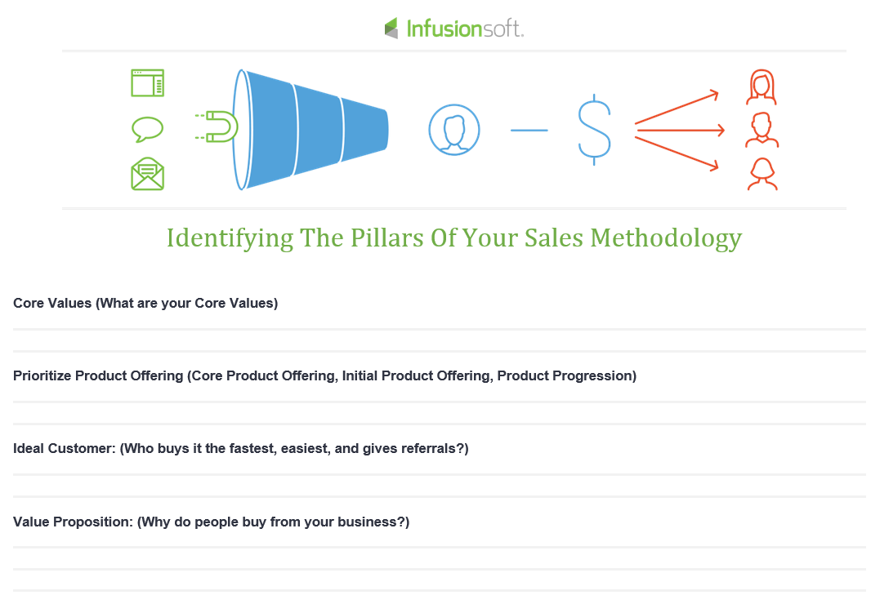

Slide 12
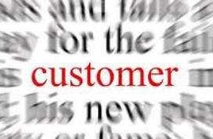
Piecing It All Together…
Core Values
Attract
Product Progression
Convert
Value Proposition
Ongoing Relationship

Slide 13
The Top 10 Sales Methodologies
There is no need to reinvent the wheel…
1. Target Account Selling
2. SPIN Selling
3. SNAP Selling
4. The Challenger Sale
5. Value Selling Framework
6. Solution Selling
7. Conceptual Selling
8. The Sandler Selling System
9. MEDDIC
10. Customer Centric Selling

